Slide 1
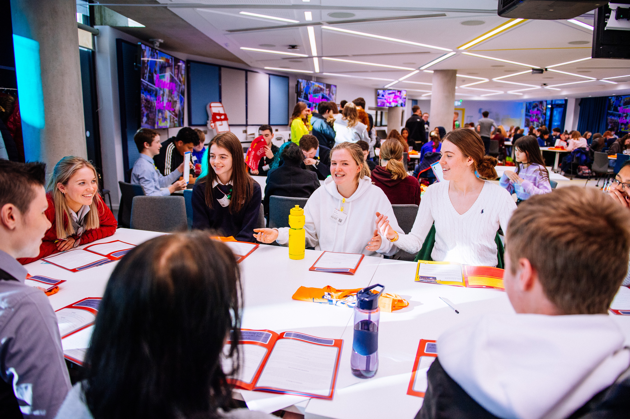








Safer Internet Day 2026
AI AWARE:
Safe, SMART AND IN CONTROL
Primary Presentation:
6th Class

Slide 2

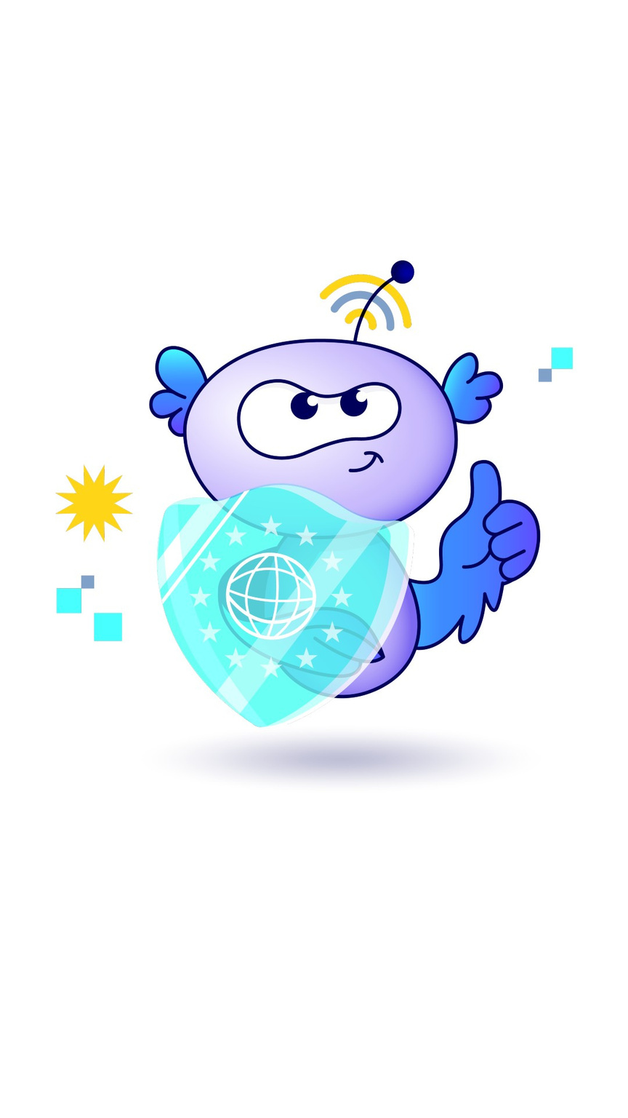
What is Safer Internet Day?
webwise.ie/saferinternetday
  A day to create awareness of a better internet for ALL users​
​
  Safer Internet Day will be celebrated on Tuesday, February 10th 2026
​
  Over 200,000 young people celebrated Safer Internet Day in Ireland in 2025

Slide 3
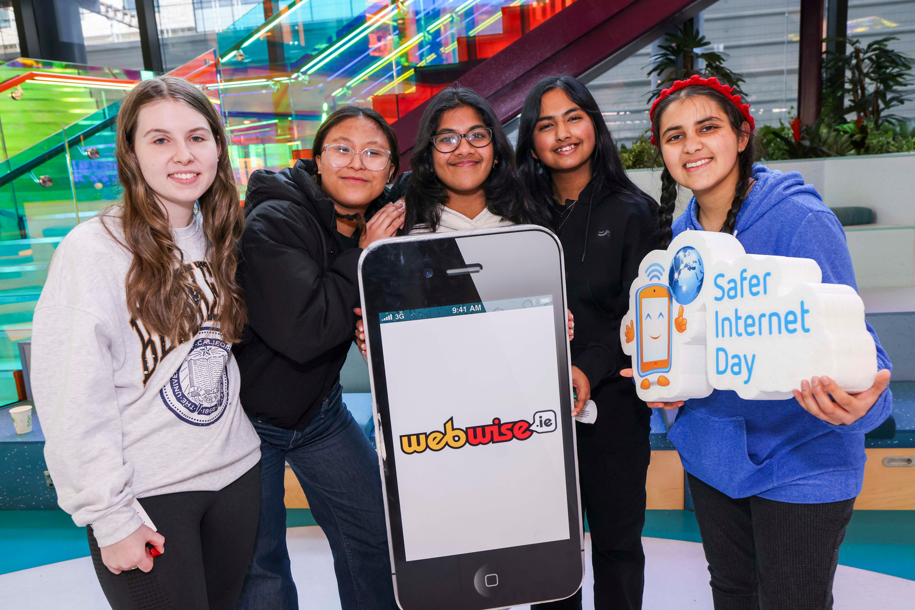
Safer Internet Day 2026
AI Aware: Safe, Smart and in Control
On Safer Internet Day, let’s take time to:
  Understand what Artificial Intelligence (AI) is, including a type of AI called Generative AI (Gen AI) and how it works.
  Recognise some potential benefits and drawbacks of using Gen AI.
  Reflect on how we can use Gen AI in a safe and responsible way.

Slide 4
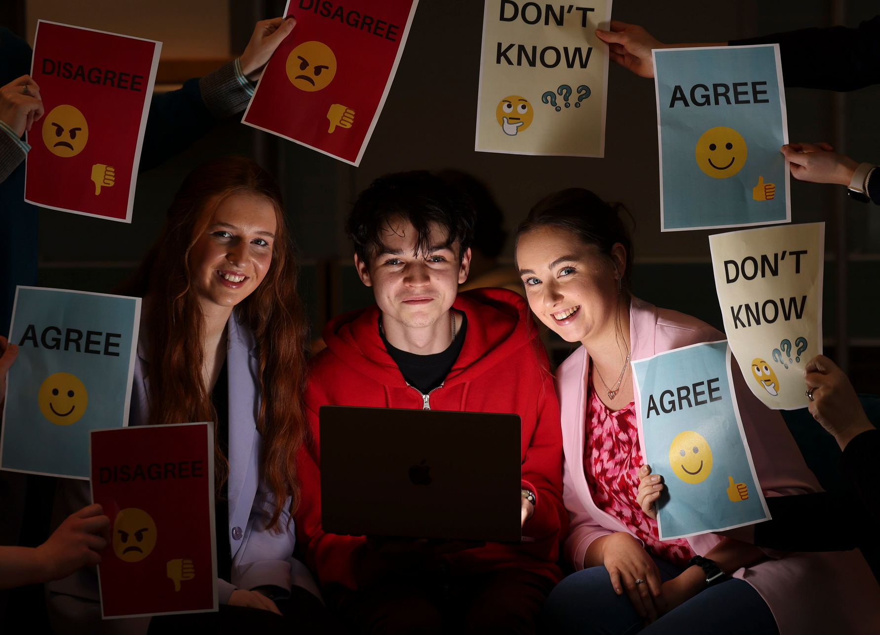
AI Aware: Safe, Smart and in Control
Let’s Brainstorm:
What comes to mind when you hear hear the words: Artificial Intelligence

Slide 5
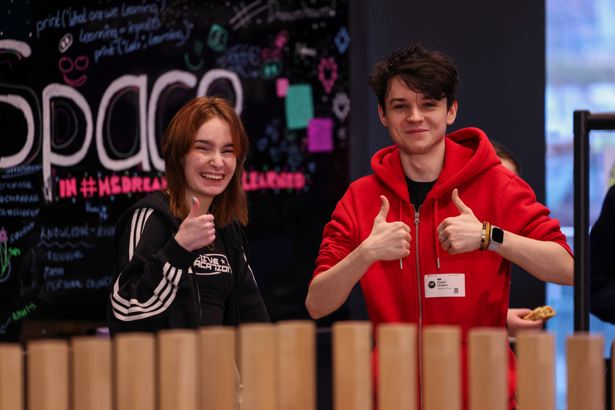
Explained: Artificial Intelligence
  Artificial intelligence (AI) refers to computer systems that can gather information and put it together to perform a task in a human-like way
  AI systems have been “trained” to also become good at tasks like these and like us they did that by using “data” – information about the world
  Recent AI systems can talk to us and understand us really well, but older and simpler AI systems were already using data to recommend things to us

Slide 6
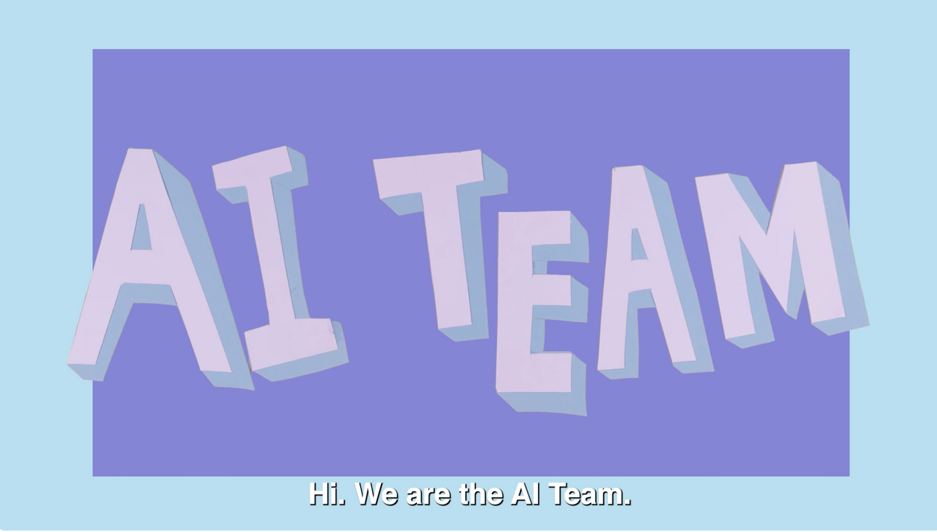
Explained: Artificial Intelligence
Watch this video by Members of Children's Parliament (aged 10-12) from Edinburgh to find out more.

Slide 7
Explained: Artificial Intelligence
After watching the video answers the following questions:
  What does AI mean?
  List one example of the type of data or information an AI tool is trained on?
  What four tasks does the video list that AI is good at?
  Give one example the video mentions about where AI can be found in our lives?
  AI is good at classifying things - putting them in groups. What tasks might AI be helpful with by classifying things for us?

Slide 8
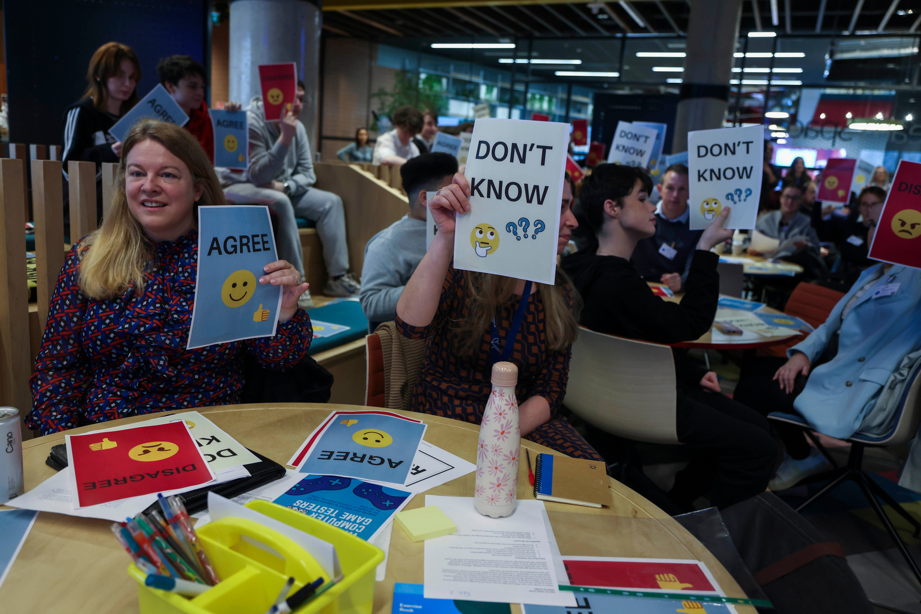
Explained: What is Generative AI?
Generative Artificial Intelligence (also known as Gen AI) is a type of computer program that can create new things like stories, pictures, and music, based on what it has learned from lots of information or data.
Gen AI systems learn from massive amounts of data to form a model of how words work together in language, how colours look in various images, what musical notes sound good to us, etc., and they can seem to create new examples based on this.

Slide 9
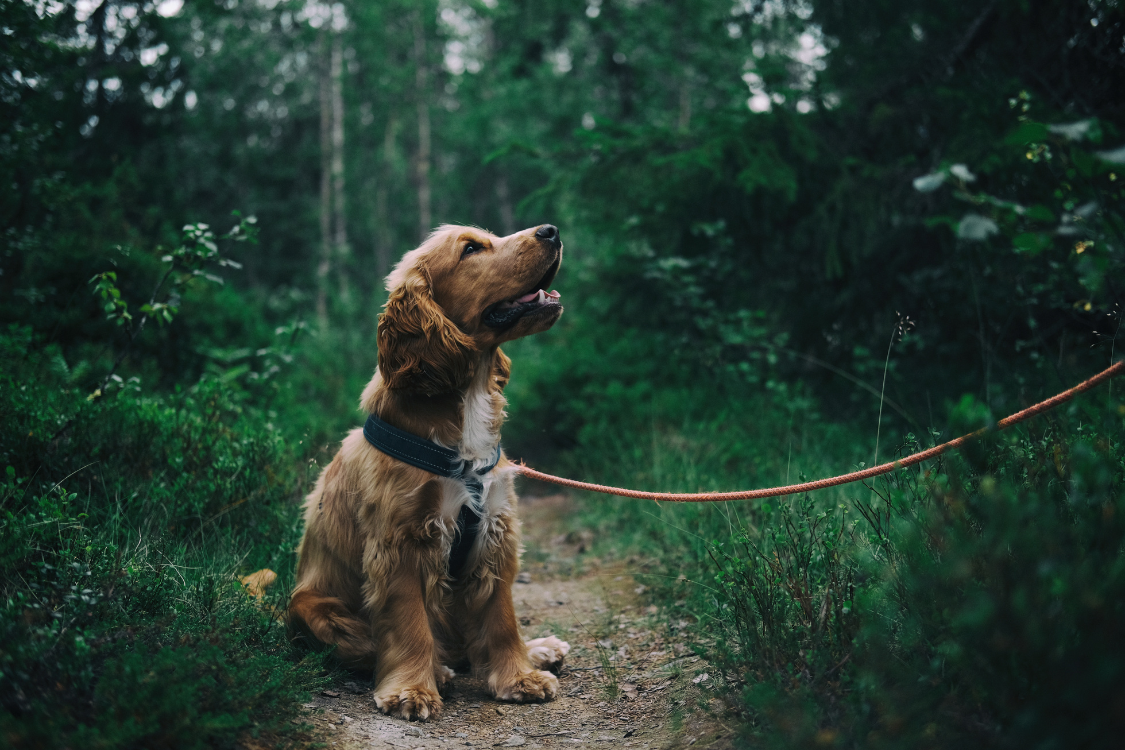
Role Play Activity:
Act like a Gen AI tool
Gen AI can only give answers based on the information they’ve been trained on.
Now we are going to do an activity to help us understand the benefits and drawbacks that come with using Gen AI.

Slide 10
Role Play Activity:
Act like a Gen AI tool
Questions/Prompts:
  List 5 facts about dogs.
  What do dogs look like?
  Are dogs better than cats?
  Should I get a dog as a pet?

Slide 11
Role Play Activity: Reflection
  What could our Gen AI answer well?
  What couldn’t it answer?
  Did it ever sound silly or give the wrong information?
  What kind of mistakes or bias could a real AI make if its training data wasn’t complete, balanced, or correct?
  What does this teach us about using Gen AI tools?

Slide 12
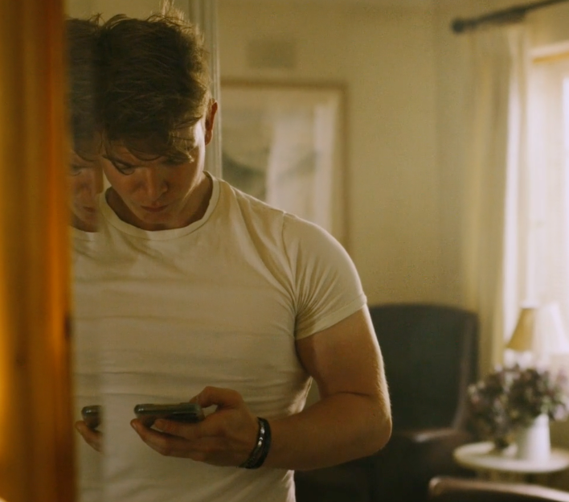
Exploring the Benefits and Challenges of Gen AI
Imagine your older sibling was using a Gen AI tool to help with a project.
  What’s one way it could be helpful?
  What’s one thing that could go wrong?

Slide 13
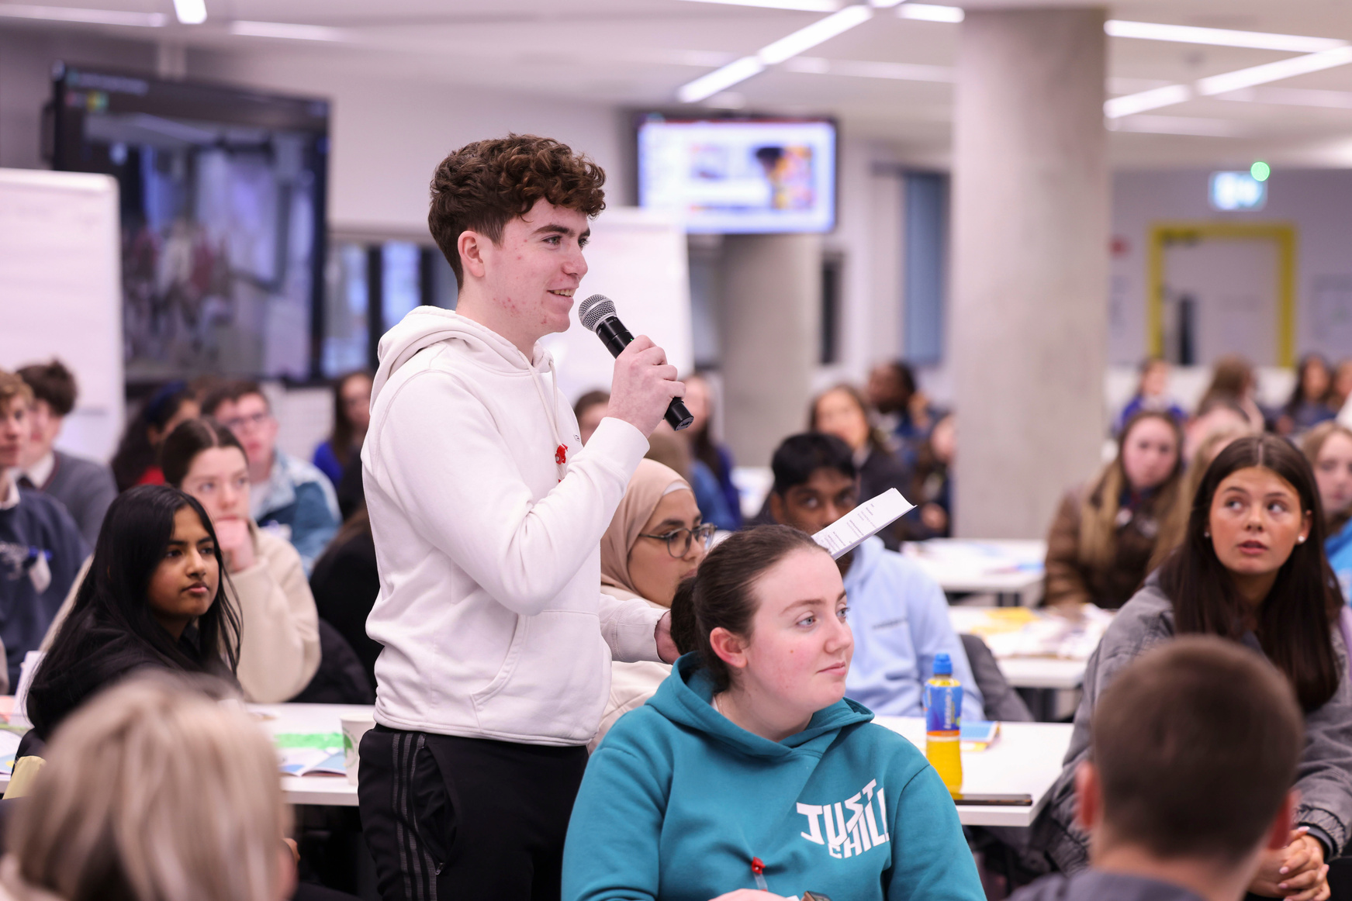
Scenarios: Benefit or Challenge?
  Gen AI explains a tricky topic in a simpler way.
  Gen AI gives an answer that sounds convincing and right but is factually wrong.
  A college student asks Gen AI to write their essay instead of writing it themself.
  Gen AI suggests new ideas for a story or design project.
  The Gen AI chatbot feels like chatting to a real person, so someone starts telling it personal things and looking for advice on a medical condition they have or how to deal with someone who is bullying them.

Slide 14
Scenarios: Benefit or Challenge?
  Gen AI only shows one side of an issue because of biased training data.
  Gen AI uses lots of electricity and water in massive data centres, which can harm the environment.
  Gen AI helps a language student practise French vocab without feeling embarrassed.
  The Gen AI tool being used was trained on art, music, or books without the original creators’ permission.

Slide 15
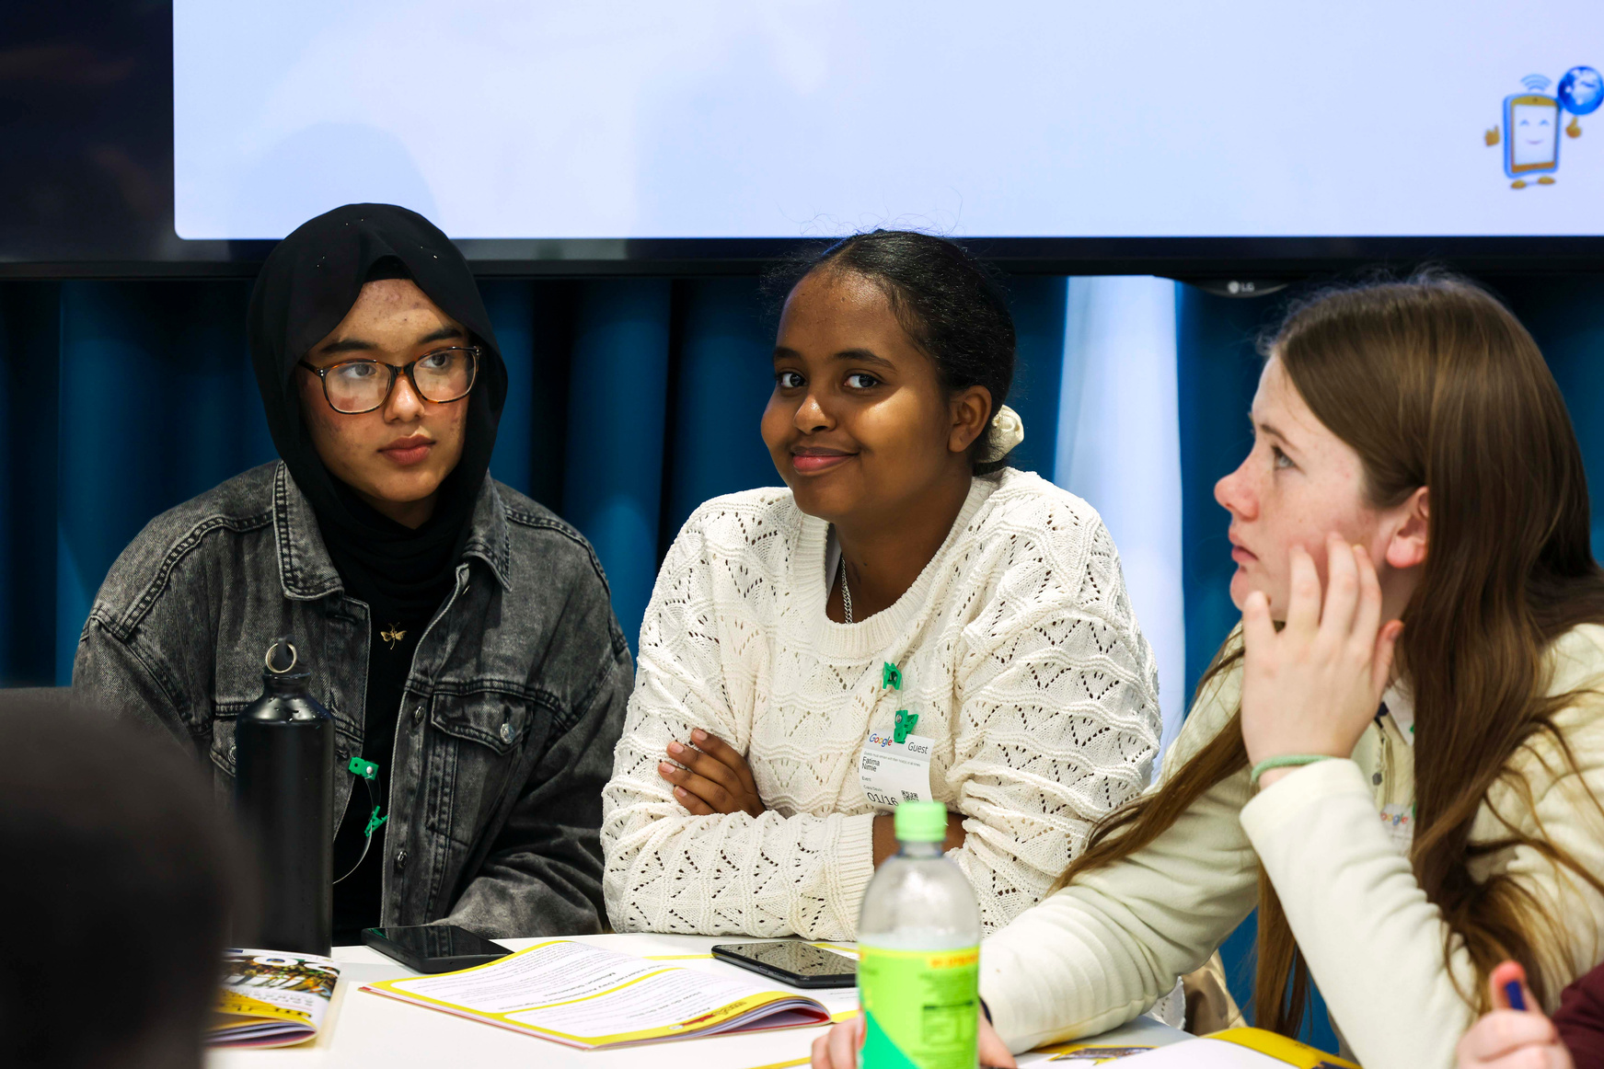
Gen AI: Benefits
  Learning: It can explain tricky topics in a simpler way.
  Creative Inspiration: Generating story ideas, or design inspiration.
  Language Learning: Practising new languages or improving writing.
  Brainstorming: Coming up with ideas for projects, clubs, or hobbies.
  Learning at Your Own Pace: Asking questions as often as needed without feeling judged.

Slide 16
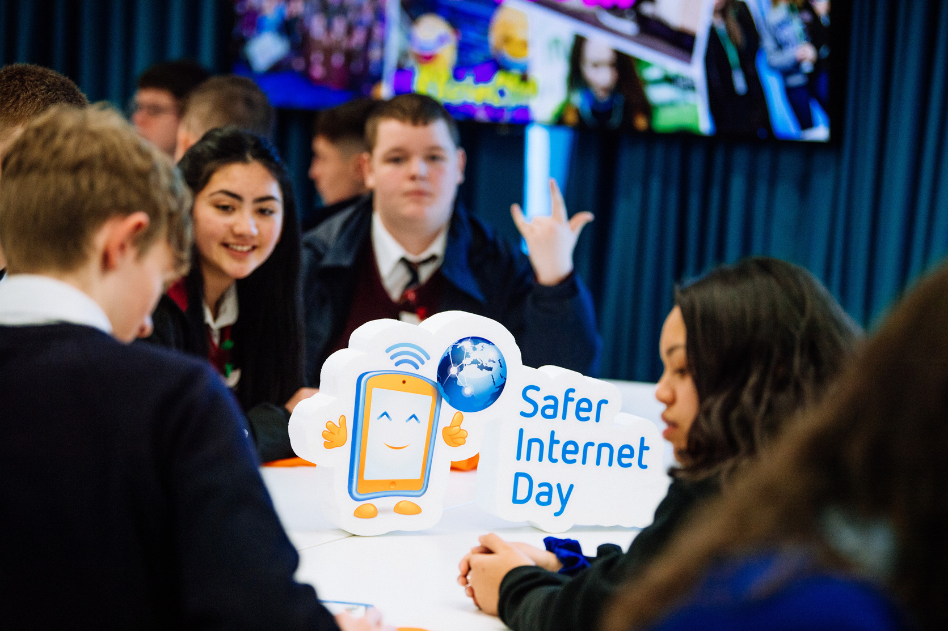
Gen AI: Challenges
  False Information: Gen AI can “hallucinate” or make things up, giving you wrong or outdated facts or advice.
  Over-reliance: If we let Gen AI do all the work, we miss the chance to think and be creative ourselves.
  Bias/Unfairness: Gen AI learns from information made by humans, so it can sometimes repeat unfair or one-sided ideas.
  Privacy Risks: Sharing too much personal information with Gen AI tools. How is our personal information collected, stored and used by these companies?
  Plagiarism & Cheating: If someone uses Gen AI work as their own without giving credit or acknowledgement that is dishonest and unfair.

Slide 17
Gen AI: Challenges
  Emotional Manipulation: Gen AI content could try to influence opinions or feelings. AI chatbots might agree with everything your say, even if it’s wrong or unsafe, which can lead to bad advice.
  Oversharing: Chatting with Gen AI can feel like chatting to what seems to be a real person and this could cause you to share too much personal information.
  Intellectual Property: The data or information such as artworks, writings, and music used to train Gen AI often came from real people without their permission.
  Environmental Impact: Training and running Gen AI uses huge amounts of energy and water. Even something simple - like asking a chatbot a question - uses around ten times more electricity than doing a Google search. Experts say AI systems could soon use six times more water than Denmark - undoing some of the progress we’ve made in fighting climate change.
  Power and Influence: Most generative AI tools are owned by a small group of extremely wealthy U.S. based tech companies, giving them lots of power and control.

Slide 18
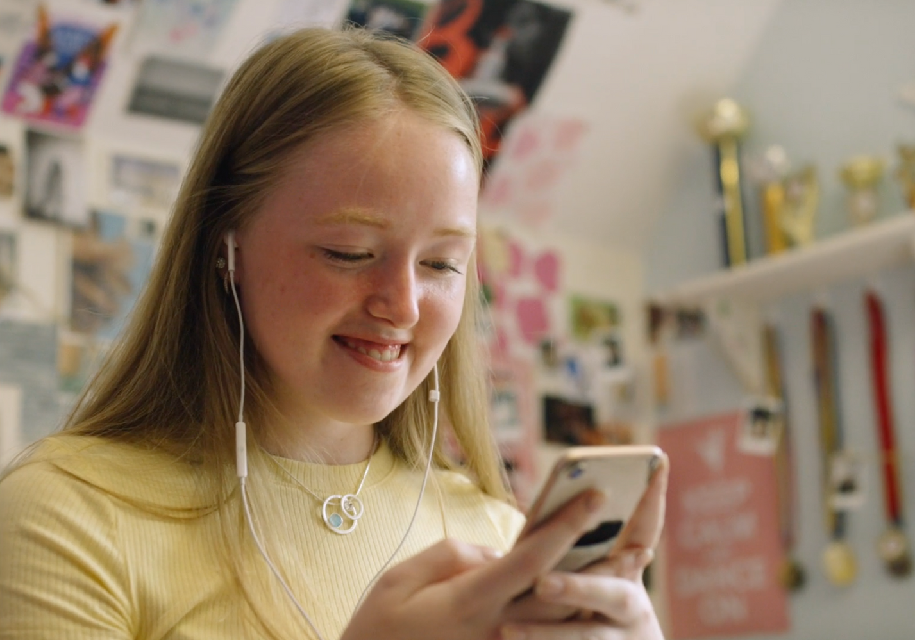
Using Gen AI Creatively, Safely and Responsibly: Top Tips
Only Use Gen AI with a Trusted Adult
  Most AI tools have an age limit which can vary from app to app but the minimum being at least 13 years of age. You cannot use the tool if you are under 13 years of age and if you are 13 or older you must have your parent or legal guardian’s permission to use it.
  When you’re are old enough to use Gen AI tools, they can be useful but sometimes they give wrong or inappropriate answers. Having a trusted adult with you can help you learn how to use them safely and spot any mistakes or problems.
  Follow your schools and parents’ guidelines for using Gen AI.

Slide 19
Using Gen AI Creatively, Safely and Responsibly: Top Tips
Understand the Impact
  AI tools are made to keep you asking questions and chatting with them, but every request uses a huge amount of electricity and resources. Try to use AI only when you really need it and avoid long or unnecessary chats just for fun. This helps reduce its impact on the environment and protects our planet.
Avoid Sharing Personal Information
  Never give Gen AI your full name, address, school name, phone number, or personal photos or other private information about you or others.
  Treat Gen AI chats like talking to a stranger online.

Slide 20
Using Gen AI Creatively, Safely and Responsibly: Top Tips
Check Before You Trust
  Gen AI can make mistakes, make things up, or give outdated information.
  Always double-check facts with trusted sources (teachers, books, reputable websites).
  Advice from a Gen AI chatbot may be false or unreliable – always talk to a trusted adult for advice or a concern.
Use it to Help
  Gen AI is great for brainstorming ideas or explaining things, but we shouldn’t just copy the answers it gives us.
  Gen AI should be used a tool to help with learning not instead of learning.

Slide 21
Using Gen AI Creatively, Safely and Responsibly: Top Tips
Stay Critical
  Ask yourself: “Does this sound right?” and “Where might this information have come from?”
  If something feels strange or wrong, it probably needs checking.
Be Kind & Respectful
  Don’t ask Gen AI to create harmful, mean, or bullying content.
  Don’t use it to cheat or trick others.

Slide 22
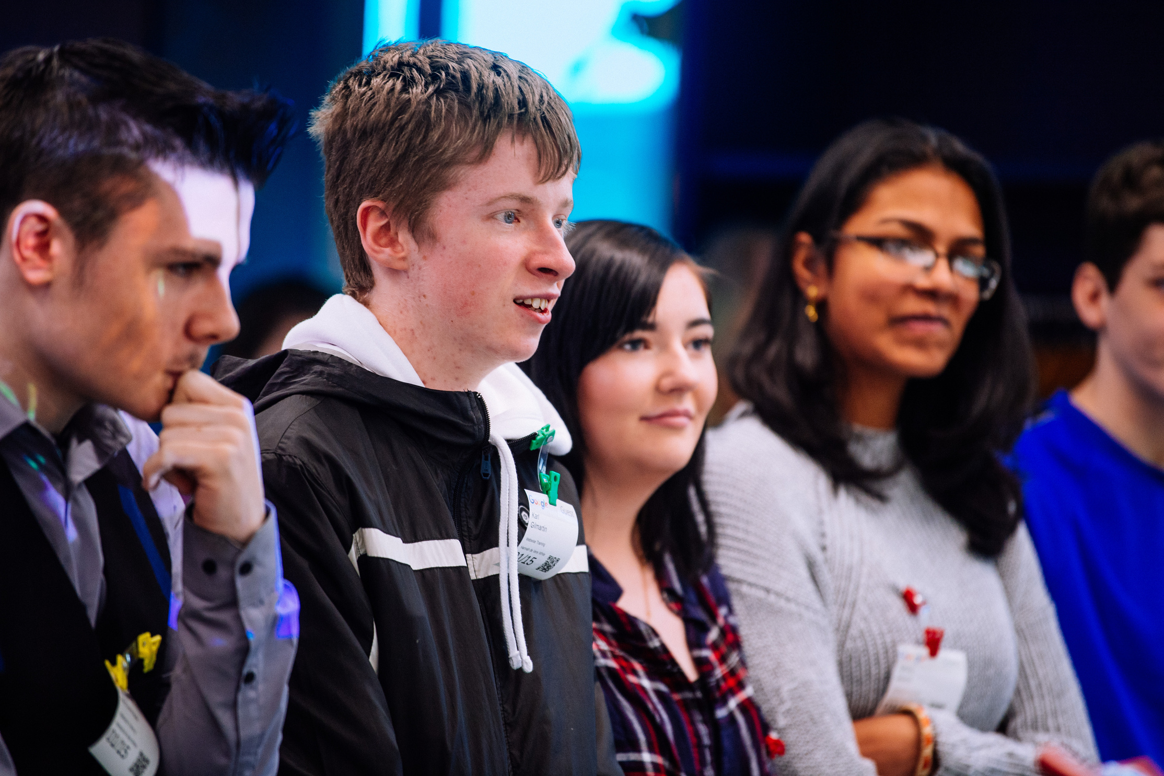
Final Reflection
Muddiest Point: What was the "muddiest point" in today's lesson?
  Write down one question you still have about Gen AI.
Important: Gen AI is a tool, and like any tool, it's how we use it that matters.
Top Tip: Think critically and be responsible digital citizens, and to have fun with Gen AI safely.

Slide 23
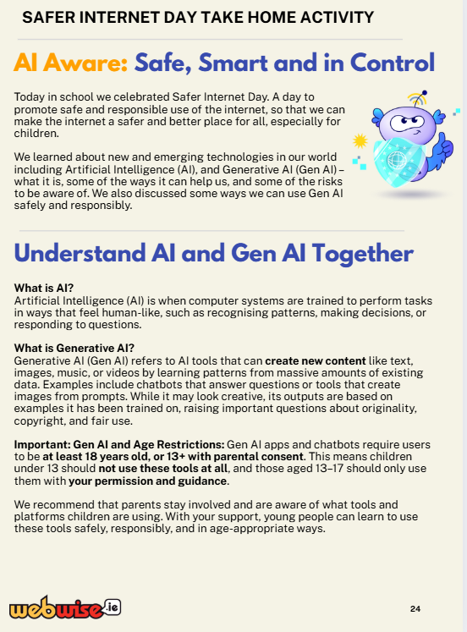
Safer Internet Day 2026
AI Aware: Safe, Smart and in Control
Take Home Activity
  Read about what you have learned about AI with your parents/ guardians.
  Discuss the benefits and challenges of Gen AI.
  Decide and agree on a rule around safe technology use at home.

Slide 24
Safer Internet Day 2026
AI Aware: Safe, Smart and in Control
On Safer Internet Day, you have learned:
  What Artificial Intelligence (AI) is, including a type of AI called Generative AI (Gen AI) and how it works.
  To recognise some potential benefits and drawbacks of using Gen AI.
  To reflect on how we can use Gen AI in a safe and responsible way.

Slide 25


THANK YOU
© Webwise_Ireland​
This work is made available under the terms of the Creative Commons Attribution Share Alike 3.0 Licence http://creativecommons.org/licenses/by-sa/3.0/ie/. You may use and re-use this material (not including images and logos) free of charge in any format or medium, under the terms of the Creative Commons Attribution Share Alike Licence.​

