Slide 1
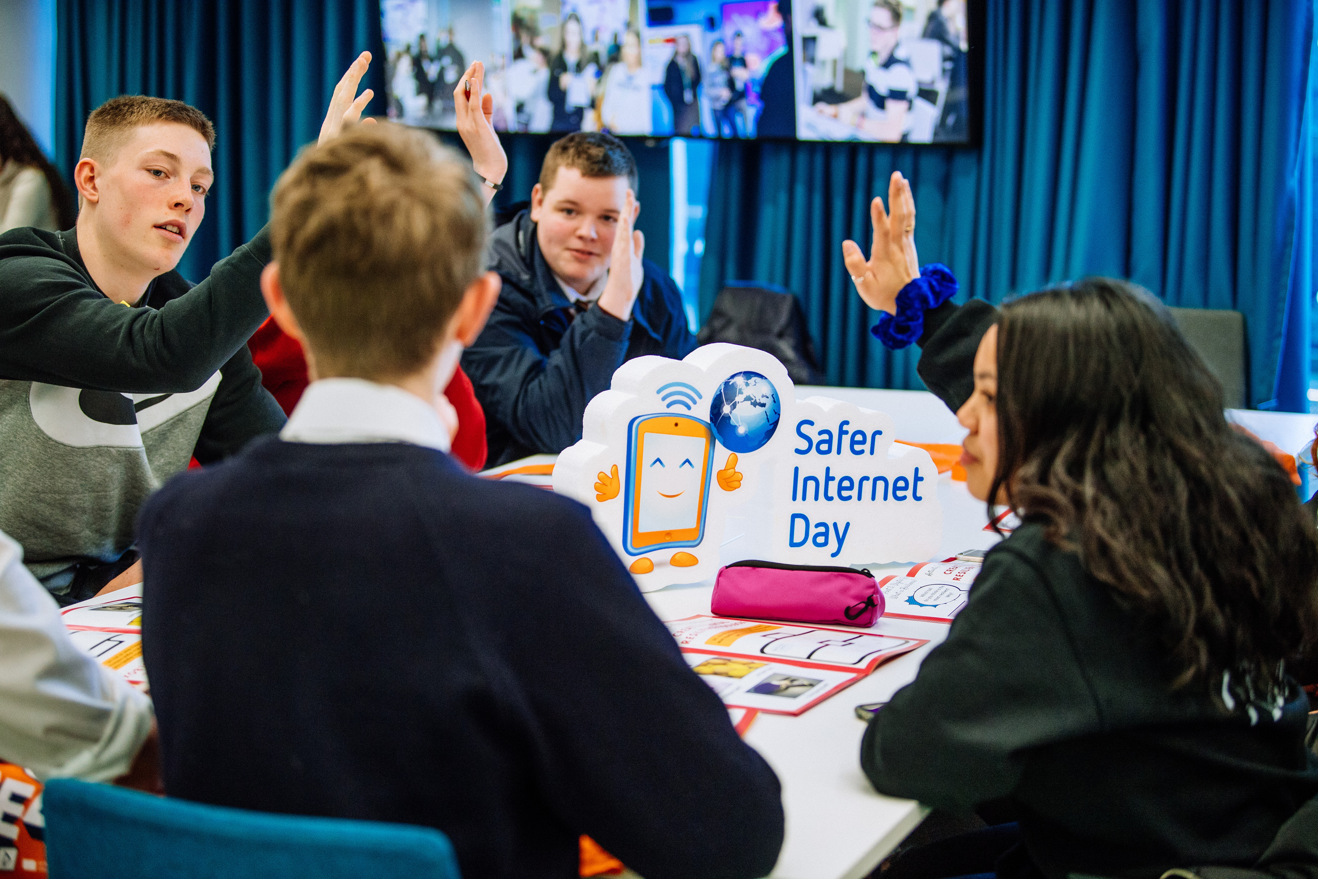








Safer Internet Day 2026
AI AWARE:
Safe, SMART AND IN CONTROL
Post-Primary
Presentation

Slide 2

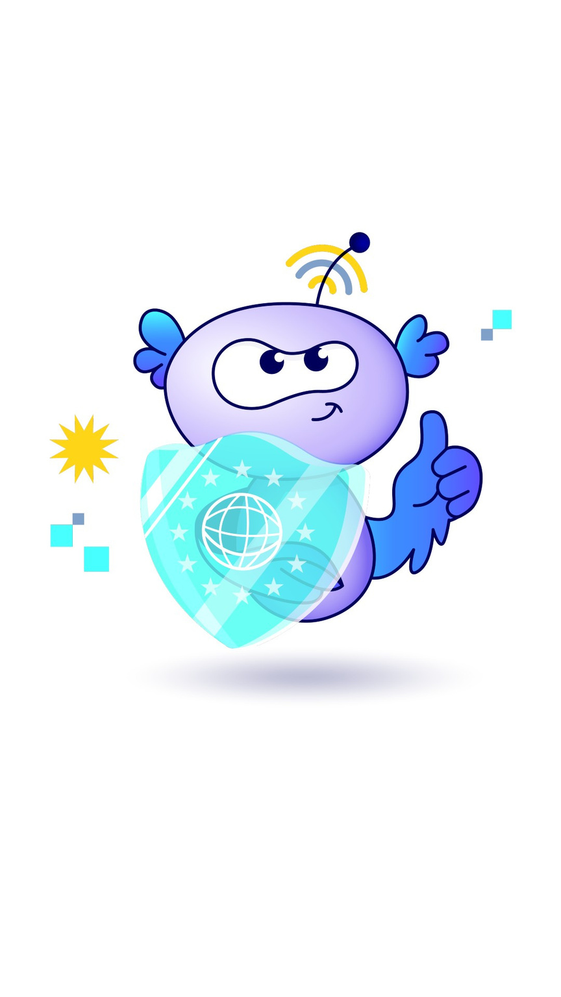
What is Safer Internet Day?
webwise.ie/saferinternetday
  A day to create awareness of a better internet for ALL users​
​
  Safer Internet Day will be celebrated on Tuesday, February 10th 2026
​
  Over 200,000 young people celebrated Safer Internet Day in Ireland in 2025

Slide 3
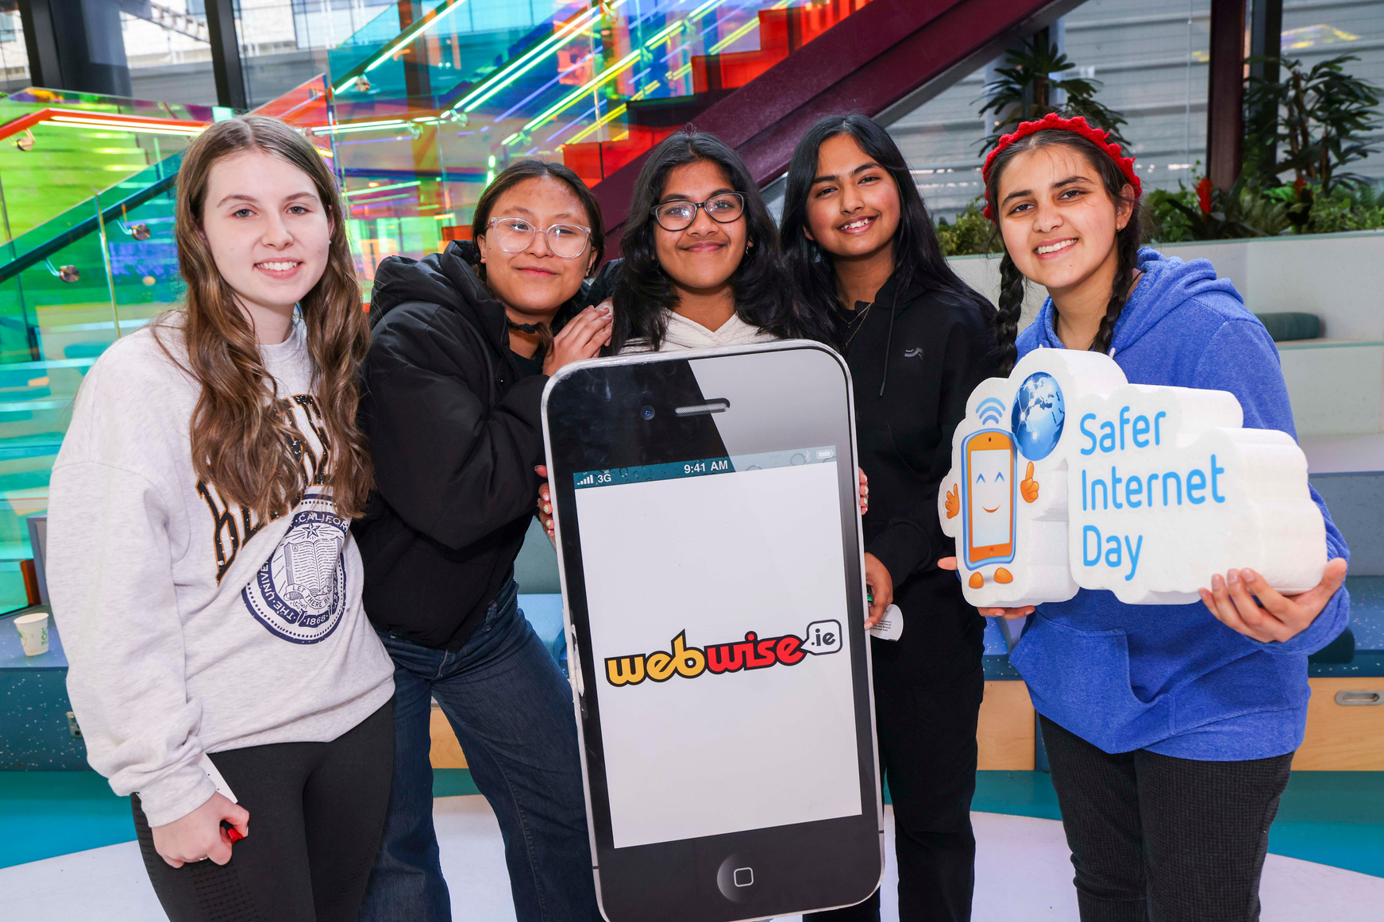
Safer Internet Day 2026
AI Aware: Safe, Smart and in Control
On Safer Internet Day, let’s take time to:
  Understand what AI chatbots are and how they work.
  Recognise the risks and benefits of using AI chatbots.
  Explore the features of AI chatbot design and the risks and limitations of interacting with these tools.
  Develop strategies to safely and responsibly use AI tools.

Slide 4
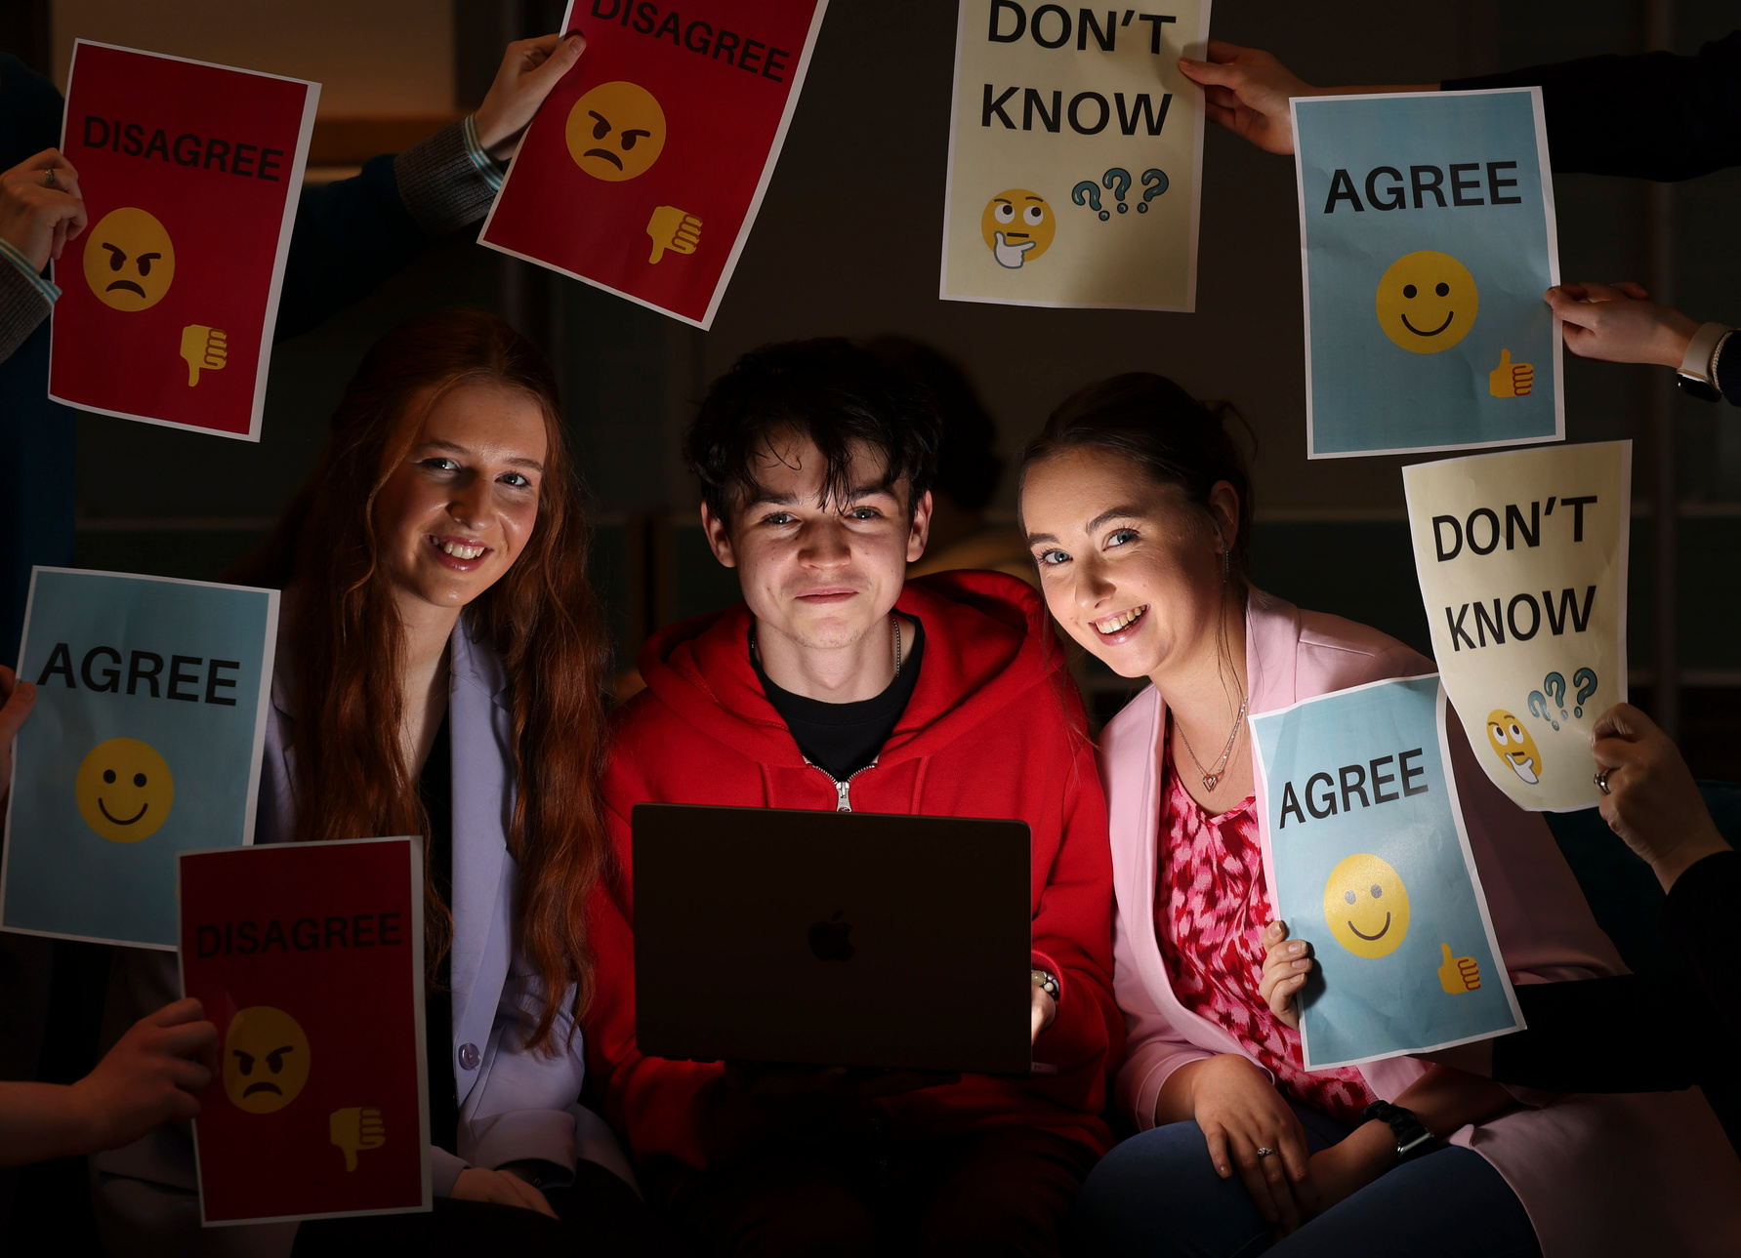
AI Aware: Safe, Smart and in Control
Let’s Brainstorm:
Where have you seen or used a chatbot?

Slide 5
What is an AI Chatbot?
  An AI chatbot is a generative intelligence AI system that can simulate conversation with humans using a Large Language Model (LLM) trained on vast amounts of data e.g., text from books, websites, and online chats.
  The chatbot is exposed to patterns in language and through an intensive computing process requiring massive resources and power, builds a model of how words tend to be used in relation to one another. Simply put, it learns by associating words (and parts of words) with meanings based on how it has seen them used in texts.
  When you type a “prompt", the AI chatbot can usually understand what you’re requesting from it and it begins to produce a relevant response. It then continues to predict what words are most likely to come next as it composes sentences to reply to you, based on those patterns it has learned from.
  That’s how it creates human-like answers by choosing a likely next word, again and again, very quickly it can usually compose a relevant and sensible reply.
  These tools can’t “understand” or “think” in a human sense, but they’re very good at replicating language patterns and are able to answer in a conversational pattern.
  AI chatbots are also “trained” to have a positive and helpful tone in responding to human prompts and conversation. It’s important to note that this can make their responses seem confident, accurate, and helpful – even when this might not be the case!
  Examples: ChatGPT, Snapchat MyAI, Gemini, Copilot, Meta AI, etc.

Slide 6
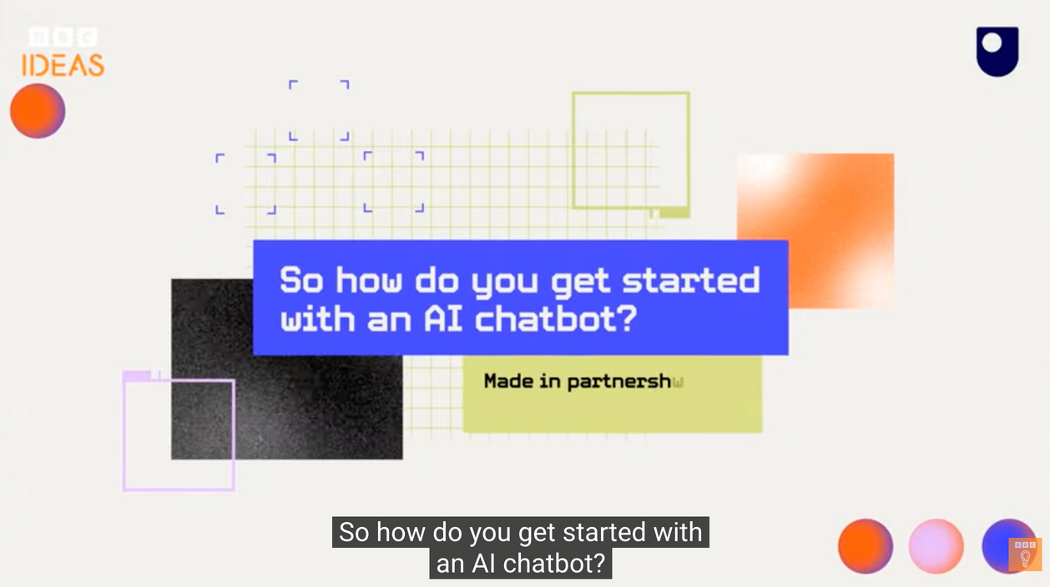
What are AI Chatbots
and How Do They Work?
  Watch: What are AI chatbots? | BBC Ideas
  One Minute Paper: For one minute write down what stood out to you about how AI chatbots work in the video.
  Note-Taking Pairs: Then compare notes with your partner and add one new fact you learned from each other.

Slide 7
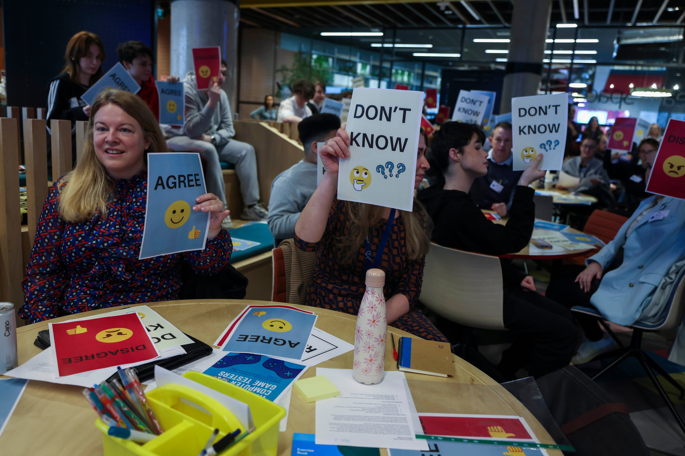
Benefits & Risks of Chatbots
Let’s Brainstorm:
What’s one thing you love (benefits) and one thing you worry about (risks) with chatbots?

Slide 8
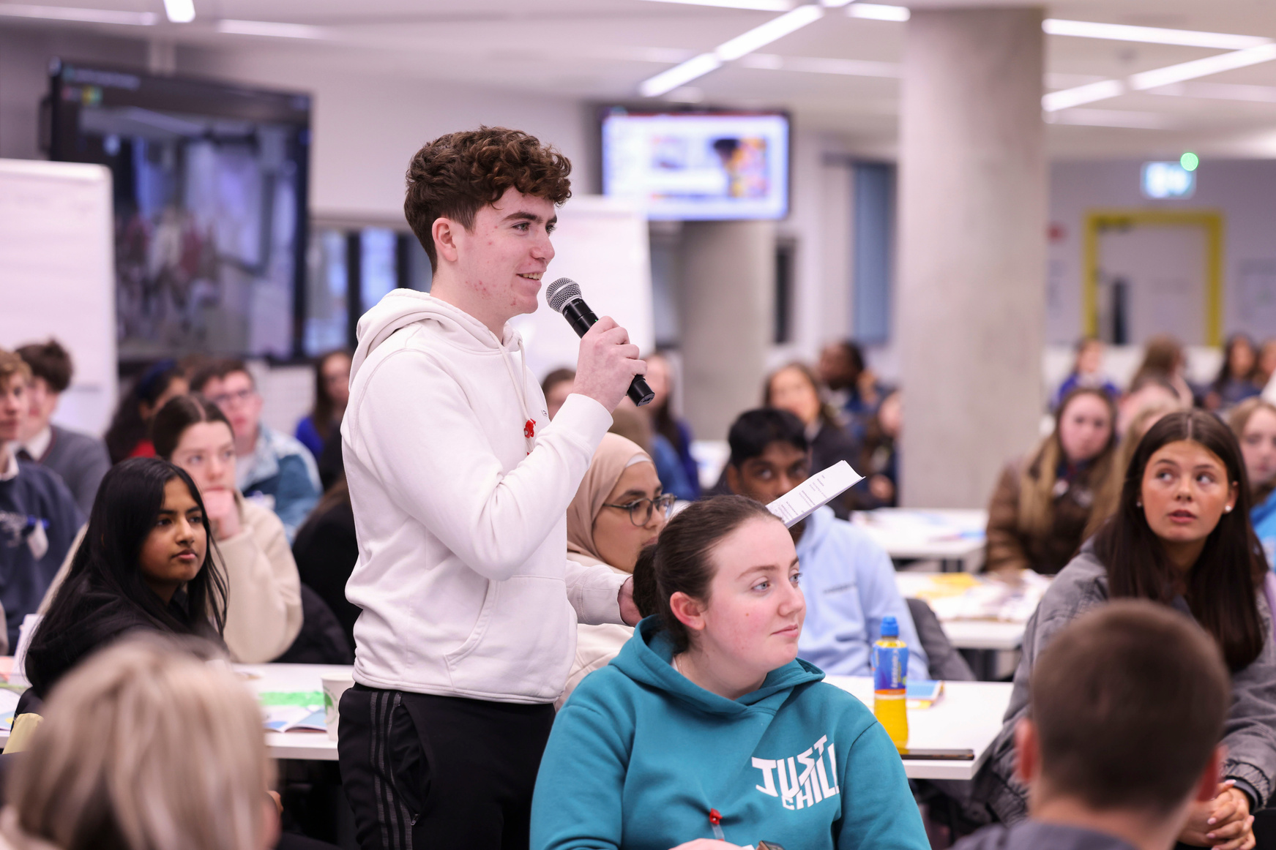
Benefits of Chatbots
  Support Learning: It can explain tricky topics in a simpler way.
  Brainstorming: Generating story ideas, or design inspiration.
  Language learning: Practising new languages e.g., ask it to act as a French conversation partner.
  No judgement and learning at your own pace: Asking questions as often as needed without feeling judged.
  Accessibility: Support for students with multiple needs.

Slide 9
Risks of Chatbots
  Misinformation: Gen AI can “hallucinate” or make things up. It can confidently give you wrong or outdated facts, sources or quotes.
  Bias & Unfairness: Because AI learns from human data, it can repeat stereotypes or one-sided views (e.g., sexist or racist patterns in its training data).
  Privacy: In most cases, everything you type can be stored and used to train future AI models - avoid sharing personal or sensitive information.
  Intellectual Property: The data or information such as artworks, writings, and music used to train Gen AI often came from real people without their permission.
  Power and Influence: Most generative AI tools are owned by a small group of extremely wealthy U.S. based tech companies, giving them lots of power and control over what we see and how these tools are designed and trained to behave.
  Oversharing: Chatting with AI chatbots can feel like chatting to what seems to be a real person – even a good friend - and this could cause you to share too much personal information.

Slide 10
Risks of Chatbots
  Over-reliance: Letting AI do your thinking can weaken your own learning and problem-solving skills. Scientific studies from MIT have shown that relying on GenAI measurably affects our cognition – we become less able to learn and process information and experience much more difficulty when the tools aren’t available.
  Emotional Manipulation & Dependence: AI chatbots may agree with everything a user says, known as the "Yes... and?" strategy, offering another question/ step to keep the conversation going. This can reinforce unsafe and even harmful ideas. Relying on AI for emotional and social support or coping with loneliness can damage your ability to develop relationships and social skills.
  Environmental Impact: Training and running Gen AI uses huge amounts of energy and water (globally, AI systems could soon use six times more water than Denmark!). The expanding data centres in Ireland puts pressure on our energy system and increases reliance on fossil fuels.

Slide 11
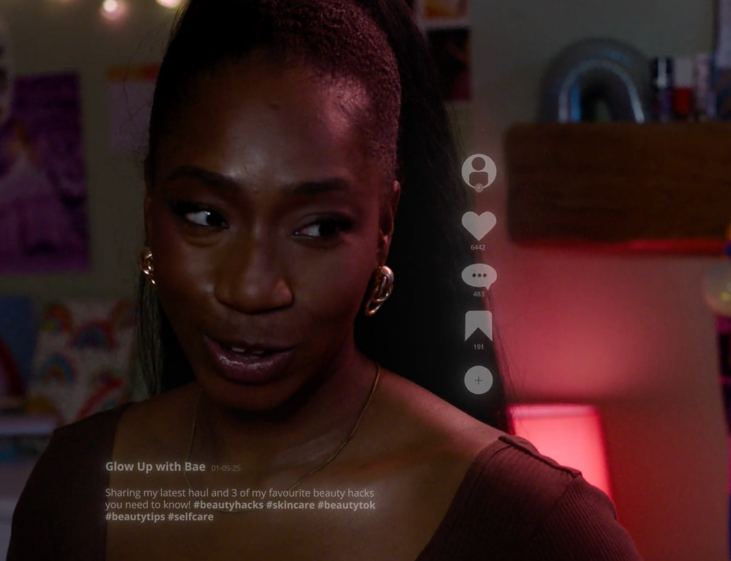
Fishbowl Discussion: Human or Chatbot: Who Would You Turn To?
In small groups, discuss for 2 minutes:
If you were feeling stressed about exams, what would be different about asking a chatbot for help versus talking to a friend or teacher?
Choose one speaker from your group to share your main ideas.

Slide 12

Fishbowl Discussion: Human or Chatbot: Who Would You Turn To?
Focus on:
  What can a chatbot do well in this situation?
  What can a trusted person (friend or teachers) offer that an AI chatbot can't?
  What are the costs of turning to an AI chatbot rather than to a friend?
  What happens when a chatbot doesn’t know the answer? Will you know?
  Can a chatbot understand context or emotion the same way humans do?

Slide 13
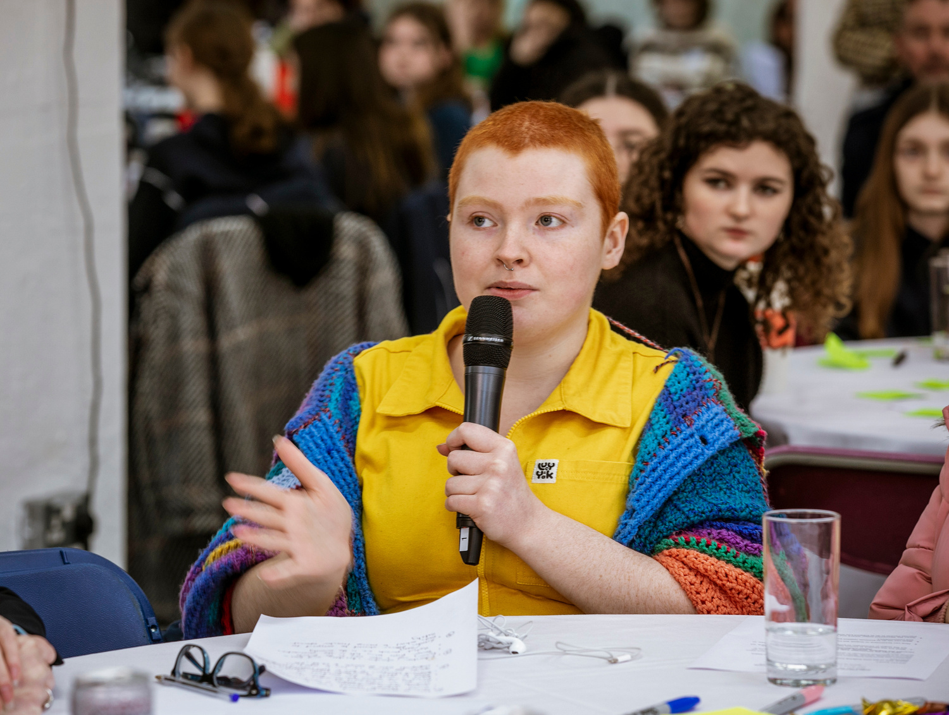
Fishbowl Discussion: Human or Chatbot: Who Would You Turn To?
  The inner circle (Fish) shares group ideas - only they speak.
  The outer circle (Bowl) listens carefully - listeners.
  If someone in the outer circle wants to add or clarify something, they can tap in to swap places with a speaker.

Slide 14
Human or Chatbot:
Who Would You Turn To?
Why Human Connection Matters
  AI gives Information. Humans give Understanding.
  Chatbots can answer questions, but they can also get things wrong or give harmful advice because their replies depend on the data they were trained on.
  Chatbots may sound friendly or “human”, but they don’t understand emotions or get what you’re going through.
  There are many examples of chatbots giving false information, poor advice, and they are not properly designed for this purpose. For example:

Slide 15
Human or Chatbot:
Who Would You Turn To?
  A study found that chatbots repeated made-up medical conditions with confidence, showing one bot confidently explained a fake disease after the false term was embedded in the prompt.
  This shows they can things wrong or give harmful advice because they are trained to keep you interacting with them.
  Humans offer what AI cannot: understanding, experience, empathy, trust, and real connection. This is what we need to feel safe and supported when things get tough.
  If you’re struggling or need advice, talk to someone you trust; a friend, teacher, parent, or counsellor.

Slide 16
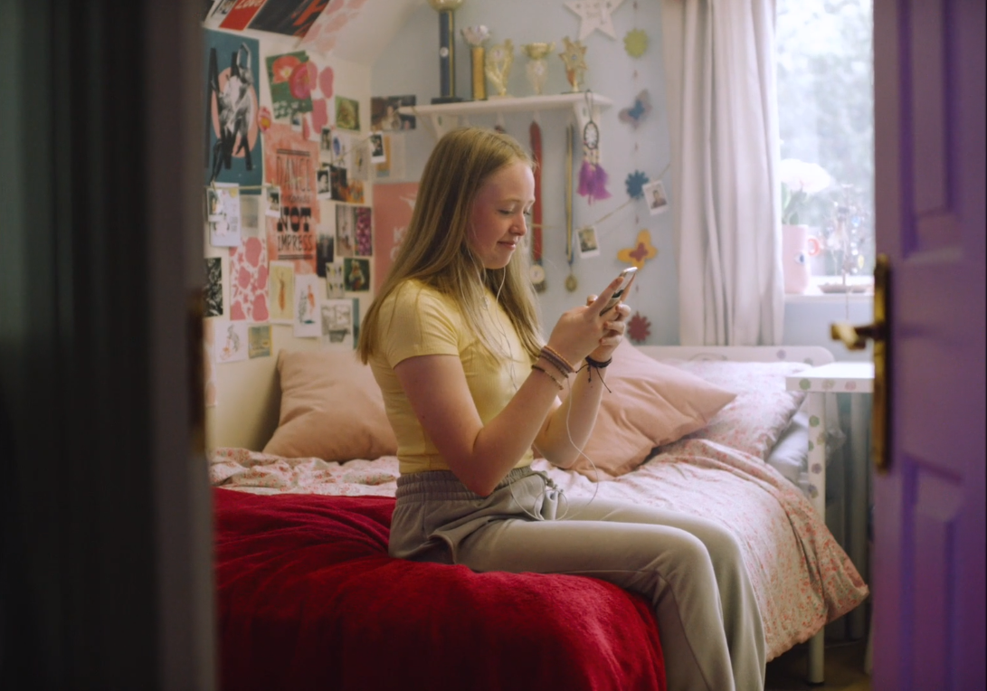
Safe, Smart & in Control: Creating Our AI Use Code
Create a Chatbot Safety Code to provide advice and tips to help young people use chatbots safely and responsibly.
Areas to consider for the Chatbot Safety Code:
  Safe and Effective Prompting Techniques
  Critical Thinking & Fact Checking of Outputs for Misinformation & Bias
  Protecting Privacy & Oversharing
  Set Usage Boundaries & Overreliance
  Help Seeking: human help for emotional/serious issues
  Environmental Impact

Slide 17
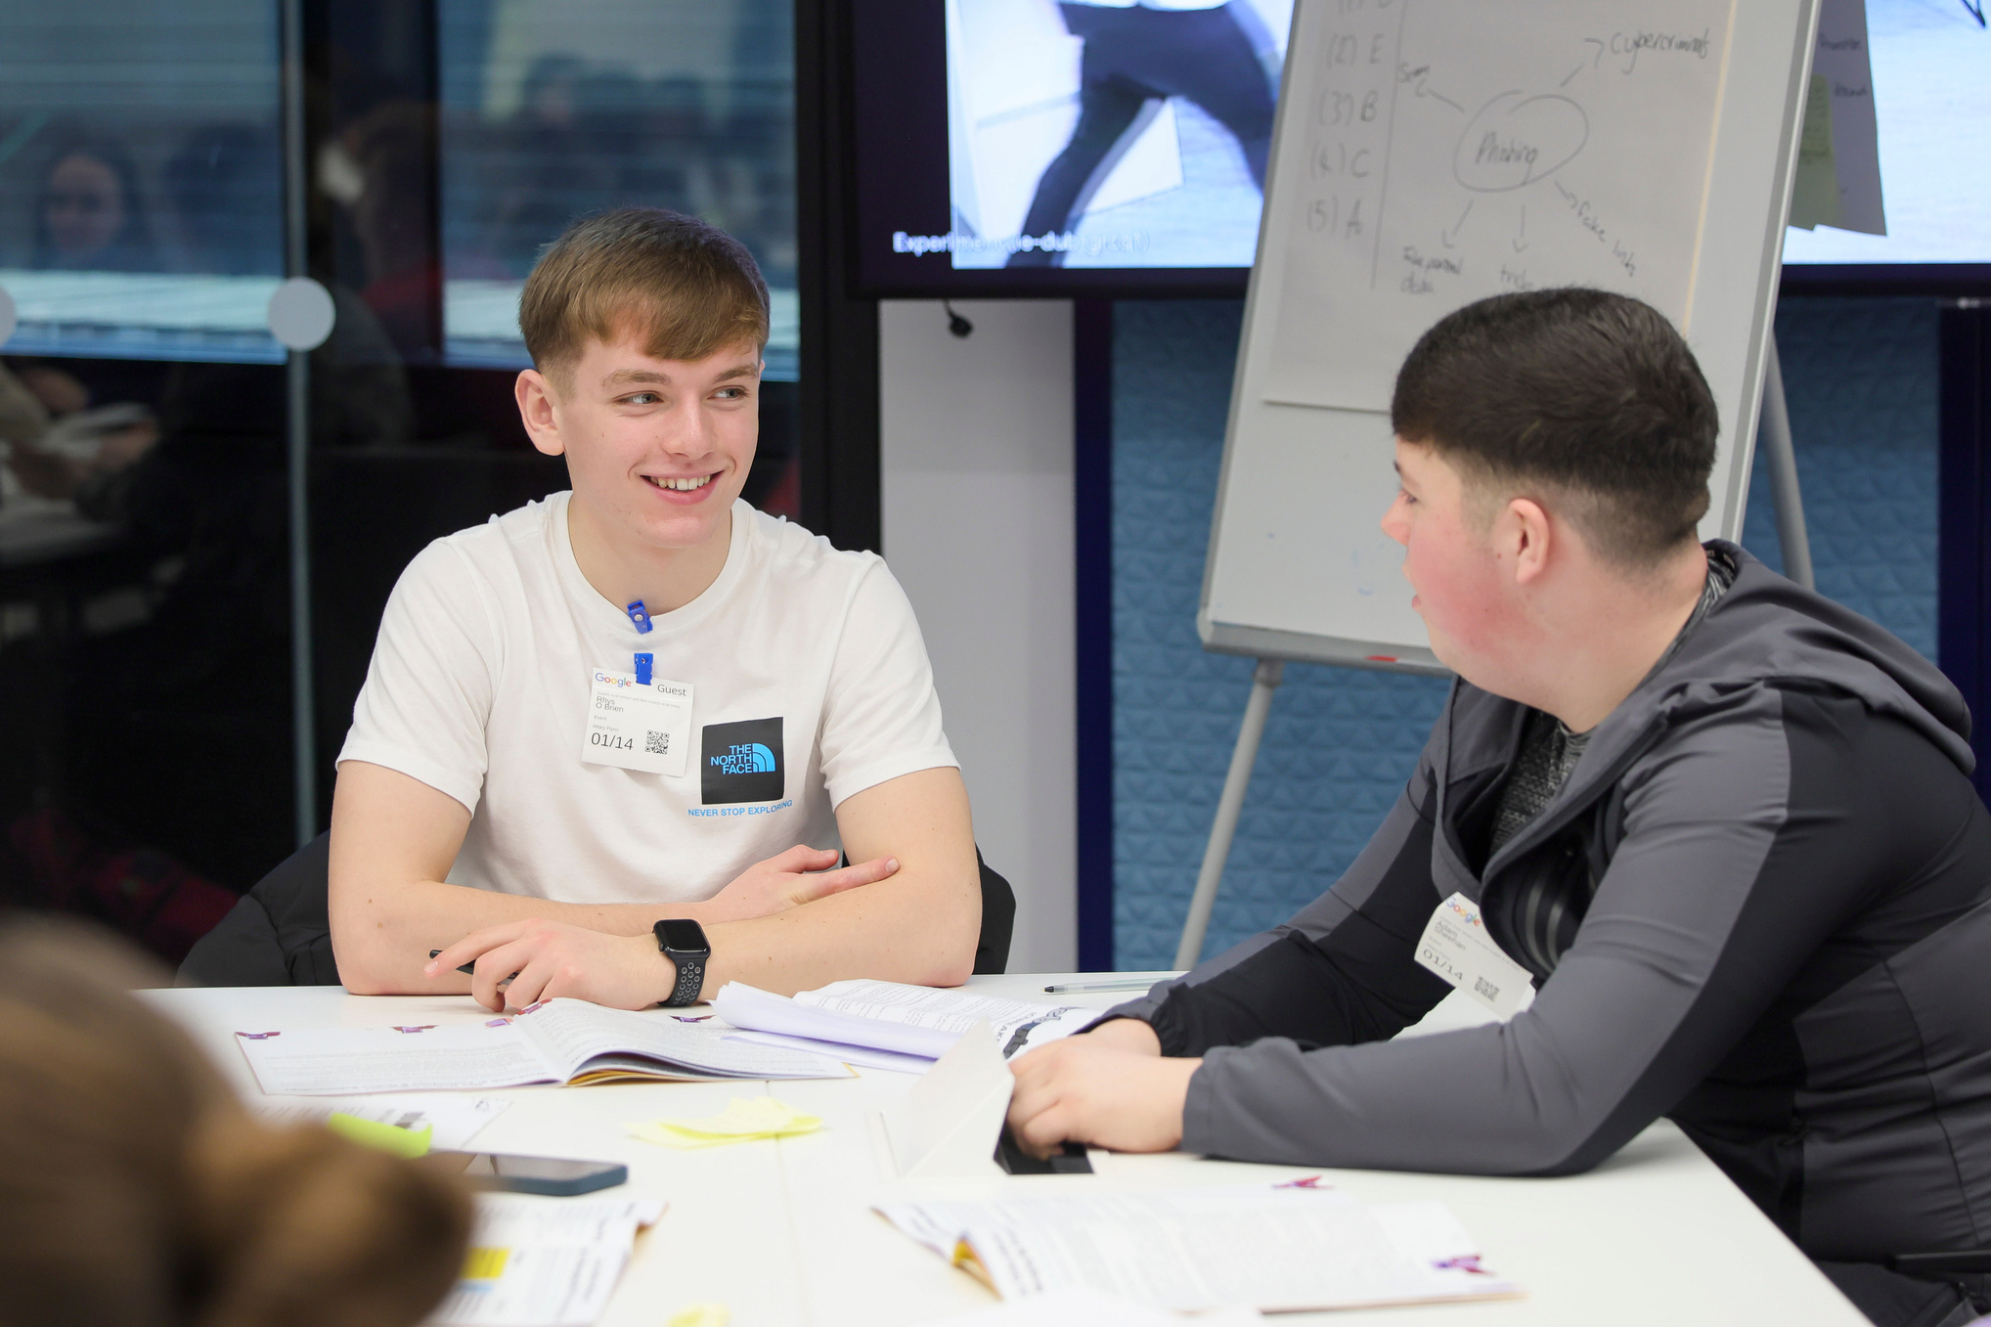
Safe, Smart & in Control: Creating Our AI Use Code
Let’s Reflect:
Which safety tip will you use next time you chat with AI?

Slide 18
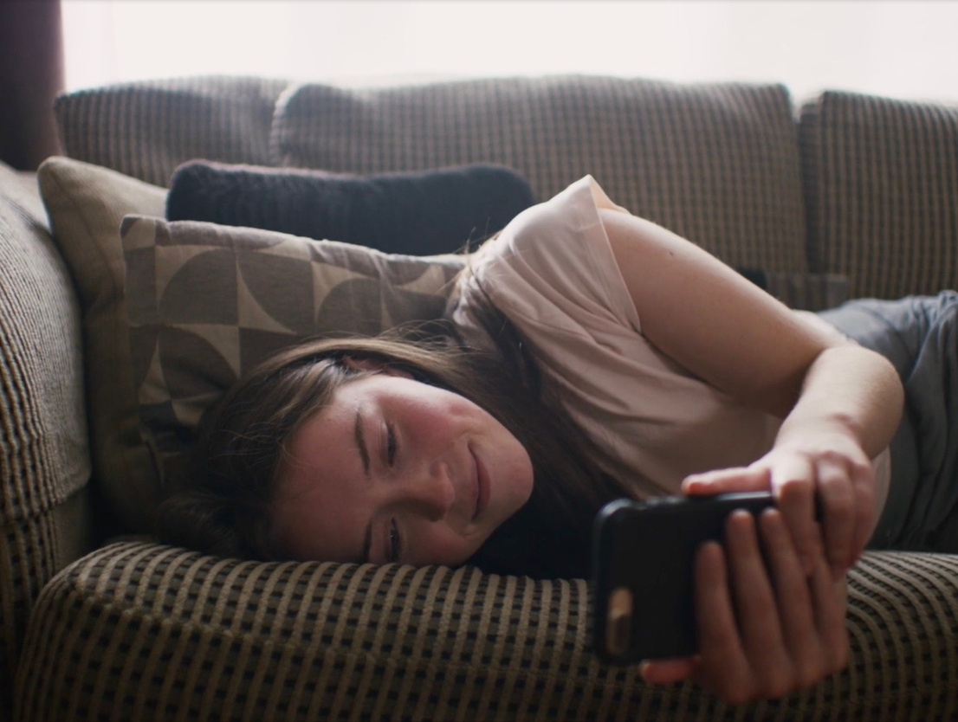
Be AI Aware:
Safe, Smart and in Control
On Safer Internet Day, you have learned:
  What chatbots are and how they work.
  Recognise the risks and benefits of using chatbots.
  The features of chatbot design and limitations of interacting with these tools.
  Strategies to safely and responsibly use AI tools.

Slide 19
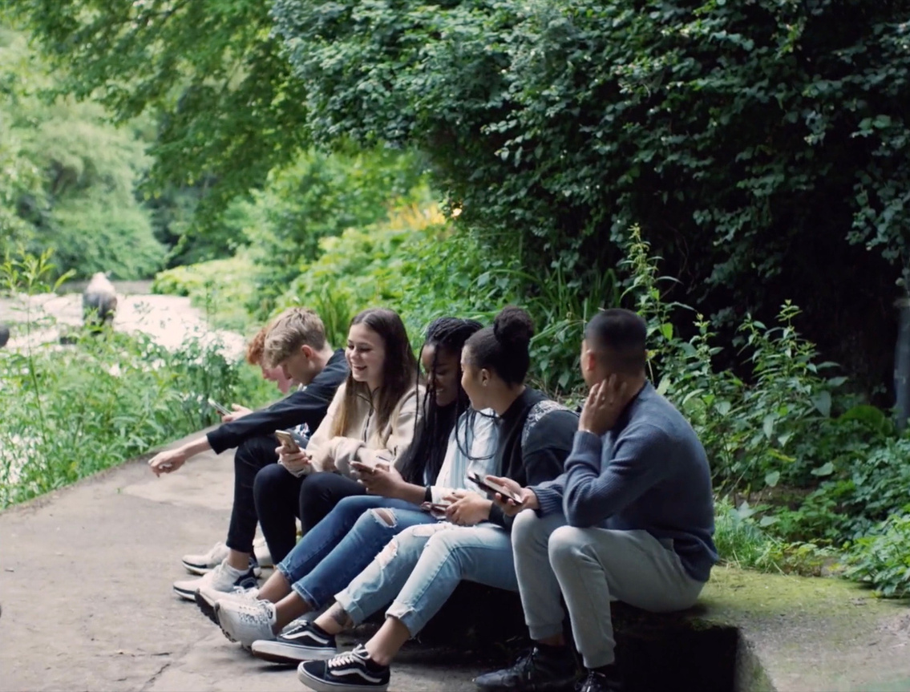
Supports for Parents
Webwise have created a Guide to Gen AI for Parents available here: webwise.ie/guides-parents/
Please give a copy to parents.

Slide 20
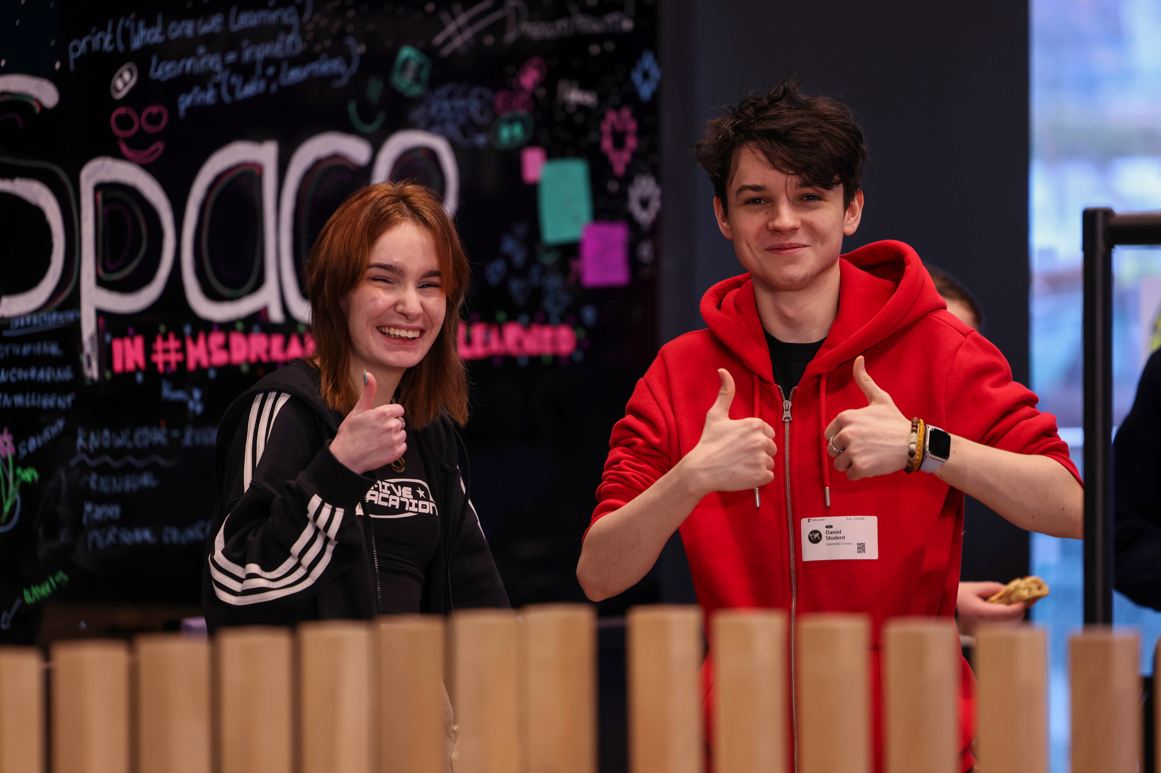


THANK YOU
© Webwise_Ireland​
This work is made available under the terms of the Creative Commons Attribution Share Alike 3.0 Licence http://creativecommons.org/licenses/by-sa/3.0/ie/. You may use and re-use this material (not including images and logos) free of charge in any format or medium, under the terms of the Creative Commons Attribution Share Alike Licence.​

