Slide 1
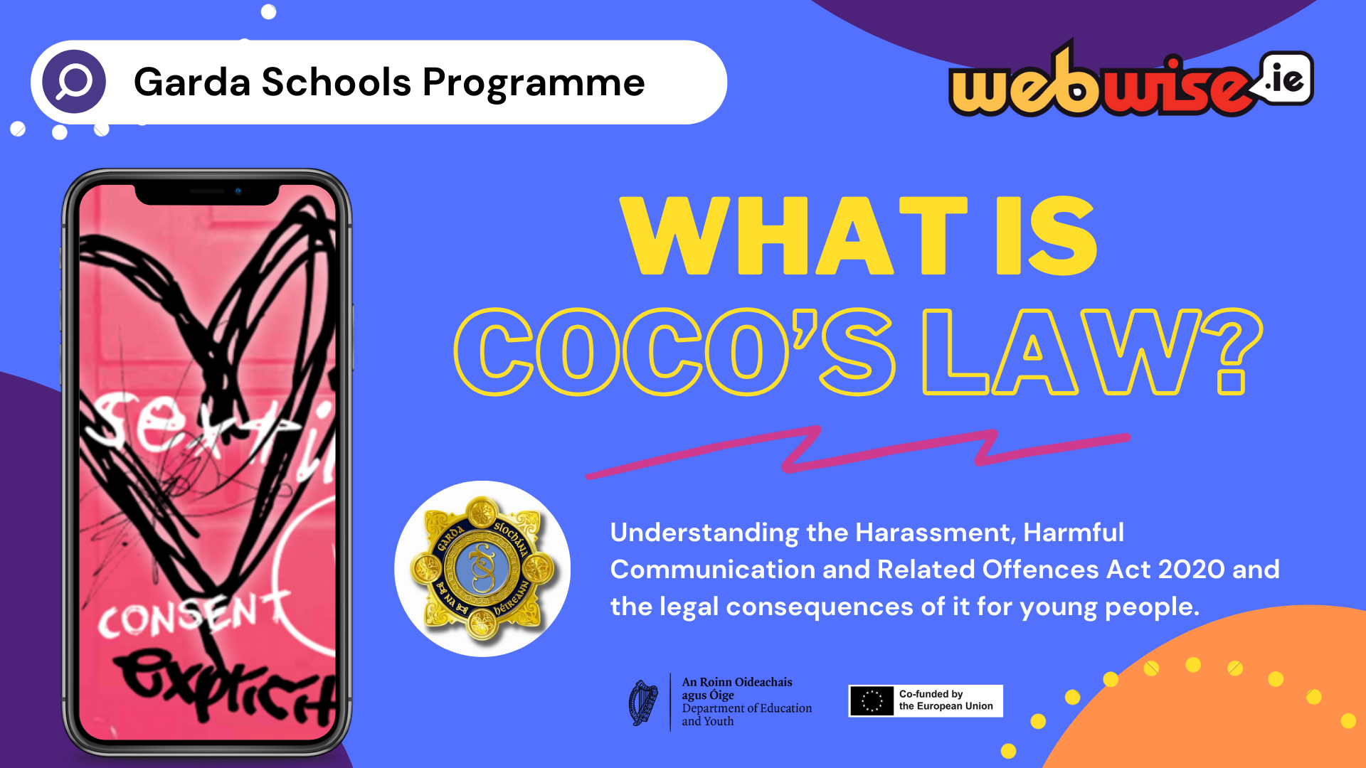
Notes:
At the beginning of the talk, introduce yourself and your partner.
Script: We are here today to talk to you all about a law that is referred to as Coco’s Law. The full name is the Harassment, Harmful Communication, and Related Offences Act 2020. You will have learned about it when you covered the Webwise ‘What is Coco’s Law’? lesson in class recently. Our goal today is to explain what this law is all about and why it’s important for people your age to understand it.

Slide 2
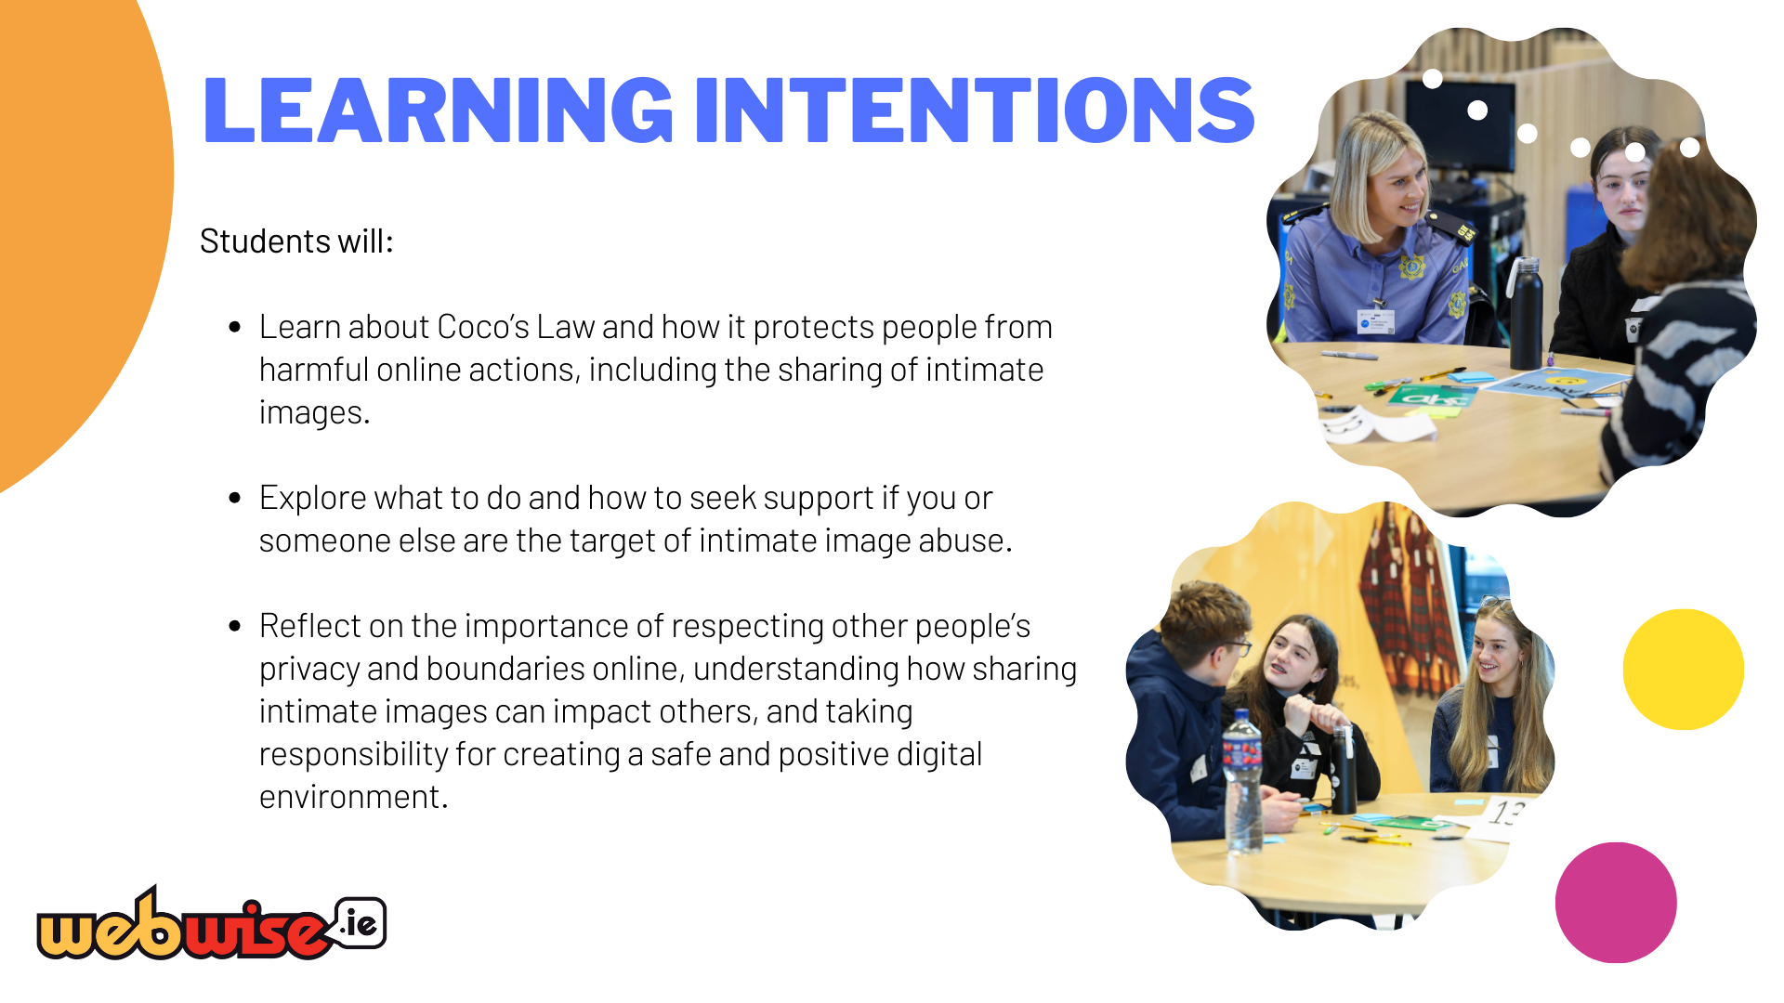
Notes:
Script: Let's have a quick look at what we hope you will learn during this lesson: explore appropriate actions to take if they encounter harmful online content, such as receiving an intimate image, including reporting, seeking help, and understanding their rights. reflect on the importance of respecting others’ privacy and boundaries online, understanding the impact of their actions, and taking responsibility for creating a safe and positive digital environment.

Slide 3

Notes:
Script: Firstly, there will be opportunities for you to ask questions and share opinions, so when you’re sharing your thoughts, try to use 'I' statements like 'I think,' 'I feel,' or 'I believe.' This helps ensure the conversation doesn't refer to anyone else’s experiences. Also, please don’t share specific examples from your own life or from others. This isn’t just to protect privacy, but also to keep the focus on the topic rather than individual situations. It’s really important that everyone gets a chance to speak, so listen carefully when others are talking and try not to interrupt. Show respect in what you say and how you act – avoid any put-downs, rude gestures, or things like eye-rolling. We want to make sure everyone feels comfortable sharing. Lastly, it is really important that you understand that if you share anything in the group that makes us concerned about your welfare, we can’t keep it to ourselves. We have a responsibility to ensure that you are safe and protected, so we may need to take it to the right people to get you the right support.

Slide 4
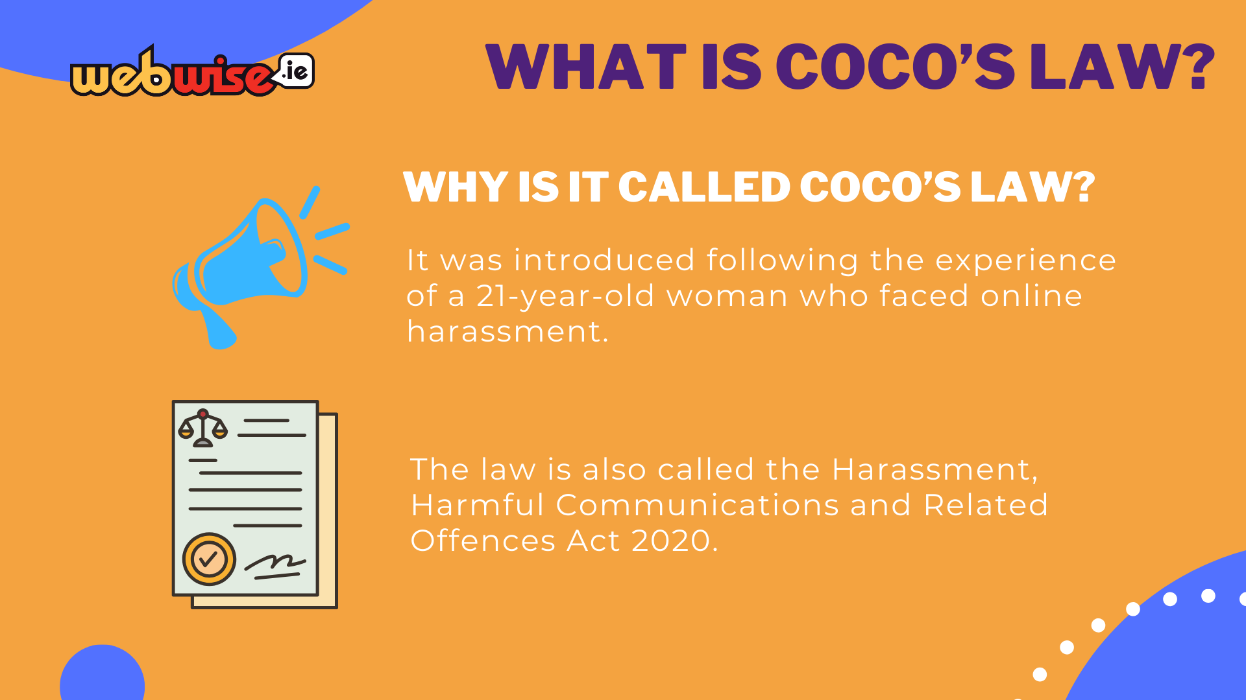
Notes:
Facilitation Information: Ask the group to summarise the law using three words to gauge their memory from the ‘What is Coco’s Law?’ classroom lesson.
Invite 5-6 students to put their hands up if they are willing to share. Invite them to share the words that come to mind. Students may share words like ‘consent’ ‘illegal’ ‘sharing images’ ‘online pictures’ etc.
Once students have shared, inform students that In February2020 the Harassment, Harmful Communications and Related Offences Act was commenced.
Script: Sometimes this is known as Coco’s Law, after the 21 year old woman who’s experience of online harassment spurred the government to action. This law is in addition to existing legislation which makes it illegal to send, threaten to send, share or receive any sexually explicit images, video or text of someone under 18 years of age.

Slide 5

Notes:
Script: Before we dive into the details of the law, let’s start with an activity called an ‘Anticipation Exercise.’ In this activity, you’ll try to guess the answers to some questions. Later on, after we’ve gone through everything, you’ll get to check if your guesses were correct. Let’s see how much you already know.
Facilitation Information: Hand out a copy of the ‘Anticipation Exercise’ (Worksheet 1) to each student to complete individually. Alternatively, you can share one between two and allow them to complete in pairs.
Invite them to write their answers into the ‘guess’ column. Observe how the students are getting on. Once the majority have all 11 questions answered, bring their focus back to the presentation.

Slide 6
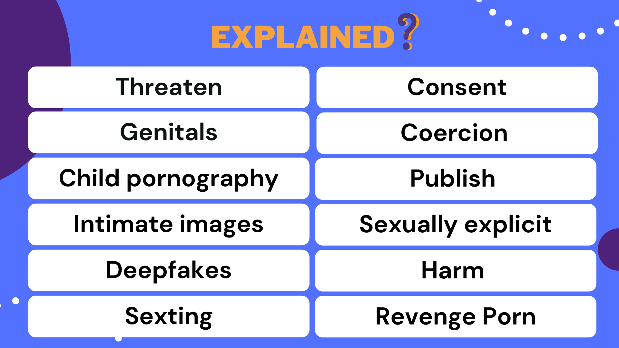
Notes:
Script: What you will see on the screen is a list of words that are related to Coco’s Law. Some of these words might look familiar and some might not. It is important that you understand these terms to fully understand the law. Let's go through each of them.

Slide 7
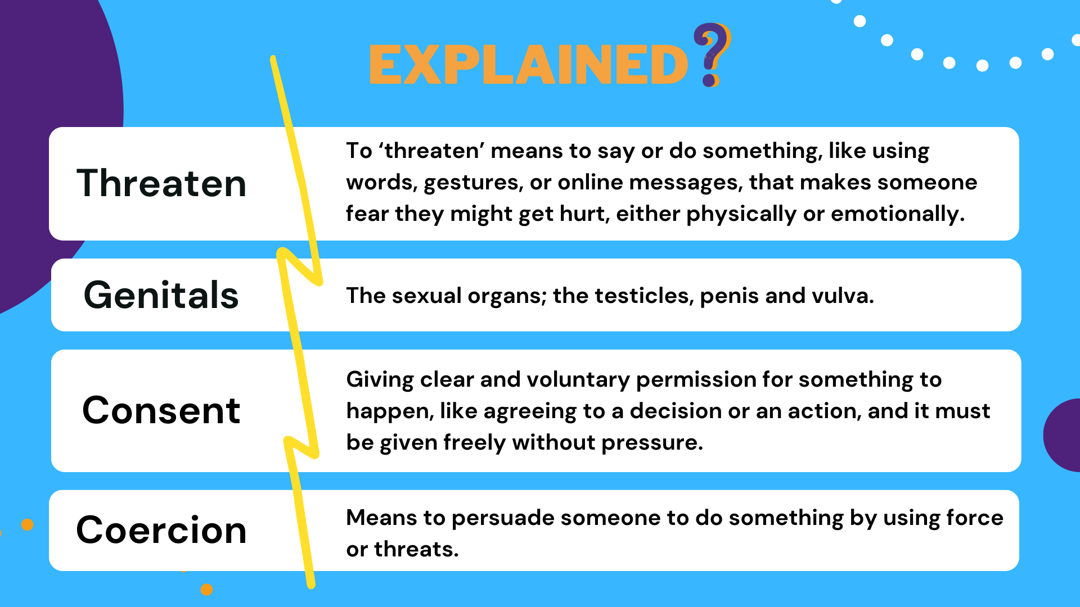
Notes:
Script:
Threaten: Threatening to publish and distribute an intimate image without consent is in itself an offence, even if the threat is not carried out.
Genitals: The genitals refer to the testicles, penis, and vulva. The vulva is a part of the female body and includes the female reproductive organs outside the body.
Consent: The law protects people from having their private pictures shared without their permission. It’s illegal to share someone’s intimate pictures without their clear consent because it can really hurt them. This law helps keep people in control of their personal images and stay safe online.
Prompt Question: What is the difference between an intimate image and an explicit image?
Coercion: This means pressuring or forcing someone to do something by using threats or intimidation. It’s when someone feels they have no choice but to do what the other person wants because of fear.

Slide 8
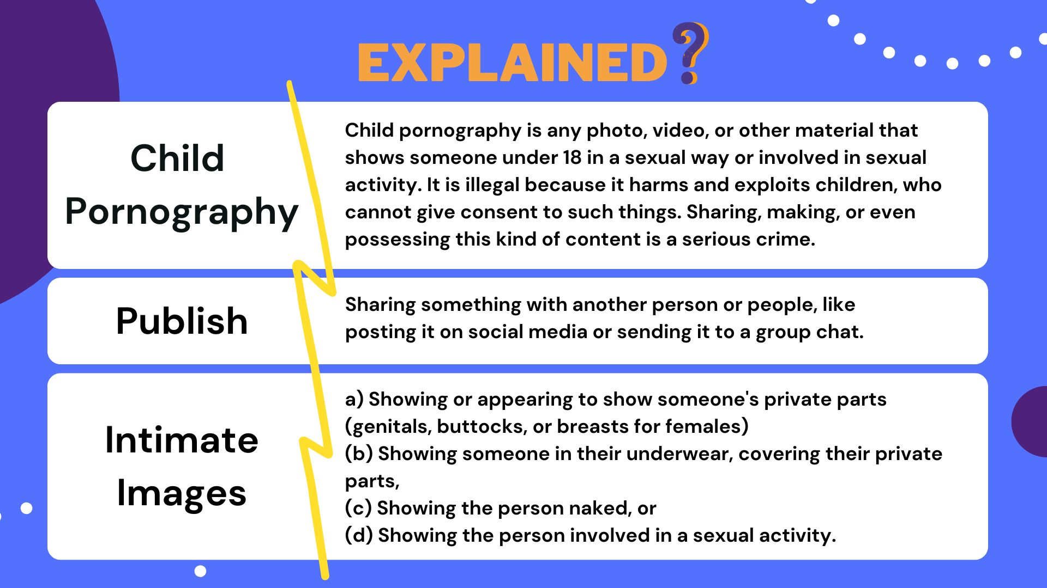
Notes:
Script:
Child Pornography: On the last slide I mentioned another law that refers to pornography. It is very important that you are aware that if sexually explicit images, videos, or even written messages involving someone under the age of 18 are taken, itis considered child pornography, and this is illegal. For example, if someone shares or takes a nude photo or sexual video of a person who is under 18, even if the person agrees to it, this is considered child pornography and is against the law. In Irish legislation, terms such as ‘child pornography’ are frequently used to explain illegal activities involving the abuse of children. However, these terms are not considered victim-centered because they tend to focus on the content rather than the harm inflicted on the victims. The term ‘child pornography’ is misleading because it suggests a form of pornography, which people might think that consent was given, but it actually involves the abuse and exploitation of children, so it's better to call it ‘child sexual abuse material’(CSAM) to show it’s a serious crime.
Publish: Under Coco’s Law, "publishing" an intimate image means sharing it with others, even if it's just one person. Some young people think publishing only applies to large-scale sharing (like on social media), but the law also includes sending a private image to a single person without consent. This is still considered publishing under the law.
An intimate Image: An intimate image refers to: (a) Showing or appearing to show someone's private parts (genitals, buttocks, or breasts for females), (b) Showing someone in their underwear, covering their private parts, (c) Showing the person naked, or (d) Showing the person involved in a sexual activity.
Sexual activity is when people do things that involve touching private parts or other actions related to sex. The person in the image or video does not need to be naked or fully undressed. For a picture or video involving sexual activity, the person can be fully clothed and it will still be considered an intimate image.
Script Sexting: Sexting is when someone sends or receivesmessages, photos, or videos that are sexual in nature, usuallythrough a phone or social media. Revenge Porn: This refers to the sharing of private, intimateimages or videos of someone without their consent, usually toembarrass or hurt them. It is illegal and can cause significantemotional harm to the person involved. Although the termrevenge porn is used in the law, ‘image based sexual abuse’ ismore appropriate. Remember, it's important to know that once these images orvideos are sent, it’s nearly impossible to get them back orcontrol who might see them once shared.

Slide 9
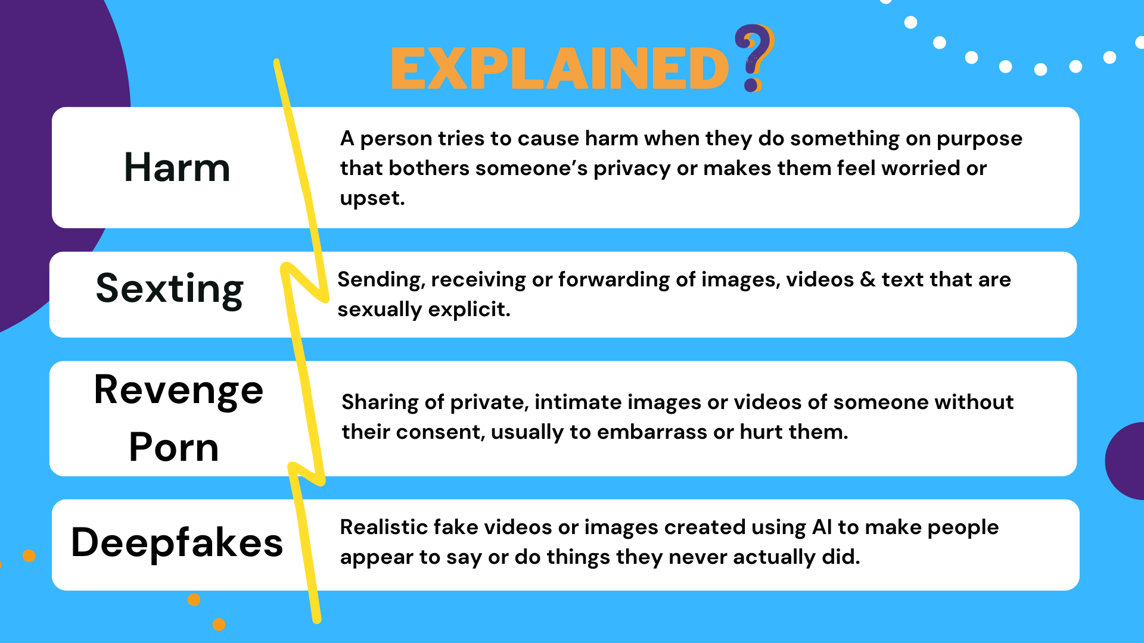
Notes:
Script:
Harm: This is an important definition to know to fully understand Coco’s law. Harm can be understood as when someone does something on purpose that invades another person’s privacy or makes them feel upset, worried, or stressed. The proper legal definition is when someone intentionally interferes with another person’s peace and privacy, or causes alarm and distress. Harm doesn’t just mean physical harm. It also includes emotional or mental harm, like making someone feel anxious, scared, or depressed.
Sexting: Sexting is when someone sends or receives messages, photos, or videos that are sexual in nature, usually through a phone or social media.
Revenge Porn: This refers to the sharing of private, intimate images or videos of someone without their consent, usually to embarrass or hurt them. It is illegal and can cause significant emotional harm to the person involved. Although the term revenge porn is used in the law, ‘image based sexual abuse’ is more appropriate. Remember, it's important to know that once these images or videos are sent, it’s nearly impossible to get them back or control who might see them once shared.
Deep Fakes: These are fake videos created using digital software, machine learning and face swapping. Deep fakes are computer-created artificial videos in which images are combined to create new footage that shows events, statements or action that never actually happened. The results can be quite convincing.
Additional Note for Facilitator: In Irish legislation, terms such as ‘revenge porn’ are frequently used to address the non-consensual sharing of intimate images. However, this term is not considered victim-centered because it tends to focus on the content rather than the harm inflicted on the victims. The term ‘revenge porn’ implies that the primary issue is revenge, downplaying the severe violation of privacy and dignity experienced by victims. A more victim-centered approach would use terms like ‘image-based sexual abuse,’ which focuses on the harm done to the individual rather than the motivations of the perpetrator. While these terms are embedded in legal language, they fail to fully capture the extent of the harm caused to the victims, which should be central to the discourse.

Slide 10
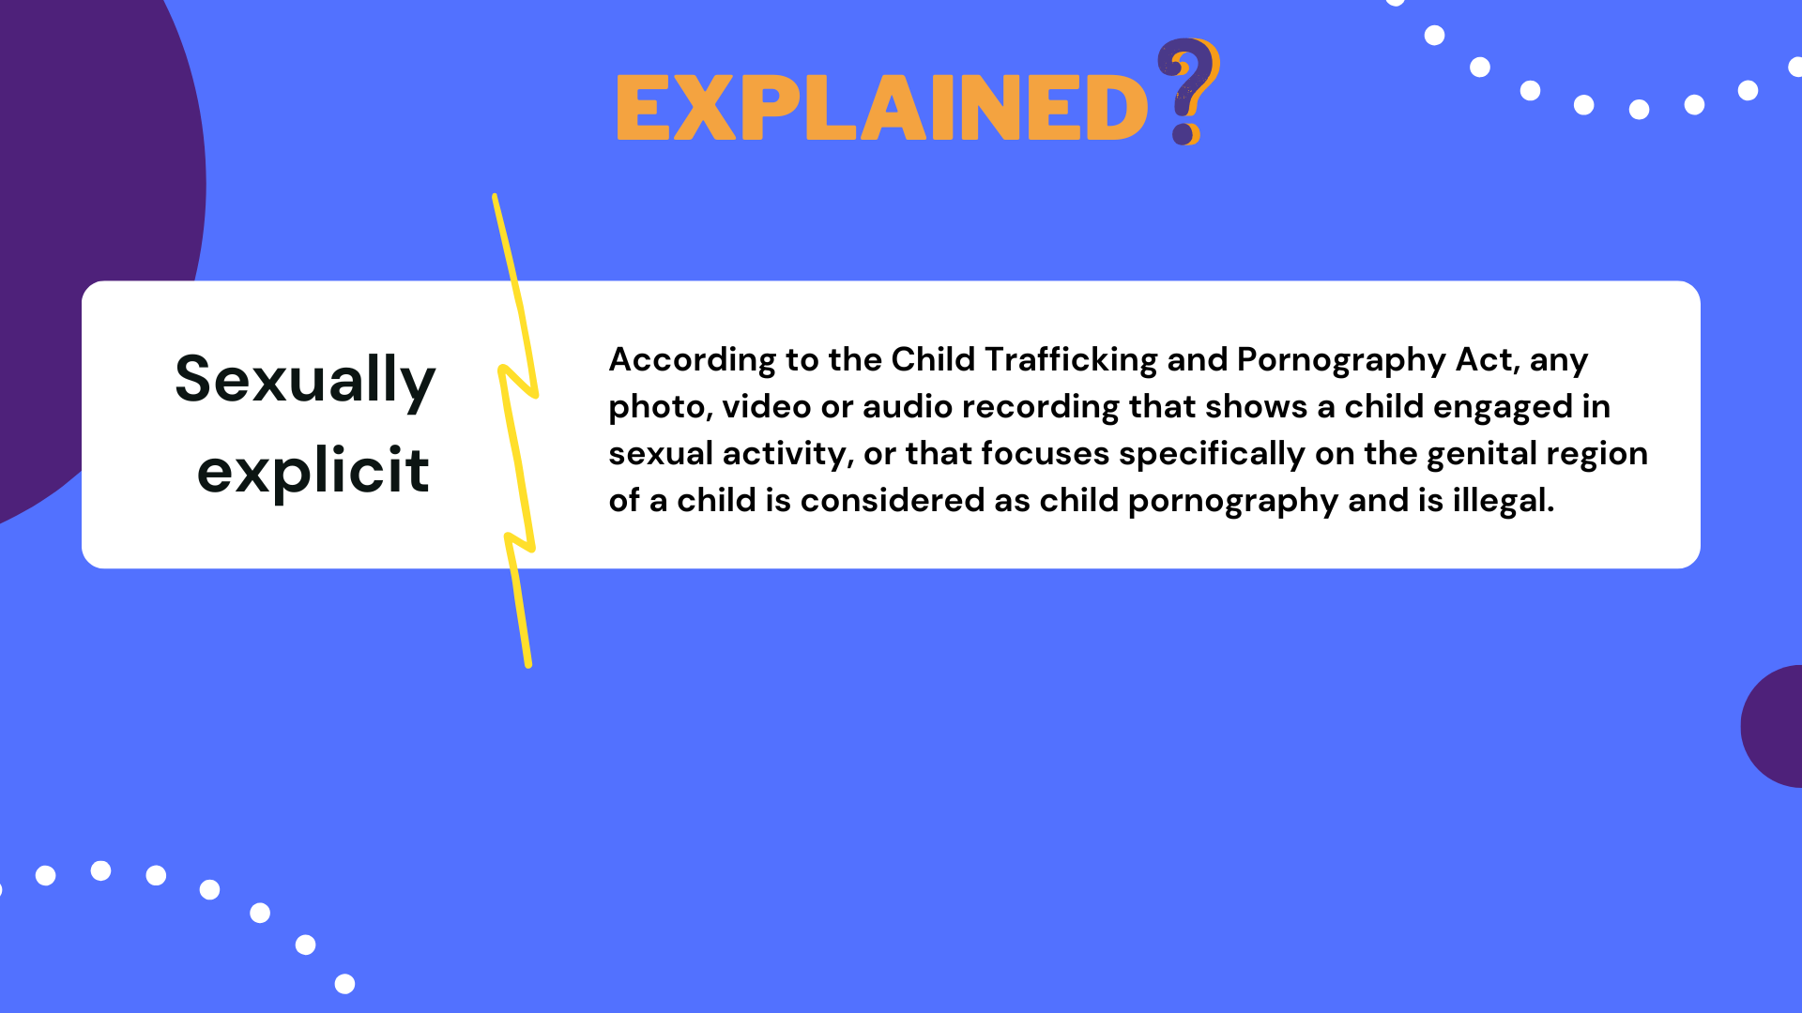
Notes:
Script:
Sexually Explicit: According to the Child Trafficking and Pornography Act, sexually explicit material includes any photo, video, or audio recording that shows a child (someone under 18)involved in sexual activity or focuses on their genital area. This kind of content is considered child pornography and is illegal. Note: Sexually Explicit means any depiction of actual or simulated sexually conduct.

Slide 11
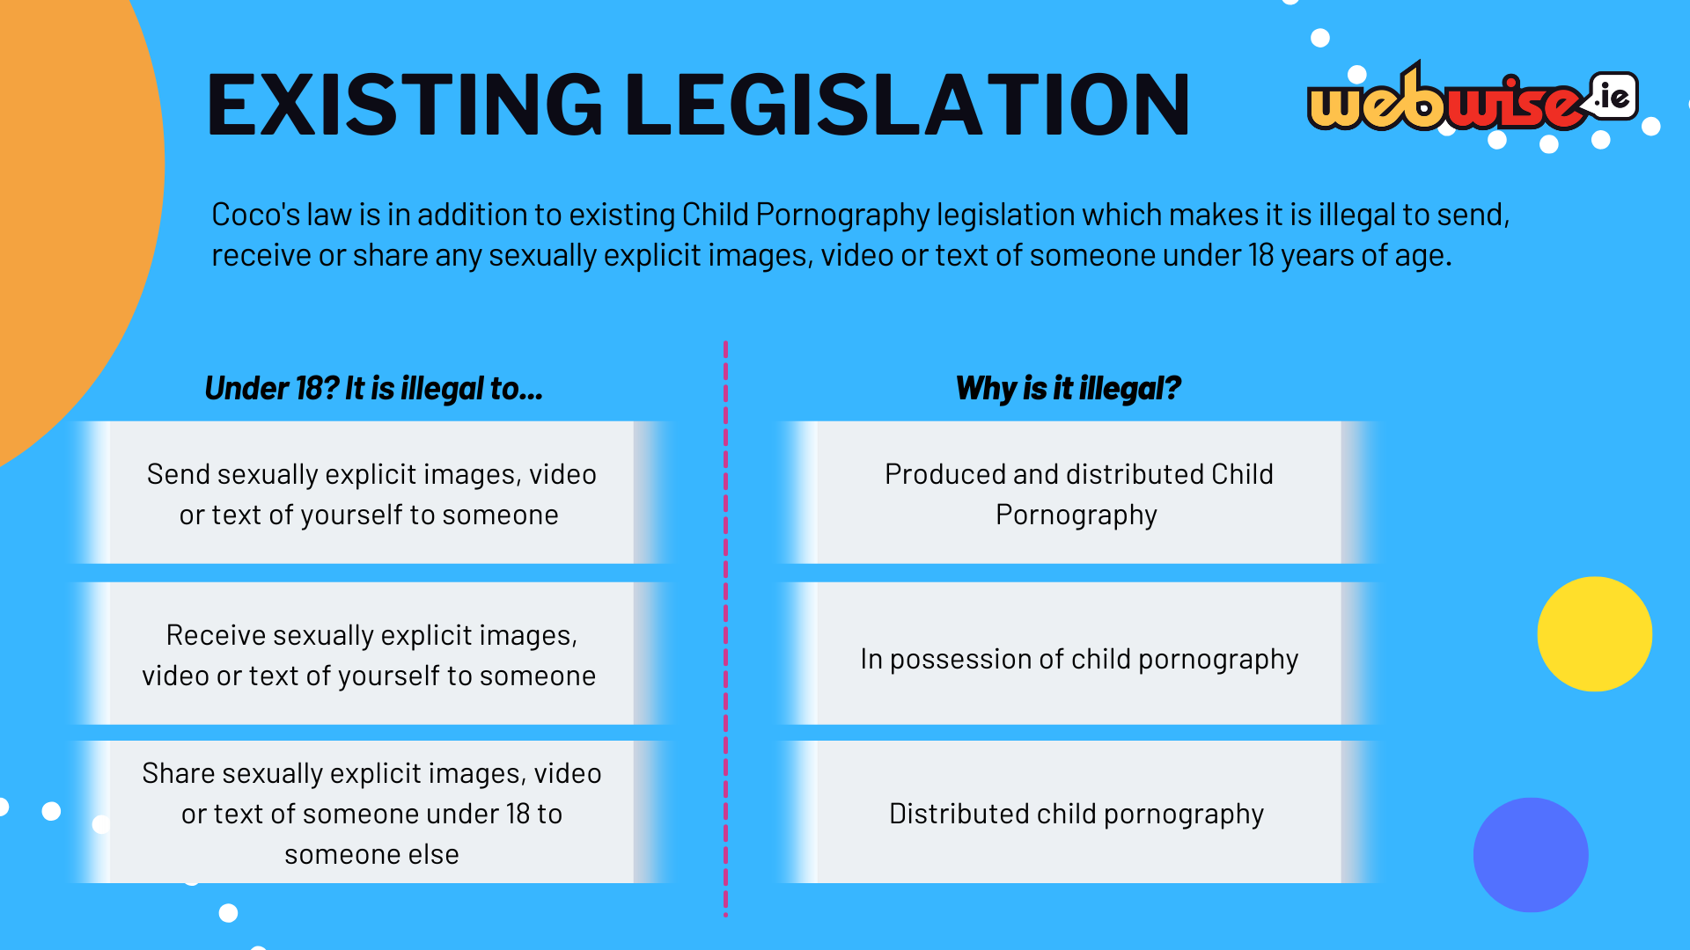
Notes:
Script: Coco's Law works alongside other laws (Child Pornography Act) that make it illegal to send, receive, or share any sexually explicit images, videos, or texts of someone under 18 years old.
This means that anyone who creates, sends, shares, stores, or even receives explicit images of a person under 18 could face legal issues under this law.
The purpose of the law is to protect children from being exploited, not to punish them for their behaviour.
If someone under 18 sends, receives, or shares explicit content, it’s not only breaking Coco's Law but also this law, the Child Trafficking and Pornography Act 1998.

Slide 12
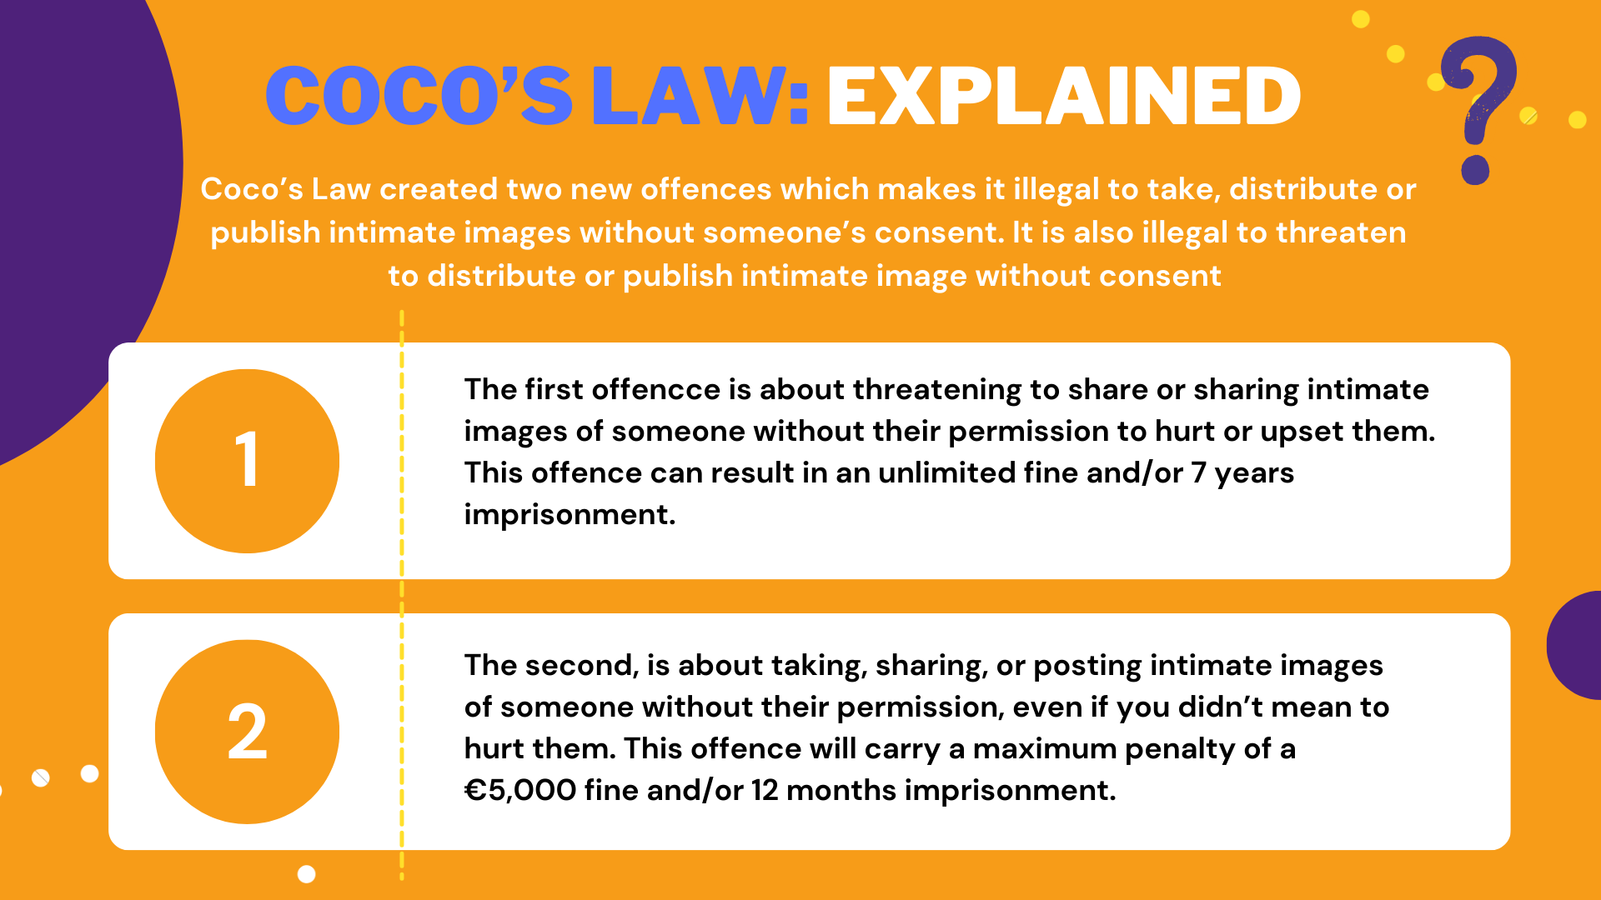
Notes:
Script: Let's return to Coco’s law and unpack the sections of the law. There are two important new offences in this law. Before we share these, let's just ensure there is an understanding of the term ‘threaten’ and ‘distribute’. To ‘threaten’ means to say or do something, like using words, gestures, or online messages, that makes someone fear they might get hurt, either physically or emotionally.
When it says ‘distribute’ this means sharing or passing on content, like images or videos, directly to other people or groups. This includes showing an intimate image to people (in person, on your phone). This is still sharing. Just because there is no record of you showing someone doesn't mean it is okay. Sending an intimate image to someone through a messaging app like Snapchat is seen as distribution.
You’ll remember from earlier that ‘publish’ means making content available to the public or a portion of the public, such as posting an image on a website, social media, or other public platforms. Even if the content is only shared with a small group, it can still count as publishing.
1. The first of these new offences is the most serious and carries the most serious penalties if convicted. The penalties can be an unlimited fine and/or 7 years imprisonment.
2. Not all cases of intimate image distribution may involve intention to cause distress. Sometimes, such content is shared without considering the impact on the victim. These cases may not be capable of being prosecuted under the more serious section because the intent to cause or harm element may not be present, but it is still seen to be an offence under this new law. This offence will carry a maximum penalty of a €5,000 fine and/or 12 months imprisonment.

Slide 13
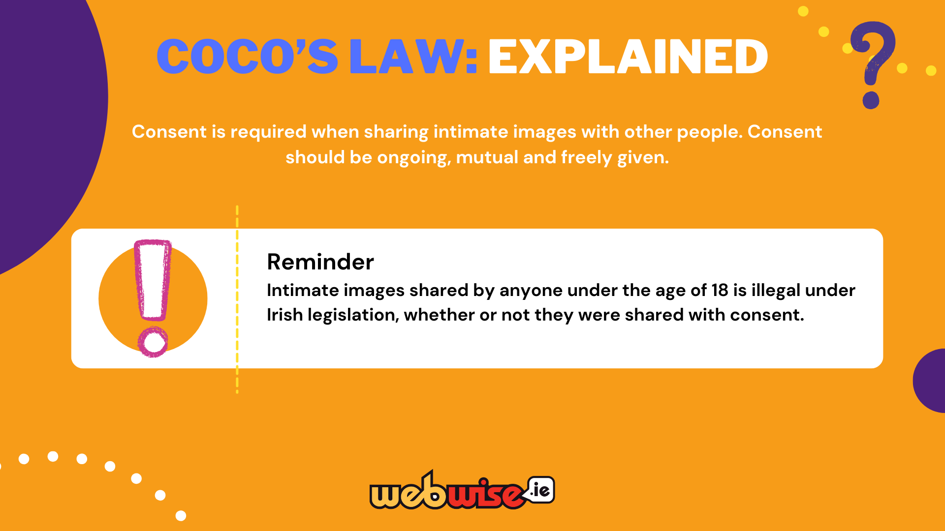
Notes:
Script: What is really important for you to all know is that Coco’s Law applies even if the person gave consent for the picture to betaken at the time, but then the picture was shared with others at a later stage.

Slide 14
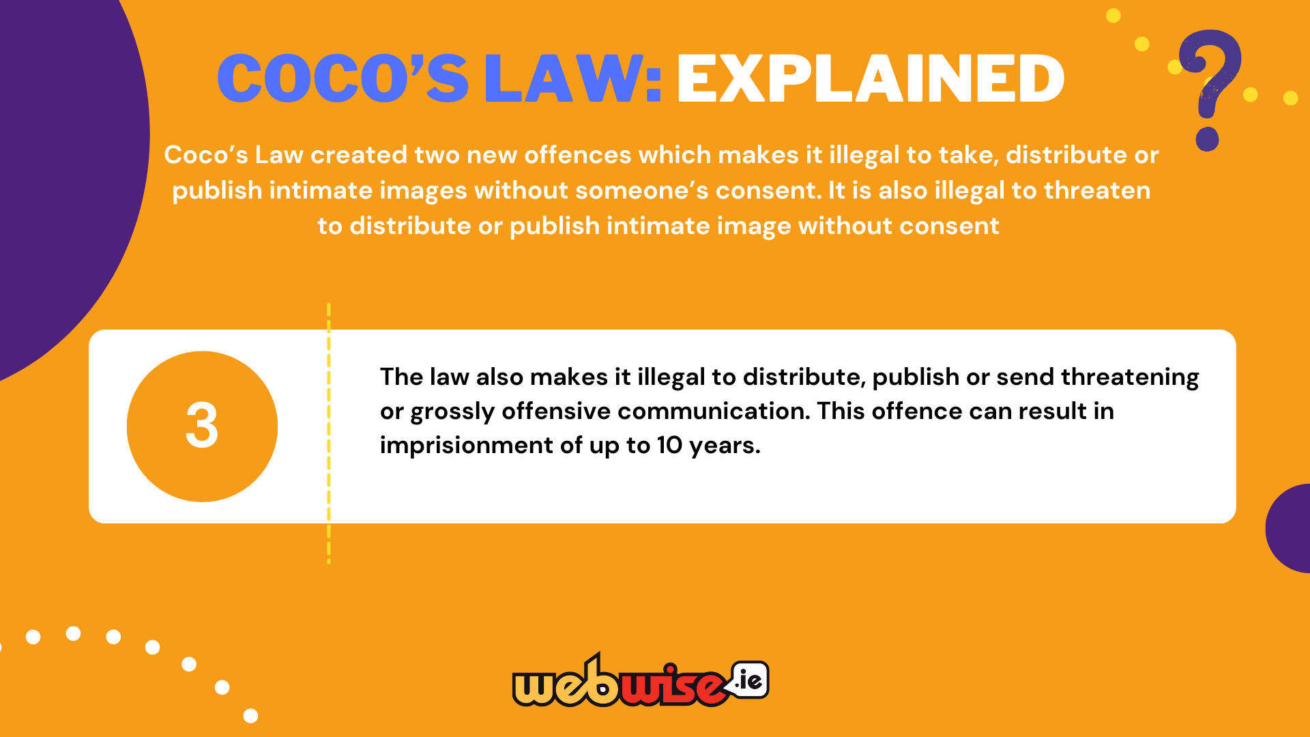
Notes:
Script: There is also another section of Coco’s law that also makes it illegal to distribute, publish or send threatening or grossly offensive communication. Basically, this means that it is also breaking the law if they share something that is extremely insulting, hurtful, or upsetting beyond what is socially acceptable. It goes beyond just being rude or mean and includes things that could seriously harm or distress someone.

Slide 15
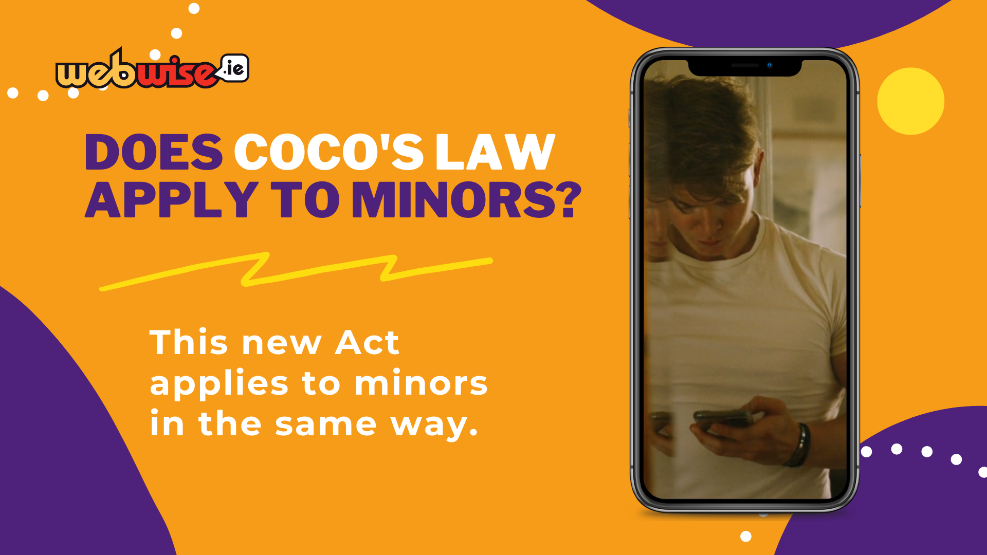
Notes:
Script: You might be wondering if Coco’s law only applies to people over the age of 18. Coco’s law applies to minors as well as adults.

Slide 16
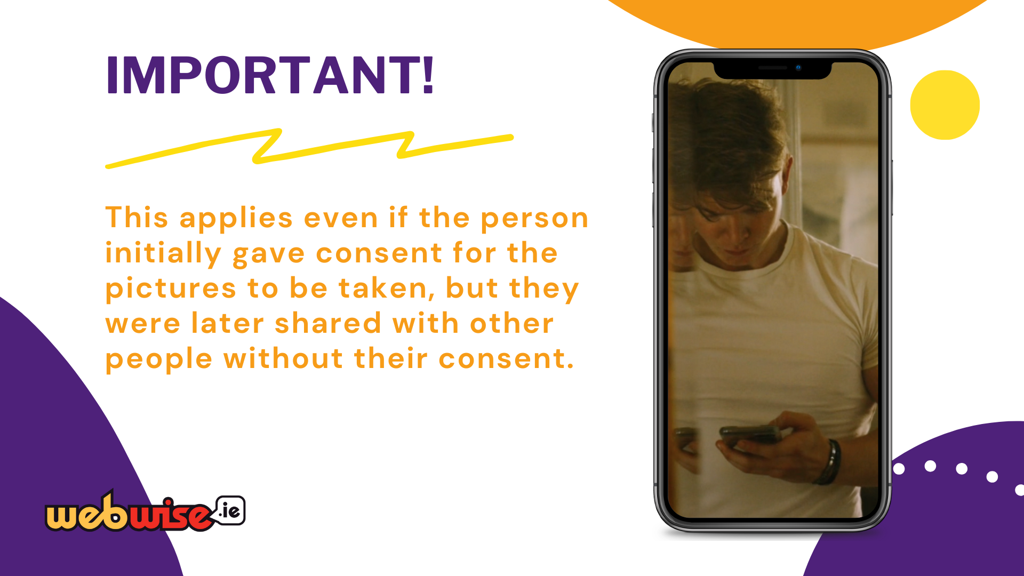
Notes:
Script: There are two key messages to sum up a lot of what we have just discussed.
1.Consent must always be given if intimate images are shared with others. It is not consensual if the person feels under pressure to say yes. It must be freely given.
2.Intimate images shared by anyone under 18 is illegal under Irish law, whether or not consent was given.

Slide 17

Notes:
Script: Now, let's return to the Anticipation exercise and check your answers! How many of these did you get correct?
Facilitation Information: Invite students to refer back to their Anticipation exercise worksheet. Go through each question and share the correct answer for each, using the ‘Anticipation Exercise Answer Sheet’. Invite students to write the correct answer into the second column named ‘correct answer’.

Slide 18
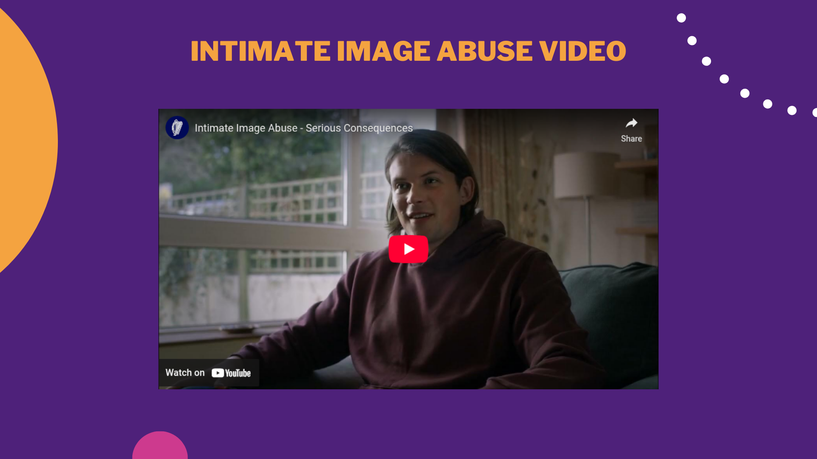
Notes:
Facilitation Information: Play the short 30 second clip.
After it has played highlight the following:
1.Pictures that someone sends you are not automatically yours because they are now on your phone.
2.Even if someone sends a picture to you, this does not give you permission to share them with others.
3.Threatening to share intimate images is a crime.
Video link: https://www.youtube.com/watch?v=qcXjnxSGenc

Slide 19
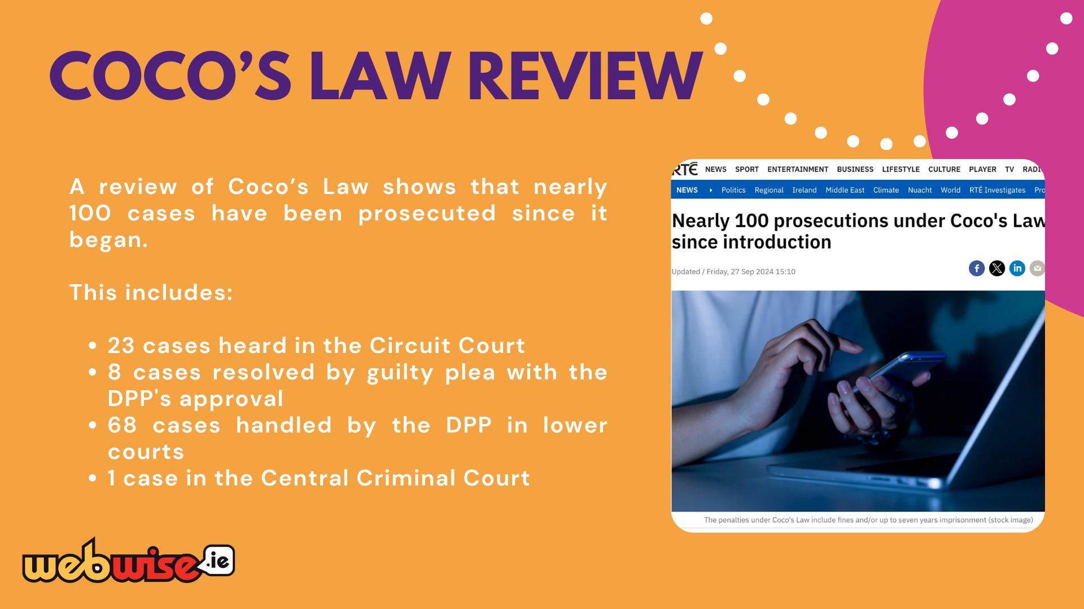
Notes:
Script: Let’s have a look at the impact that Coco’s law has had since its introduction into law. A review of Coco's Law shows that nearly 100 cases have been prosecuted since it began.
This includes: - 23 cases heard in the Circuit Court - 8 cases resolved by guilty plea with the DPP's approval - 68 cases handled by the DPP in lower courts - 1 case in the Central Criminal Court The reason why some were dealt with in the Circuit Courts and some in the Central Criminal Courts is due to the seriousness of the crimes.
The Circuit Court deals with serious crimes, which usually require a trial with a jury. However, it does not handle the most severe crimes. The Central Criminal Court is a part of the High Court and deals with the most serious crimes. This includes cases like murder and aggravated sexual assault.
Facilitation Notes: Students may ask how many of these prosecutions involve minors. If this question comes up, let them know that the age categories of the cases are private and protected information, so you do not have that detail.

Slide 20
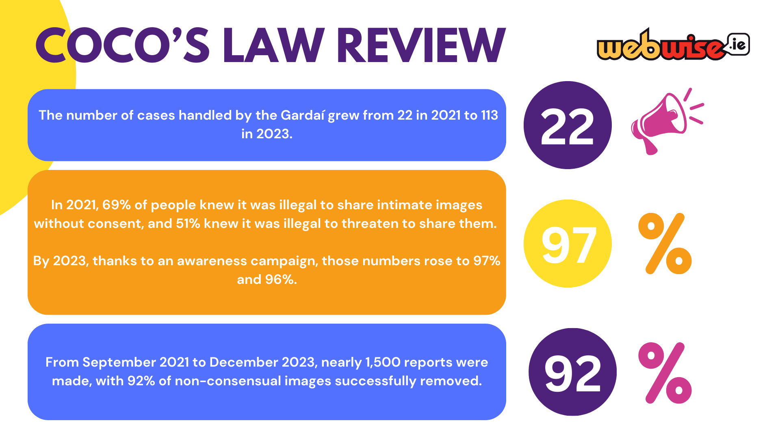
Notes:
Script: The Department of Justice found positive results from early prosecutions and increased public awareness since the introduction of Coc’s Law.
The number of cases handled by the Gardaí grew from 22 in 2021 to 113 in 2023. In 2021, 69% of people knew it was illegal to share intimate images without consent, and 51% knew it was illegal to threaten to share them.
By 2023, thanks to an awareness campaign, those numbers rose to 97% and 96%.
The Department also partnered with Hotline.ie to create a way for victims to report intimate image abuse.
From September 2021 to December 2023, nearly 1,500 reports were made, with 92% of non-consensual images successfully removed. Additionally, over 400 cases involved threats to share images, including sexual extortion and harassment.

Slide 21
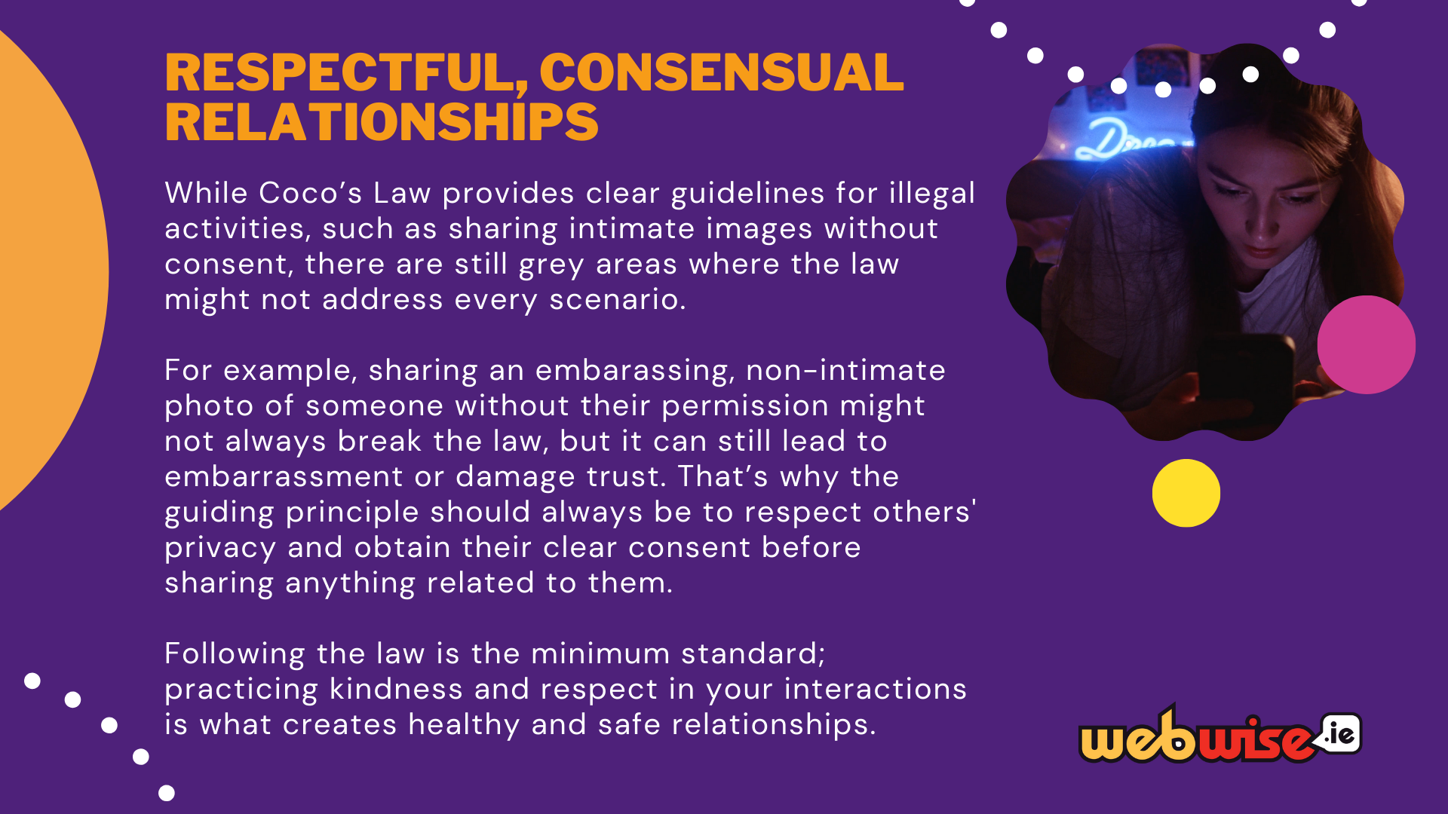
Notes:
Script: While Coco’s Law provides clear guidelines for illegal activities, such as sharing intimate images without consent, there are still grey areas where the law might not address every scenario.
This is why it’s so important to focus on respect and consent in all interactions, especially when it comes to sharing private images or messages. Even if something isn’t explicitly illegal, it can still cause harm.
For example, sharing a non-intimate photo of someone without their permission might not always break the law, but it can still lead to embarrassment or damage trust. That’s why we should always respect others' privacy and get their clear consent before sharing anything related to them.
Ultimately, following the law is the minimum standard; practicing kindness and respect in your interactions is what creates healthy and safe relationships.
Engaging in respectful, consensual activity not only keeps you on the right side of the law but also helps build a culture of mutual trust with those around you. It’s essential to always think about how your actions might affect others, even if the law doesn’t explicitly cover every situation.
Respect and consent should be your top priorities when it comes to personal boundaries and sharing content online.

Slide 22
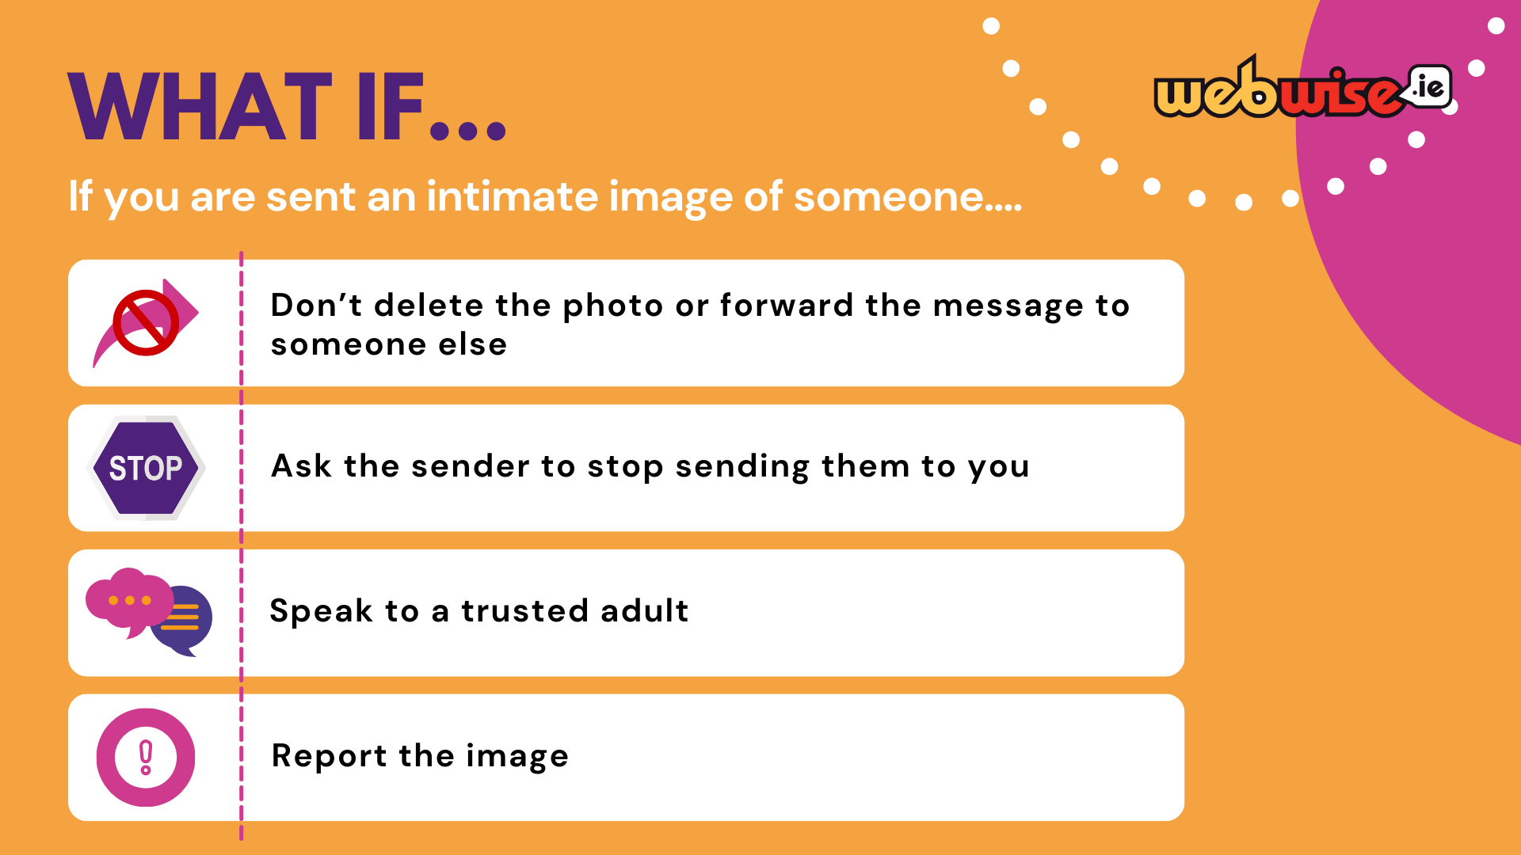
Notes:
Script: Let’s talk about what to do if someone sends you an intimate image of someone else.
First, don’t delete the photo or forward it to anyone else. Deleting it might seem like the right thing to do, but it’s important to keep it as evidence in case it needs to be reported. And forwarding it only makes the problem worse and can get you into trouble too.
Second, ask the sender to stop sending you those kinds of images. Let them know it’s not okay and that you don’t want to be involved.
Third, speak to a trusted adult. This could be a parent, teacher, or another adult you trust. They can help you figure out what to do next.
Finally, report the image. This could mean telling a teacher, contacting the platform where the image was shared, or even speaking with the authorities if necessary. Reporting helps protect the person in the image and makes sure the right steps are taken.
Remember, it’s really important to handle situations like this responsibly. You can make a big difference by taking the right actions.

Slide 23

Notes:
Script: If you are ever in a situation where you need help and support, there are numerous ways of reaching out.
Some people that you can speak to are:
In person:
1.A trusted adult in your life.
2.A teacher in your school.
3.Your local garda station. You will need to be accompanied by a guardian if you visit your local garda station in person to report an incident. The Gardaí are here to help you if ever you need them.
It is not acceptable that people are harassed or embarrassed online and we want to make sure that no one ever feels that they have nowhere to turn to.
Online:
1.Irish Internet Hotline (hotline.ie) where you can report cases of child sexual abuse material (child pornography).
Where intimate images are shared, Irish Internet Hotline can help those affected with reporting it and removing them. It can also work with the gardaí in some cases.
2. Childline.ie offers additional support for young people concerned about their wellbeing. They offer a direct contact number and an online chat function.
No matter how you are feeling, know that you are never alone. Society is getting better informed about these matters and there is always somewhere to turn.

Slide 24
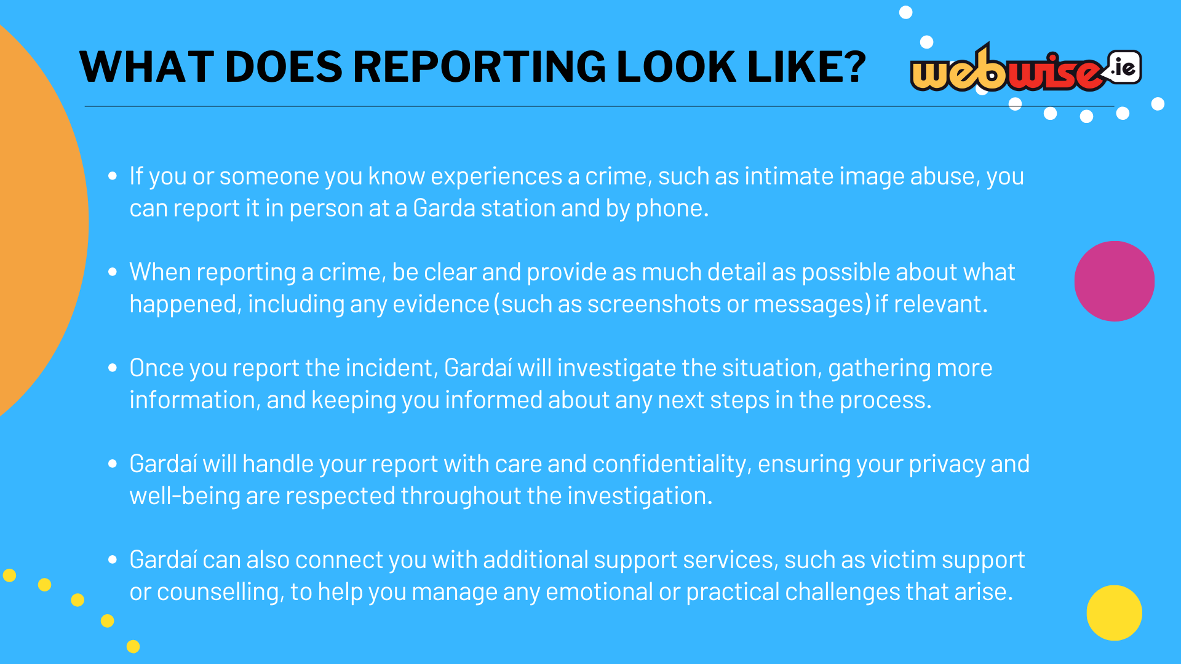
Notes:
Script: If you or someone you know experiences a crime, such as intimate image abuse, you can report it in person at a Garda station, by phone, or through Gardaí's online services.
When reporting a crime, be clear and provide as much detail as possible about what happened, including any evidence (such as screenshots or messages) if relevant.
Once you report the incident, Gardaí will investigate the situation, gather more information, and keep you informed about any next steps in the process.
Gardaí will handle your report with care and confidentiality, ensuring your privacy and well-being are respected throughout the investigation.
Gardaí can also connect you with additional support services, such as victim support or counselling, to help you manage any emotional or practical challenges that arise.

Slide 25
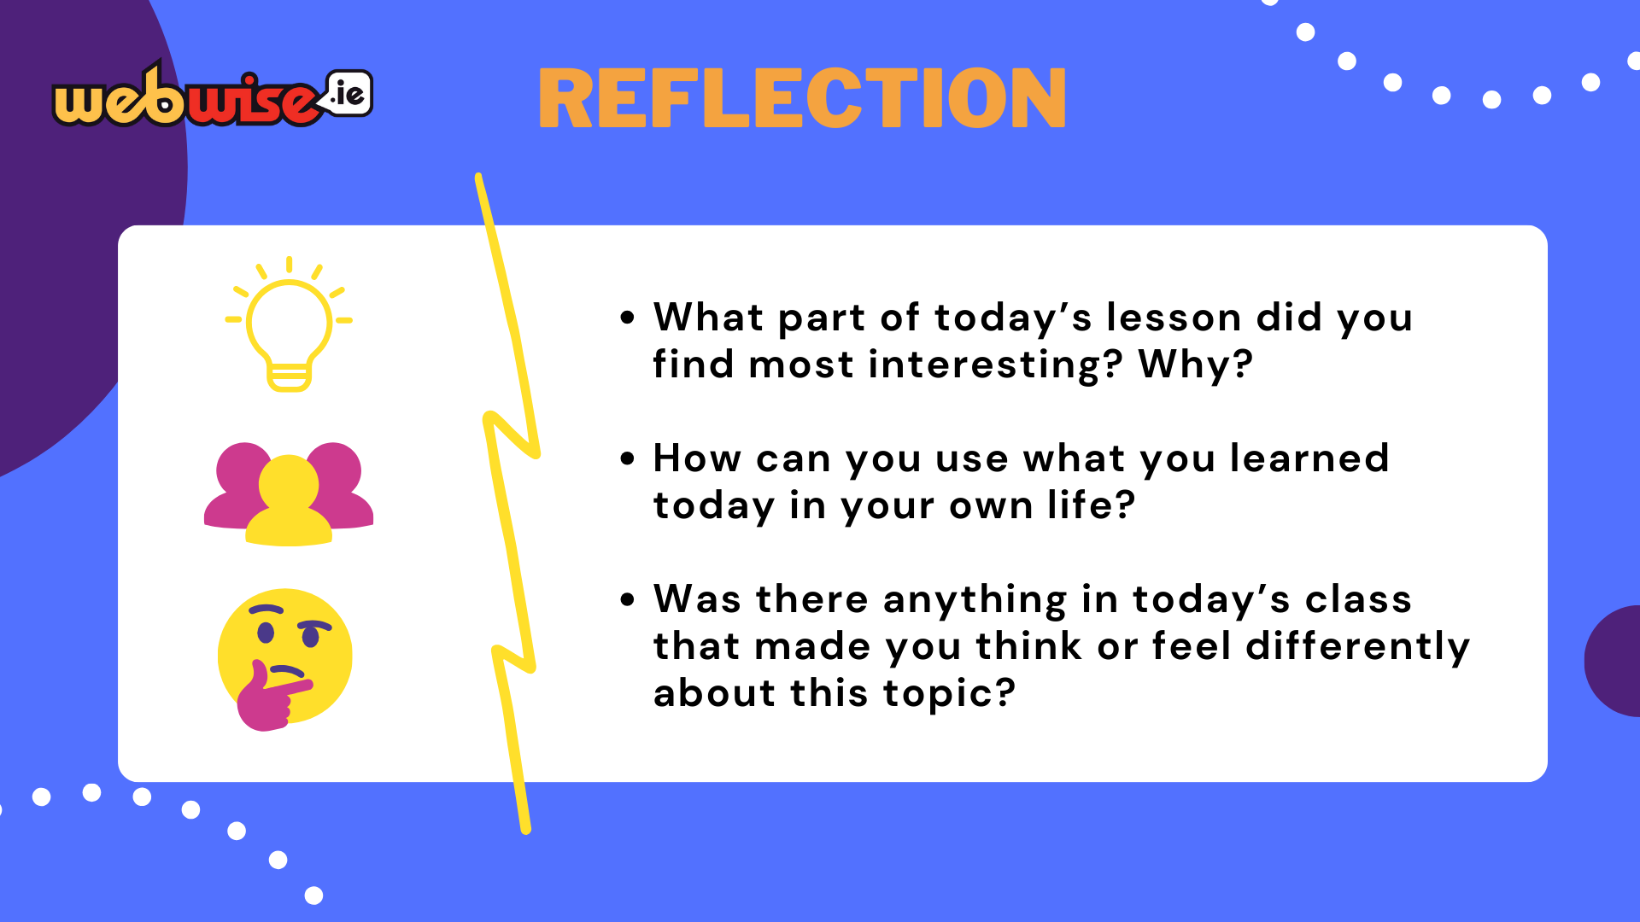
Notes:
Script: We have come to the end of our Coco’s Law lesson.
Before we wrap up, we want to give you an opportunity to reflect on what you have learned from this lesson.
Allow 2-3minutes for the students to reflect on the questions on the screen and think about their answers.
1.What part of today’s lesson did you find most interesting? Why?
2. How can you use what you learned today in your own life?
3.Was there anything in today’s class that made you think or feel differently about this topic?
Facilitation Notes:
If you would like students to write down their reflections, you can distribute post-its for them to jot down a few words foreach question to help them process their learning.
As students reflect on their learning, this would be a good time to place the ‘Supports Poster’ on their tables for them to familiarise themselves with. It also allows them the time to take down numbers in a discreet manner. Spare copies can begiven to the teacher in attendance. They can place them in prominent places around the school building or share them on their online Team/ Google Platform.
Students are not required to share their reflections, as these are personal. If using post-its, encourage them to take their notes with them when they leave the room.

Slide 26

Notes:
Script: Now that we have concluded the lesson, has anyone any questions that they would like to ask about the content explored today?
If students bring up specific questions about active cases or inquire about cases they have seen in the media, it’s important to avoid discussing these topics in detail. Such cases often involve sensitive and private information that cannot be shared or speculated about.

