Slide 1
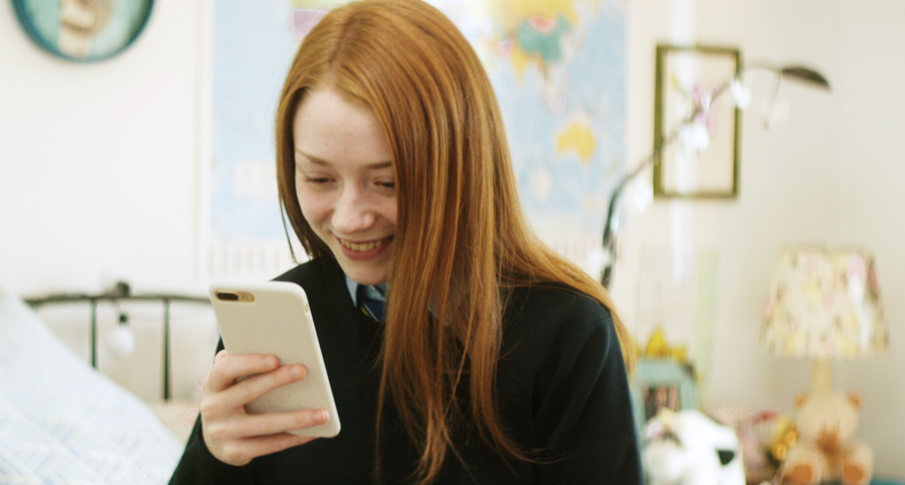




Webwise // Parents

Slide 2

Hello!
I am INSERT NAME
Co-financed by the European Union - Connecting Europe Facility & Department of Education and Skills.
The overall objective of this workshop is to provide parents with information and skills to support their children's online activity.
Notes:
Notes for speaker – brief introduction and welcome.
Explain how long the talk will take and the types of things you will be doing over that time. For example
‘This evening we are going to talk to you about some common concerns parents have around internet safety. This one hour talk will look at topics such as screen time, cyber-bullying, social media and we’ll also do some group activities. The aim of the talk this evening is to give you an introduction to the topic, give you some tips for talking to your child, find out what supports are available and how to access them.’

Slide 3
Top concerns for Irish Parents: cyberbullying, spending too much time online, online grooming/exploitation and accessing in appropriate content.
Webwise // NPC Parenting Survey 2017

Slide 4

ACTIVITY: BENEFITS OF THE INTERNET FOR CHILDREN
REMEMBER THE BENEFITS OUTWEIGH THE RISKS!
Place your screenshot here
While undoubtedly there are valid concerns about children spending too much time online, accessing inappropriate content, and communicating with people with intent to harm or exploit them: it is equally clear that the internet presents fantastic opportunities for children,
What do you think are the main benefits for children from using the internet ?
Notes:
Group Discussion Activity
Ask the group ‘What do you think are the main benefits for children from using the internet ?’
Sample responses: Learning, communicating with people, developing new skills – coding, creativty, etc.

Slide 5
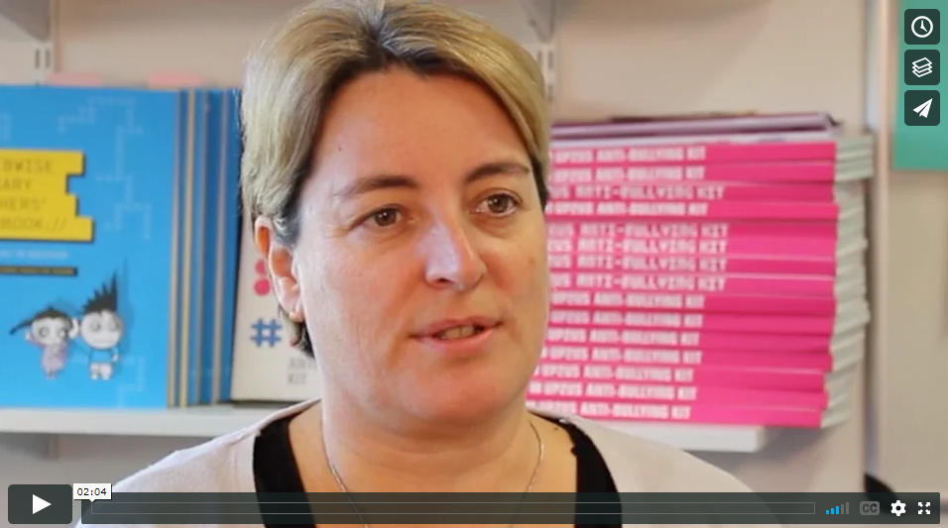
VIDEO >>> TALKING TO YOUR CHILD ABOUT WHAT THEY DO ONLINE
Click the Link to play video: https://vimeo.com/191045340
Notes:
CEO of National Parents Council; Áine Lynch on the importance of talking to your child about what they do online.
Click the Link to play video: https://vimeo.com/191045340
Please ensure pop-ups are enables on your computer. Video will play on vimeo. Alternatively videos can be accessed on the Webwise.ie/parents page.

Slide 6





SCREEN TIME
How much is too much?
Agree limits
Walk the talk
Notes:
Are you concerned about how much time your child spends on their phone, tablet, or computer? We’ve put together a guide for parents to help deal with this tricky issue.
It is important to remember that children often welcome time-off from social media and games and can welcome clear guidelines and boundaries in this area.
How much is too much?
Unfortunately there is no magic number, children use their devices and computers for lots of different reasons – to learn, to play, and to socialise. The most important thing is to agree clear rules on screen time and set a good example, if you are concerned your child is spending too much time online.
Helpful Pointers
Agree a clear set of rules with your child on screen time in the home. Talk to your child on when and where you think it is appropriate to use screens. Agree times when screens are allowed and when they are not allowed in the home. We suggest dinner time, homework time and bed time is a good start to the not-allowed list.
Do as you say. Modelling behaviour is the most powerful way you can influence your child’s behaviour.
Restrict the use of computers and devices in the bedroom. Depending on the age of your child you may want to set a curfew or ban devices from the bedroom completely.
Buy an alarm clock for your child’s bedroom and charge their phones in your room or downstairs at night time. This can be a helpful way of giving them a break from the internet.
Try not to rely on screens too much to keep the kids amused. It can be easy to encourage them to pick up the tablet or play a game on the computer to keep them occupied. This only confuses rules on screen time, try and stick to the agreed rules with your child and remember to set a good example.
Chat to your child about what they do online and encourage them to use their screen time for learning and education.
Pick one evening a week where you do a family activity together, whether it’s movie night or games night. Doing activities together as a family will help implement screen time guidelines and offer fun alternatives.
Don’t have screens always on in the background. Turn off TVs and computers when not in use, these can be distracting for kids if they are trying to participate in another activity.
Finally, join in, why not set some time aside to play your child’s favourite computer game and discover the online world together.

Slide 7

ACTIVITY: INTRODUCING TECH AT HOME
TECHNOLOGY CAN BE A SOURCE OF CONFLICT IN THE HOME
Place your screenshot here
One of the areas of conflict in the home nowadays betweens parents and children is over their use of technology. There are lots of things you can do to reduce the stress and anxiety.
Set Rules
Negeortiagte and listen to your children
Think about consequences and enforce rules
Work with a partner to come up with three tips for parents who are introducing screens and the internet into their child’s life.
Notes:
Notes for Speaker
Activity Slide
‘Work with a partner to come up with three tips for parents who are introducing screens and the internet into their child’s life.’
Note: Give the group 5 mins to discuss, then take 5 minutes to go through the responses.

Slide 8
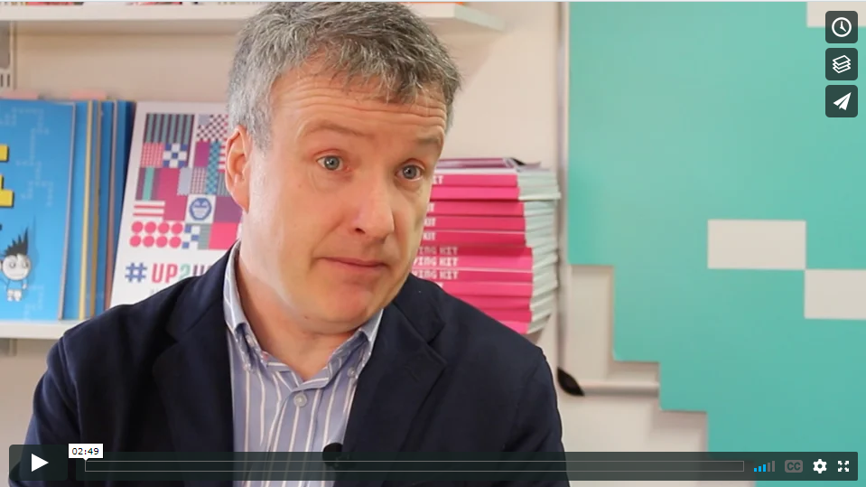
VIDEO >>> DEALING WITH CONFLICT AROUND TECHNOLOGY USE AT HOME
Click the Link to play video: https://vimeo.com/200805499
Notes:
Child Psychologist, Dr. John Sharry offers advice on how parents can deal with conflict around technology use in the home
Click the Link to play video: https://vimeo.com/200805499
Please ensure pop-ups are enabled on your computer. Video will play on vimeo. Alternatively videos can be accessed on the Webwise.ie/parents page.

Slide 9


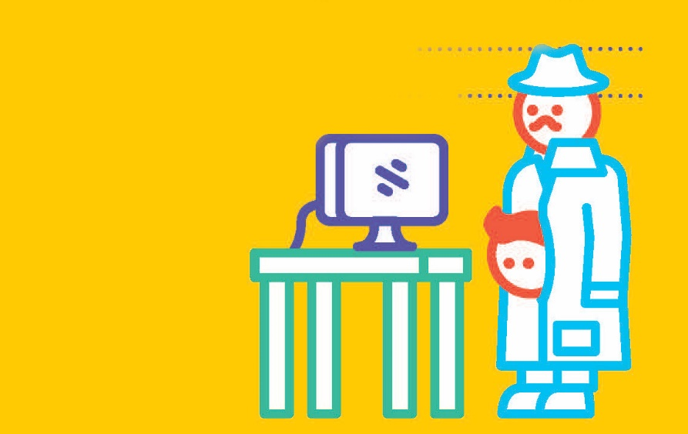



SOCIAL NETWORKING
WHAT IS THE RIGHT AGE TO START?
AGE RESTRICTIONS
SUPERVISION + SETTINGS
EXPECTATIONS
Notes:
AGE RESTRICTIONS ON SOCIAL MEDIA – WHAT I NEED TO KNOW
●Most social media platforms and services have a minimum age requirement, for the majority of these services it is 13 years old and some are set at 16 (WhatsApp). Therefore technically, children under the age of 13 should not have a social media account. However most social media platforms do not have robust age-verifications in place making it relatively easy for underage users to sign-up with a false age.
●Under the new E.U General Data Protection Regulation (GDPR), Ireland has now set the Digital Age of Consent to 16 years old. This is the age at which children can legally consent to companies/organisations processing their personal data or information for example when you sign up to an online platform or social media account. For children under the age of 16, consent must be given/authorised by the parent or guardian of the child. For the purposes of data collection teenagers between the age of 13 and 16 years old must have parental permission to sign-up to social media services.
What are the Key Things to Think About?
In Ireland, children under the age of 16 years old are not permitted to access social media services. This follows the introduction of the new EU data protection regulations; GDPR.
When your child goes on to social networking sites, these are the keys things to think about.
Ultimately, you need to decide if your child is equipped to deal with the social pressures that arise from social networking. The pressure to ‘fit in’ and/or to ‘be popular’ can be intense. Romance, group dynamics, and bullying can contribute to create choppy waters that even adults find difficult to navigate.
Here are a few considerations and helpful points to start a conversation with your child on the topic.
1.Firstly, agree an appropriate platform that you are happy for your child to use.
It is more than likely that if your child wants to use social media, they probably have a network or app in mind that they wish to access. Take time as a parent to review the app and decide if it is inappropriate service for your child to first use. Some things you may want to check out before agreeing anything with your child are: is there privacy settings? Who can my child communicate with? Is there potential for harassment or accessing inappropriate content? Ensure you and your child understand how the platform works, how to report and manage privacy settings.
2. Open Communication
Sometimes a child may not speak to a parent about a bad experience they have had online because they fear that you might solve the problem by keeping them off their favourite social networking services or they may feel embarrassed or indeed that their bad experience is somehow their own fault. However, if they feel they can talk about their online habits with you, without judgement, or the threat of being disconnected it will lead to more honesty in the long run. In order to open up the channels of communication with your child over their social networking use, don’t be too critical of their online experience or the sites they may want to sign-up to. Reassure your child that if anything happens that they are not comfortable with for any reason, they should not be embarrassed or afraid to come to speak to you about it.
3. Ask them about what type of information they think is private on social media.
It is very important that your child understands how privacy settings work and the need to review them regularly. For young children, parents should regularly engage with them on social media use – for example parents should be aware of how much time their child is spending on social media and who they may be talking to. It is a good idea to let them know that even with the tightest privacy controls, content posted online can be easily copied and shared with audiences they can’t control. A simple rule for younger children should be that the child should not give out their name, phone number or photo without your approval.
4. It’s a good idea too to talk about your child’s friends list. “Friends” is the catch all term for any contacts on social networking sites. Sometimes, in their desire for popularity, young people become too relaxed about who they’ll accept as ‘friends’. Talk to your child about friending or communicating with people they do not know online. Encourage your child to review their list of online ‘friends’ regularly, so they are sharing their information only with people they trust.
5. Be sure to put emphasis on the fact that they should NOT reply to any unwanted or unsolicited messages.
Although it may seem obvious, often scam artists or predators use messages which draw responses from young people. So it’s good to make sure your child knows how important it is to ignore them and to speak to you if something bad happens.

Slide 10
ACTIVITY: SOCIAL NETWORKING
Place your screenshot here
If your child is using social media, there are a few things you should talk with them about.
Managing your online reputation has never been more important. Children are now documenting and sharing huge chunks of their lives online and may not be fully aware of the importance of managing their online reputation or of the potential risks involved.
Work in groups of four to rank the social networking tips on pages 11 and 12 in order of importance.
Notes:
Notes for Speaker // Activity Slide
‘Work in groups of four to rank the social networking tips on pages 11 and 12 in order of importance.’
Give 5 mins for the activity and allow 5 mins for group discussion

Slide 11
What is Cyberbullying?
“placing a once-off offensive or hurtful public message, image or statement on a social network site or other public forum where that message, image or statement can be viewed and/or repeated by other people will be regarded as bullying behaviour”
Notes:
What is Cyberbullying
Cyberbullying or online bullying is something you should talk about with your child before it happens. Ideally when your child starts using social media for the first time, when they are moving from primary to secondary school, and regularly thereafter.
This type of bullying is increasingly common and is continuously evolving. It is bullying carried out through the use of internet and mobile phone technologies. Being the target of inappropriate or hurtful messages is the most common form of online bullying. Cyberbullying does not require face to face contact, it can occur at any time (day or night).
Many forms of bullying can be facilitated through cyberbullying. For example, a child may be sent homophobic text messages or pictures may be posted with negative comments about a person’s sexuality, appearance etc.
Be clear on what constitutes online bullying. The procedures published by the Department of Education and Skills say “placing a once-off offensive or hurtful public message, image or statement on a social network site or other public forum where that message, image or statement can be viewed and/or repeated by other people will be regarded as bullying behaviour”.
Cyberbullying can happen to anyone. It’s always wrong and it should never be overlooked or ignored. You know your child better than anyone else. It means you are best placed to identify and deal with any cyberbullying they may encounter.

Slide 12
ACTIVITY: DEALING WITH CYBERBULLYING
Your 14 year old daughter comes to you and tells you that she is upset and doesn’t want to go into school tomorrow. She says that she is being excluded from group chats her classmates use to share jokes and make plans for the weekend.
She has been told that rumours are being spread about her in the chat and that some children have photo shopped her face onto faces of photos of animals and obese adults and were posting them alongside nasty comments about her appearance.
How do you think you should respond?
Notes:
What can I do if my Child is Being Bullied Online?
Praise your child for coming to speak to you about the problem. Sometimes that first step of asking for help is a difficult one. Try to stay calm and not overreact. Reassure your child by reminding them that many people have had similar experiences.
The first thing to do is to listen. Listen supportively, don’t interrogate your child. If they come to you looking for help, they have demonstrated trust in you. Be careful not to damage that by losing your cool or taking action that they are uncomfortable with. At the same time you should make it clear that in order to help them you may have to talk with their teachers and the parents of other children involved.
Once you have established that bullying is taking place, you should get in touch with your child’s school or youth organisation. If the cyberbullying is very serious, or potentially criminal, you could contact your local Gardaí.
Schools have a particular responsibility to address bullying. Talk with your child’s teacher if the bullying is school related. A pupil or parent may bring a bullying concern to any teacher in the school. Individual teachers must take appropriate measures regarding reports of bullying behaviour in accordance with the school’s anti- bullying policy. All schools must have an “Anti – Bullying” policy. You should familiarise yourself with your school’s policy, so you know the steps to be taken if required.
Encouraging your child to talk to you about cyberbullying is key to maintaining an open and positive environment which can help you deal with the situation. Responding negatively by barring internet use or taking away their mobile phone or other device can damage trust and may also put you out of the loop if cyberbullying happens again.
Help your child to build his/her confidence and self-esteem in other areas. This can be supported through your child engaging in out of school activities, such as sports, music or art activities. If your child is very distressed it’s important that they have someone with whom they can speak. A professional counsellor might be able to help. Childline offers a listening support service for children.

Slide 13
DEALING WITH CYBERBULLYING
Don’t reply
Keep the message
Block the sender
Talk to someone
Notes:
What Advice Should I Give my Child?
Don’t Reply: Young people should never reply to messages that harass or annoy them. The bully wants to know they have upset their target. If they get a response it feeds into the problem and makes things worse
Keep the Messages: By keeping nasty messages your child will be able to produce a record of the bullying, the dates and the times. This will be useful for any subsequent school or Garda investigation
Block the Sender: No one needs to put up with someone harassing them. Whether it’s mobile phones, social networking or chat rooms, children can block contacts through service providers
Report Problems: Ensure your child reports any instances of cyberbullying to websites or service providers. Sites like Facebook have reporting tools. By using these, your child will be passing important information to people who can help eradicate cyberbullying
Children need to understand the emotional damage cyberbullying, and all other forms of bullying, can cause. All forms of bullying hurt, all cause pain and all should be stopped. By stressing this to your child – and by emphasising the importance of not standing by while someone else is being bullied – it will encourage them to be more responsible and considerate internet users.

Slide 14

DIGITAL FOOTPRINT
5 Steps for Managing your Digital Footprint
Check your settings
Do the search
Create strong passwords
Be kind online
Think before you post
Notes:
What is a digital footprint?
The information we leave every time we use the internet.
Every time we go online we leave a trail or footprint. Your digital footprint includes the websites you visit, emails you send, information you give to websites or social networks, the photos you share online and what other people share about you.
Ensure your child’s online experience is a positive one with these tips to managing your online reputation.
1. Check your settings
Some of the most popular social networks are set to public by default, meaning everyone can see our photos, what we are sharing or talking about. Regularly check your privacy settings across your social networks and apps. We recommend a ‘friends only’ option for your online profiles.
2. Do the search
Do a quick search for yourself online, if you find something you don’t like report it with the website or network host requesting the content be removed.
3. Create strong passwords
Social media changes so quickly, it can be easy to forget about old accounts or networks we’ve signed up to. If you’re not using an account delete/deactivate it, this can help avoid risk of accounts/profiles being hacked.
4. Be kind online
What we do online can follow us around, ensure you make a positive impact. Whether it’s starting a blog, raising awareness for something you care about or becoming the next Mark Zuckerberg… the possibilities are endless!
5. Think before you post
Before you share, comment, like, post, Tweet or pin anything… ask yourself if this is something you want everyone to see? Use the THINK model if you're unsure about posting something online >>> Ask yourself is it True? Is it Helpful? Is it Illegal? Is it Necessary? Is it Kind?

Slide 15

INAPPROPRIATE CONTENT
VIOLENT CONTENT
PORNOGRAPHY
PROMOTING HATE
UNRELIABLE INFORMATION
Notes:
Another concern parents have around their child’s use of the internet is encountering inappropriate content. This can be upsetting for children so it is important that parents are aware of the risks and how to deal with issues that may arise as their child explores the internet. It is also important that parents understand that this is an ongoing process, so regular conversations with their children will ensure they are more likely to have positive experiences online and be better equipped to deal with any potential negative content. Harmful content could include material relating to sex, violence, discrimination, graphic crime reporting, drug addiction, and cult worship. While not explicitly prohibited by law, this kind of material could, in the context of certain individuals, result in harm.
There is a general acceptance amongst parents and educators that exposure to harmful material can often give rise to false and distorted beliefs about the world. Children tend to believe everything they read online. They assume that the same checks and regulations that apply to printed works also apply to online content. Most children use the Internet for school work – often this can be project work done at home. They need to be helped to develop strategies to cope with the knowledge and the influences introduced by the Internet
Here are a few talking points to help start a conversation on what to do if your child encounters something unpleasant online
Unreliable Information
Violent Content
Whether on a video game on encountered on social media or a video site, your child may encounter violent content online. It is important that they understand if they do, they should come and talk to you about it. Explain to your child that if they come across anything upsetting, tell them to close the computer or put down the device, come to you and speak to you about it. You can report any inappropriate content with the site host. In the instance of gaming, parents should be familiar with the games their child are using. We recommend parents check the age rating and whether the games contain offensive content before making an agreements with their child. (Note we will go into more details on gaming in the next section).
Online Pornography
The reality of life today is that, whether accidentally or on purpose, your child may come across pornography on the internet. You may find that you need to talk to your child if your child accidentally comes across inappropriate pornographic content. Explain to your child that there are some things that are for adults only and that if they ever see anything on the internet that bothers them, they should come and tell you. Be direct and tell them that if they ever see pictures of a naked person, they should come and tell you.
Promoting Hate
The internet is a powerful tool for spreading messages which can be a good thing but has potential for encountering online abuse and hate speech. It is important that your child understands what to do if they come across upsetting material or speech. Young children should be supervised while using the internet. Tell them if they see this type of content, to show it to you and talk about it. As a parent you can report the content with the site host it may also be a good time to review parental controls.
Unreliable Information
Teach your child about evaluating information and being critically aware of information found online. Most children use the internet to improve and develop their knowledge in relation to schoolwork and personal interests. Children should be aware that not all information found online is correct, accurate or relevant. Unreliable information can include content like clickbait, sponsored posts from bloggers/influencers, fake news, online scams. Show your child how to check information they find by comparing it to alternative sources on the same topic. Show them trusted sites they can use to compare information.

Slide 16
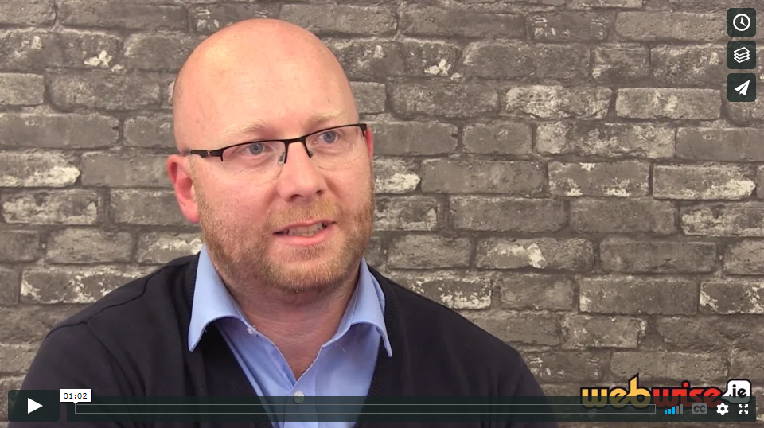
VIDEO >>> TALKING TO YOUR CHILD ABOUT PORNOGRAPHY
Click the Link to play video: https://vimeo.com/200804644
Notes:
Child and Adolescent Psychotherapist Colman Noctor offers advice for parents on talking to your child about online pornography.
Click the Link to play video: https://vimeo.com/200804644
Please ensure pop-ups are enables on your computer. Video will play on vimeo. Alternatively videos can be accessed on the Webwise.ie/parents page.

Slide 17
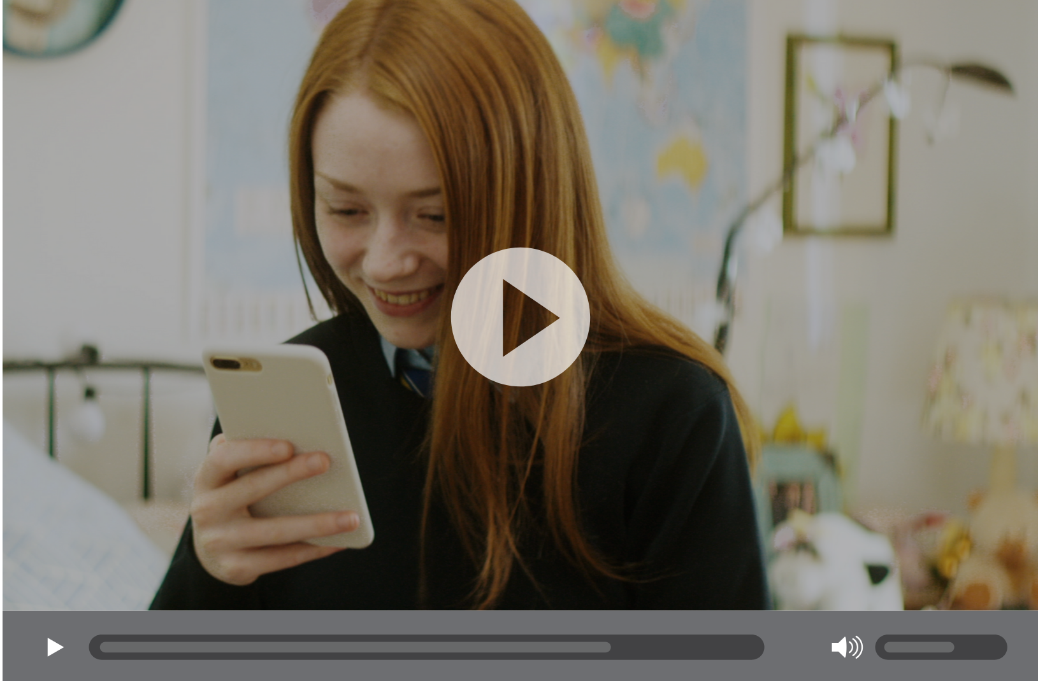
VIDEO >>> TALKING TO YOUR CHILD ABOUT SEXTING
Click the Link to play video https://vimeo.com/353983237
Notes:
Elaine Byrnes, Doctoral Researcher-Psychology, NUI Galway explains why teens may get involved in sexting and offers advice on how parents can talk to their teen about image-sharing.
Click the Link to play video or click the picture on the screen: https://vimeo.com/353983237
Please ensure pop-ups are enables on your computer. Video will play on vimeo. Alternatively videos can be accessed on the Webwise.ie/parents page.

Slide 18
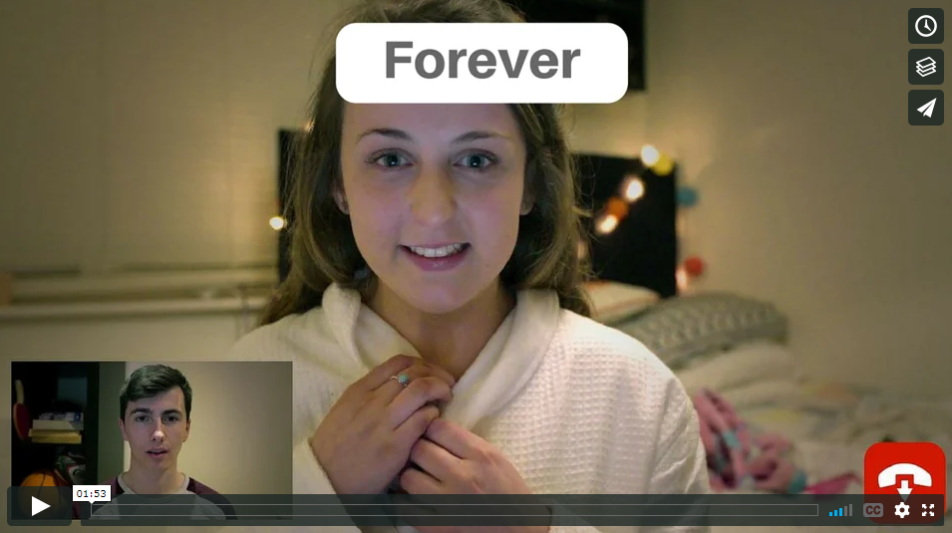
VIDEO >>> FOREVER
Click the Link to play video: https://vimeo.com/154299804
Notes:
This a great video for parents to watch with their child and start the conversation…. Click the Link to play video: https://vimeo.com/154299804
It is important that your child is aware of the risks of sharing online and how to protect themselves from these risks. Here are a few important talking points for parents:
Help your child to understand the consequences they could face for sending or sharing nudes. Make sure they understand that taking possessing or sending sexual images can be a criminal offense and can also result I sanctions in schools.
Talk to your child about what to do if they are asked to send nude images themselves.
Remind your child about what to do if they are asked to send images of themselves.
Remind your child that once an images is sent they have no control over what happens that image.
A big part of teenage life is making new friends on and offline. Unfortunately, Irish teens have become victims of webcam blackmail and sextortion. Children should be reminded that not everyone we meet online is who they say they are. It can be easy to create fake profiles and pretend to be someone else on a social network.
Discuss the importance of being respectful to others online. Children may not understand how harmful sharing intimate images of others can be. Explain that this is a violation of trust and can result in serious harm to the person in the picture.
Peer pressure can play a big part in why teens act and behave in certain ways. You can rehearse different scenarios with them to help them be comfortable with saying no.

Slide 19

IMAGE SHARING // TALKING POINTS
What is personal information?
What is okay to share online?
Saying no!
Fake profiles…
Sharing without
permission
Notes:
Image-sharing can be a big concern for parents, having regular conversations with your child on these topics is key. Here are a few conversations starts to help parents speak to their child.
1. What is personal information?
One approach to starting this conversation is to pick a well known public figure and talk about what you know about them. Let’s say you pick Niall Horan (the guy from One Direction); ask your child what they know about him. Then ask what they don’t know. Do they know his phone number, his address, his deepest most intimate thoughts? What type of thing would Niall’s family know about him that his friends might not?
2. What types of things are okay to share online?
Listen to what your child says and talk to them about the type of content you would be uncomfortable with your them sharing. Make sure you specifically talk about photographs. Be very clear on the types of photo you would be unhappy with them posting . Discuss the importance of being a good digital friend by not sharing images or other personal information that might hurt or embarrass their friends or peers.
Did you know? Remind your child that pictures ad video contain a lot of information other than just what you see (metadata) that we may not be aware of. This metadata includes your location, this can be disabled in the location settings on most devices.
3. What would you do if someone asked you to do something online that you are not comfortable with?
Peer pressure can often influence what type of photos young people post online, encourage your child to be themselves! This is also a good opportunity to let your child know that they can come to you if they encounter anything negative online.
4. Is it possible to create a fake profile online?
It is important that young social media users understand that people may not always be who they say they are. Remind them that is is very easy to set up a fake social media profile. It is a good idea to go through privacy settings of social networks and encourage them to use a friends only setting for their social media profiles.
5. Would you share a photo of someone online without their permission?
Young people may not realise the consequences of sharing harmful images of others without their permission. Ask your child how they would feel if a photo or video of them was shared without their permission. Discuss the consequences of when sharing goes wrong. Remind your child that once something is shared online they lose control over where it can go.
One of the most important things parents can do to help their child online is lead by example. If you are prepared to walk the talk, let your child know that you would not share photos of them without their permission and you expect them to do the same. For tips on sharing photos of your kids, go to: https://www.webwise.ie/parents/oversharing-online/

Slide 20
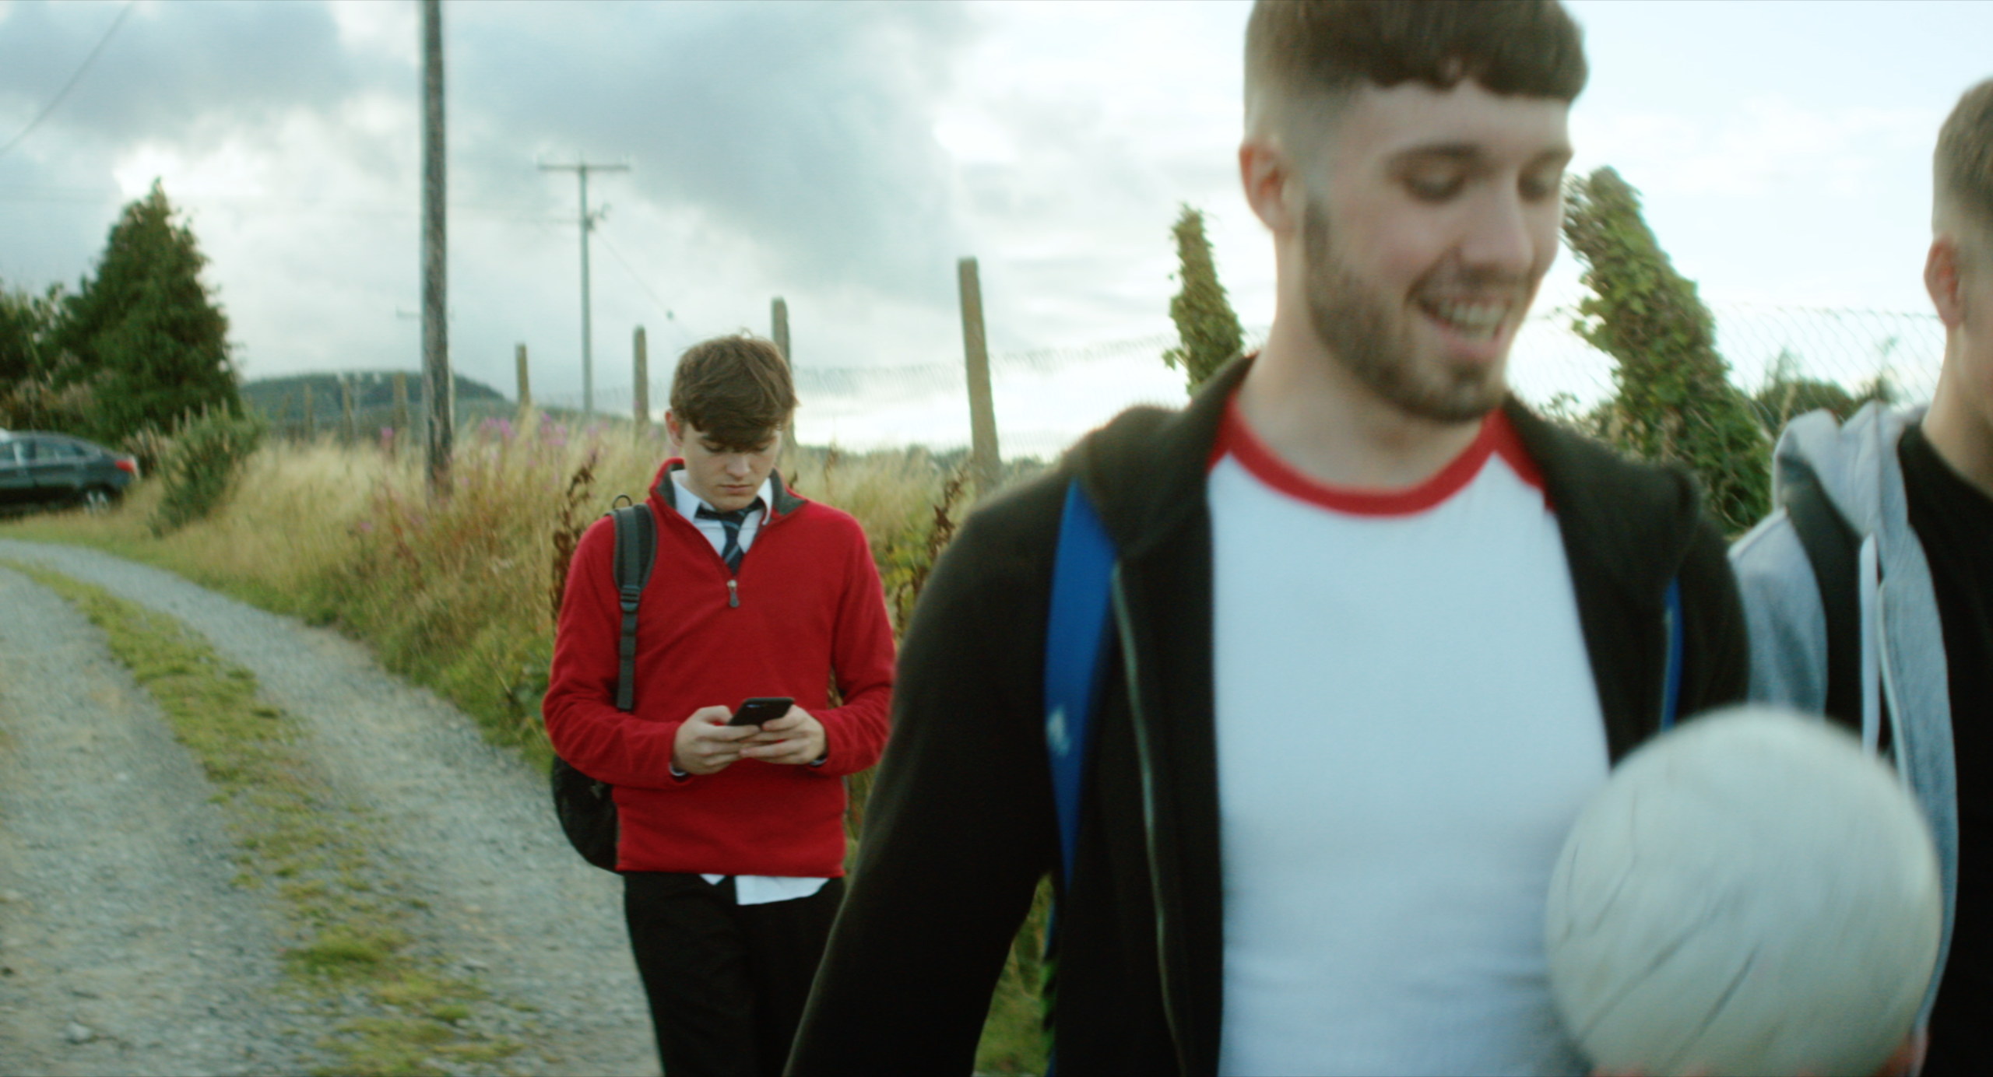
VIDEO >>> #BEINCTRL
Click the Link to play video: https://vimeo.com/289090948
Notes:
The Be In Ctrl video address criminal aspects of online activity , online grooming and webcam blackmail. Click the Link to play video: https://vimeo.com/154299804
The purpose of this video is to inform young people that this behaviour is a crime, raise awareness of how to protect themselves online, where to find help and support and to give them Ctrl!
Use this video to start a conversation with your child about ways they can protect themselves online.

Slide 21

PROTECTING YOURSELF: #BEINCTRL
Don’t share more. Don’t pay more
Preserve evidence. Don’t delete anything
Stop the communication. Block the person
Report the problem to An Garda Síochána
Notes:
Criminal Aspects of Internet Safety
The online sexual coercion and extortion of children is a crime. It occurs when someone a child has only met online asks them to send sexual photos and/ or videos, or perform sexual acts via webcam. The offender may ask the child
to keep the contact secret, threaten to post the photos or videos on the internet or share them with the child’s friends and family if the child does not send more or pay money.
When targeting a minor, offenders have two main motivations:
No.1 A sexual interest in children, where the objective of the extortive exchange is the procurement of sexual material (photos and/or videos depicting the child) or a sexual encounter offline.
No.2 An economic interest, where the objective is to gain financially from the extortion.
(A combination of both is also possible.)
A lot of teenagers don’t realise that it is very easy for anyone to set up a fake profile online and what many teenagers may not be aware of, is the ease with which fake videos can be broadcast online to make it appear that you are speaking with an attractive man or woman.
Victims of webcam blackmail or grooming may think s/he is in conversation with a potential romantic interest, however a criminal gang is really behind the communication. These criminal gangs are in fact broadcasting a fake video pre-recorded video, which can be done very simply with the right software.
What makes these so convincing are, the people in the video are programmed to obey commands and can react to the other person they are communicating with. For example they can smile, wave etc.
Teens may also not be aware that webcam chats and video chats can be recorded easily without their knowledge by the other person in the chat. This can be done simply by using screen capture software which is widely available.
It is important teens know how to protect themselves online and what to do if they experience something that makes them feel uncomfortable. Here are some tips:
#Control
No regrets—anything you send to someone, post online or do over a webcam can be saved/recorded without your knowledge.
Trustworthy
A friend of a friend?—it’s easy to post fake photos or stream a fake video, ask your friend if they have met them in person.
Reality Check
Be aware of your online presence—think about how your online prole makes you appear to others.
Location
Put your safety first—don’t share your location or meet up with someone you have only met online. Keep your privacy settings private.
If your child is a victim, here is the advice from Gardaí:
Don't share more. Don’t pay anything.
If they ask for more photos or videos, don’t send any more. Many victims who have paid have continued to get more demands for money. In some cases, even when the demands have been met the offenders will still go on to post the explicit videos.
Preserve evidence. Don’t delete anything.
Keep the evidence, don't delete anything, save messages, take screenshots and record any details you have.
Report the problem to An Garda Siochána
Contact your local Garda. They will take your case seriously, and deal with it in confidence, without judging you.

Slide 22
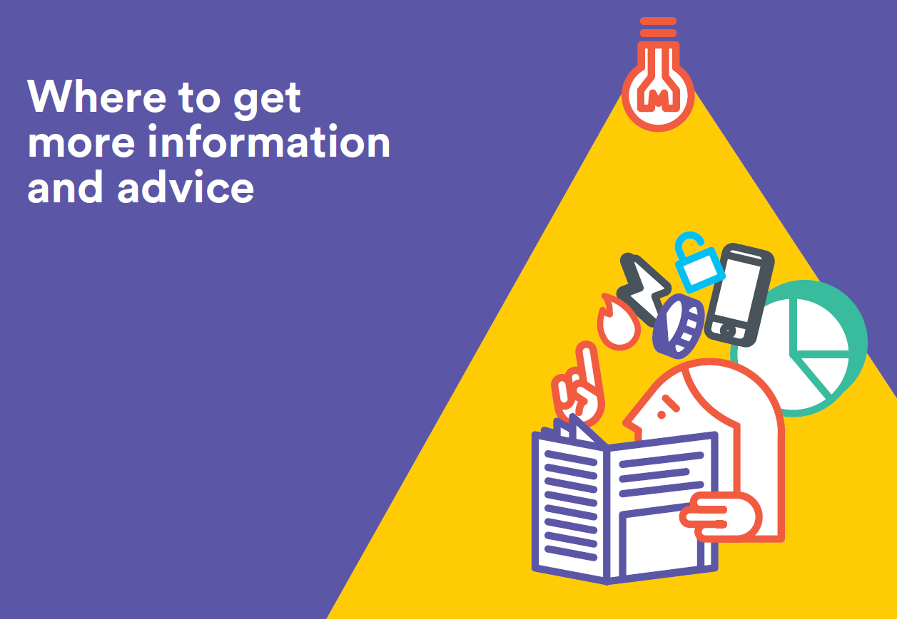
WEBWISE.IE/PARENTS
Expert Advice Videos
Advice
Talking Points
How to
Notes:
Resources for Parents:
Parents' Guide to a Better Internet
This guide gives parents support, advice and information to help their children have a positive experience online. Topics explored in the guide include cyberbullying, screen time, sexting, social media and online pornography. This can be downloaded for free at Webwise.ie/parents
Advice Videos
The Webwise parenting experts offer advice on everything from talking to your child about sexting to modelling good behaviour. The expert videos feature advice from child psychologists, education experts, SPHE experts and tech experts.
Articles
‘Apps Explained’ - the latest apps and social networks children are using explained. This is updated on a regular basis and is an excellent starting point for parents who have children using social media for the first time.
‘Advice for Parents’ - advice and support for parents on key issues such as making friends online and sharing personal information.
‘Talking Points’ - to facilitate parents open communication with their child around internet safety.
‘How to’ -provide support and step by step instructions on blocking, reporting, parental controls and more.

Slide 23
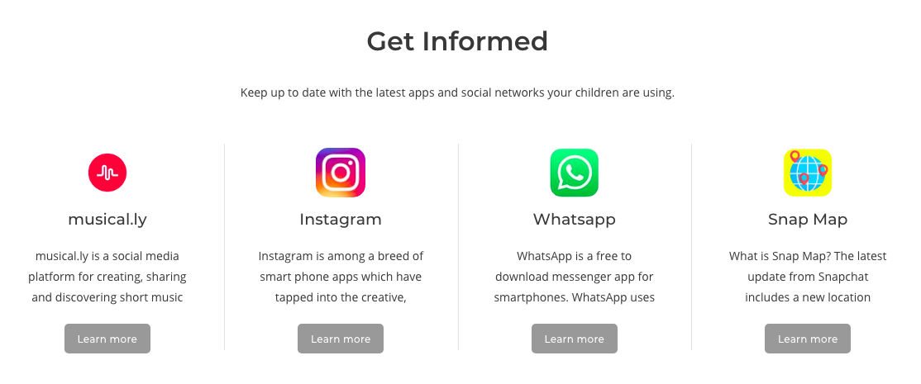
Webwise.ie/Parents – Apps Explained
Notes:
‘Apps Explained’ - the latest apps and social networks children are using explained. This section of the Webwise Parents hub is updated on a regular basis and is an excellent starting point for parents who have children using social media for the first time or if you are concerned about an app or platform your child may be using – you can find out more about it in this section.
Important: The Digital Age of Consent in Ireland is now set at 16 years old. This means young people under the age of 16 are not permitted to access online services including social media services, messaging apps, email services etc.

Slide 24
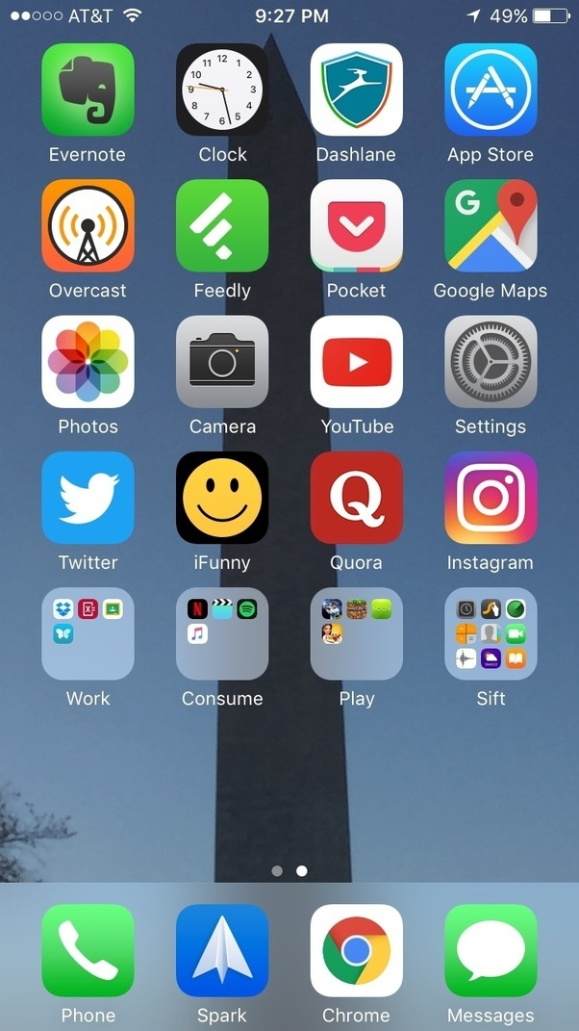
ACTIVITY: GET INFORMED
As a parent it is important that you understand what apps, games and social networks your child is using
Work in groups of four
Visit Webwise.ie/parents – Get Informed
Find the relevant explainer for the app/game/network given to your group
Read the explainer, note down main functions, why kids like it and what are the risks.
Notes:
Activity Suggestion – Break the group into small groups and give them one app/network to look up on Webwise.ie
Ask each group to explain how each app works, risks and how children can protect themselves.

Slide 25
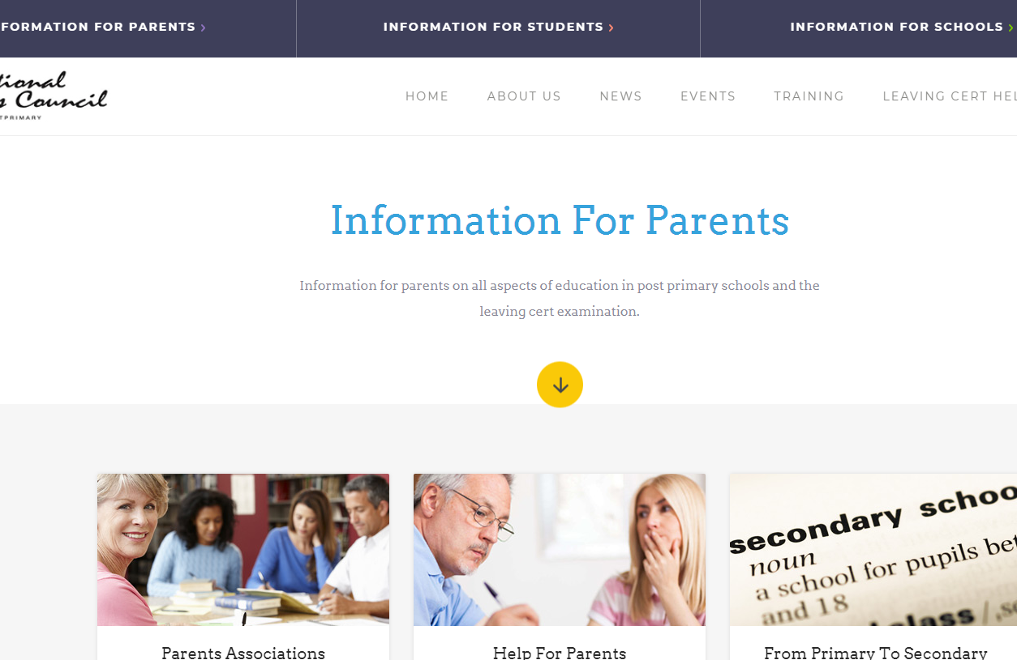

SUPPORT FOR PARENTS: NPCPP.IE
Notes:
National Parents Council Post Primary
The National Parents Council Post Primary (NPCpp) is a voluntary group that gives national voice to parents of students in post primary schools in Ireland. NPCpp aims to provide a forum that actively supports parents and guardians in their parenting role and to interact effectively with schools and other education partners on issues that have an impact on the education, the development and the general well-being of young people within the post-primary education system.
The National Parents Council post primary works as umbrella group for parent associations in the secondary section of the Irish education system.
Additional Support for Parents – Parents Line
http://www.parentline.ie/
LoCall 1890 927277 or 01 8733500

Slide 26
ACTIVITY: REFLECTION
Think back over some of the issues we have spoken about today:
Managing Screen time
Dealing with conflict
Talking to your child about what they do online
Social Media
Image-sharing
Digital Footprint
Responding to cyberbullying
Teaching your child how to protect themselves online
Create a to do list of actions that you think will help your children to have more positive online experiences.
Notes:
Reflection slide
Think back over some of the issues we have spoken about today:
Managing Screen time
Dealing with conflict
Talking to your child about what they do online
Social Media
Image-sharing
Digital Footprint
Responding to cyberbullying
Teaching your child how to protect themselves online.
ACTIVITY
Create a to do list of actions that you think will help your children to have more positive online experiences.
Suggestion – go around the room and take some responses from the group

Slide 27

START THE CONVERSATION…
What are your favourite things to do online?
What sort of information should you keep private?
What can you do to be safe online?
What would you do if something online made you uncomfortable?
Notes:
Now that we have looked at some of the biggest concerns parents have around their child’s internet use. Lets look at what we can do!
Having open communication with your child around internet safety is one of the best ways to help your child navigate the online world safely. Here are a few conversation starters to help.
Parents should be aware that a one off conversation will not suffice, as children grow up online, their interests and needs change. It is important that parents guide children through this process. Before having a conversation, parents should think about what the goal of the conversation is, what guidelines do they want to discuss and set down. Are both parents/partners/grandparents etc involved and in agreement?
Remember to go at the child’s pace, this is an ongoing conversation, so it may take a few different conversations to go through different topics and expectations. Allow your child to talk about what they want and give them time to explore topics as something may arise out of the conversation that you may not have thought about or be aware about. Allow time for the childs concerns to be discussed. A childs concerns about the internet may be very different from a parents, so it is important that we give children the time to go through their worries or any pressures they may feel online.
Top tips for parents
1. Discover the Internet together
Be the one to introduce your child to the internet. For both parent and child, it is an advantage to discover the internet together. Try to find websites that are exciting and fun so that together you achieve a positive attitude to internet exploration. This could make it easier to share both positive and negative experiences in the future.
2. Agree with your child rules for Internet use in your home
Try to reach an agreement with your child on the guidelines which apply to Internet use in your household. Here are some tips to get started:
Discuss when and for how long it is acceptable for your child to use the Internet
Agree how to treat personal information (name, address, telephone, e-mail)
Discuss how to behave towards others when gaming, chatting, e-mailing or messaging
Agree what type of sites and activities are OK or not OK in our family
Follow the rules yourself! Or at least explain why the rules are different for adults.
3. Encourage your child to be careful when disclosing personal information
A simple rule for younger children should be that the child should not give out their name, phone number or photo without your approval. Older children using social networking sites like Facebook should be encouraged to be selective about what personal information and photos they post to online spaces. Regardless of privacy settings, once material is online you can no longer control who sees it or how it is used.
4. Talk about the risks associated with meeting online “friends” in person
Adults should understand that the internet can be a positive meeting place for children, where they can get to know other young people and make new friends. However, for safety and to avoid unpleasant experiences, it is important that children do not meet strangers they have met online without being accompanied by an adult you trust. In any case, the child should always have their parents’approval first. In addition, it is also a good idea to have a fail-safe plan in place such as calling them shortly after the meeting begins so that they can bail out if they feel uncomfortable.
5. Teach your child about evaluating information and being critically aware of information found online.
Most children use the internet to improve and develop their knowledge in relation to schoolwork and personal interests. Children should be aware that not all information
found online is correct, accurate or relevant. Show your child how to check information they find by comparing it to alternative sources on the same topic. Show them trusted sites they can use to compare information.
6. Don’t be too critical towards your child’s exploration of the Internet
Children may come across adult material by accident on the web. Also, a child may intentionally search for such websites; remember that it is natural for children to be curious about off-limits material. Try to use this as an opening to discuss the content with them, and perhaps make rules for this kind of activity. Be realistic in your assessment of how your child uses the internet.
7. Let your children show you what they like to do online
To be able to guide your child with regard to Internet use, it is important to understand how children use the Internet and know what they like to do online. Let your child show you which websites they like visiting and what they do there.
8. Remember that the positive aspects of the Internet outweigh the negatives.
The Internet is an excellent educational and recreational resource for children. Encourage your child to make the most of it and explore the internet to its full potential.

Slide 28
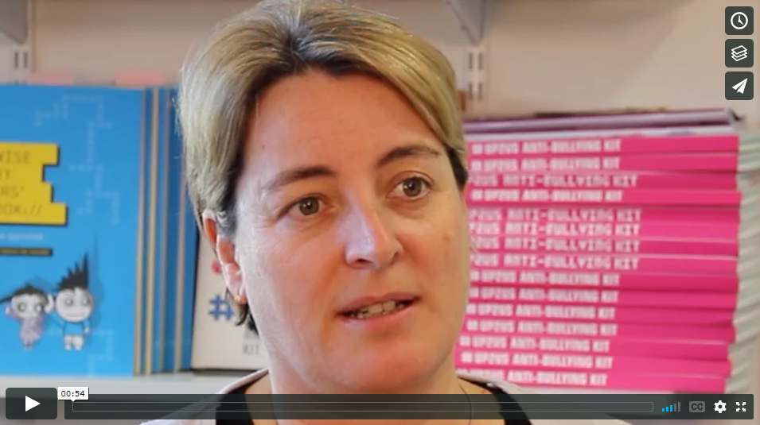
VIDEO >>> LEAD BY EXAMPLE
Click the Link to play video: https://vimeo.com/191043980
Notes:
CEO of National Parents Council; Áine Lynch on the the importance of modelling good behaviour when it comes to addressing internet safety in the home.
Click the Link to play video: https://vimeo.com/191043980
Please ensure pop-ups are enables on your computer. Video will play on vimeo. Alternatively videos can be accessed on the Webwise.ie/parents page.

Slide 29

NEXT STEPS
Visit Webwise.ie/Parents
Have the chat
Agree guidelines
Keep up to date..
Follow Webwise Ireland

Slide 30

THANKS!
ANY QUESTIONS?
www.webwise.ie
© Webwise_Ireland
This work is made available under the terms of the Creative Commons Attribution Share Alike 3.0 Licence http://creativecommons.org/licenses/by-sa/3.0/ie/. You may use and re-use this material (not including images and logos) free of charge in any format or medium, under the terms of the Creative Commons Attribution Share Alike Licence.

