Slide 1
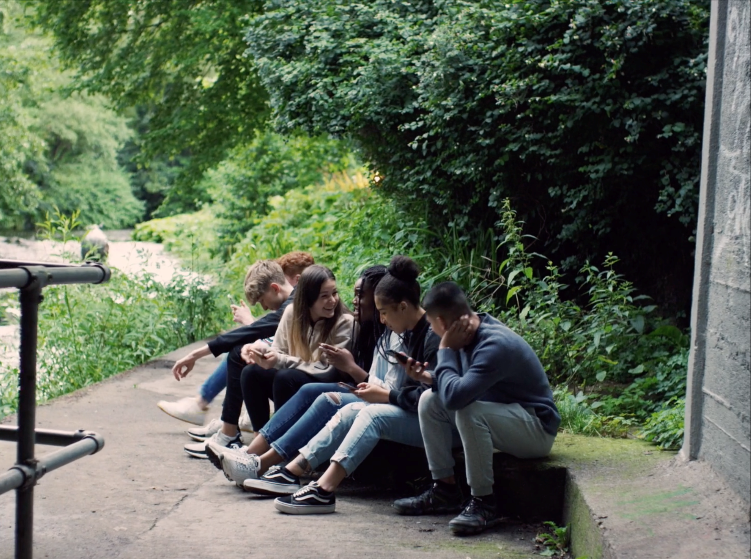

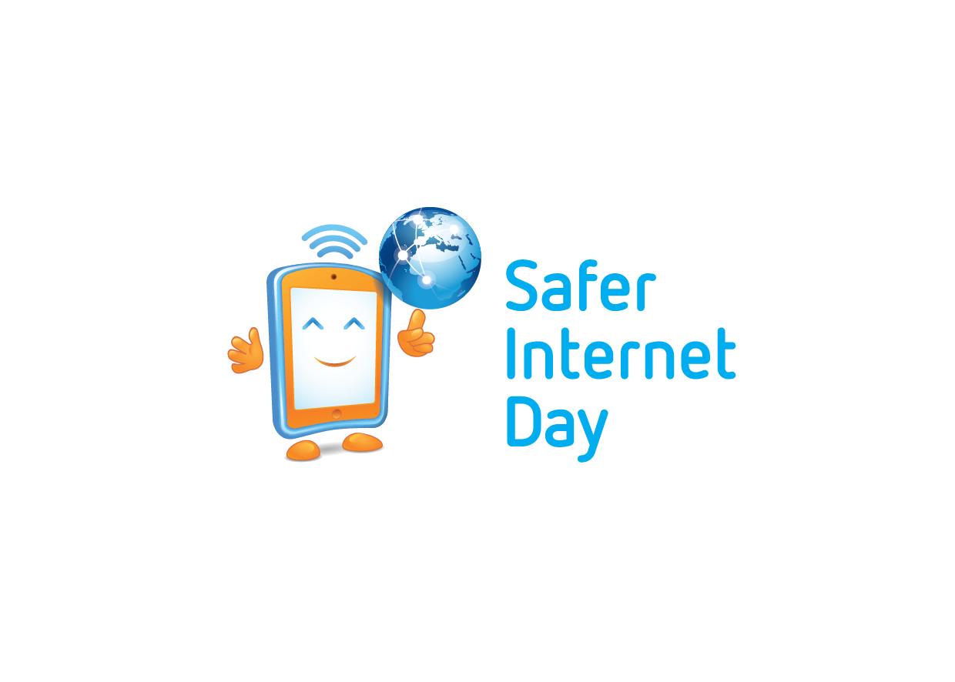



SAFER INTERNET DAY
MANAGING YOUR ONLINE WELLBEING
Notes:
Notes for speaker – brief introduction and welcome.
Explain how long the talk will take and the types of things you will be doing over that time.
For example:
‘‘Today we are joining millions of people around the world in celebrating Safer Internet Day, a day for promoting a safer and better internet for all users, especially young people. During this assembly we are going to talk about being online and using the internet. We will look at the positives and possible negatives of the internet as well as some general advice on how to manage your online wellbeing.’

Slide 2

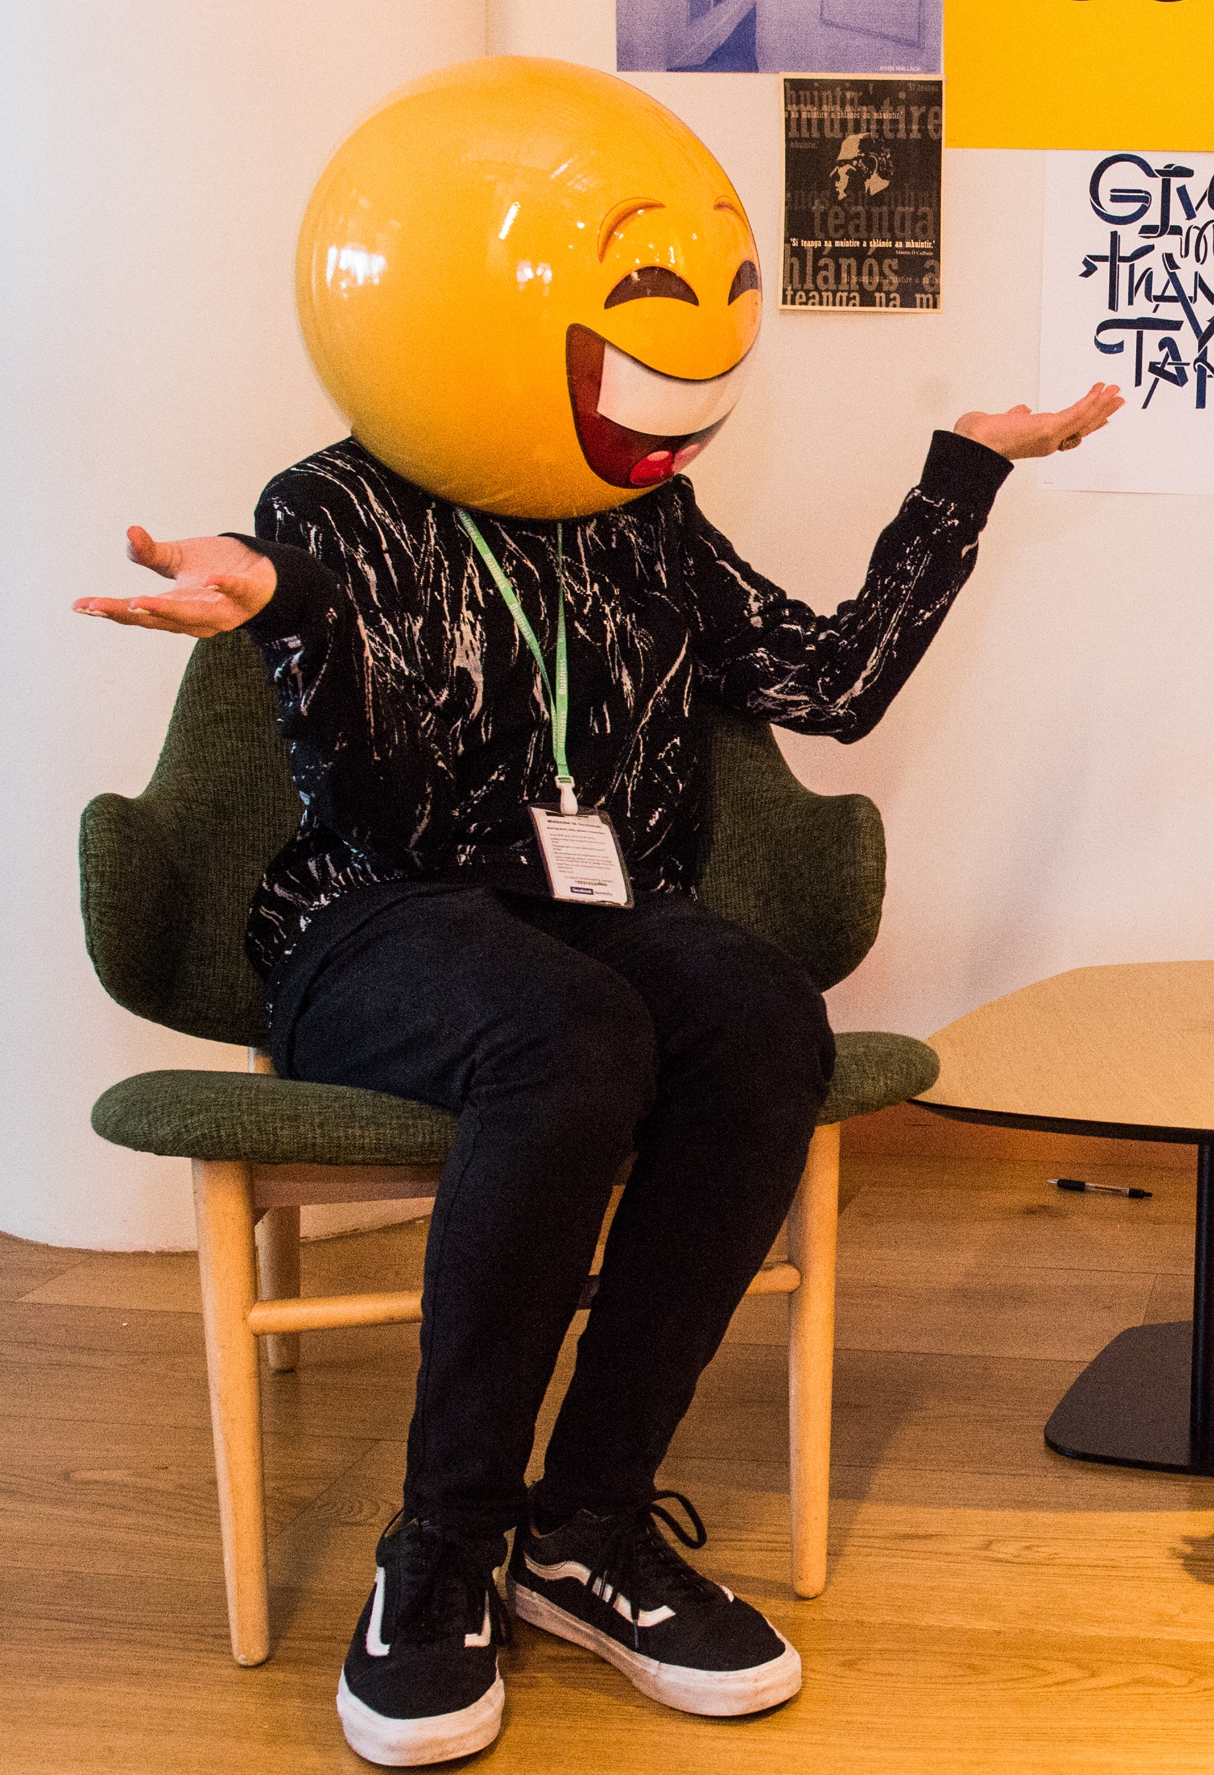
ABOUT WEBWISE
Irish Internet Safety Awareness Centre that promotes safer use of the internet by young people
Responsible for the promotion and coordination of Safer Internet Day in Ireland
Develop education resources and programmes for schools to address a range of online safety initiatives
Webwise are supported by a Youth Advisory panel made up of second-level students from across Ireland
Provide free training programmes to second-level students to support schools engaging in Safer Internet Day
Provide information, advice, and tools to parents to support their engagement in their children’s online live
Students can find more information on the dedicated youth hub: http://webwise.ie/youth
Notes:
Today’s talk has been developed by Webwise. Irish Internet Safety Awareness Centre that promotes safer use of the internet by young people
Some of the work Webwise are involved in:
Responsible for the promotion and coordination of Safer Internet day in Ireland
Develop education resources and programmes for schools to address a range of online safety initiatives
Webwise are supported by a Youth Advisory panel made up of second-level students from across Ireland
Provide free training programmes to second-level students to support schools engaging in Safer Internet Day
Provide information, advice, and tools to parents to support their engagement in their children’s online live
Students can find more information on the dedicated youth hub: http://webwise.ie/youth

Slide 3
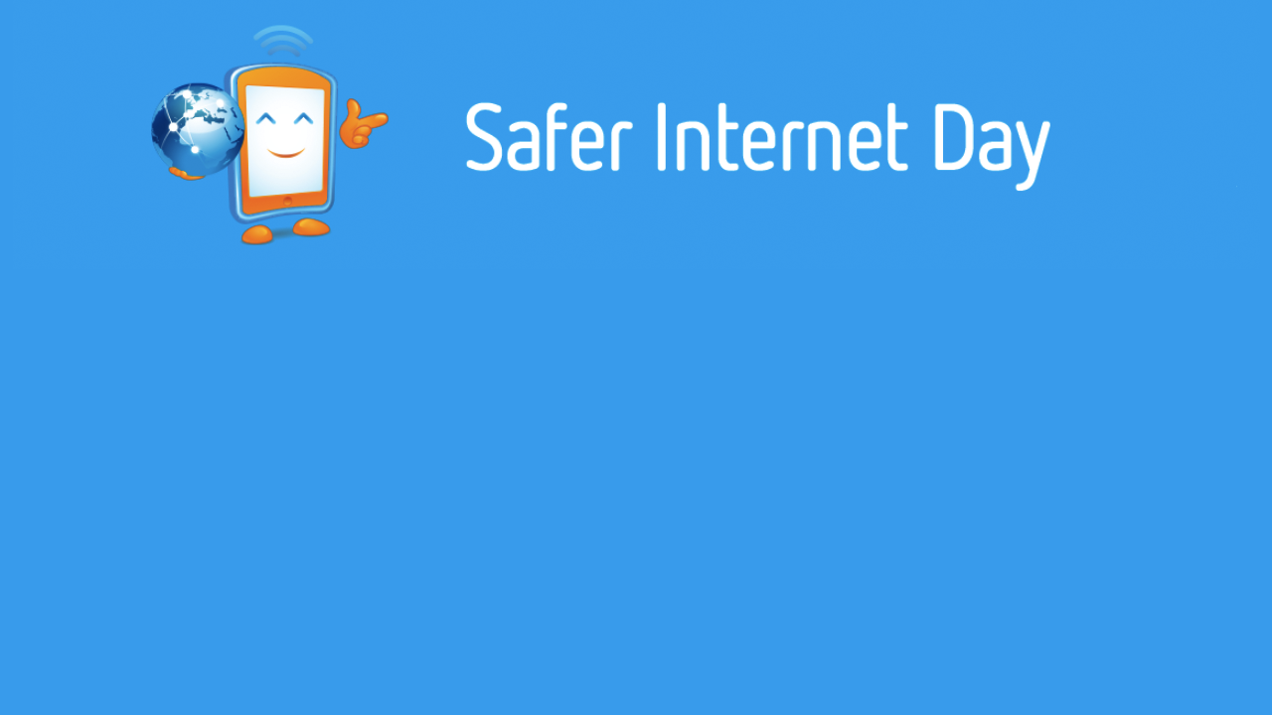
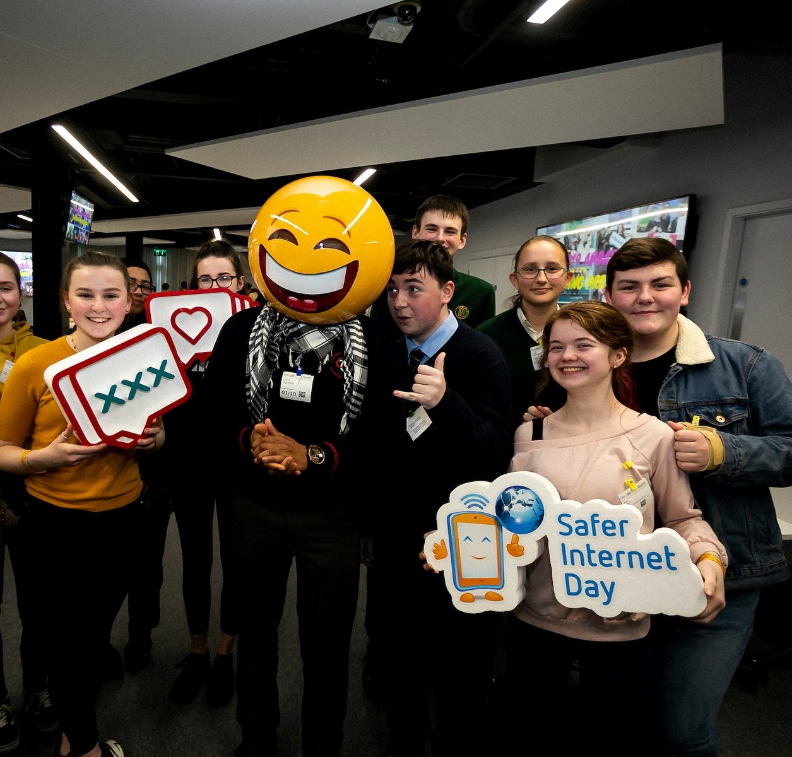
What is Safer Internet Day?
A day to create awareness of a better internet for ALL users
The theme for Safer Internet day is “Together for a Better Internet”
Safer Internet Day is celebrated all across Europe on the second Tuesday, of the second month, every year.
Notes:
Notes: Safer Internet Day (SID) is an EU wide initiative to promote a safer internet for all users, especially young people. Safer Internet Day in Ireland is promoted and coordinated by Webwise, the Irish Internet Safety Education Awareness Programme. The Theme for Safer Internet Day is “Together for a Better Internet“.
The aim of the day is a call on all stakeholders - industry, government and the public to join together to make the internet a safer and better place for all, and especially for children and young people.
Safer Internet Day is a day to promote safe and responsible use of the internet, a day for us to consider how all the different ways we use the internet and how we can make the internet a safer and better place for all, and especially for children and young people.

Slide 4
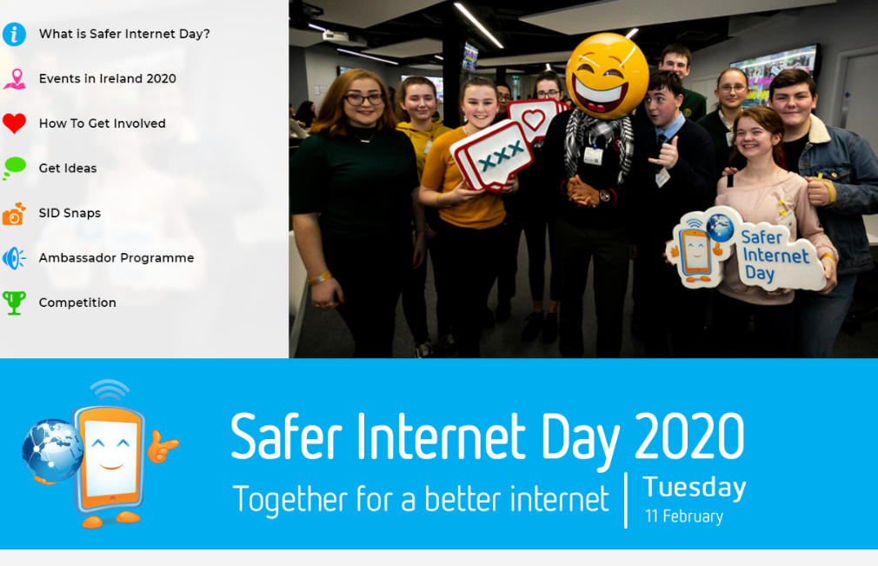

Getting involved in Safer Internet Day
webwise.ie/saferinternetday/
01
IDEAS & INSPIRATION
02
PLAN YOUR CAMPAIGN
03
FREE RESOURCES
04
FREE SID WRISTBANDS
05
VIDEOS & PRESENTATIONS
Notes:
Notes: Safer Internet Day provides an opportunity for students to take the lead in raising awareness of internet safety concerns and issues of young people to the school community including teachers, students and parents/guardians. It provides an opportunity to address the issue of cyberbullying and internet safety by leading awareness-raising campaigns in their clubs, schools, and communities.
There are lots of ideas for SID activities on the Safer Internet Day page: www.webwise.ie/saferinternetday.
Register your school's Safer Internet Day events on the Webwise event’s map and see how other schools are celebrating Safer Internet Day here: www.webwise.ie/saferinternetday

Slide 5
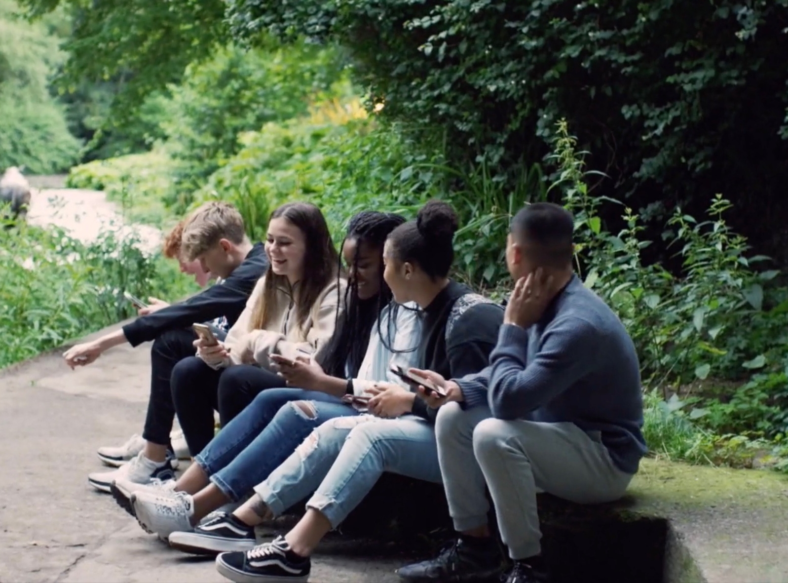
LETS DISCSSS // THE BENEFITS
Let’s consider the positives and negatives of the internet?
Notes:
Notes: Today we are going to consider the positives and negatives of the internet and look at ways to manage your online wellbeing.
Let’s consider the positives and negatives of the internet?
Ask pupils to list:
What might be the positive things about the internet?
What might be the negative things about the internet?
Examples of the benefits of using the internet might be; communicating with friends who live far away, instant access to music or films you want to watch, researching for homework/project work, developing and learning new skills or creating content.
Examples of negative effects of the internet might be that the children could see something they don’t want to see, cyberbullying, spending too much time online. This lesson also gives the class and teacher a chance to recap on the Stay Safe programme and Stay Safe rules.

Slide 6
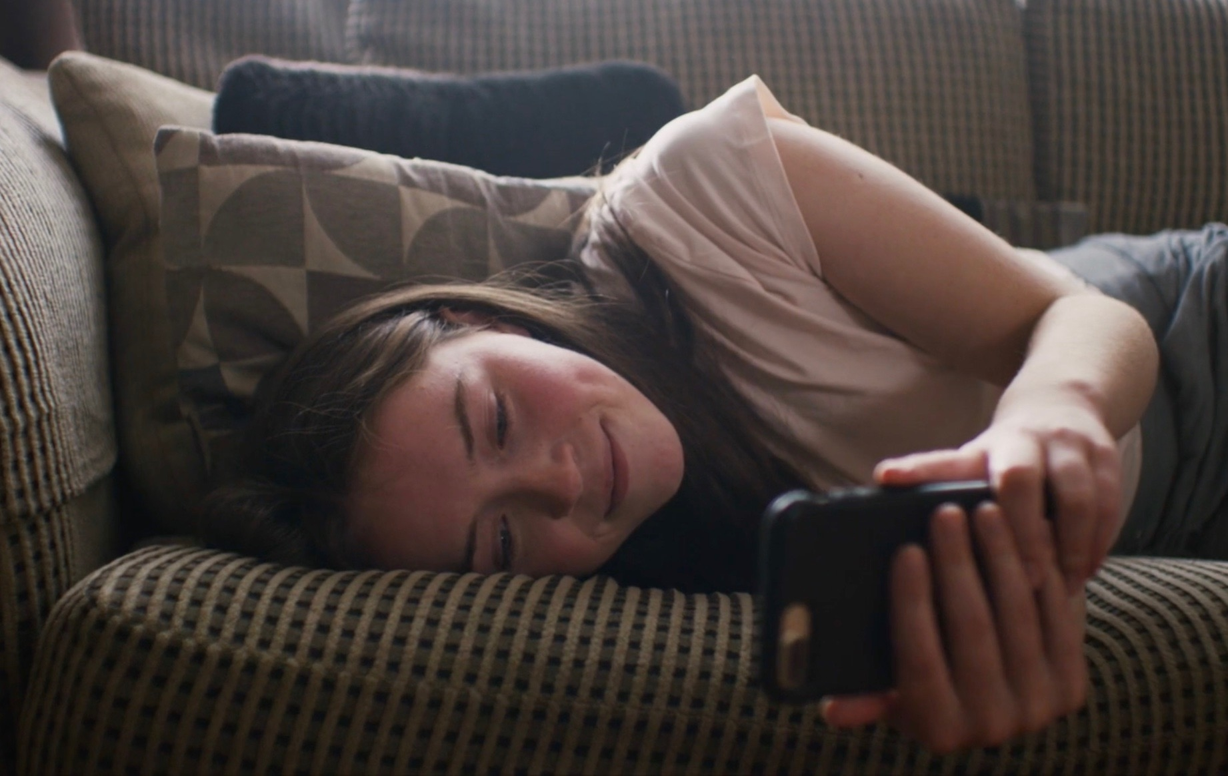
LETS DISCUSS // THE CHALLENGES
How can we avoid the negative things on the internet?
Notes:
How can we avoid the negative things on the internet?
Notes:
Lead the discussion to how we could prevent the negative things associated with the internet or even lessen their harmful effects.
You can use this as an opportunity to stress the importance of ground rules when using the internet in school and at home.
Also, emphasise the point that it can be easy to come across something inappropriate or upsetting on the internet and that if they do it is important to tell an adult about it when it happens.
Reassure the pupils that they are not to blame if they come across something online that makes them feel uncomfortable.
Experiencing cyberbullying or online harassment is another issue that can affect anyone.
Experiencing online harassment can have a huge impact both emotionally and physically on the victim, but there are ways to deal with it, and supports are available to people.
Types of Online Harassment
Personal threats and intimidation
This behaviour includes receiving threatening messages, posting abusive and threatening comments on the victim’s profile or other websites.
Impersonation
This involves setting up fake profiles and web pages that are attributed to the victim and it can also involve gaining access to someone’s social media profile or messaging apps and using it to contact others while impersonating the account or profile owner
Stalking or harassment
This can include repeatedly sending unwanted messages, or making phone calls. Using social media or message boards, to repeatedly harass, or to post derogatory or defamatory statements. Tracking a person’s activity and collecting information about them.
Exclusion
This can include blocking an individual from a popular group or community such as a school or class group, deleting them from friends lists, and/or using ‘ignore functions’
Personal humiliation
This behaviour involves posting images or videos intended to embarrass someone, it can involve users sharing and posting images or videos of victims being abused or humiliated offline, or users sharing personal communications such as e-mails or messages with a wider audience than was intended by the sender
False reporting
This behaviour involves making false reports to the service provider or reporting other users for a range of behaviours with a view to having the user’s account or website deleted.

Slide 7
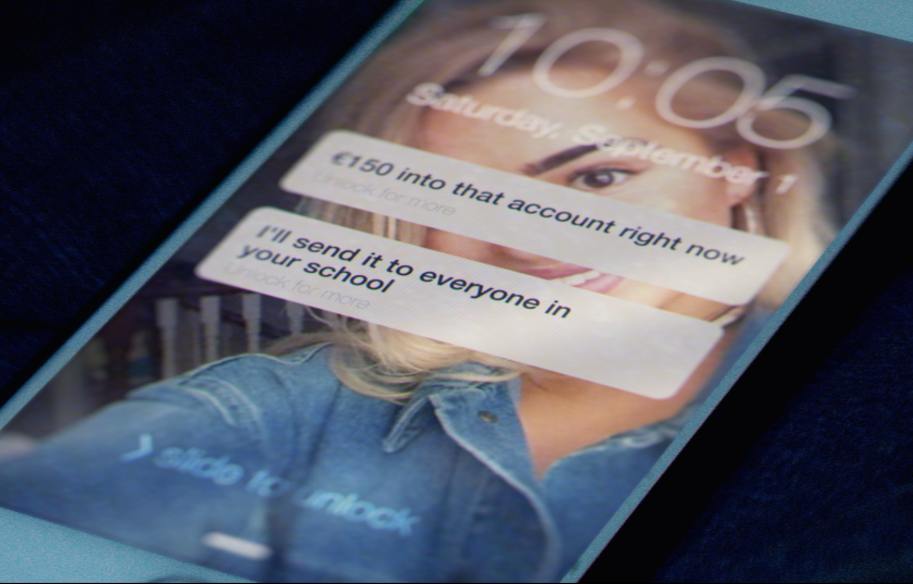
LET’S DISCUSS // THE CHALLENGES
Who would you tell if you saw something on the internet that you did not like?
Notes:
Who would you tell if you saw something on the internet that you did not like?
Notes: ‘Who would you tell if you saw something on the internet that you didn’t like or that made you feel unsafe?’. They can discuss this in their pairs and feedback to you when they have finished.

Slide 8


Key Points:
The positives & negatives of the Internet
The internet is a brilliant resource that you can use to do lots of different things.
If you do experience harassment or cyberbullying online:
Don’t reply to messages that harass or annoy you.
Keep the Message
Block the Sender
Talk to someone you trust, and get support
Report the Problem
Notes:
What can students do if they are experiencing online harassment?
Don’t Reply to messages that harass or annoy you. Even though you may really want to, this is exactly what the sender wants. Put down your phone or take a step back. Responding immediately can sometimes makes the situation even worse, particularly in serious cases of harassment.
Keep the Message: You don’t have to read it, but keep it. If you keep getting messages that upset you, you will need to have evidence in order to get help. Website owners, mobile phone companies and the Gardaí will all look for evidence before they will be able to take any action to help you.
Block the Sender: You don’t need to put up with someone harassing you. If you are getting messages that upset you, block the person. All popular social networks and messaging apps allow users to block other users. On most social networks this is a straightforward process done through the app setting or by clicking on the user profile. On some mobile phones you can block a caller’s number. You might need to check the manual or ask an adult to help you do this.
Talk to someone you trust, and get support: Speaking to your parents/guardian, friends, or someone you trust is usually the first step in dealing with any issue. In the case of school related bullying messages you should also talk to a teacher you trust. If you need to speak to someone straight away please call Childline on 1800 66 66 66. In serious cases of bullying and harassment you should contact the Gardai. More services and supports are available from a number of organisations.
Report the Problem: to the people who can do something about it. You can take control, by not putting up with offensive content by reporting it when you come across it. Responsible websites, social networks and mobile phone operators provide ways for their users to report things such as inappropriate content, cyberbullying or hate speech and or other offensive material.
What to do if a friend is being bullied online?
Remember to be a good friend and digital citizen, if you see someone being harassed online or are aware of bullying, there are steps you can take to help that person.
If you are worried a friend or someone you know is being bullied online:
Let your friend know you are there for them
Don’t join in or share any comments,posts or pictures that may hurt others
Report the bullying to someone who can help – a parent or teacher.
If you see offensive comments online report them to the platform
No one should ever experience harassment online, we can all help make the internet a better place by standing up to online harassment and bullying.

Slide 9
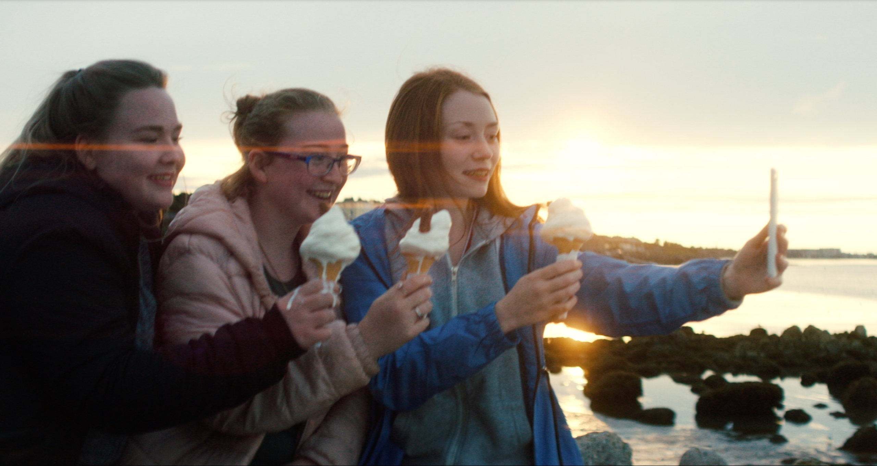
Managing our online wellbeing
Notes:
Notes: Our overall wellbeing is based on the emotional and physical experiences we have. As technology is a significant part of life, it is also important to recognise the impact it can have on how we feel. This is called our ‘digital or online wellbeing’, and is essentially about being aware of how being online can make us feel, and making sure that we look after ourselves and other people. This can include paying attention to the impact it has on our mental, or physical health, and knowing how to cope with difficult experiences - which is what we will explore in the next couple of slides.

Slide 10
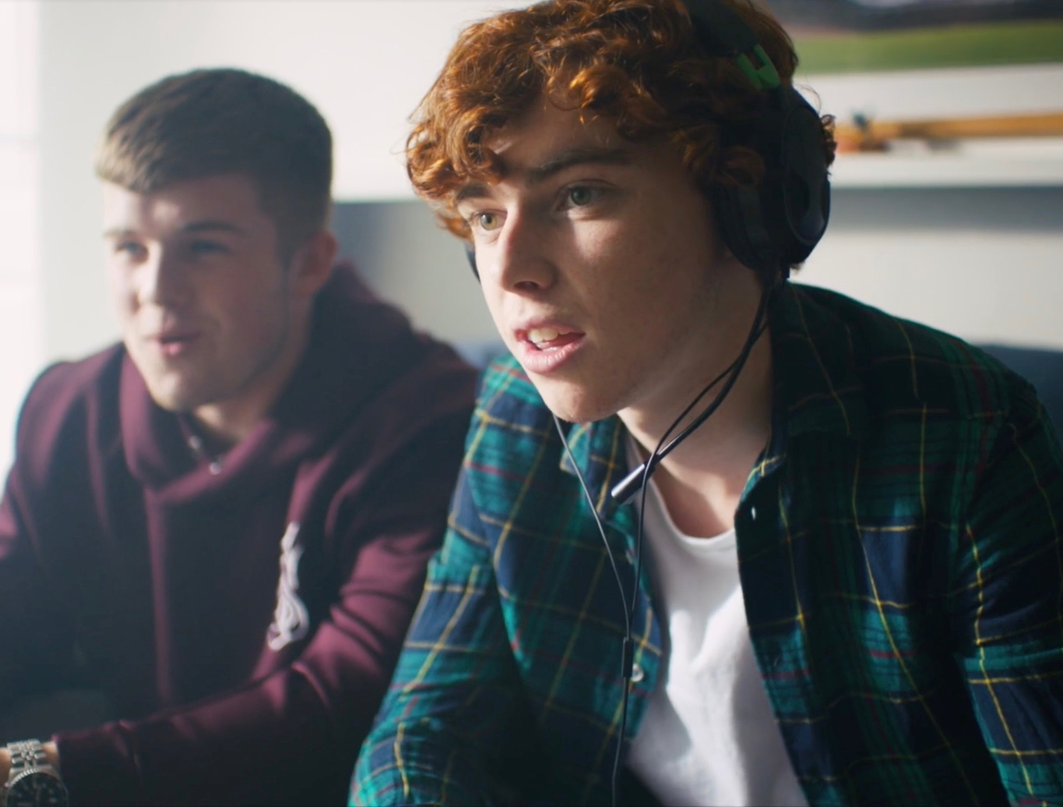
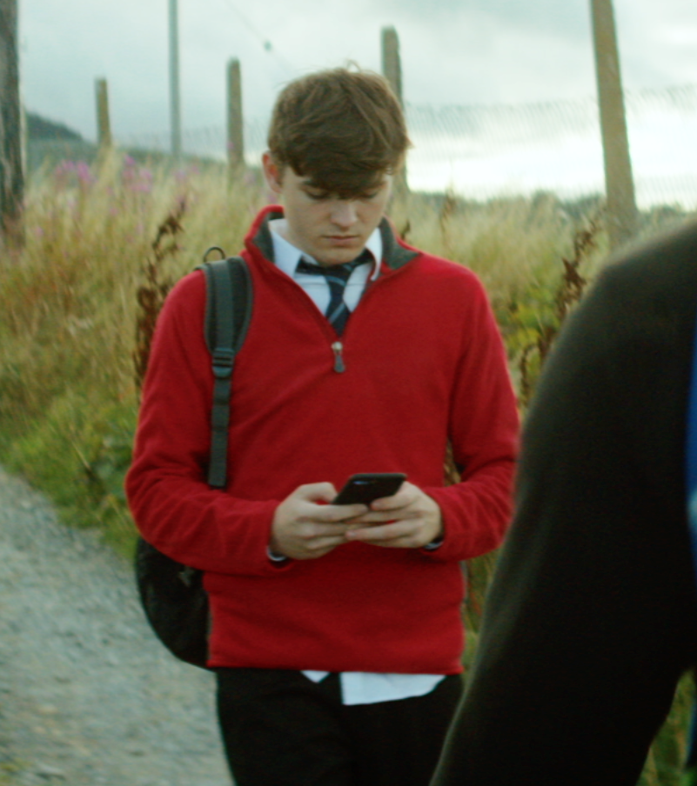
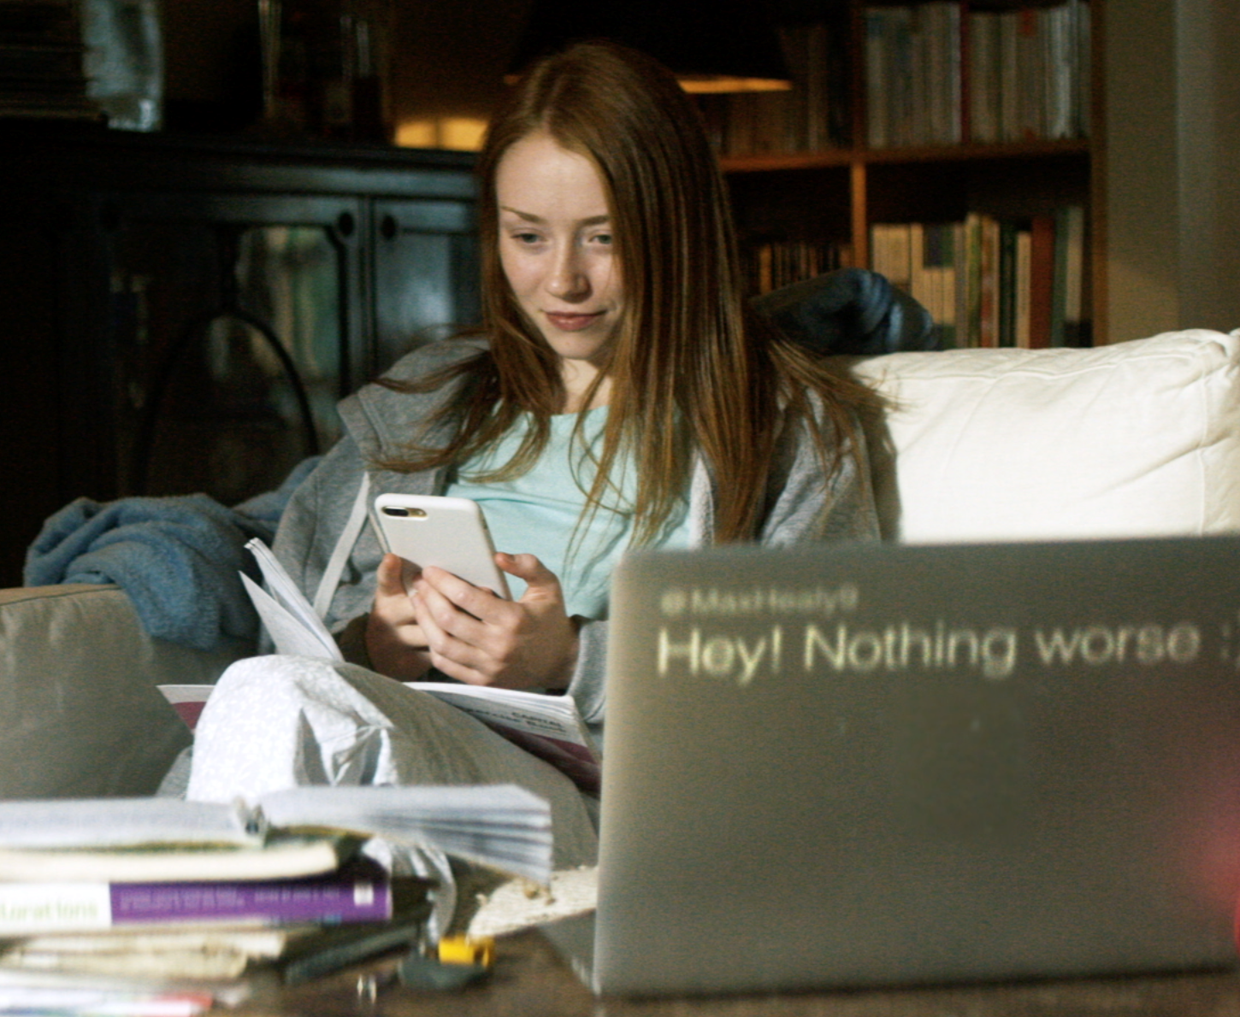
LET’S DISCUSS // DIGITAL STRESS
Digital stress refers to stress we get from using digital devices (e.g. smartphones, laptops, tablets, game consoles) and digital media (e.g. social media, online games, messenger apps).
Notes:
Notes: Now we are going to look at the idea of what digital stress means. Experiencing digital stress refers to stress we get from using digital devices (e.g. smartphones, laptops, tablets, game consoles) and digital media (e.g. social media, online games, messenger apps).
Suggestions on what causes digital stress e.g. mean or harassing comments on social media, impersonation, constantly checking social media for fear of feeling left out, or social media makes you feel like other people are having more fun or living better lives than you. Emphasise that some level of digital stress is to be expected if you use technology and that these lessons will help us to identify and employ strategies to cope with that stress.

Slide 11





What is resilience?
Which ball do you think is the most resilient?
A rubber ball? A foam ball? A ping pong ball?
Notes:
Notes: Next we will consider resilience and what it means to be resilient. We will do this by comparing 3 different types of balls: a foam ball, a ping pong ball and a rubber ball. Ask the students to decide which ball they think is the most resilient and ask for an explanation for their choice.
Prompts for the students to consider are:
— Is the rubber ball resilient or just solid?
— What happens to a ping pong ball if it gets a dent or crack in it?
— Which ball can recover most?
— Which ball best represents us as human beings?
Get feedback from students on which ball they think is the most resilient out of the 3. Sample answers may include: the rubber ball is the most resilient because it just keeps bouncing, the ping pong ball is not very resilient because you cannot fix them if they crack or dent, and the foam ball is not very resilient because it can be broken up.
Discuss with students what resilience means to them.

Slide 12
Resilience is…
Not about trying to be ‘so tough’ that nothing impacts us. Resilience is not about putting up with things.
Resilience is the ability to recover from setbacks. It is ok to feel sad, angry, happy, worried...it is how we respond and adapt that is key.
Notes:
Notes: Clarify that resilience is not just the ability to bend and take knocks at times, but also being able to adapt and recover. Ask them if this has changed their opinion on which ball is the most resilient.

Slide 13
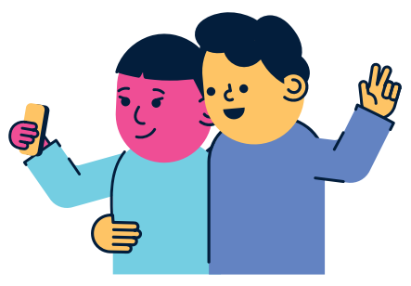
Definition of
Digital Resilience
Digital resilience is the ability to bounce back from difficult times online over time.
Notes:
Notes: Read through the definition of digital resilience. Explain to students that they have identified different types of digital stress we face, and will now look at how having digital resilience can help us deal with it effectively. When we go online it can be like a ball being bounced around, most of the time it is great fun, but there are bound to be some bumps along the way.
So ...how do you become more digitally resilient? Suggestions:
Build a support network
Give yourself a break
Make some lifestyle changes
Look after your physical health
We will explore how to do this now...

Slide 14

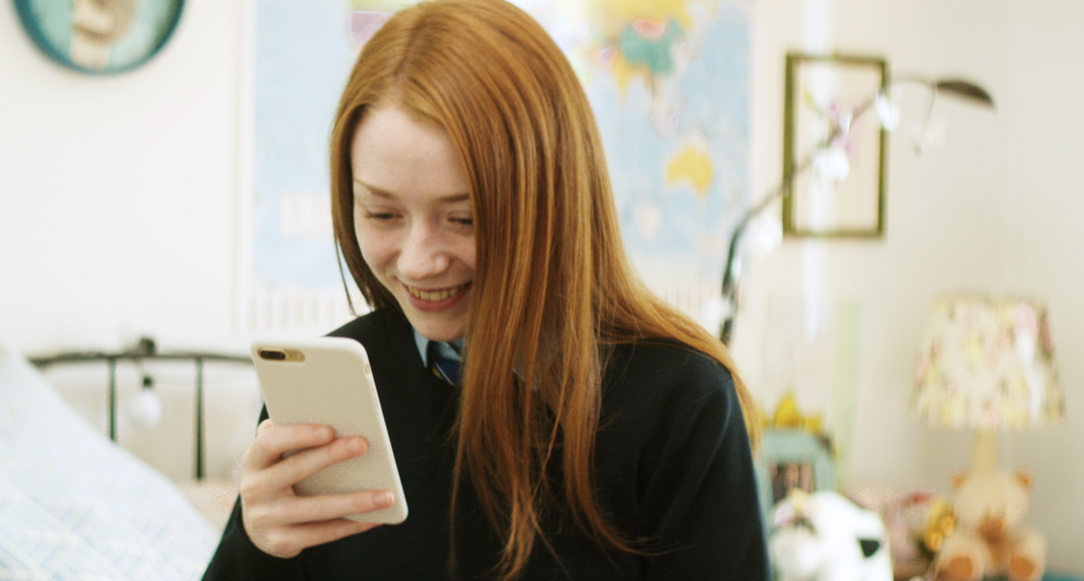
Managing our online wellbeing
Making Time for
Rest and Reflection
Changing Habits
and Attitudes
Time Management
Notes:
Notes: There are three main ways of managing your online wellbeing. The first is recognising it’s important to make time for rest and reflection so that you have a healthy balance of activities in your life on and offline. The second is through changing your habits and attitudes to make the most of your time online. Finally, by being mindful of your time management: if your time is better organised, your online life won’t get in the way of other things you need to do.

Slide 15
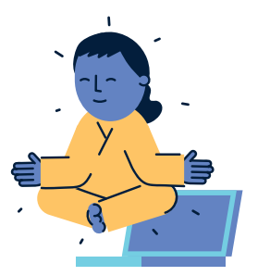
Making Time for
Rest and Reflection
Turn off your notifications
Play a game of “phone stack” with your friends
Log out of all your social networks, turn off wi-fi or turn off your phone at bedtime.
Schedule screen free times
Take an occasional break from social media and digital devices.
Notes:
Notes: Making time for rest and reflection means recognising it’s important to make time for rest and reflection so that you have a healthy balance of activities in your life on and offline.
Turn off your notifications.
Play a game of “phone stack” with your friends: when you’re hanging out together, everyone puts their phones (or any other digital device) in a pile. Whoever can last longest without picking theirs up wins!
Log out of all your social networks, turn off wi-fi or turn off your phone at bedtime.
Schedule screen free times e.g. things like going for a walk, exercising, or spending time with a friend can do a lot to relieve stress.
Take an occasional break from social media and digital devices.

Slide 16
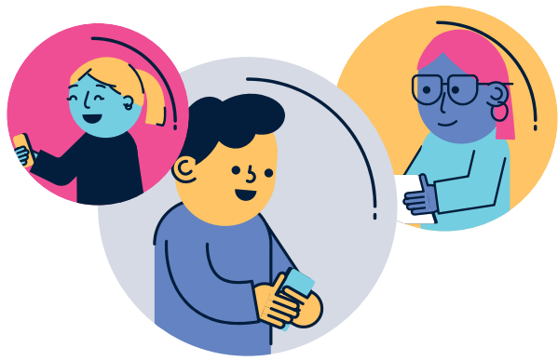
Changing Habits and Attitudes
Don’t compare yourself to people you see online – including your friends.
Be in the moment. Enjoy what you’re doing and don’t worry about getting pictures of it!
Accept that you can’t be there for everything – even virtually.
Don’t take it personally.
Notes:
Notes: The second way for managing your online wellbeing is through changing your habits and attitudes to make the most of your time online.
That means:
Don’t compare yourself to people you see online – including your friends.
Be in the moment. Enjoy what you’re doing and don’t worry about getting pictures of it!
Accept that you can’t be there for everything – even virtually. Trying to keep tabs on everything will just stress you out.
Don’t take it personally. Odds are, your friends aren’t posting things to make you jealous: they’re trying to make themselves and their lives look good, just like you.

Slide 17
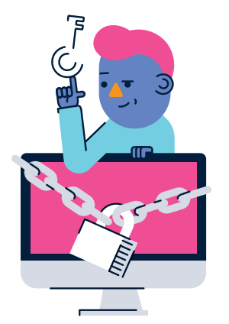
Time Management
You can’t do everything. Think about the things that are most important to you (School? Family? Hobbies? Work?) and make sure to put those first.
Make a to-do list of things you need to do and
use a planner to keep track of them.
Put an alarm on when playing games online to show you how long you have been playing for and to take a break from the screen.
Decide specific time when you’re going to check social media.
Notes:
Notes: Finally, if your time is better organised, your online life won’t get in the way of other things you need to do. Being mindful of your time management means understanding:
You can’t do everything. Think about the things that are most important to you (School? Family? Hobbies? Work?) and make sure to put those first.
Make a to-do list of things you need to do and
use a planner to keep track of them.
Put an alarm on when playing games online to show you how long you have been playing for and to take a break from the screen.
Decide specific time when you’re going to check social media.

Slide 18
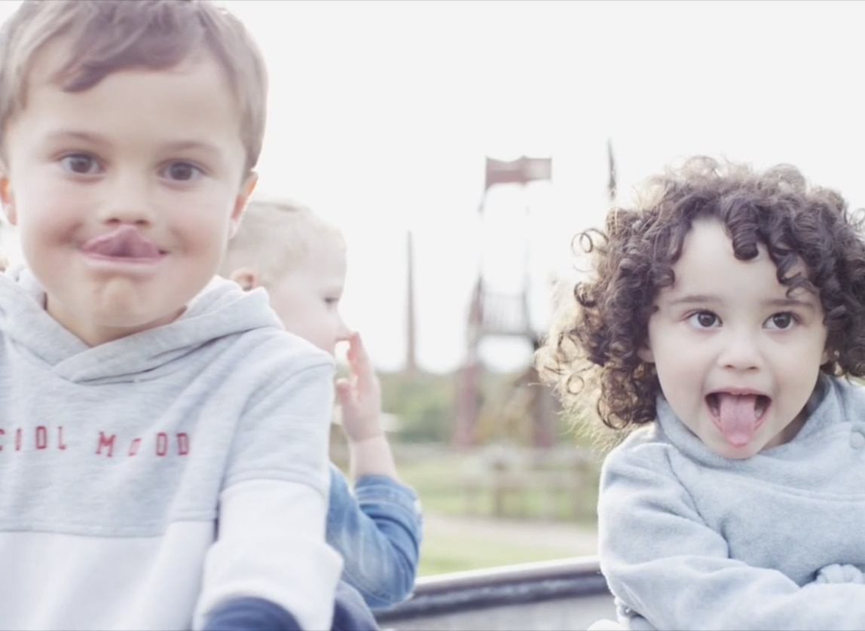
Respectful Online Communication
Sticks and stones may
break my bones…
But words will never hurt me…
Notes:
Notes: “sticks and stones may break my bones but words will never hurt me”
Ask students if they have ever heard of the rhyme sticks and stones may break my bones but words will never hurt me before and what they think this means. Typical responses will include a call to rise above insults from our peers, that you might be able to hurt me physically but not by insults. This is the ideal response but is it always the case? Can words hurt us sometimes? Should we perhaps see this as a call to be more mindful of how we treat others? Should we understand it as meaning Treat other people with respect.

Slide 19
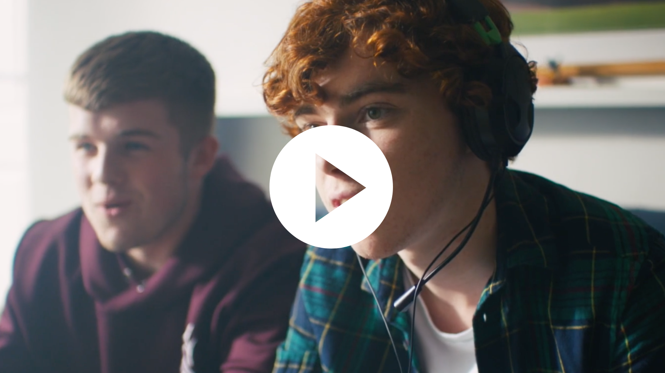
#CONNECTED
RESPECTFUL ONLINE
COMMUNICATION
Click the link to play video:
https://vimeo.com/359094916
Notes:
Notes: Connected
Connected video: https://vimeo.com/359094916
Play the Connected video (www.webwise.ie/connected) for students.
Based on real life experiences, Connected is a short film exploring how young people communicate and connect online. The film encourages young people to reflect on why their actions matter and the impact it can have on others. We shape the internet everyday with our interactions. You can play a part in creating a better, connected online world.
2. Ask students again what they understand the rhyme to mean after watching the Connected video. When getting feedback from students draw from key quotes in the Connected video to prompt discussions on treating other people with respect:
“People say things without thinking, not really understanding how it can affect someone.”
“People say stuff sometimes and you just want to explode and just write the worst things ever you know, I guess you get back what you put out into the world.”
“We’re all so connected but what we do with that connection matters.”
Let students discuss this for a moment and then suggest, if no students already have, that the sticks and stones rhyme isn’t in conflict if we understand it as meaning treat other people with respect: we all want to be treated with respect, but to respect people we sometimes have to understand how they’re different from us (such as recognising that what might be considered ‘just a bit of fun’ might be upsetting and hurtful for others).

Slide 20
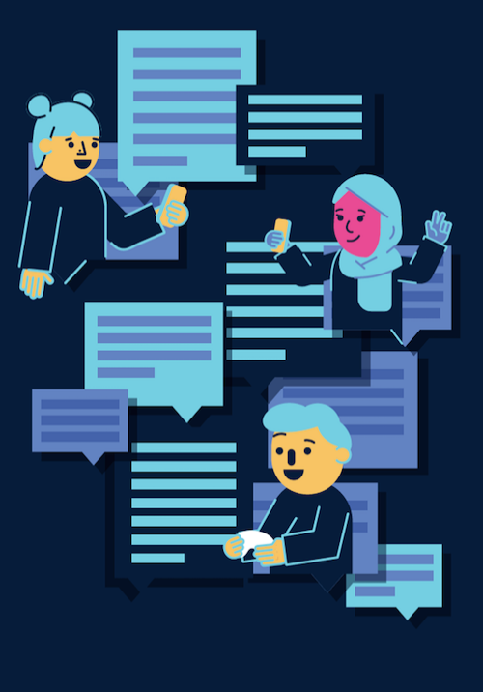
LETS DISCUSS // RESPECT ONLINE
What does respect online look like, sound like, feel like?
Notes:
Notes: Ask students what respect means for them and what being treated with respect or respecting people looks like, sounds like, feels like. Make sure to explain that you’re talking about respect in terms of how you behave towards people (or they behave towards you), not how you feel about someone. You might gain or lose respect for someone depending on what they do, or things you learn about them, but that everyone deserves to be treated with respect at all times. Ask students to think about what respect means in an online context, what behaviours do they associate with being treated with a lack of respect online and in various contexts e.g. social media, sharing possibly upsetting or harmful content, messaging, gaming, uploading media of other people (i.e. pictures, videos, audio).
Emphasise to students that the Connected film is based on real life experiences and encourages young people to reflect on why their actions online matter and the impact it can have on others. It carries an important message to be more mindful in our everyday communications as we shape the internet everyday with our interactions.

Slide 21

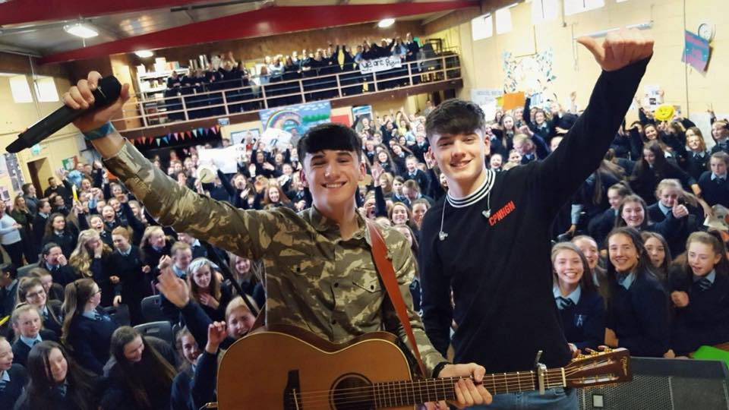
Safer Internet Day Selfie
Webwise love seeing all your photos from your online safety campaigns and Safer Internet Day activities.
Send in your photos, videos and posters to Webwise and you could be in with a chance of winning some great prizes.
Notes:
Notes: Webwise love seeing all your photos from your online safety campaigns and Safer Internet Day activities. Send in your photos, videos and posters to Webwise and you could be in with a chance of winning some great prizes. Just email: internetsafety@pdst.ie.
Share your SID activities
We love seeing all your photos from your online safety campaigns and Safer Internet Day activities. Connect with us on:
Twitter @Webwise_Ireland
Facebook: facebook.com/webwise_Ireland
Instagram: webwiseireland
Share ideas tips/plans using #SaferInternetDay
Share your internet safety messages on webwise.ie/saferinternetday

Slide 22
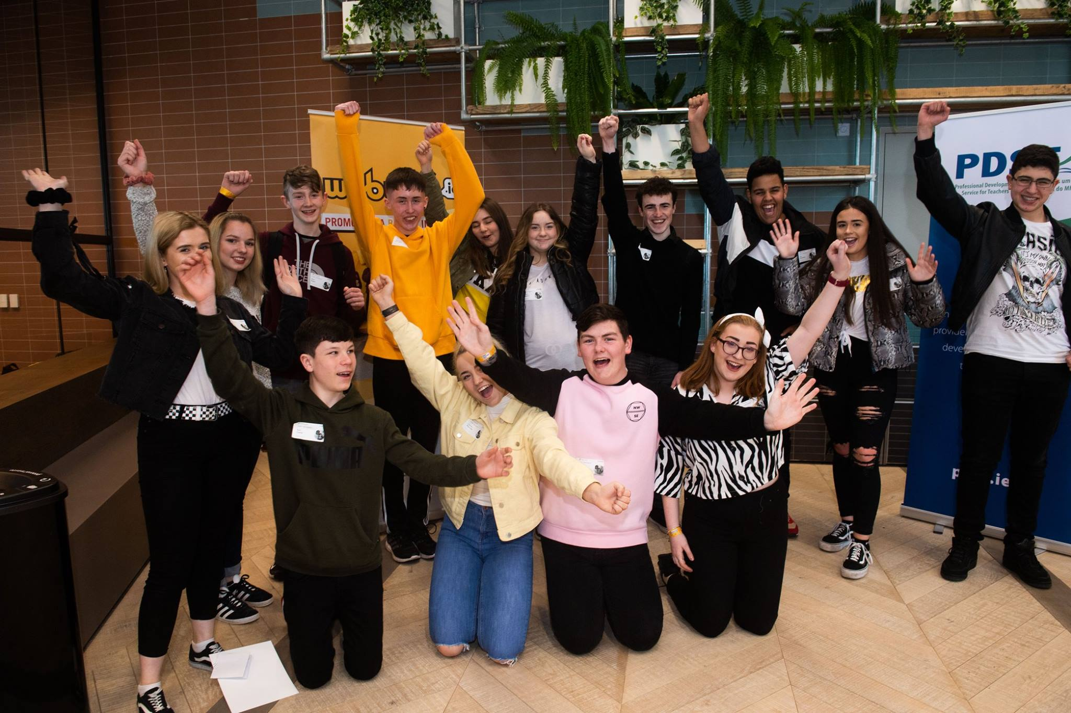

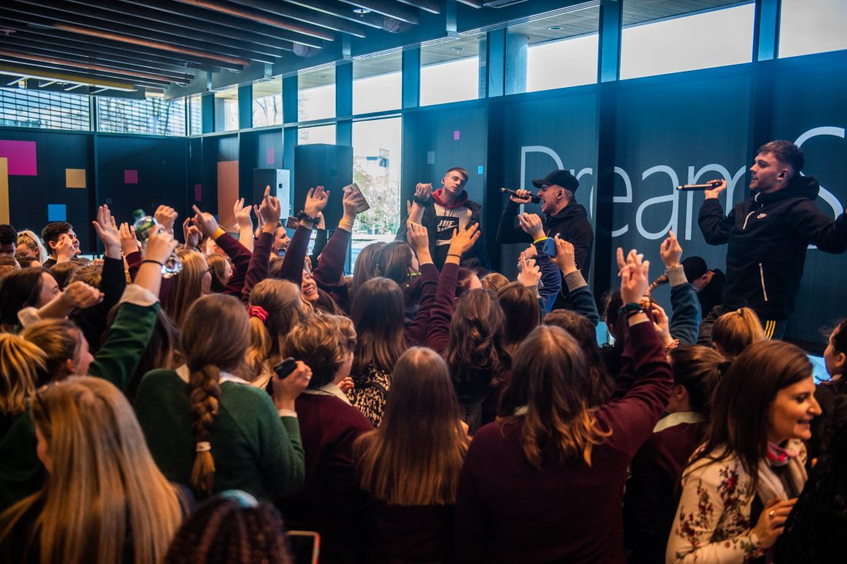
Safer Internet Day Awards
Enter the Post Primary School Safer Internet Day Competitions and your school
could win some great prizes. Find out more about competition categories and prizes here: www.webwise.ie/saferinternetday
Notes:
Enter the Post Primary School Safer Internet Day Competitions and your school
could win some great prizes. Find out more about competition categories and prizes here: www.webwise.ie/saferinternetday

Slide 23
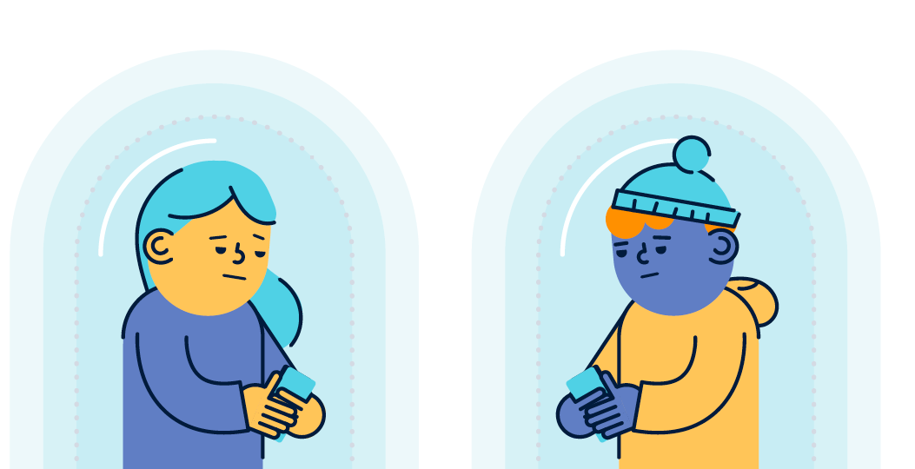
Join the conversation
#SaferInternetDay #Webwise
Connect with Webwise on:
Twitter: @Webwise_Ireland
Facebook: facebook.com/webwise_Ireland
Instagram: webwiseireland
Notes:
Join the conversation!
Connect with Webwise on:
Twitter: @Webwise_Ireland
Facebook: facebook.com/webwise_Ireland
Instagram: webwiseireland

Slide 24

THANKS!
ANY QUESTIONS?
www.webwise.ie
© Webwise_Ireland
This work is made available under the terms of the Creative Commons Attribution Share Alike 3.0 Licence http://creativecommons.org/licenses/by-sa/3.0/ie/. You may use and re-use this material (not including images and logos) free of charge in any format or medium, under the terms of the Creative Commons Attribution Share Alike Licence.
Notes:
Notes: Webwise would encourage you to download copies of the Parents' Guide to a Better Internet booklets and or Parent’s checklists to distribute to pupils to take home to their parents. The booklet can be ordered for free at Webwise.ie/parents

