Slide 1
Notes:
Introduction
Today I’ve been invited in by your teacher to help cover the topic of online harassment and cyberbullying. This can cause confusion for some people as the internet doesn’t enable us to see people’s reactions the way we do in real life and so sometimes we can cross the line without realising it. The impact of our online actions can be much bigger than we realise. Sometimes we see things online and aren’t quite sure what to do about it. Today this lesson will focus on helping identify incidents of harassment and bullying, thereby making it clearer for us what is and is not over the line. Hopefully this will prevent any of us becoming caught up in something serious. The internet can be a wonderful way of connecting with others, we want to make sure it is a safe and respectful place too.
At any point during the presentation if someone breaks one of the rules gently point it out to them by saying something like “oh hang on, I think you are forgetting the ground rules your class came up with, remember the one about…”.

Slide 2
CLASS AGREEMENT
GROUND RULES
Use I statements: I think, I feel, I believe.
Don’t give examples of your own experience or examples of what has happened to others.
If something offends you during a discussion acknowledge it immediately, don’t let it simmer.
Ensure everyone has a chance to speak. No interrupting each other.
Show respect to everyone, no put downs or eye rolling!
What is shared in class stays in class … but there is a limit to this if a teacher is concerned.
Everyone has the freedom to change their opinion based on reflective discussion.
Notes:
Slide 2: Ground Rules
One way of staying safe and being respectful is having a clear set of rules to help us. Before we get started, let’s remind ourselves of some key ground rules for class discussion. Go through the points on the slide.
Please ensure you explain the second last one clearly:
What is shared in class stays in class … but there is a limit to this if a teacher is concerned. It might be appropriate here to point out that the school is required by law to seek advice and support from TUSLA if they are concerned you are in danger.
Ask them if they know who the DLP Designated Liaison Person in the school is and the Deputy Designated Liaison person is.

Slide 3
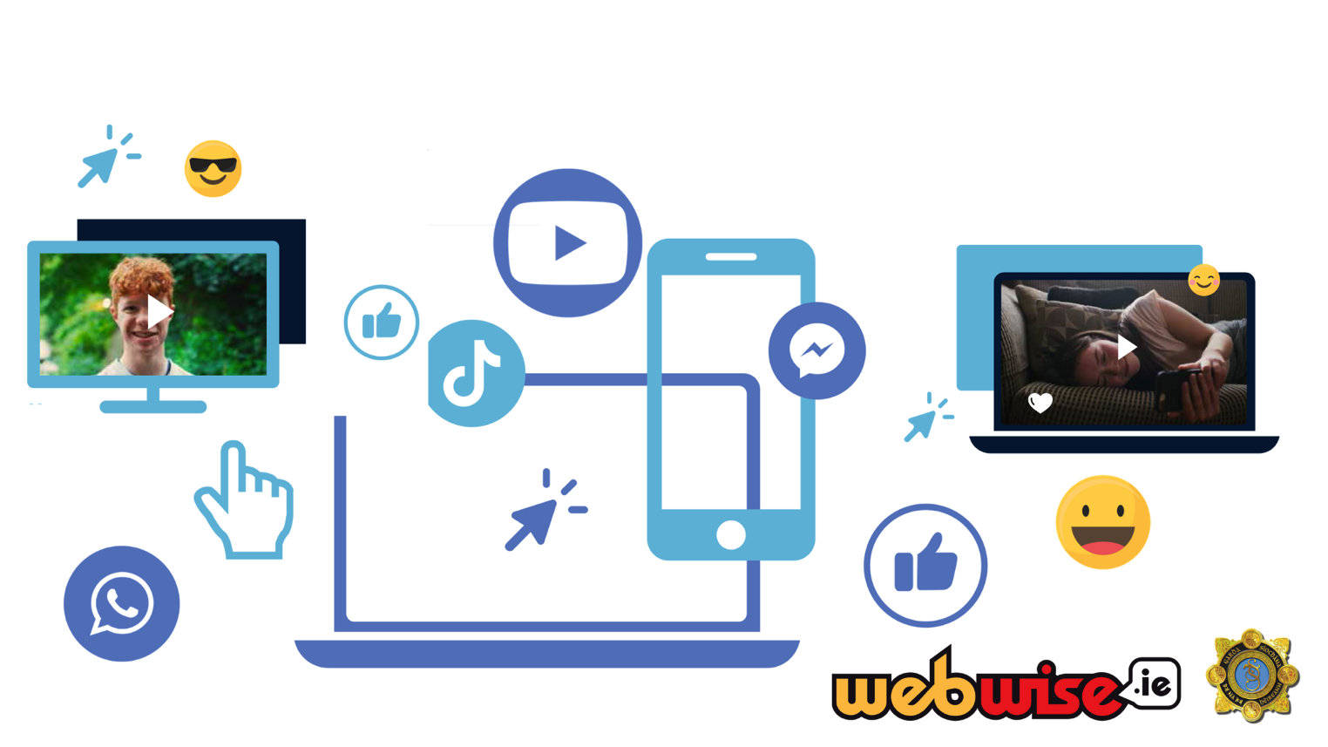
HOW DO WE CONNECT?
Notes:
Slide 3: How do we Connect?
Young people have lots of ways of connecting with others online. We are going to do a matching activity now to see if we can identify all the different ways we create online connections. (Either at this point or as they have entered the room get the teacher to help you distribute one card to each student – See Appendix 4). Ten people in the room have symbols, ten people have descriptions and ten people have the names of these methods of communication. When I say so you are going to stand up and try to find your corresponding group. When you have found your group, raise your hand. (Give them time to do this, it will probably be loud but that’s ok!)

Slide 4
LET’S DISCUSS…
Let’s consider the positives and negatives of the internet?
Notes:
Slide 4: The Positives and Negatives.
We know that there are lots of positive aspects of being online, but we also know that there can be negative aspects to life online as well. In your groups of 3 can you identify one good thing and one bad thing about your group’s ‘ way of connecting? (Give the students a few minutes to discuss this and then take feedback from each group. Try not to comment on their feedback unless they break one of the ground rules established at the start of the activity). Are there similarities between the groups in terms of positives and negatives?

Slide 5
CYBERBULLYING
What is bullying?
Bullying is defined as unwanted negative behaviour, verbal, psychological or physical conducted by an individual or group against another person (or persons) and which is repeated over time.
What is cyberbullying?
Cyberbullying is defined as “placing a once-off offensive or hurtful public message, image or statement on a social network site or another public forum where that message, image or statement can be viewed and/or repeated by other people will be regarded as bullying behaviour”
(Anti-Bullying Procedures, Department of Education and Skills, 2013)
Notes:
Slide 5: Cyberbullying
The focus for today’s talk is respectful communication. It is important to acknowledge with students the importance and benefits of communicating online and that while the internet is a brilliant resource that you can use to do lots of different things we are going to look at what happens when communication is not respectful, or in some cases turns into harassment and how to deal with that. Go through with students the definition of bullying and cyberbullying with students. It is also important to give them an understanding of the different types of online harassment (see Appendix 3).
What is bullying?
Bullying is defined as unwanted negative behaviour, verbal, psychological or physical conducted by an individual or group against another person (or persons) and which is repeated over time.
What is cyberbullying?
Cyberbullying is defined as “placing a once-off offensive or hurtful public message, image or statement on a social network site or another public forum where that message, image or statement can be viewed and/or repeated by other people will be regarded as bullying behaviour” (Anti-Bullying Procedures, Department of Education and Skills, 2013)

Slide 6
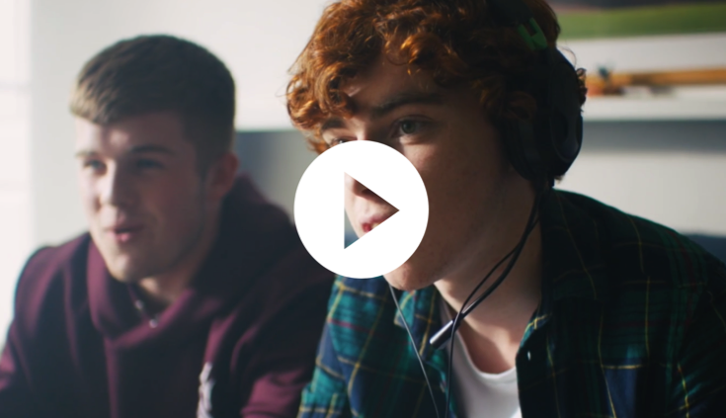
#CONNECTED
RESPECTFUL ONLINE
COMMUNICATION
Click the link to play video:
https://vimeo.com/359094916
Notes:
Slide 6: Connected video
This video I’m about to show you is based on young people’s real-life experiences of communicating and connecting online. As you watch it I want you to think about the actions of those involved and the impact they have had on others. Connected film is available here: webwise.ie/connect-with-respect or at garda.ie.
Notes: Connected
Connected video: https://vimeo.com/359094916

Slide 7
LET’S DISCUSS…
How would you feel?
Who would you tell if you saw something on the internet that you did not like?
Notes:
Slide 7: How would you feel?
Distribute a copy of worksheet 1 to each group. Go through the worksheet with students. As a group discuss the characters we have seen in the video. Put yourself in their shoes, imagine you had that experience. How would you feel and why? Play the Connected video again for students before asking them to discuss and write their answers.
Give the students time to properly discuss this and write their answers. Get the teacher to help you circulate the room and chat to the students as they do it, prompting them to add more detail and to keep them on track. This should take no more than 5 minutes. Take feedback from the groups, try and get one emotion at least from all ten groups. Explain that by definition cyberbullying and online harassment takes place online, but that it’s important to remember that it impacts the offline world too. The consequences can sometimes be felt in the student’s school or local community.
Explain that not every person experiences the same emotions or reacts the same way. There is no right or wrong way to feel as a result of online bullying or harassment. What is important here is how we as a community both in and outside of school support someone who may be going through this.

Slide 8
QUIZ TIME:
THE LAW, THE INTERNET and ME
Click for Kahoot quiz:
https://play.kahoot.it/v2/?quizId=6e6765fd-1256-4f49-a92c-07148add8a17
Notes:
Slide 8: Quiz time – How does my school and the law protect me?
Keeping the students in their preexisting groups, distribute the quiz questions – Worksheet 2. This activity should take ten minutes to complete. Alternatively this quiz can be done online: https://play.kahoot.it/v2/?quizId=6e6765fd-1256-4f49-a92c-07148add8a17
This is designed to be an informative quiz, not a competitive one. When students are finished the quiz provides feedback on the correct answers. The answer sheet in Worksheet 2.A will help with this.
There are also FAQs in Appendix 5 if the students ask questions that are very detailed.
It is important to point out here that all of these are ways we are protected and not designed solely to punish us but more to ensure we know the limits of our rights so we don’t disturb or impact on someone else’s rights. They mark the line of acceptable behaviour in our school community and our society as a whole. Emphasise that even though the law gives us some boundaries, any behaviour which is unwanted is unacceptable, regardless of whether it breaks the law or not.

Slide 9
ACTIVITY:
CROSSING THE LINE
Notes:
Slide 9: Crossing the line
This slide is a placeholder for you to explain the instructions for the next activity. If you jump ahead to the scenarios the students will miss out on the instructions and not complete the activity well.
Not all nasty messages constitute bullying. A lot of cyberbullying occurs when we lose sight of the consequences of our actions. Some people don’t think sending messages which they see as “just messing” or “joking” is bullying, and don’t understand how it can hurt someone. Internet anonymity empowers bullies and leaves them feeling like they cannot be traced. This is where we all need to play a role in protecting each other. In the next activity I will present some scenarios and, in your groups, you will decide if the actions involved have crossed the line. Be prepared to explain your answer!

Slide 10
Notes:
Slide 10 and 11: Crossing the line scenarios
Keeping students still in their preexisting groups allocate one scenario per group. Ask the teacher for guidance in selecting relevant scenarios for the group. Distribute copies of Worksheet 3: Crossing the Line Scenarios to each group. Give the students time to read and discuss their scenario. Instruct students that they are to read through their scenario and answer the following:
- Whether they believed it to be over the line aka unacceptable behaviour or not?
- Suggest advice or a coping skill to the young person in this scenario for how to deal with this form of online harassment.
Depending on their ability level it should take between 5-8 minutes. When students have completed the task go through each of the scenarios asking for feedback on their responses. Note: We are attempting to make an analogy here, it is our duty to stand up and say something when we see unacceptable behaviour online.
Suggested answers may include:
A: Keyshia has had her image published without her consent. This is persistent unwanted behaviour and would be considered cyberbullying. Advice may include speaking with Sophie about why she does not want to be tagged in her posts/pictures, report Sophie’s posts to the social media app.
B: Shane has had his image manipulated and shared without his consent. He has asked for it to stop, it has not. This is persistent unwanted behaviour and would be considered cyberbullying. Advice for Shane may include save the evidence and speak with a trusted teacher about the video clip, offer support and remind Shane that it is not his fault, reporting the clip and requesting it be taken down from the social media platform.
C: David is receiving threatening and intimidating repeated behaviour whenever the anonymous player joins the game. It is persistent and results in David receiving threatening and harassing messages and not feeling like he can play the online game he enjoys safely without being harassed. Suggested advice for David includes don’t respond to the messages, keep/screenshot the evidence/messages, and report the user to the gaming platform.
D: While Laura is not at fault in this scenario she is a member of a messaging group where someone is being talked about unkindly. This is an example of Relational or Social Bullying. Rather than be a bystander to this Laura needs to be an upstander. What could Laura do? This links to the next slide. Advice for Laura includes be an upstander and show friendship and support to the girl and ask the group to stop these nasty comments, save the evidence and confide in a trusted teacher/adult.
E: Sarah has created a fake social media profile of Rachel to specifically target and impersonate her and is using social media to tarnish Rachel’s good name and reputation by publishing false information. This is a form of cyberbullying. Advice for Rachel includes don’t retaliate by doing the same to Sarah, speak with a trusted adult, screenshot the evidence and report it to the social media platform, block Sarah from all social media accounts, protect your social media accounts by setting new, stronger passwords
F: Raj is being harassed, humiliated and body shamed by his classmates. It is intentional and constitutes cyberbullying. Advice for Raj includes speak with a trusted adult and report it to teachers and the social media platform, save the evidence, don’t retaliate and know it is not your fault, seek support in trusted friends. Remind students: If ever you need us, any of your local Gardaí would be happy to help.

Slide 11
Notes:
Slide 11: Continued:
- Whether they believed it to be over the line aka unacceptable behaviour or not?
- Suggest advice or a coping skill to the young person in this scenario for how to deal with this form of online harassment.
D: While Laura is not at fault in this scenario she is a member of a messaging group where someone is being talked about unkindly. This is an example of Relational or Social Bullying. Rather than be a bystander to this Laura needs to be an upstander. What could Laura do? This links to the next slide. Advice for Laura includes be an upstander and show friendship and support to the girl and ask the group to stop these nasty comments, save the evidence and confide in a trusted teacher/adult.
E: Sarah has created a fake social media profile of Rachel to specifically target and impersonate her and is using social media to tarnish Rachel’s good name and reputation by publishing false information. This is a form of cyberbullying. Advice for Rachel includes don’t retaliate by doing the same to Sarah, speak with a trusted adult, screenshot the evidence and report it to the social media platform, block Sarah from all social media accounts, protect your social media accounts by setting new, stronger passwords
F: Raj is being harassed, humiliated and body shamed by his classmates. It is intentional and constitutes cyberbullying. Advice for Raj includes speak with a trusted adult and report it to teachers and the social media platform, save the evidence, don’t retaliate and know it is not your fault, seek support in trusted friends. Remind students: If ever you need us, any of your local Gardaí would be happy to help.

Slide 12
Where can you get
support and advice?
School (Teacher, counsellor, principal)
Parent/Guardian/Trusted adult
Support organisations (Childline)
Gardaí
Notes:
Slide 12: Where can you get support and advice?
A lot of the suggestions in the last activity involved talking to someone or asking for help. What I’d like now is for you to think about where you can go for help. Is there someone here at school you can have a word with? What trusted friend would be good to talk to? Is this something you could discuss with your parents or guardians? There are a lot of organisations out there that offer support and help. What ones can we name? Take feedback from the group on organisations they know or people in school they could talk to e.g. guidance counsellor, tutor, year head etc. If ever you need us, your local Gardaí would be happy to help.

Slide 13
ANY QUESTIONS?
Notes:
Slide 13: Questions
Take questions from the floor. Use the FAQ and the Protocol in appendix 5 to help you.
It’s ok to say, hang on and I’ll look that one up as I want to be sure I give you the correct answer.
If you don’t know the answer to a question, admit it.
Don’t guess or give false information, say “I haven’t come across that question before, I’ll have to ask back at the station and find out. When I do I’ll email your teacher.” Make sure you always get the
information back if possible.
Reminder - An additional lesson is available for teachers to explore the topic in detail. This lesson is available at: webwise.ie/connect-with-respect.
Provide the teacher with a copy of appendix 6 which includes information on the follow-up lesson and additional resources.
The End

