Slide 1

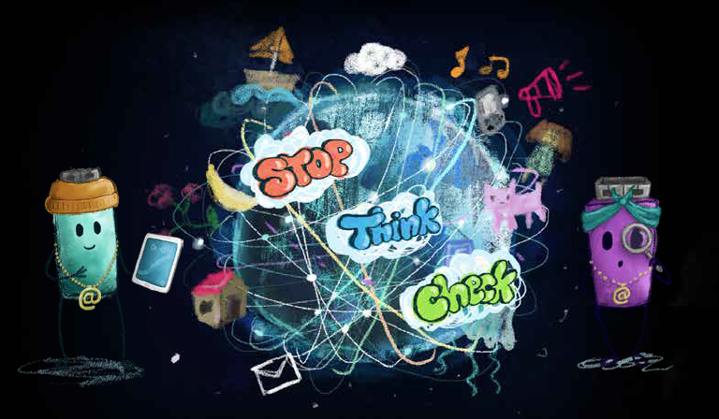




SAFER INTERNET DAY
An Introduction to the Internet 1st & 2nd Class
Notes:
Notes for speaker – brief introduction and welcome.
Explain how long the talk will take and the types of things you will be doing over that time.
For example:
‘Today we are joining millions of people around the world in celebrating Safer Internet Day, a day for promoting a safer and better internet for all users, especially children. During this assembly we are going to talk about being online and using the internet. We will look at the positives and possible negatives of the internet as well as some general advice on how to stay safe while using the internet.’

Slide 2

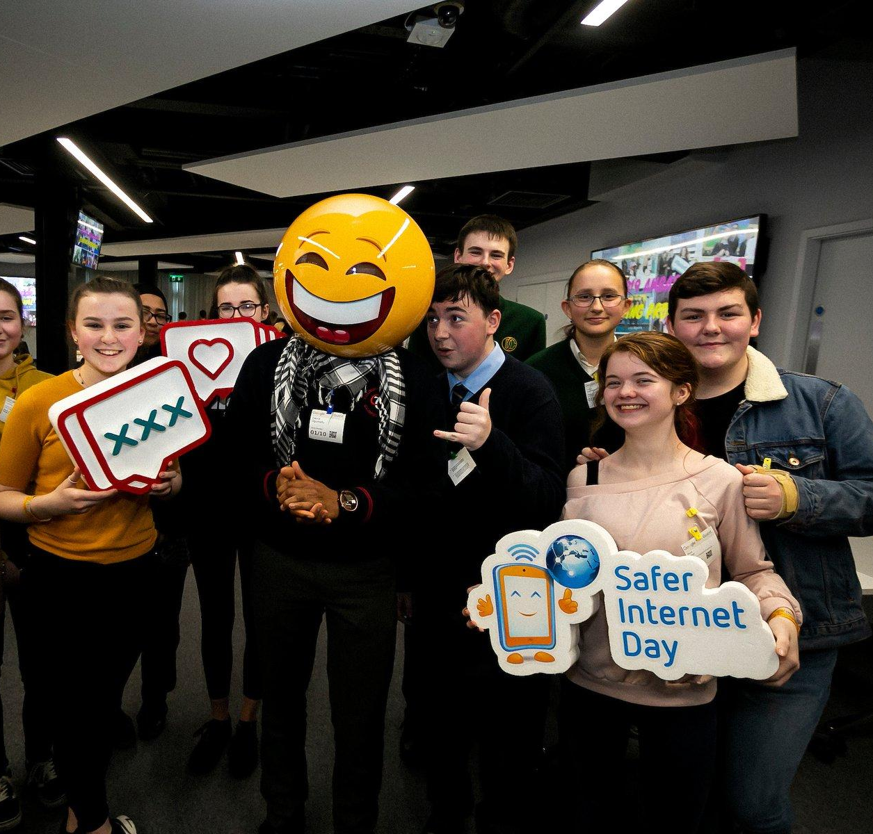
What is Safer Internet Day?
A day to create awareness of a better internet for ALL users
The theme for Safer Internet day is “Together for a Better Internet”
Safer Internet Day is celebrated all across Europe on the second Tuesday, of the second month, every year.
Notes:
Notes: Safer Internet Day (SID) is an EU wide initiative to promote a safer internet for all users, especially young people. Safer Internet Day in Ireland is promoted and coordinated by Webwise, the Irish Internet Safety Education Awareness Programme. The Theme for Safer Internet Day is “Together for a Better Internet“.
The aim of the day is a call on young people, parents, teachers, schools, government, businesses to join together to make the internet a safer and better place for all, and especially for children and young people.
Safer Internet Day is a day to promote safe and responsible use of the internet, a day for us to consider all the different ways we use the internet and how we can make the internet a safer and better place for all, and especially for children and young people.

Slide 3
WHAT IS THE INTERNET?
Notes:
Notes: Today we are going to look at what the internet is, what we mean when we are talking about being online. Before we can talk about being safe online we have to consider all the different ways we can be online and use the internet - what exactly do we mean when we are talking about the internet.
Ask pupils what is the internet? Elicit responses. Then move to the next slide for the definition and introduction video.
Please remember children’s online experience will be varied.

Slide 4
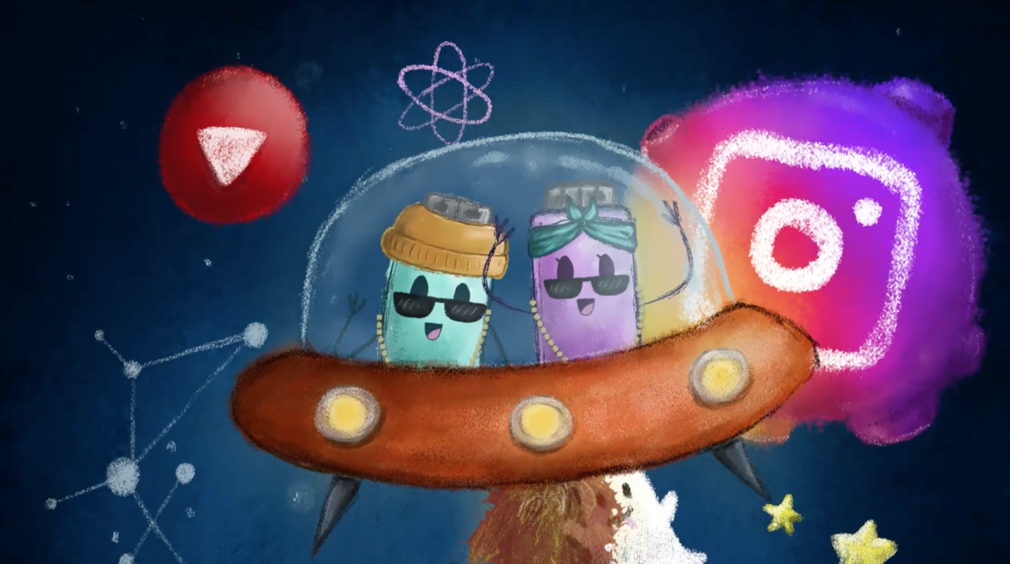
WHAT IS THE INTERNET?
The internet is a network or ‘web’ that connects all computers worldwide.
Information on the internet is arranged in websites or web pages.
People can view websites using internet browsers such as Google Chrome or Internet Explorer.
Click the Link to play: https://vimeo.com/313425824
Notes:
Notes: Explain to pupils that the internet is a network or ‘web’ that connects all computers worldwide. Information on the internet is arranged in websites or web pages. Each website has its own web address, and lots of these addresses begin with “www,” which stands for “World Wide Web”. People can view websites using internet browsers such as Internet Explorer, Google Chrome or Mozilla Firefox.
Next play the video from the HTML Heroes programme: What is the internet?
Let’s begin by watching this video by the HTML Heroes, Archie and Ruby, who are going to look at what is the internet.
This video introduces the pupils to the HTML Heroes, two plucky usb keys, Archie and Ruby, who will rap catchy rhymes to teach your pupils about the internet. The children’s experience will be varied.
Video available here: https://vimeo.com/313425824

Slide 5
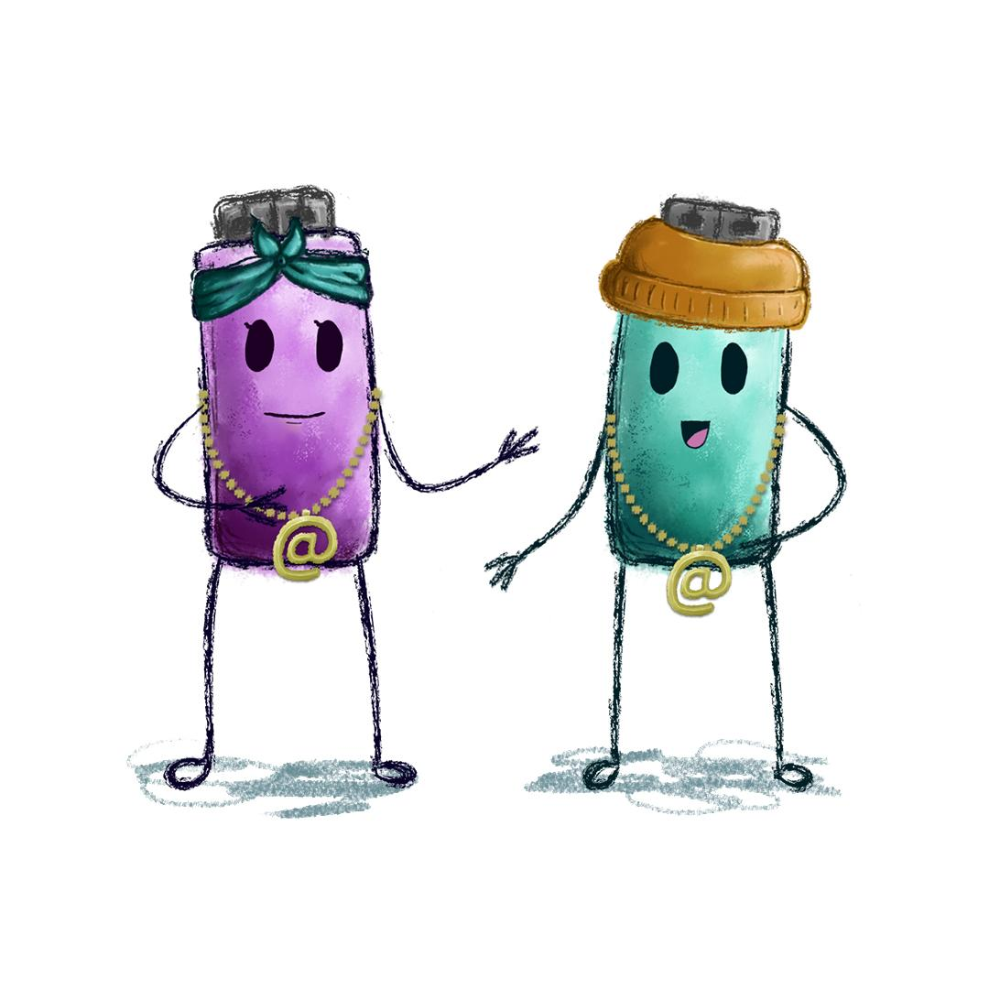
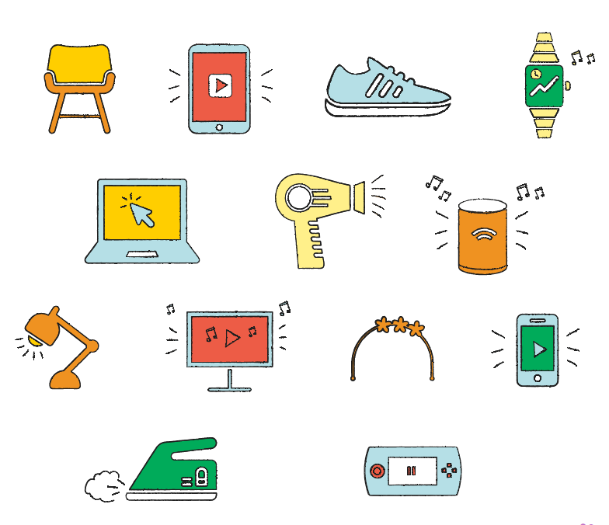
Which of the items below can be
used to connect to the internet?
Notes:
Notes: The internet is a brilliant resource that you can use to do lots of different things. Next, explain to pupils that to use the internet you must first connect to it. You can do this using a lot of different devices. Most devices don’t need wires to connect to the internet. They can connect using ‘Wi-Fi’ or wireless internet connection.
Ask pupils to look at the various items you might find at home and identify which items can be used to connect to the internet.
Answers: Items shown on this slide that can connect to the internet include smart tv, smart phone, computer, laptop, tablet/iPad, game console, smartwatch, smart speaker/digital assistant e.g. Amazon’s Alexa or Apple’s Siri.

Slide 6
How can the internet help or benefit people?
Notes:
Notes: Once pupils have successfully identified all digital items, ask the pupils to consider how being connected to the internet and using the internet can help or benefit people? Use each of the digital devices to ask pupils to think of one way each of these items might help or benefit people?
For example, a smart watch can tell us the time but people can also use it to stay healthy, set fitness goals and track how many steps they have walked that day. Other examples might include communicating with friends who live far away, instant access to music or films you want to watch, researching for homework or project work, developing and learning new skills.
Remind pupils that because the internet holds so much information on just about everything, it is a great tool we can use to help us in lots of ways in our lives day-to-day for example, to help us keep in touch, learn, work, play and understand the world around us.

Slide 7
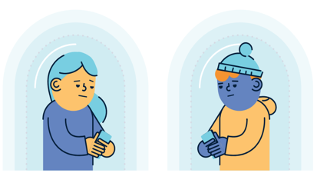
Let’s consider… what are some potential negatives on the internet?
Notes:
Notes: While there are many positives to the internet as we have just discussed there can also be some potential downsides or negatives about the internet. Let’s now consider what might be some negative things about the internet?
Ask pupils to list: What might be the negative things about the internet?
Examples of negative effects of the internet might be that the children could see something they don’t want to see, cyberbullying, spending too much time online. This lesson also gives the class and teacher a chance to recap on the Stay Safe programme and Stay Safe rules.

Slide 8
How can we avoid negative things on the internet?
Notes:
Notes: How can we avoid the negative things on the internet?
Lead the discussion to how we could prevent the negative things associated with the internet or even lessen their harmful effects. You can use this as an opportunity to stress the importance of ground rules when using the internet in school and at home.
Also, emphasise the point that it can be easy to come across something inappropriate or upsetting on the internet and that if they do it is important to tell an adult about it when it happens.
Reassure the pupils that they are not to blame if they come across something online that makes them feel uncomfortable.

Slide 9
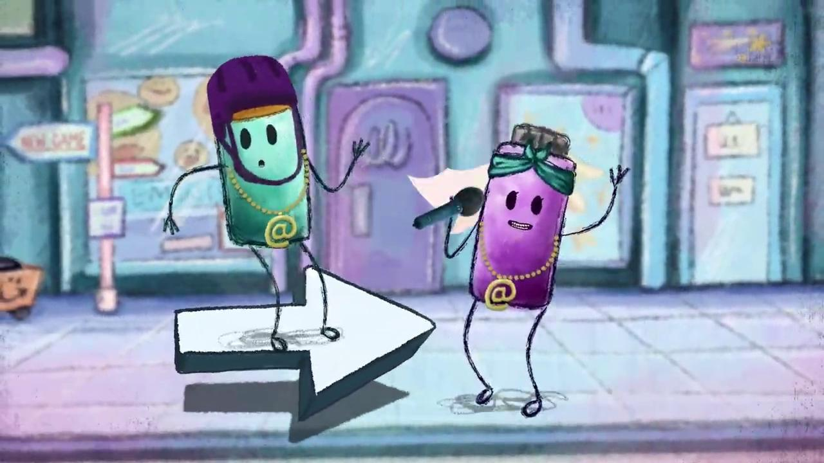
How to stay safe on the internet
Ruby and Archie’s Online Safety Code
Sing along to the HTML Hero’s Online Safety Code Song and learn their top tips for staying safe when using the internet.
Click the Link to play: https://vimeo.com/527704460
Notes:
Notes: Explain to pupils that while the internet is a helpful tool we can use to do lots of different things, it is important to remember it is a big space to navigate with lots of different websites and apps. That means, that just like in the real world, it is easy to get lost and end up somewhere you didn’t mean to go or come across something that is not meant for you.
Luckily the HTML Heroes (Ruby and Archie) have created an online safety code song to help you stay in spaces meant for children and have fun when using the internet.
Play the song, Ruby and Archie’s Online Safety Code Song, for the pupils to listen to and enjoy. If time allows, play the song a second time, invite the pupils to join in and sing along by reading the subtitles on the screen.
Video available here: https://vimeo.com/527704460

Slide 10
Ruby and Archie’s Online Safety Tips
STOP THINK CHECK
STOP, THINK, and CHECK with a parent or trusted adult before you connect.
Stick to websites that are secure - look out for the padlock and https (the ‘S’ stands for secure).
Check the age rating of apps and games online.
It’s important not to keep secrets online -
Always TELL a parent or guardian if you see something mean or upsetting online.
Notes:
Notes: The internet is a big space with lots of different websites and apps and sometimes you might come across something you didn’t mean to. It is just as important to stay safe in the online world as it is the offline world. So let’s think about some of the safety tips we can follow in Ruby and Archie’s Online Safety Code song.
STOP, THINK, and CHECK with a parent or trusted adult before using the internet or before clicking on something new.
Stick to sites that are secure - look out for the padlock and https (the ‘S’ stands for secure) at the beginning of the website address.
Check the age rating - apps and games online have age ratings so you can know if it’s meant for you or not.
It’s important not to keep secrets online - Always tell a parent or guardian if you see something mean or upsetting online.
This is a chance to recap on the Stay Safe programme and Stay Safe rules.

Slide 11
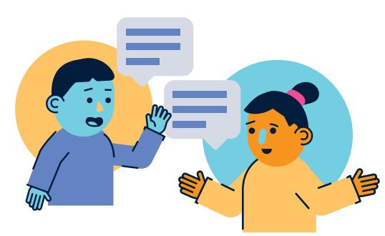
Who would you tell if you saw something on the internet that you did not like?
Notes:
Notes: Who would you tell if you saw something on the internet that you did not like?
‘Who would you tell if you saw something on the internet that you didn’t like or that made you feel unsafe?’. Ask pupils to discuss this in their pairs and feedback to you when they have finished.

Slide 12
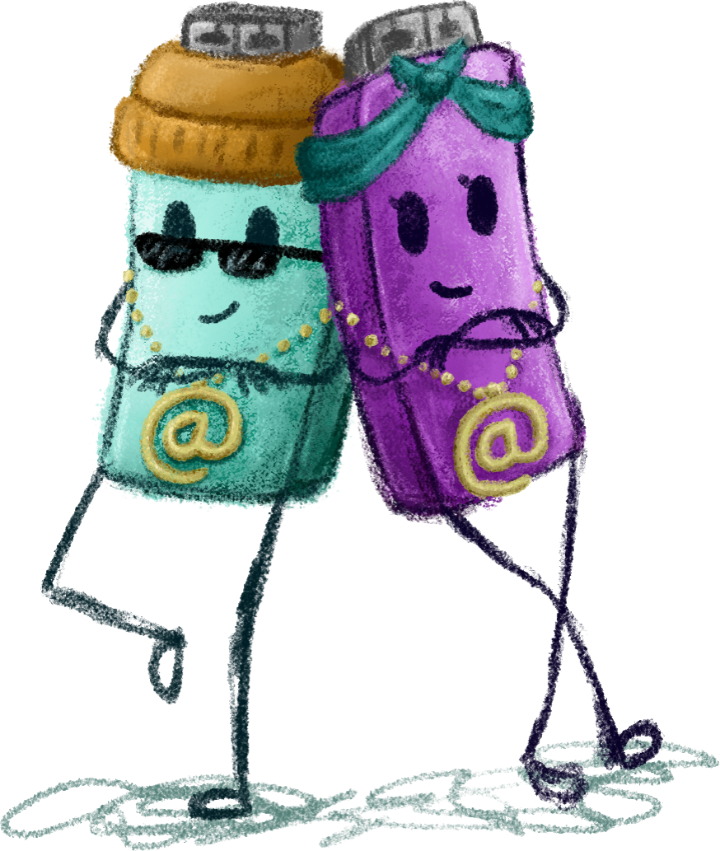
The Good and Bad of the Internet
The internet is a brilliant resource that you can use to do lots of different things. It’s not always your fault if you come across nasty stuff on the internet.
The best thing to do if you see something online that worries you or makes you feel uncomfortable is:
close it down by clicking the X button at the top left of the screen
tell your parents/guardians or your teachers as soon as possible
Notes:
Notes: Take a moment to recap these main points to pupils.
The internet is a brilliant resource that you can use to do lots of different things
It’s not always your fault if you come across nasty stuff on the internet
The best thing to do if you see something online that worries you or makes you feel uncomfortable is:
close it down by clicking the X button at the top left of the screen
tell your parents/guardians or your teachers as soon as possible

Slide 13

Take Home Safer Internet Day Activity
Notes:
Notes: Distribute the Safer Internet Day take home activity sheet available at www.webwise.ie/saferinternetday
Pupils are to take this home and read through with their parents/guardians, agree on terms listed and sign.

Slide 14
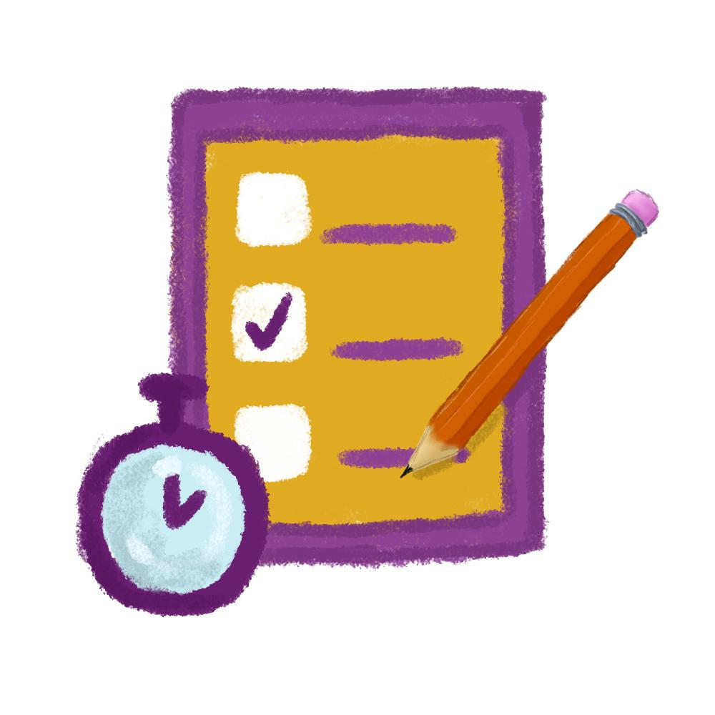
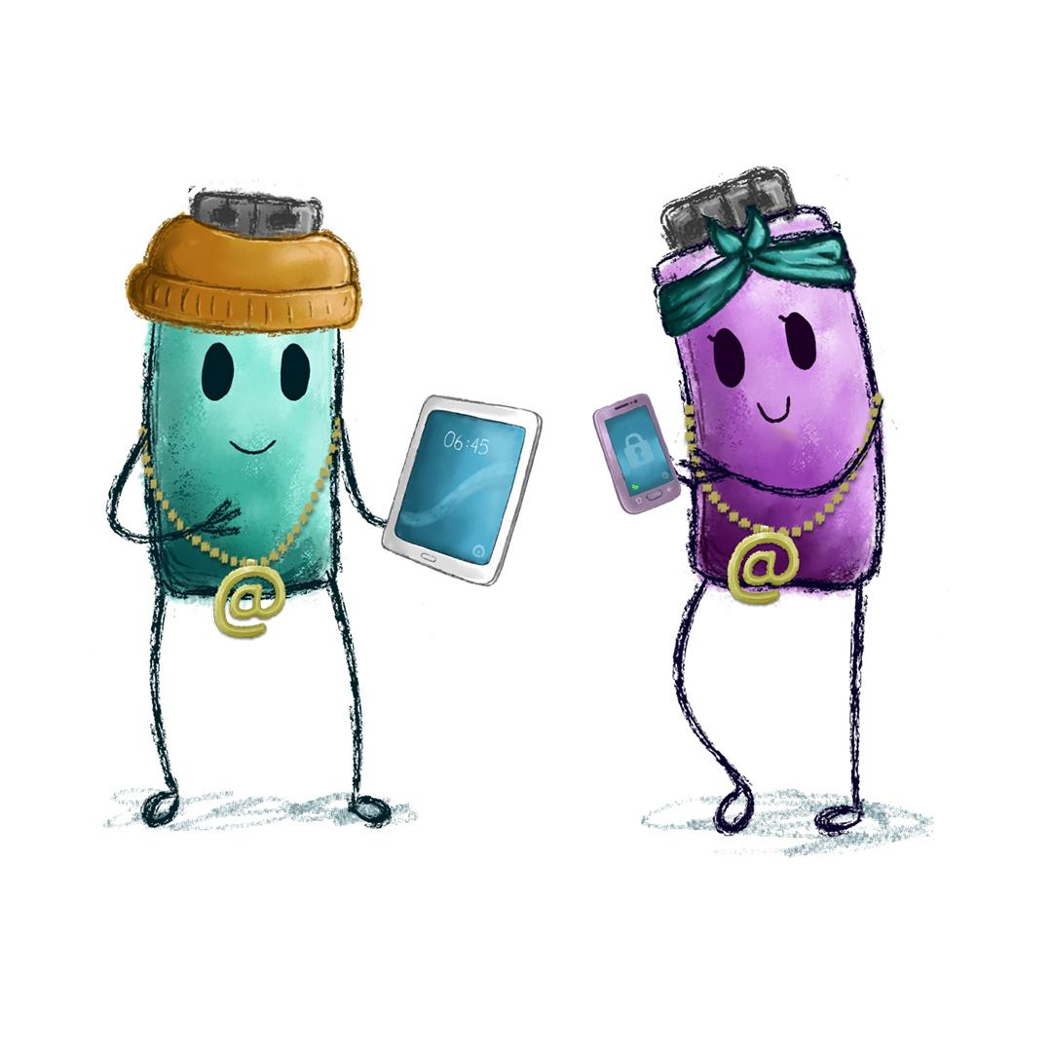
HTML Heroes Online Safety Code Quiz
Take the Online Safer Internet Day Primary Quiz
and find out how to stay safe on the internet!
Go to https://bit.ly/3cJWYvX
Notes:
Notes: HTML Heroes Ruby and Archie’s Online Safety Code Quiz
Now we are going to take this short Take the Online Safer Internet Day Primary Quiz and find out how to be safe online!
Go to https://bit.ly/3cJWYvX to play the quiz. This Kahoot quiz contains questions that recap the main safety points of the presentation.
There is an option of leading pupils through the questions on screen or if they have access to devices they can play along themselves.

Slide 15

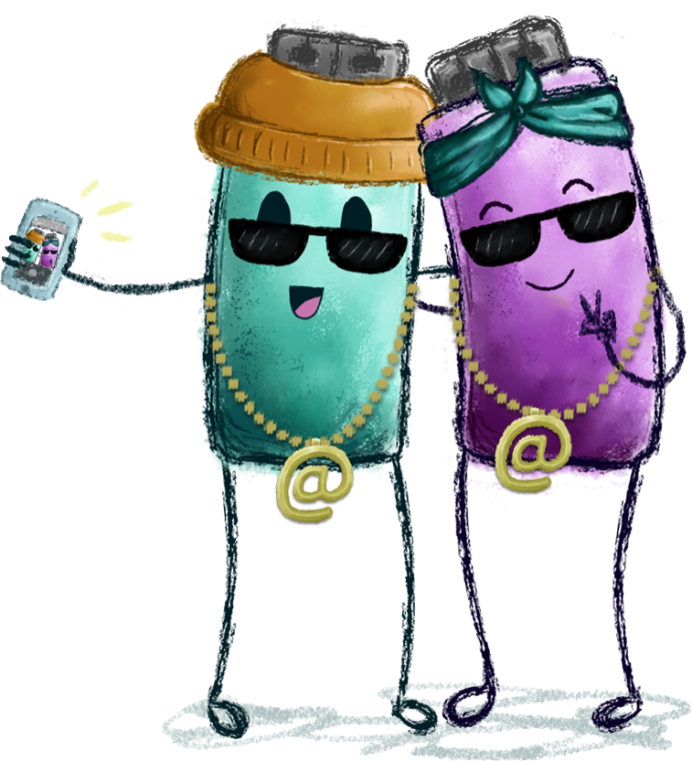
Safer Internet Day Selfie
Webwise love seeing all your photos from your online safety campaigns and Safer Internet Day activities.
Send in your photos, videos and posters to Webwise.
Notes:
Notes: Take a Safer Internet Day Assembly selfie and send it into Webwise on internetsafety@pdst.ie or share you support on your school’s social media too using the hashtag #SaferInternetDay
Webwise love seeing all your photos from your online safety campaigns and Safer Internet Day activities. Send in your photos, videos and posters to Webwise and your school could be in with a chance of winning some great prizes.
There are lots of ideas and activities on the Safer Internet Day page: www.webwise.ie/saferinternetday
Register your school's Safer Internet Day events on the Webwise event’s map and receive free SID wristbands for your school. Register here: www.webwise.ie/saferinternetday
Share your SID activities
We love seeing all your photos from your online safety campaigns and Safer Internet Day activities. Connect with us on:
Twitter @Webwise_Ireland
Facebook: facebook.com/webwise_Ireland
Instagram: webwiseireland
Share ideas tips/plans using #SaferInternetDay
Share your internet safety messages on webwise.ie/saferinternetday

Slide 16
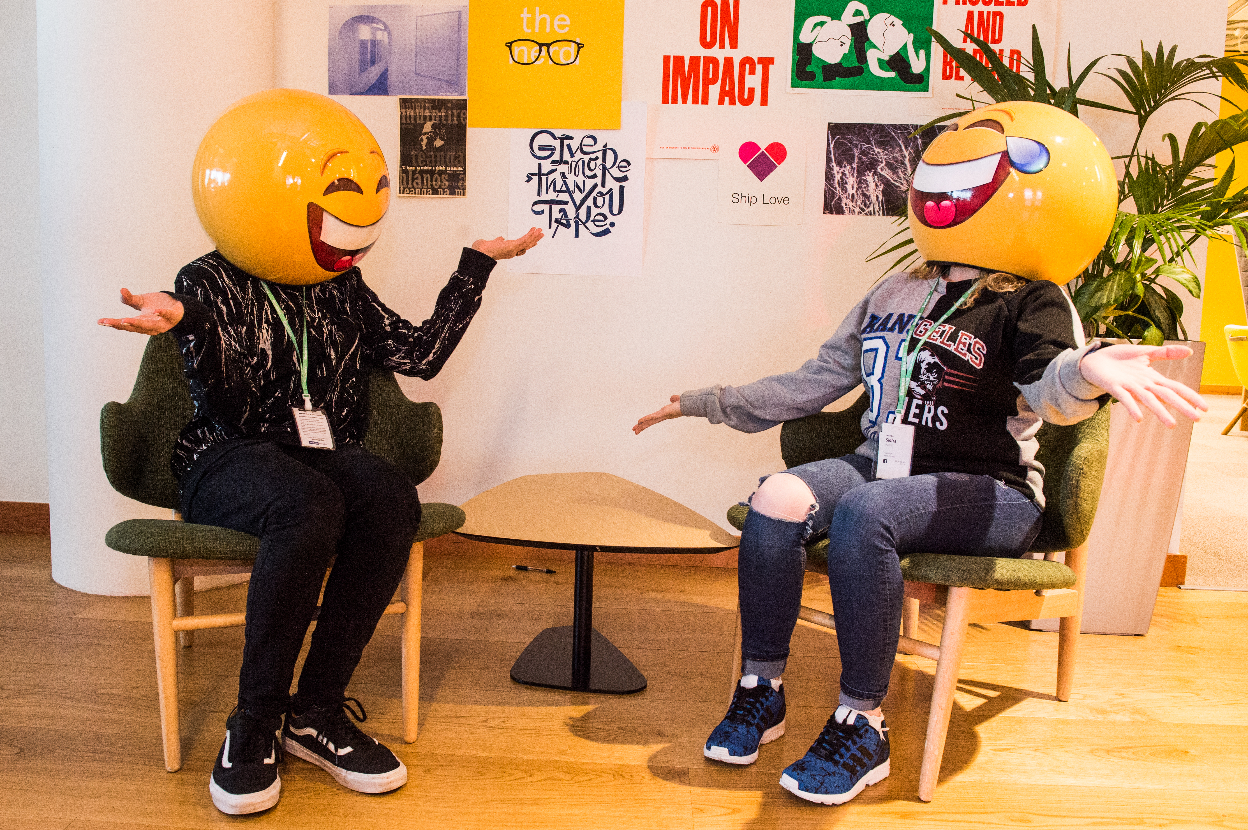

THANKS!
ANY QUESTIONS?
© Webwise_Ireland
This work is made available under the terms of the Creative Commons Attribution Share Alike 3.0 Licence http://creativecommons.org/licenses/by-sa/3.0/ie/. You may use and re-use this material (not including images and logos) free of charge in any format or medium, under the terms of the Creative Commons Attribution Share Alike Licence.
Notes:
Notes: Webwise would encourage you to download copies of the Parents' Guide to a Better Internet booklets and or Parent’s checklists to distribute to pupils to take home to their parents. The booklet can be ordered for free at webwise.ie/parents

Slide 17
EXTENDED SAFER INTERNET DAY ACTIVITIES
Notes:
Notes: The following supplementary extended Safer Internet Day slides are available for teachers to use to support the SID talk they will have just heard. The activity is to be completed in the classroom to continue the discussion on how to stay safe online.
The following slides feature a short story from the HTML Heroes 1st and 2nd class online safety programme which can be accessed here: https://heroes.webwise.ie/1st-and-2nd-class-html-heroes/

Slide 18
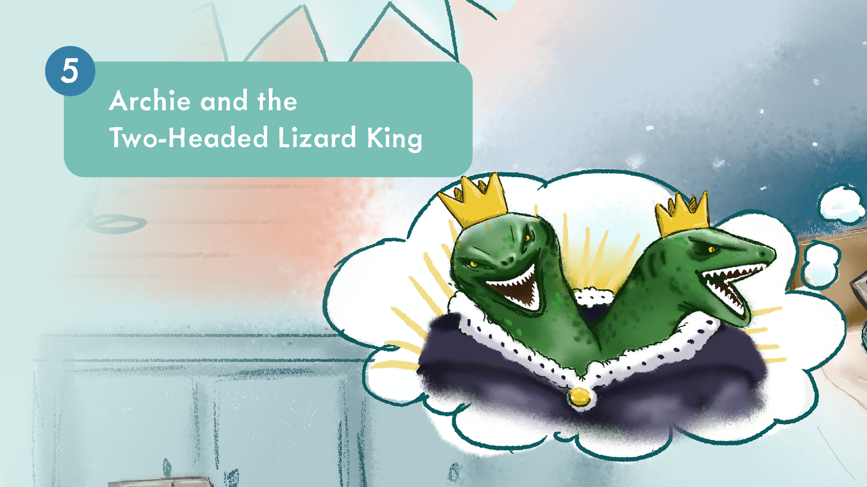
Notes:
Notes: The following short story comes from Lesson 5 My Time Online from the HTML Heroes 1st and 2nd class online safety education programme available here: https://heroes.webwise.ie/1st-and-2nd-class-html-heroes/
Display the HTML Heroes short story: Archie and the Two-Headed Lizard King on the whiteboard while you read through the story on the importance of balance between on-and offline activities.

Slide 19
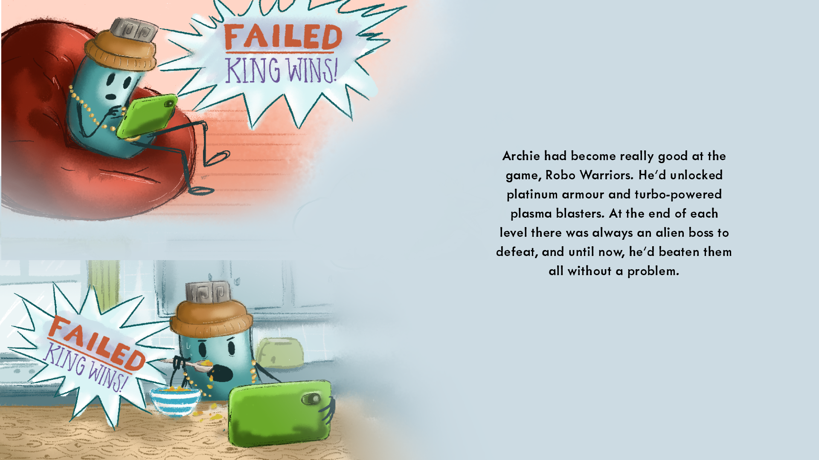

Slide 20
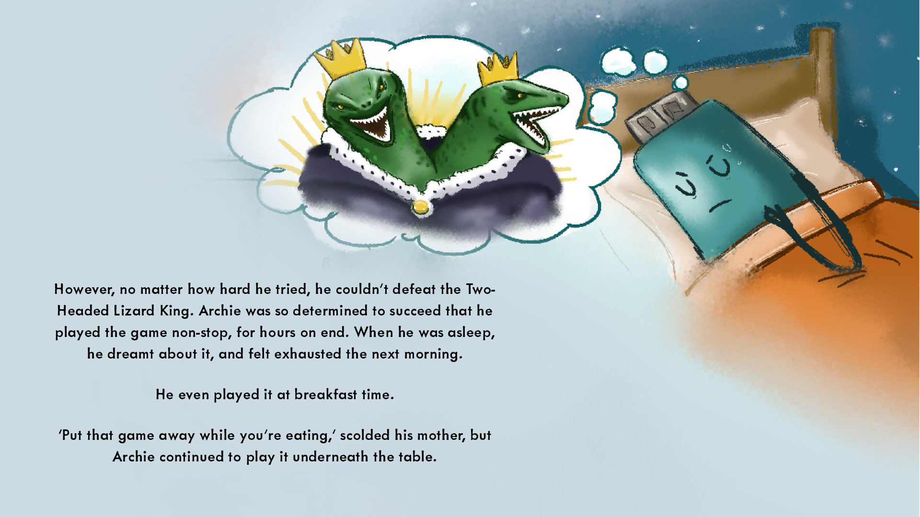

Slide 21
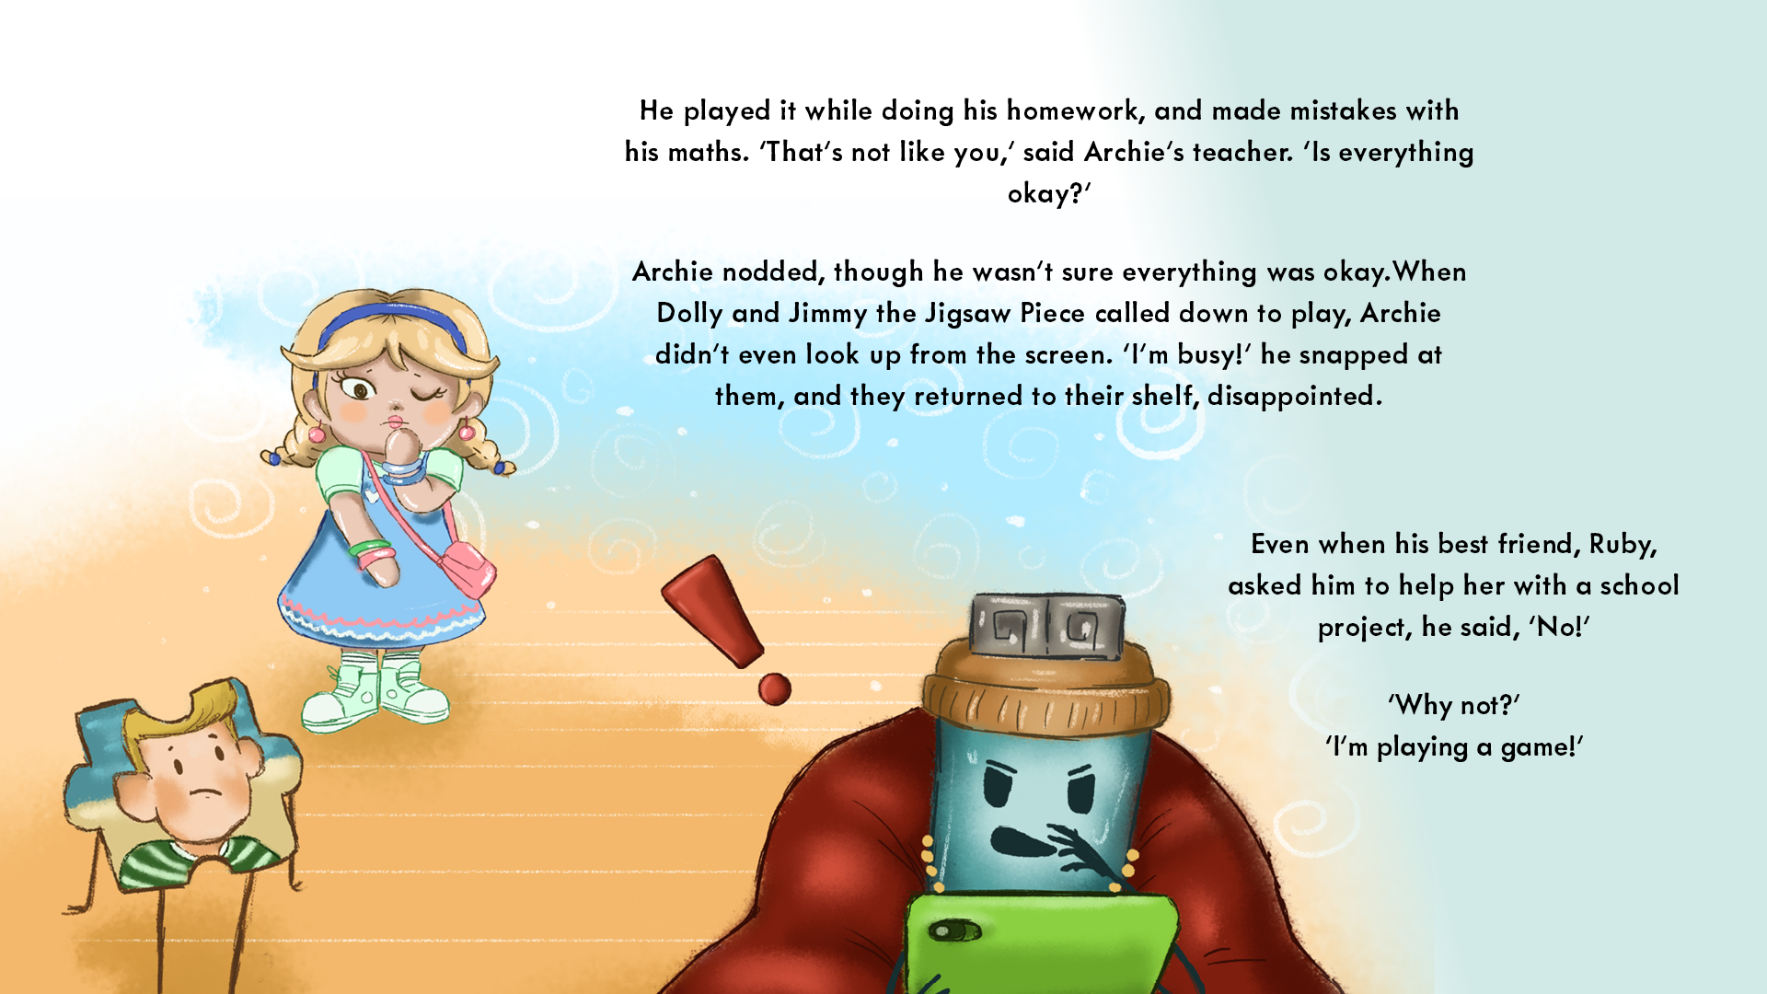

Slide 22
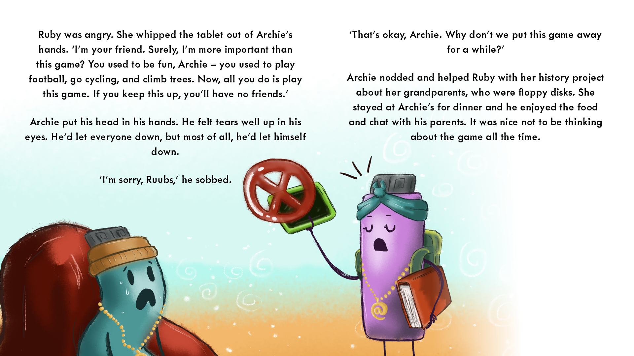

Slide 23
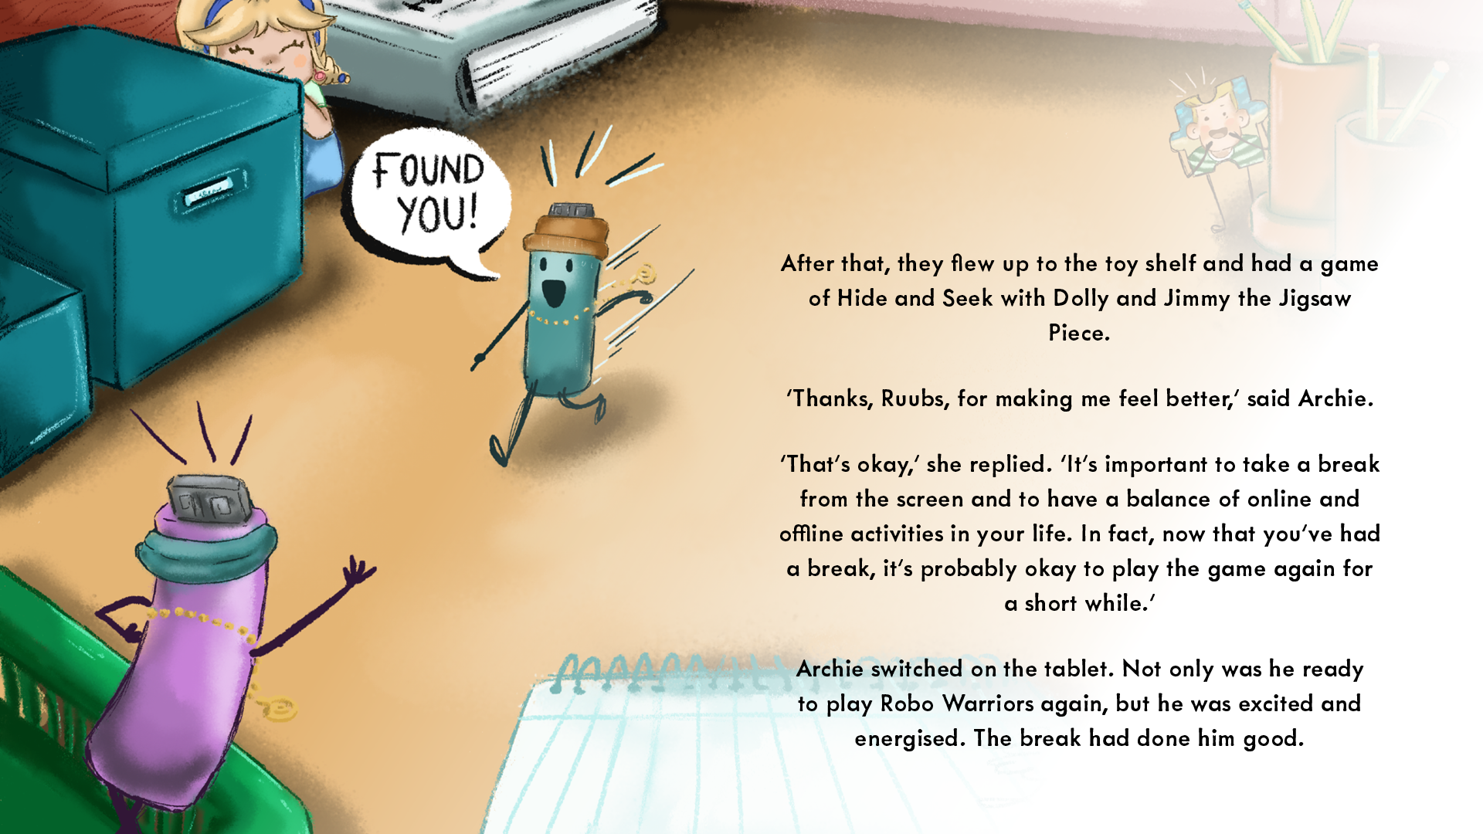

Slide 24
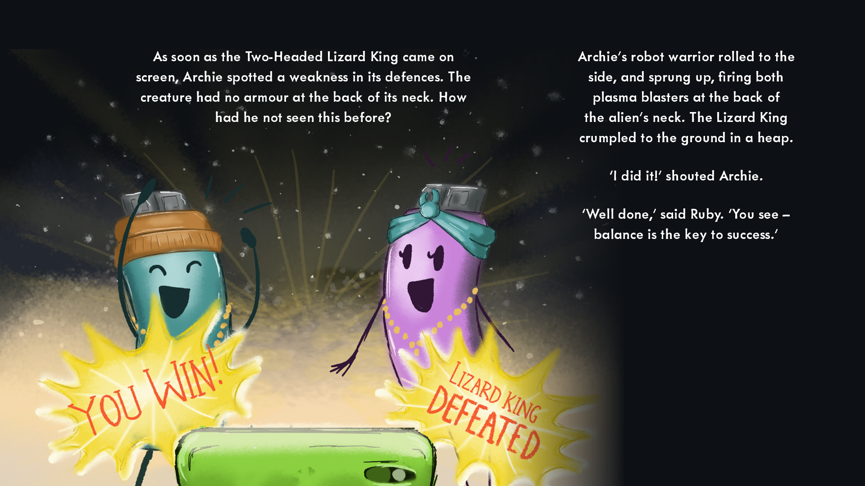

Slide 25
Archie and the Two-Headed Lizard King
What was Archie behaving at the beginning of the story?
How did Archie’s friends feel in the story?
  How do you know?
In what way did Ruby help her friend Archie?
How was Archie feeling at the end of the story?
Suggest some ways you could help to balance your time online with your time online e.g., doing your chores, playing outside.
Imagine there was a power cut at your home or school.
  How would this change your day?
Notes:
Notes: Once you have finished reading the story, go through the discussion questions to help pupils reflect on the internet safety scenario and safety messages explored in the story.
Finally, ask pupils to write down one thing they learned about spending time online today. Invite pupils to share their responses and recap with the following points:
- Make the most of your time online - play, learn, create!
- Don’t forget to make time for friends, family, playing, creating and reading offline too.
- There are times when it is okay to be online and times when it is not okay to be online, e.g., mealtimes and when going to bed.
- A healthy balance between online and offline activity is key to your wellbeing.
- Develop good device habits e.g. looking up from your screen when someone is talking to you, sharing your screen device if with a friend, devices off before bedtime.
TEACHER’S NOTE: Discussing Managing Time Online
It is important to be careful, avoid judgement and show sensitivity when discussing times it is and isn’t appropriate to spend time online as many parents and children might use devices during mealtimes, etc.

