Slide 1

SAFER INTERNET DAY
TOGETHER FOR A BETTER INTERNET
3rd & 4th CLASS
Notes:
Notes for speaker – brief introduction and welcome.
Explain how long the talk will take and the types of things you will be doing over that time.
For example:
‘Today we are joining millions of people around the world in celebrating Safer Internet Day, a day for promoting a safer and better internet for all users, especially children. During this assembly we are going to talk about being online and using the internet. We will look at the positives and possible negatives of the internet as well as some general advice on how to stay safe while using the internet.’

Slide 2

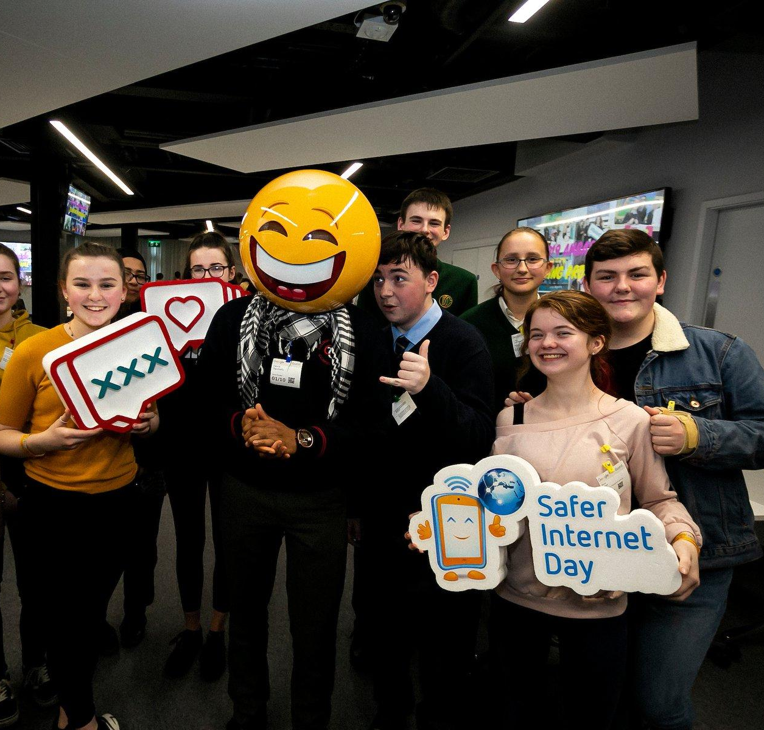
What is Safer Internet Day?
A day to create awareness of a better internet for ALL users
The theme for Safer Internet Day is “Together for a Better Internet”
Safer Internet Day is celebrated all across Europe on the second Tuesday, of the second month, every year.
Notes:
Notes: Safer Internet Day (SID) is an EU wide initiative to promote a safer internet for all users, especially young people. Safer Internet Day in Ireland is promoted and coordinated by Webwise, the Irish Internet Safety Education Awareness Programme. The Theme for Safer Internet Day is “Together for a Better Internet“.
The aim of the day is a call on young people, parents, teachers, schools, government, businesses to join together to make the internet a safer and better place for all, and especially for children and young people.
Safer Internet Day is a day to promote safe and responsible use of the internet, a day for us to consider all the different ways we use the internet and how we can make the internet a safer and better place for all, and especially for children and young people.

Slide 3




WHAT IS THE INTERNET?
Click the Link to play video:
https://vimeo.com/313425824
Notes:
Notes: Today we are going to look at what the internet is, what we mean when we are talking about being online. Before we can talk about being safe online we have to consider all the different ways we can be online and use the internet - what exactly do we mean when we are talking about the internet. Let’s begin by watching this video by the HTML Heroes, Archie and Ruby, who are going to look at what is the internet.
This video introduces the pupils to the HTML Heroes, two plucky usb keys, Archie and Ruby, who will rap catchy rhymes to teach your pupils about the internet. The children’s experience will be varied.
Video available here: https://vimeo.com/313425824

Slide 4
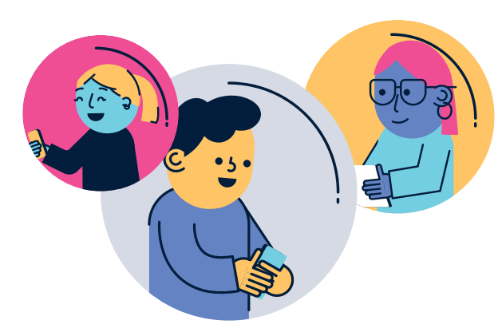
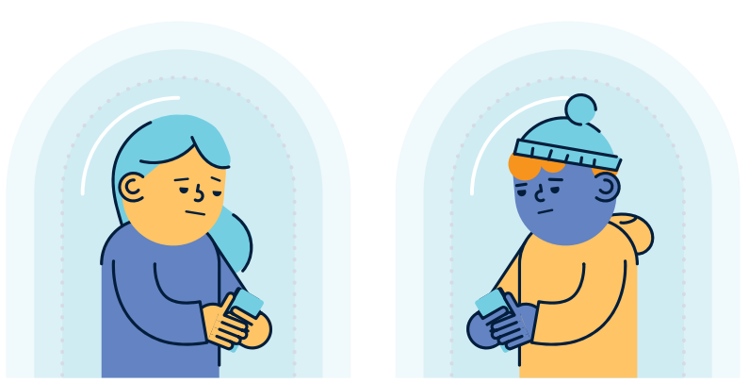
Let’s consider…
The positives and negatives
of the internet?
Notes:
Notes: Now, let’s consider the positives and negatives of the internet?
Ask pupils to list:
What might be the positive things about the internet?
What might be the negative things about the internet?
Examples of the benefits of using the internet might be; communicating with friends who live far away, instant access to music or films you want to watch, researching for homework/project work, developing and learning new skills or creating content.
Examples of negative effects of the internet might be that the children could see something they don’t want to see, cyberbullying, spending too much time online.
This lesson also gives the class and teacher a chance to recap on the Stay Safe programme and Stay Safe rules

Slide 5
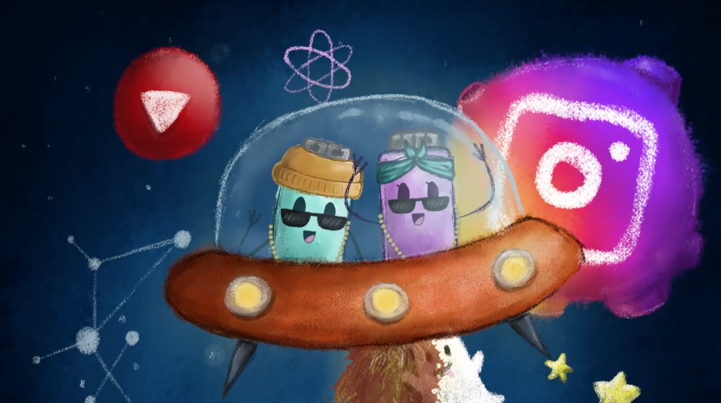
How can we avoid the negative things on the internet?
Notes:
Notes: How can we avoid the negative things on the internet?
Lead the discussion to how we could prevent the negative things associated with the internet or even lessen their harmful effects.
You can use this as an opportunity to stress the importance of ground rules when using the internet in school and at home.
Emphasise the point that it can be easy to come across something inappropriate or upsetting on the internet and that if they do it is important to tell an adult about it when it happens.
Reassure the pupils that they are not to blame if they come across something online that makes them feel uncomfortable.

Slide 6
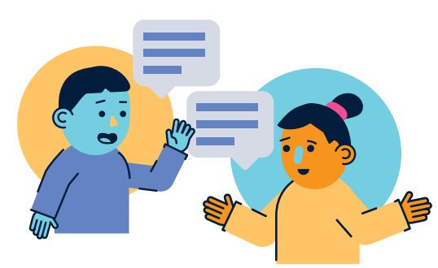
Who would you tell if you saw something on the internet that you did not like?
Notes:
Notes: Who would you tell if you saw something on the internet that you did not like?
‘Who would you tell if you saw something on the internet that you didn’t like or that made you feel unsafe?’. Ask pupils to discuss this in their pairs and feedback to you when they have finished.

Slide 7
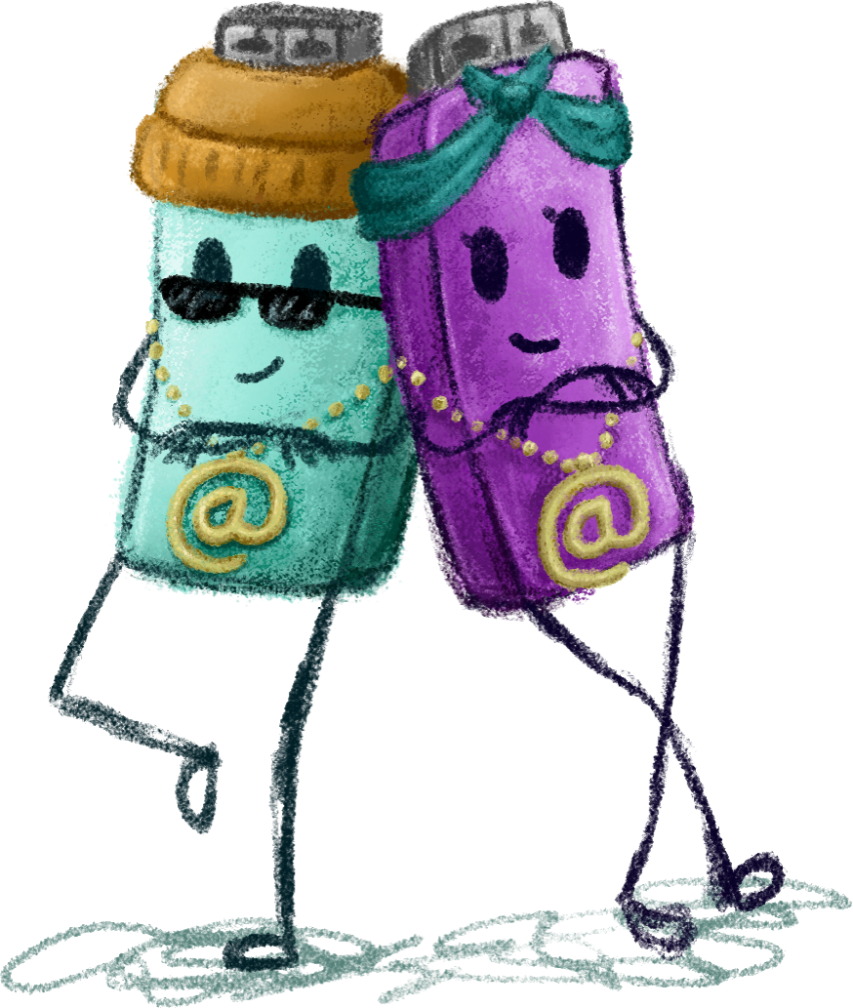
The Positives and Negatives of the Internet
The internet is a brilliant resource that you can use to do lots of different things. It’s not always your fault if you come across nasty stuff on the internet.
The best thing to do if you see something online that worries you or makes you feel uncomfortable is:
close it down by clicking the X button at the top left of the screen
tell your parents/guardians or your teachers as soon as possible
Notes:
Notes: Take a moment to recap these main points to pupils.
The internet is a brilliant resource that you can use to do lots of different things
It’s not always your fault if you come across nasty stuff on the internet
The best thing to do if you see something online that worries you or makes you feel uncomfortable is:
close it down by clicking the X button at the top left of the screen
tell your parents/guardians or your teachers as soon as possible

Slide 8

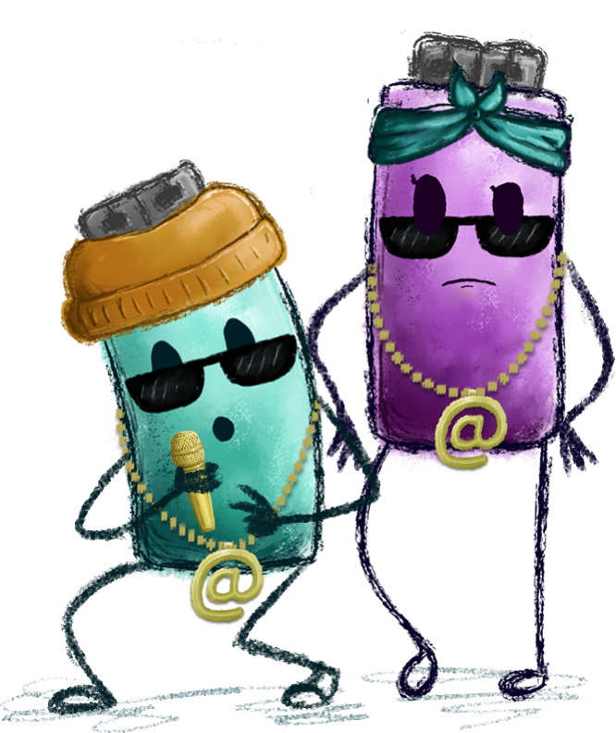
RULES OF THE INTERNET
Sing along to the ‘Rules of the Internet’ song and see if you can name the 6 rules of the internet listed in the song!
Notes:
Notes: Rules of the Internet!
Now we are going to listen to the ‘Rules of the Internet’ song. Sing along and see if you can name the 6 rules of the internet listed in the song!
Listen to the Rules of the Internet Song here:
www.webwise.ie/rules-of-the-internet
Play the ‘Rules of the Internet’ song for pupils. Ask pupils to listen for the first time hearing it.
Then play again for pupils asking them to list each of the rules mentioned in the song.

Slide 9
According to the song, there are 6 rules of the internet:
1
Keep your password safe
Know what you can share - don’t overshare
personal information
Be careful of what you post
Keep it online for friends you don’t know
Don’t stay in chats you don’t like
Don’t download junk
2
3
4
5
6
Notes:
Notes: Here are the 6 rules, mentioned in the song. Keep these in mind when you spend time online!
Keep your password safe
Know what you can share - don’t overshare personal information
Be careful of what you post
Keep it online for friends you don’t know
Don’t stay in chats you don’t like
Don’t download junk
Extended SID activity:
Once pupils have written down each of the rules, ask them to create a poster containing each of the rules mentioned in the song. Encourage the pupils to include a symbol or emoji(s) to represent each rule.
Create your own rap about internet safety. Why not work on the lyrics together and perform your rap or song. This is a great example of an activity to promote better, safer use of the internet for Safer Internet Day. Webwise would love to hear it! Send it in to us via Twitter, Facebook or Instagram, email internetsafety@pdst.ie or keep an eye out for our Safer Internet Day competition on webwise.ie and your school could win prizes!

Slide 10
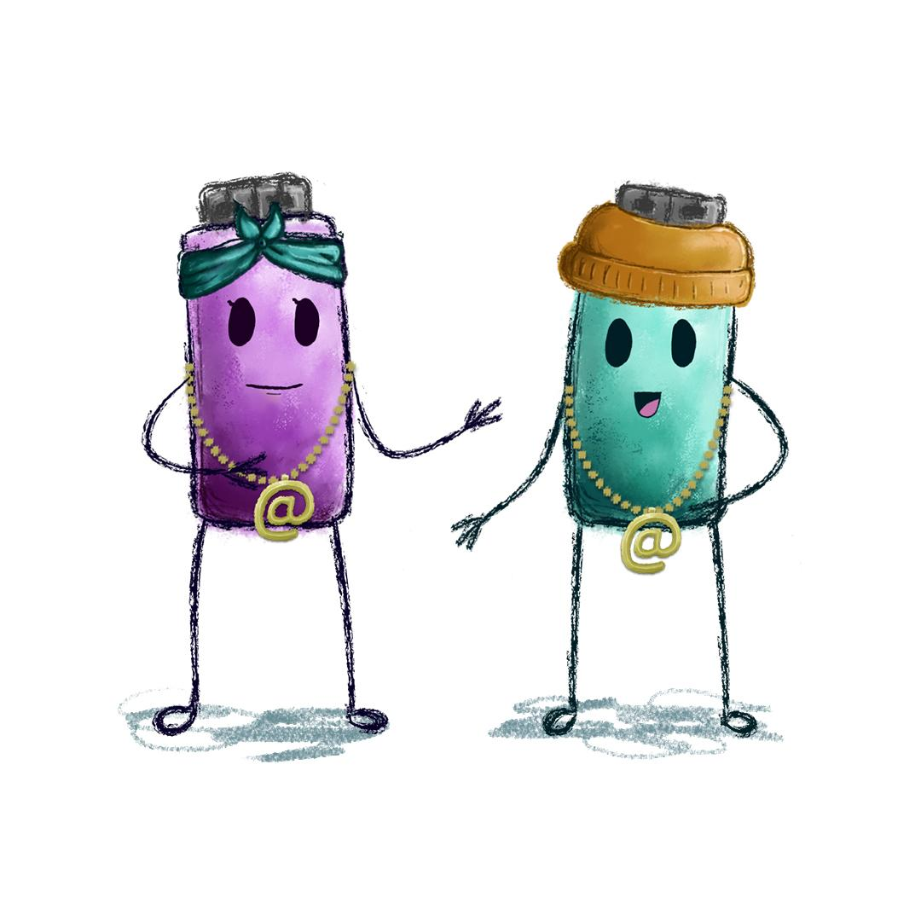
Ruby and Archie’s Online Safety Tips
Stick to safe websites - look out for a padlock and https at the beginning of the web address
Don’t download from unsecure websites
Set your personal information online to private
Use strong passwords that include a combination of numbers, symbols and letters (upper and lower case)
Don’t reply to messages from strangers
Notes:
Notes: These safety points recap the points discussed earlier and the internet safety rules mentioned in the ‘Rules of the Internet!’ song.
Only use safe websites that have the image of a padlock and https at the beginning of the web address
Don’t download anything from unsecure websites
Alway set your personal information online to private
Use strong passwords to keep online accounts safe - this means using a combination of numbers, symbols and letters(upper and lower case)
Be careful who you share personal information online with and don’t reply to messages from strangers

Slide 11
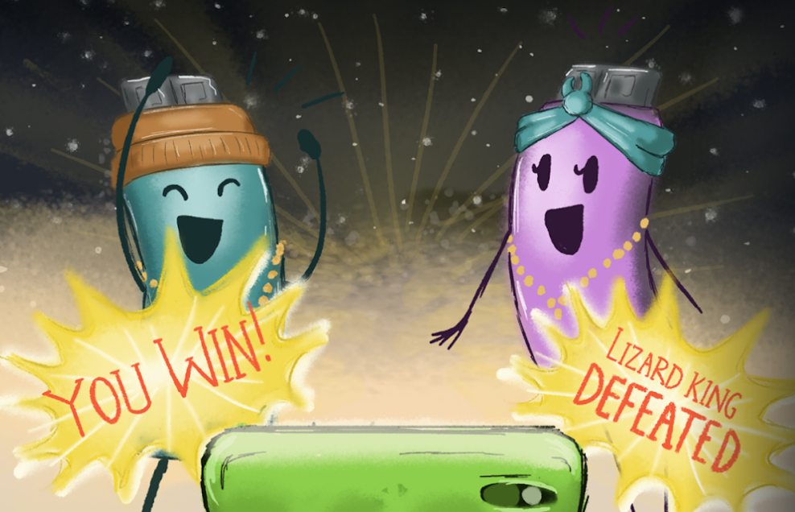
Playing Online
What are the benefits of playing games?
Notes:
Notes: Now we are going to look at the benefits of playing online games and how we can stay safe and choose the right games for us to enjoy playing games online.
Invite pupils to name a game you like to play and one thing you like about playing that game? Get feedback from pupils.
Then ask pupils to name one benefit or good thing about playing games. Elicit responses and emphasise that playing games can be fun and entertaining; they let you use your imagination to create worlds and characters and tell stories; they encourage you to think creatively and to solve problems; they give you a chance to play with other people and learn to work together as a team.

Slide 12
Educational Games: Let’s Play
Notes:
Notes: Demonstrate an educational game for pupils. On the whiteboard, demonstrate the steps involved to access RTE Junior’s Play section (available at rtejr.rte.ie/play/).
Choose one of the educational games on the website (e.g. Maths Superstar or Spelling Adventure) and play the game with the help of the pupils.

Slide 13
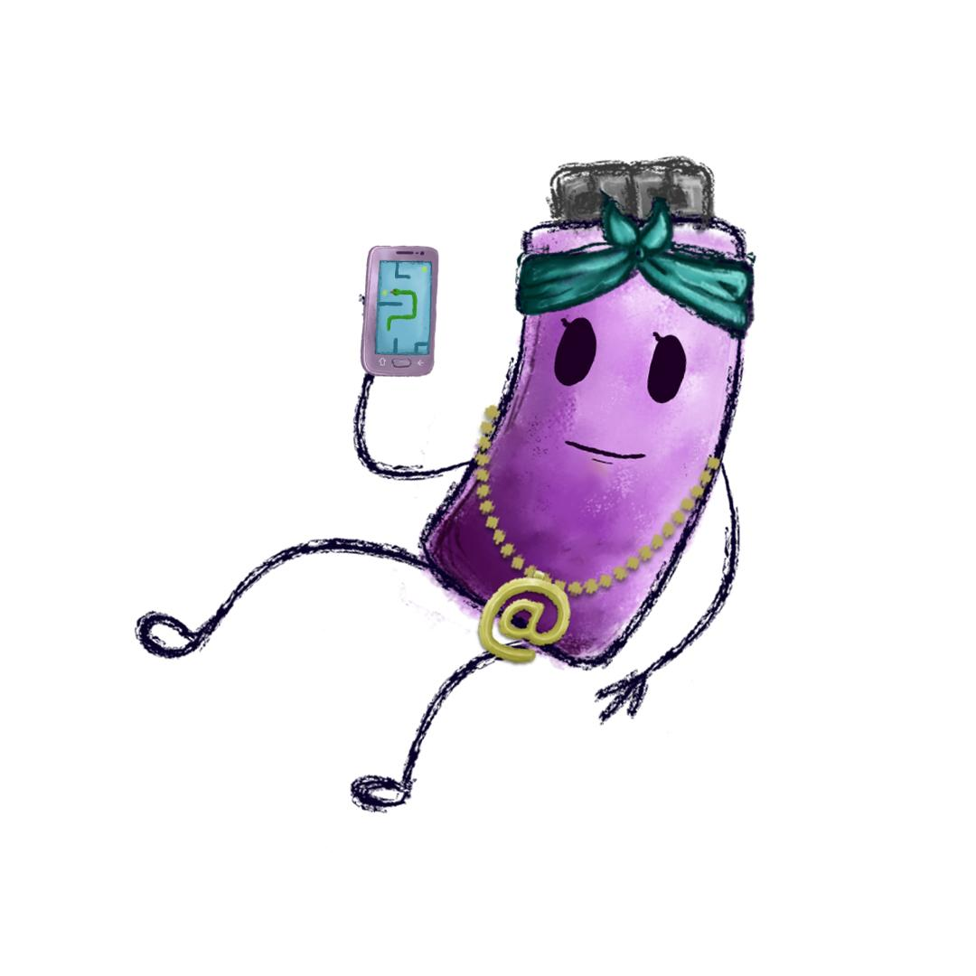
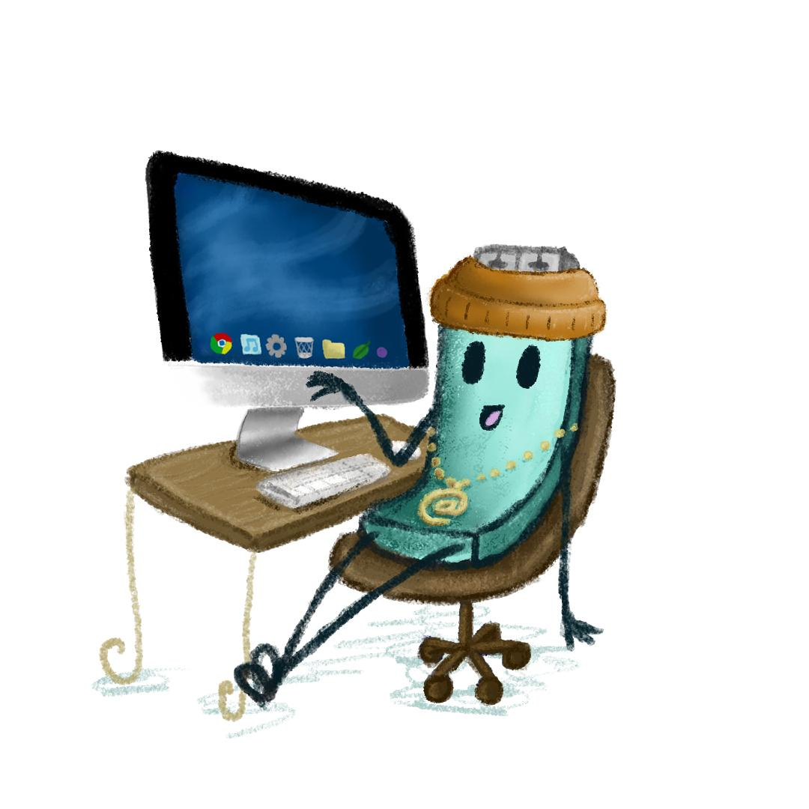
Playing Online
What do you enjoy about using a game to learn?
How do you think playing educational games could help you in your learning?
What types of games can you play online?
Notes:
Notes: After playing the game online, ask pupils what they enjoyed about using a game to learn maths or spelling and how they think playing educational games like these could help them in their learning. Next, explain to pupils that there are many different types of games available to play online including educational games that help you improve things like your maths and reading skills like the ones they just played, and games that allow you to create a new world or build something. There are also games that are designed for entertainment, these can include downloadable games and apps for devices that we can play on our own and finally, online gaming where you can play video games online with other people. The different types or categories of games include: Educational Games; Content Creation Games; Entertainment Games; Online Gaming. Ask pupils if they are aware of any examples that might fit into each of these categories of games available to play online and record.
Finally, remind pupils that the internet is a brilliant resource that allows you to play and learn. You can explore new worlds, be creative or learn something new but when we play games online we can’t always control what is going to happen. A lot of apps and games make money by getting players to pay for the game meaning their parents have to pay for the game for them to play it. They could choose a game that’s not meant for children but rather for older teenagers or adults. It is important that we check with our parents/guardians first and ask permission before deciding to download or buy a game online.

Slide 14
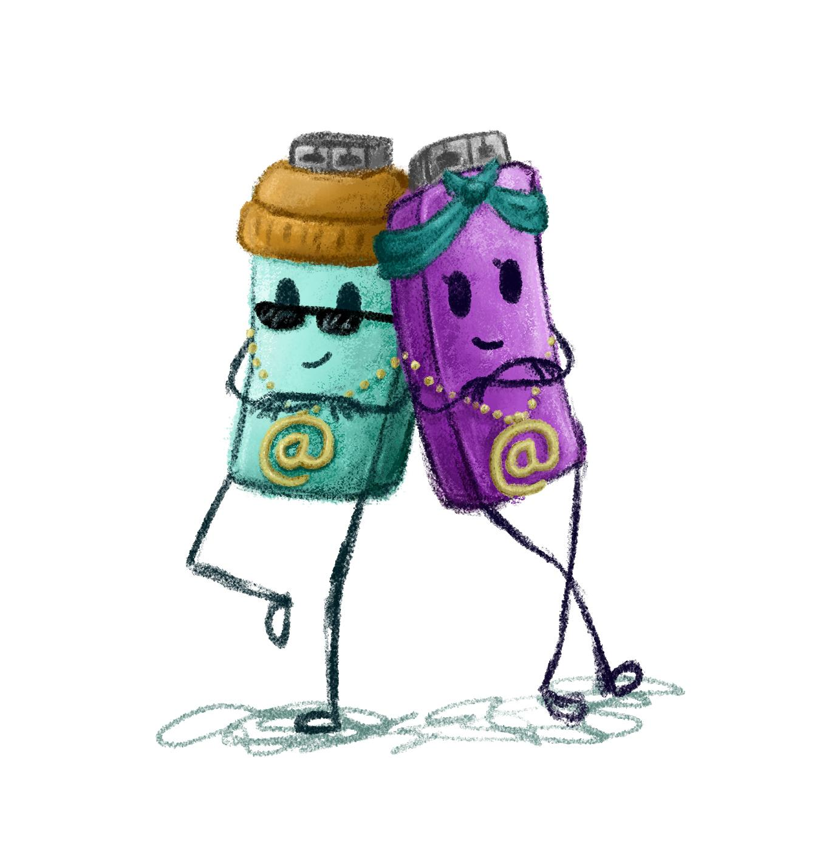
Archie and Ruby’s
Top Tips for Playing Online
Ask permission from your parents/guardian first before downloading a game.
Always check the age rating of the game before you play.
Make sure your location sharing or tagging is off.
Never buy a game or pay for anything in the game without getting permission from your parent/guardian first.
Keep your profile private and don’t use real photos or your full name.
Don’t give out personal information to people you only know online.
If you see any bad stuff or rules being broken, always tell a parent or trusted adult, even when you feel you may have done something wrong.
Notes:
Notes: Recap with the following points:
Playing games online is fun and can build important skills like team building and problem solving.
There are a lot of options of games to play and people you could meet so it’s important to stay safe while playing games online.
Here are some tips from Archie and Ruby, the HTML Heroes to help:
Always check the age rating of the game before you play.
Keep your profile private and don’t use real photos or your full name.
Don’t give out personal information to people you only know online.
Your password holds the key to your personal information online - Keep it private and only share it with your parents/guardian.
If you see any bad stuff or rules being broken, report it.
Never buy a game or pay for anything in the game without getting permission from your parents/guardians first.
Talk to your pupils about the importance of asking permission before downloading a game. Encourage them to always tell a parent/guardian or trusted adult if something has happened online, even when they feel they may have done something wrong.
Be aware that ‘free’ online games can offer additional functions, once the game is live, which users can purchase. Users typically make an in-app purchase in order to access special content or features in an app such as restricted levels, virtual money, special characters, boosts, etc. These hidden costs can lead to players inadvertently running up high bills on these games.

Slide 15

Take Home Safer Internet Day Activity
Notes:
Notes: Distribute the Safer Internet Day take home activity sheet available at www.webwise.ie/saferinternetday
Pupils are to take this home and read through with their parents/guardians, agree on terms listed and sign.

Slide 16
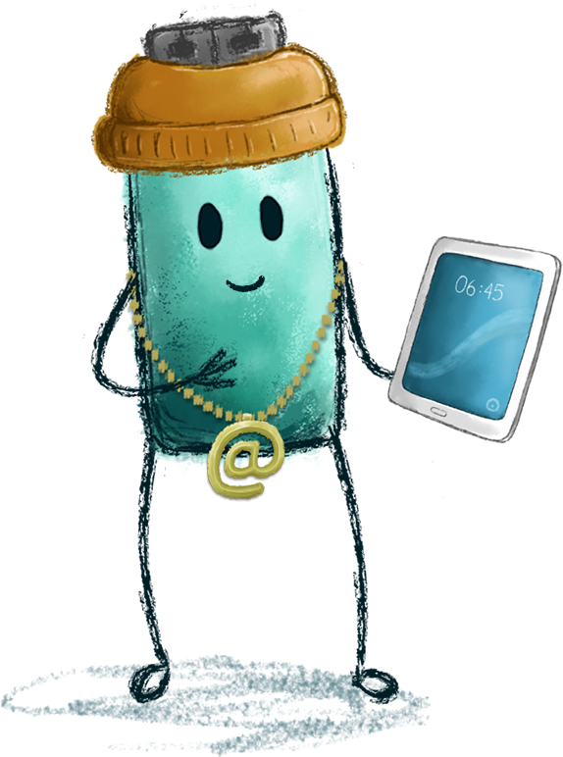

How to be safe online
Take the Online Safer Internet Day Primary Quiz and find out!
Go to https://bit.ly/2QYig0S
Notes:
Notes: How to be safe online
Now we are going to take this short Take the Online Safer Internet Day Primary Quiz and find out how to be safe online!
Go to https://bit.ly/2QYig0S to play the quiz. This Kahoot quiz contains questions that recap the main safety points of the presentation.
There is an option of leading pupils through the questions on screen or if they have access to devices they can play along themselves.

Slide 17

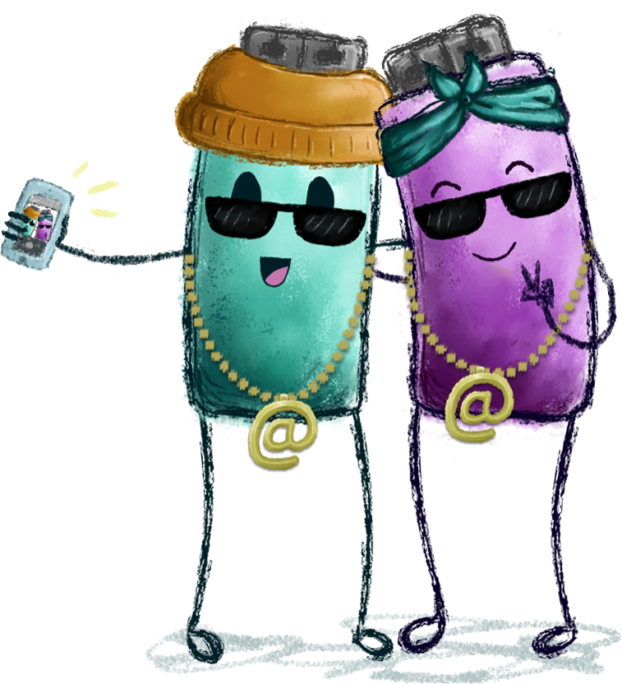
Safer Internet Day Selfie
Webwise love seeing all your photos from your online safety campaigns and Safer Internet Day activities.
Send in your photos, videos and posters to Webwise and you could be in with a chance of winning some great prizes.
Notes:
Notes: Take a Safer Internet Day Assembly selfie and send it into Webwise on internetsafety@pdst.ie or share you support on your school’s social media too using the hashtag #SaferInternetDay
Webwise love seeing all your photos from your online safety campaigns and Safer Internet Day activities. Send in your photos, videos and posters to Webwise and your school could be in with a chance of winning some great prizes.
There are lots of ideas and activities on the Safer Internet Day page: www.webwise.ie/saferinternetday
Register your school's Safer Internet Day events on the Webwise event’s map and receive free SID wristbands for your school. Register here: www.webwise.ie/saferinternetday
Share your SID activities
We love seeing all your photos from your online safety campaigns and Safer Internet Day activities. Connect with us on:
Twitter @Webwise_Ireland
Facebook: facebook.com/webwise_Ireland
Instagram: webwiseireland
Share ideas tips/plans using #SaferInternetDay
Share your internet safety messages on webwise.ie/saferinternetday

Slide 18



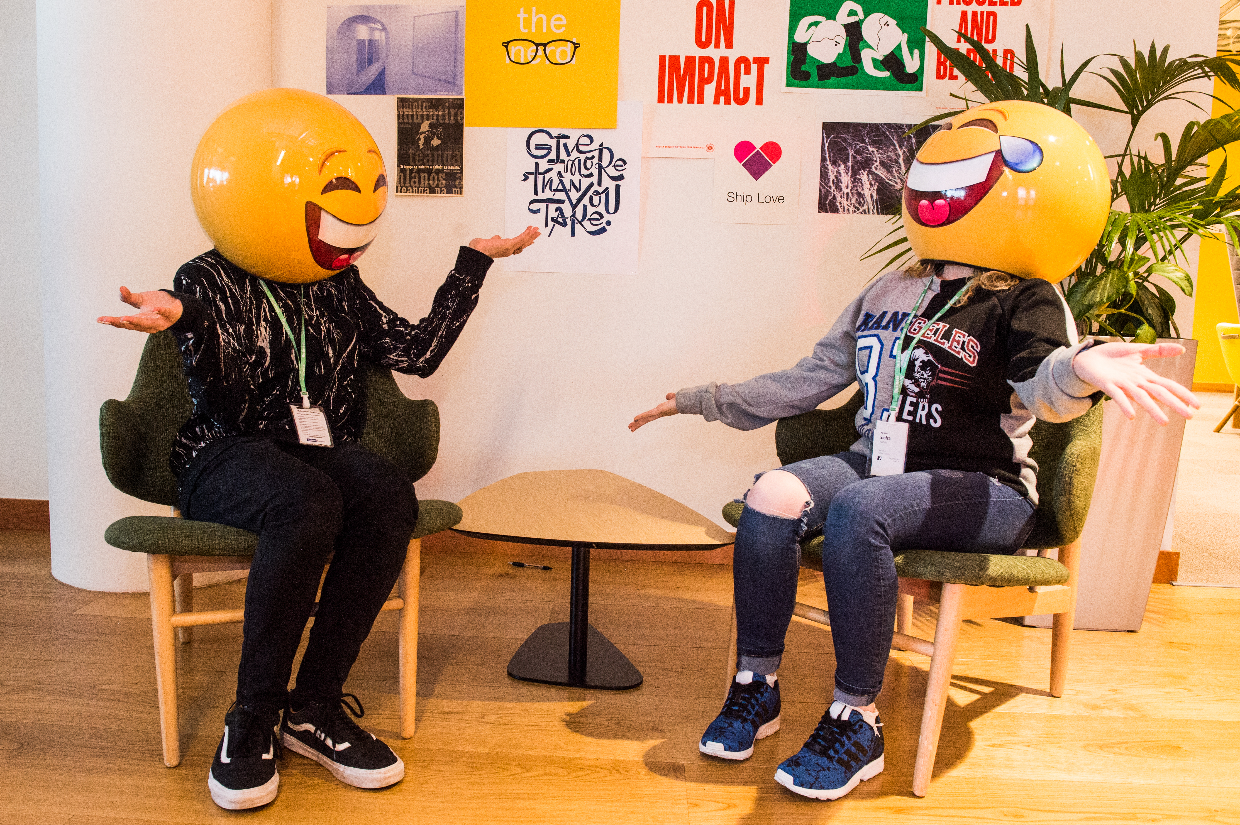

THANKS!
ANY QUESTIONS?
© Webwise_Ireland
This work is made available under the terms of the Creative Commons Attribution Share Alike 3.0 Licence http://creativecommons.org/licenses/by-sa/3.0/ie/. You may use and re-use this material (not including images and logos) free of charge in any format or medium, under the terms of the Creative Commons Attribution Share Alike Licence.
Notes:
Notes: Webwise would encourage you to download copies of the Parents' Guide to a Better Internet booklets and or Parent’s checklists to distribute to pupils to take home to their parents. The booklet can be ordered for free at webwise.ie/parents

Slide 19

EXTENDED SAFER INTERNET DAY ACTIVITIES
Notes:
Notes: The following supplementary extended Safer Internet Day slides are available for teachers to use to support the SID talk they will have just heard. The activity is to be completed in the classroom to continue the discussion on how to stay safe online.
The following slides feature a short story from the HTML Heroes 3rd and 4th class online safety programme which can be accessed here: https://heroes.webwise.ie/html-heroes

Slide 20
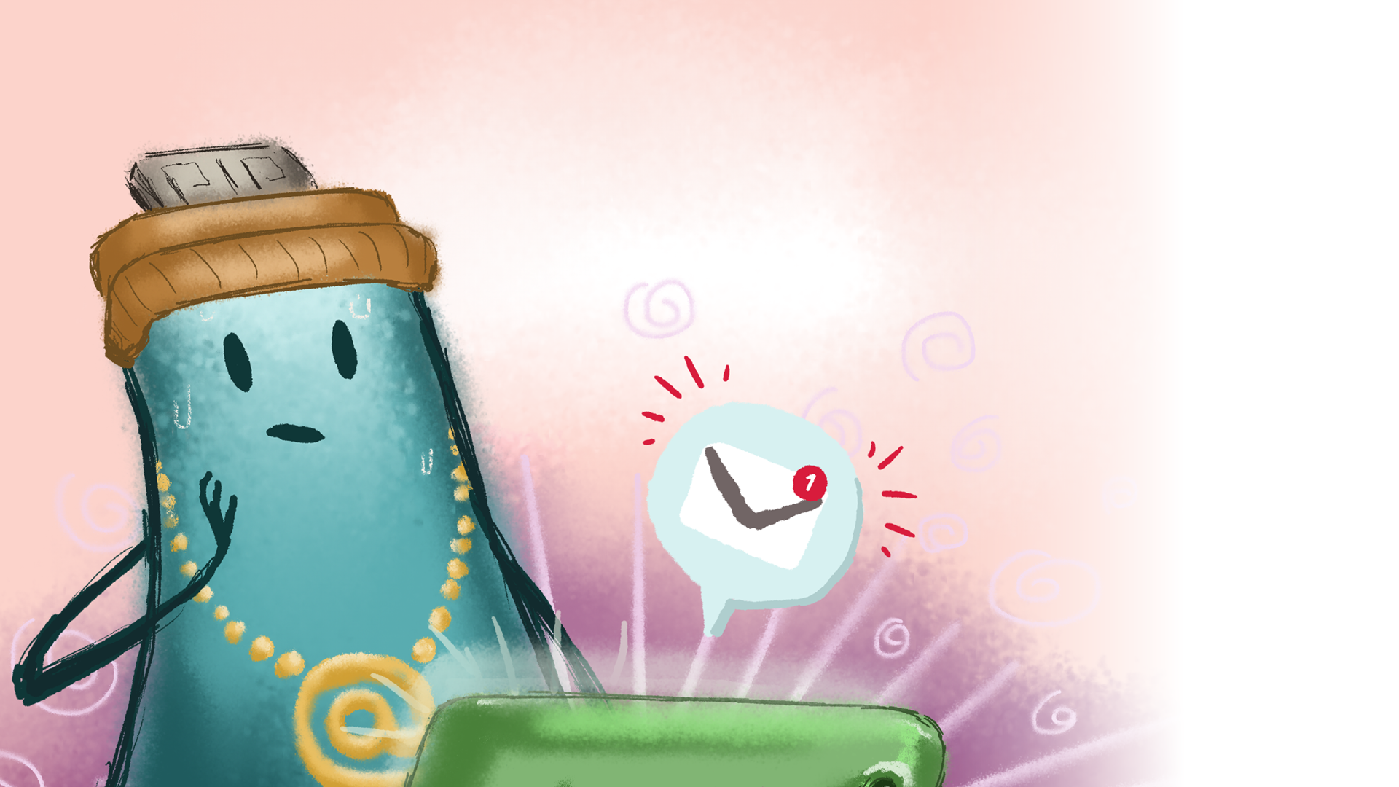

Archie plays Robo Warriors
Notes:
Notes: The following short story comes from the HTML Heroes 3rd and 4th class online safety education programme available here: https://heroes.webwise.ie/html-heroes
Display the HTML Heroes short story: Archie plays Robo Warriors on the whiteboard while you read through the story.

Slide 21
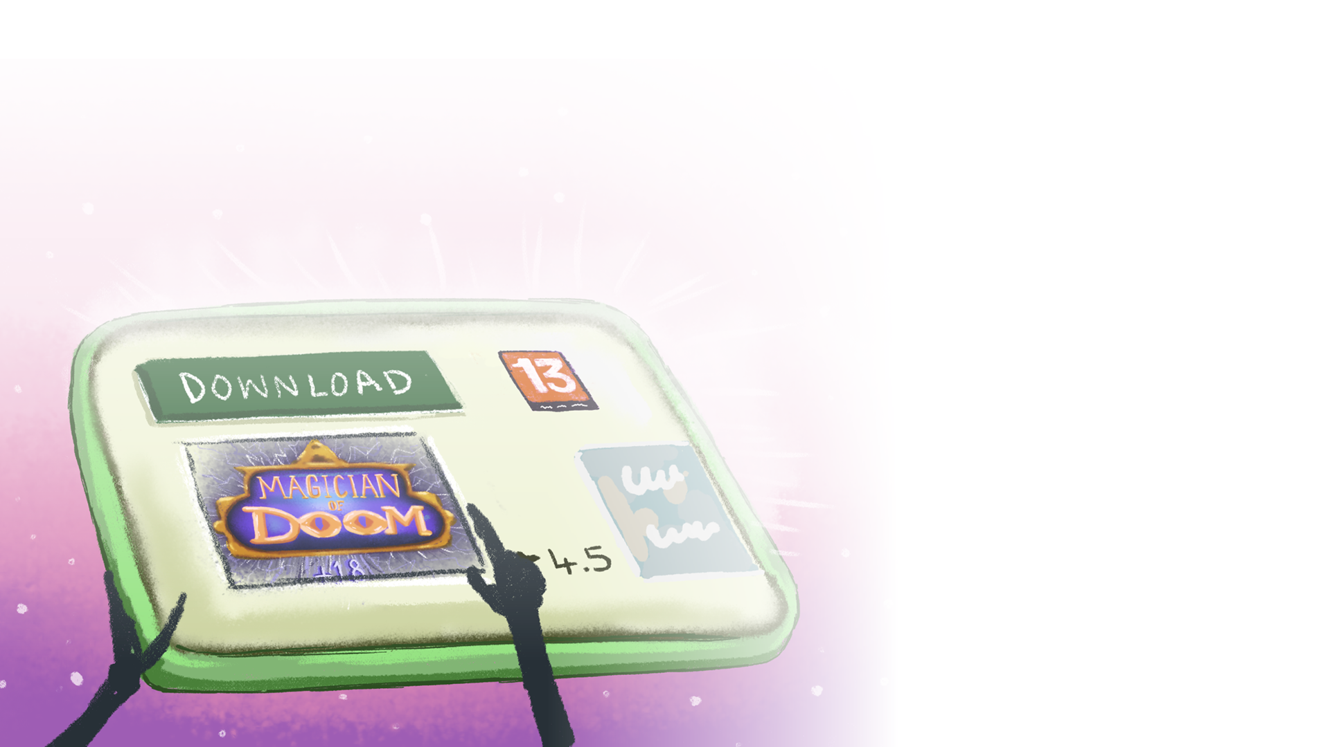
Archie’s favourite hobby is playing games. He loves playing with friends outside, and sometimes plays games on the internet.
He’d heard his friends talking about a new game called Magician of Doom and he couldn’t wait to try it. When he asked his mum if he could play it, she told him to check the age rating.
‘It’s 12,’ said Archie.
‘Then you can’t play it,’ said his mum. ‘It’s meant for older children, and wouldn’t be suitable for you. Why don’t you play Robo Warriors? You like that game.’
​Though disappointed, Archie nodded his head. He did like Robo Warriors. A lot.
In it, you played as a robot warrior, battling to protect your planet from an alien invasion. When you passed levels, you could unlock better armour and weapons. You played with other online players and worked as a team to defeat the enemy.

Slide 22
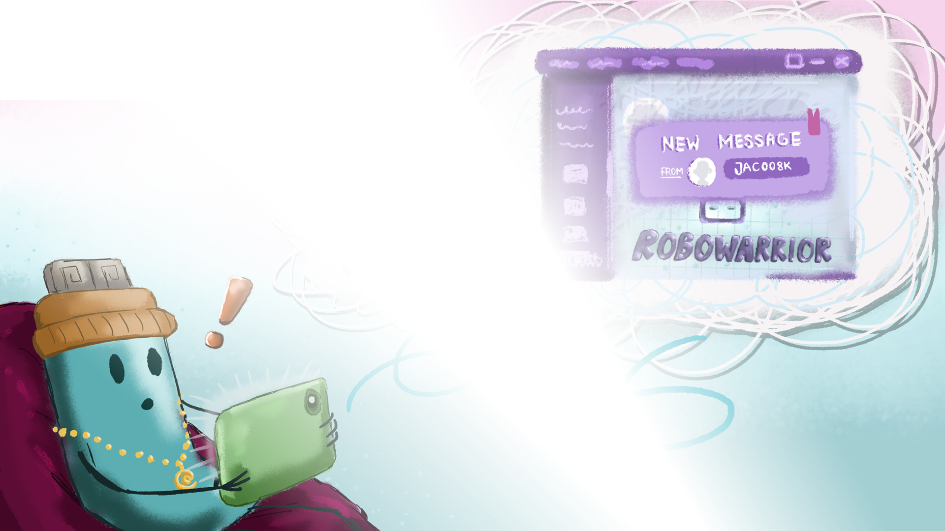
Today, there were two other players on Archie’s team. He had played with one of them before, crazycat971, but the other player was new.
While Archie was hiding behind a crashed spaceship in the game, he received a message from the new player, jac008k.
jac008k: Hi, my name’s Jack.
Archie typed in a reply. My name’s Archie.
jac008k: You’re really good at this game.
arch555: Thanks.
jac008k: I’m 9 years old. What age are you?

Slide 23

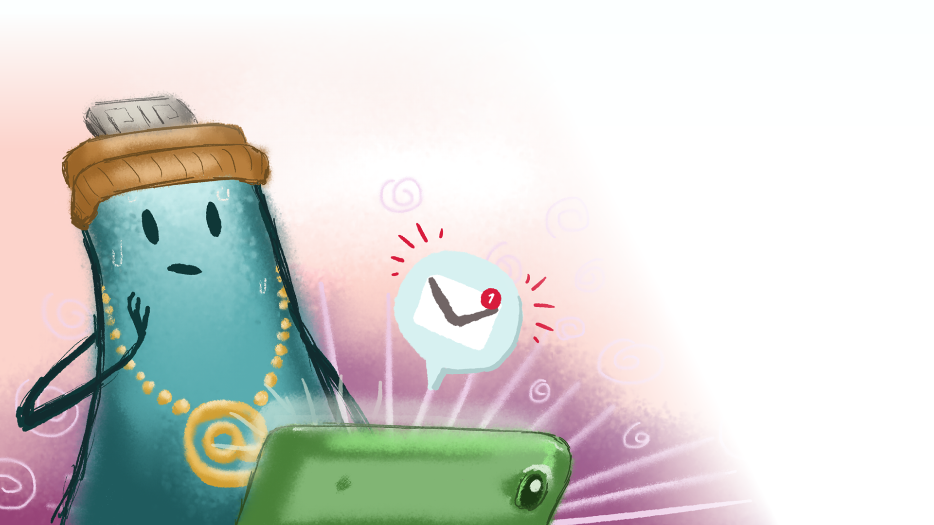
Archie wasn’t sure if he should say his age, but Jack was another kid, wasn’t he? So, it should be fine.
When Archie said his age, Jack asked him where he went to school.
Why does he want to know all this stuff? thought Archie.
Even if it felt a little wrong to do so, he told Jack where he went to school.
jac008k: What’s your address, Archie?
Archie had a funny sensation in his tummy. It didn’t feel right that this stranger was asking him so many personal questions. How was he going to get out of this situation?
jac008k: Archie, are you still there?

Slide 24
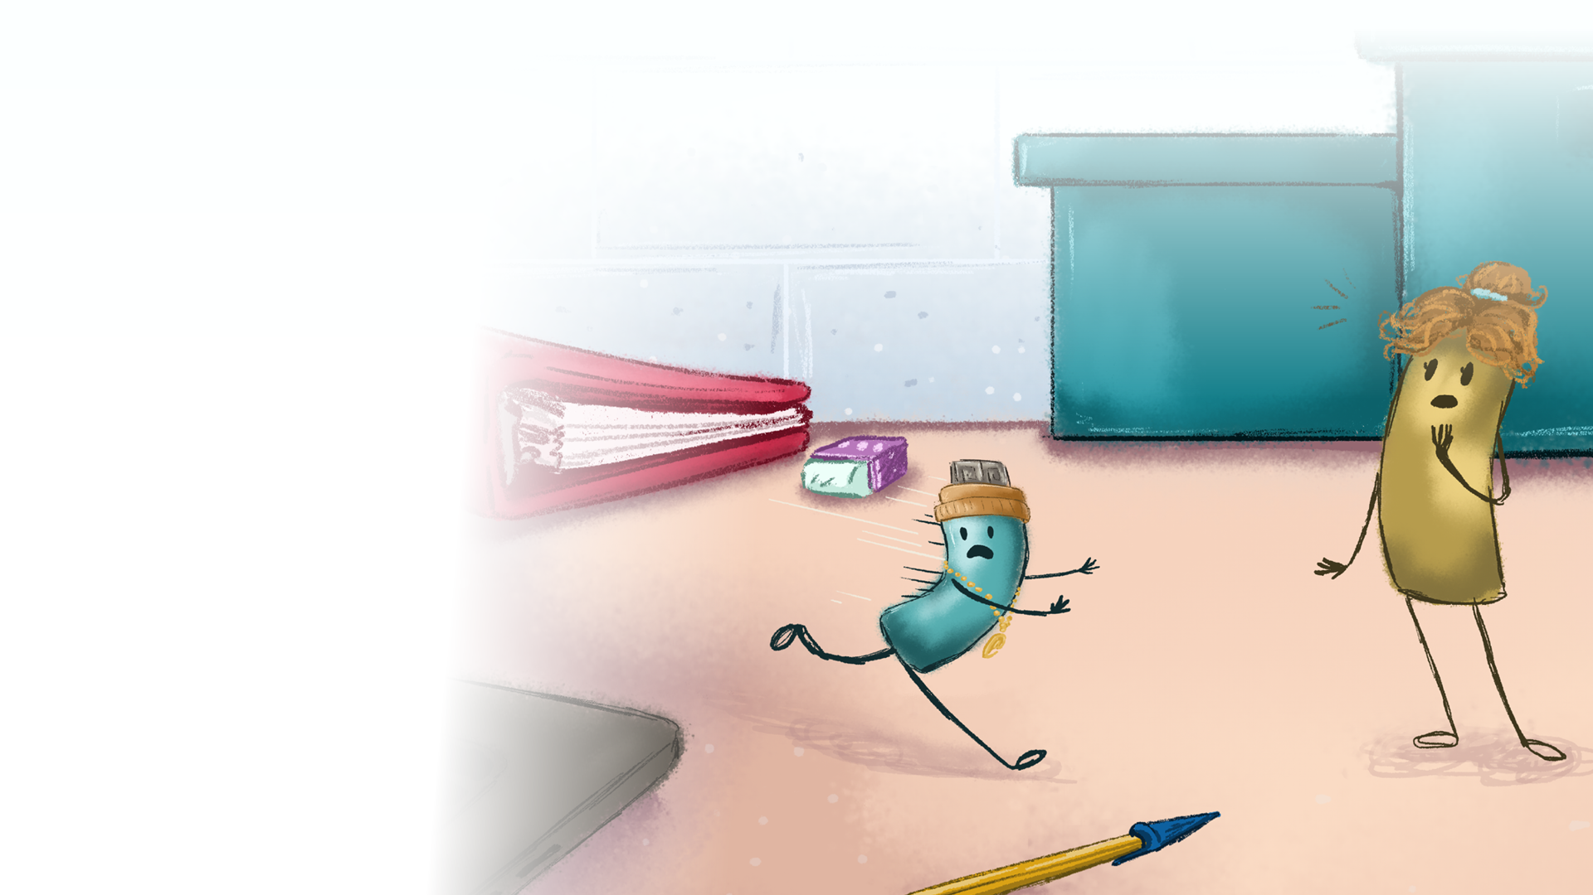

Archie jumped out of the game and ran away from the laptop to hide. Halfway across the teacher’s desk, he bumped into his mum.
‘Archie,’ she said. ‘There are tears in your eyes. What’s wrong?’
Archie wiped his eyes and told her the whole story. ‘I don’t think I should have told that kid so much about myself.’
‘Correct,’ said Archie’s mum, ‘because you can’t even be sure that person was a kid.’
‘I’m sorry,’ said Archie.
‘It’s okay. You did the right thing by telling me. You should always tell an adult if something upsets you on the internet.’

Slide 25
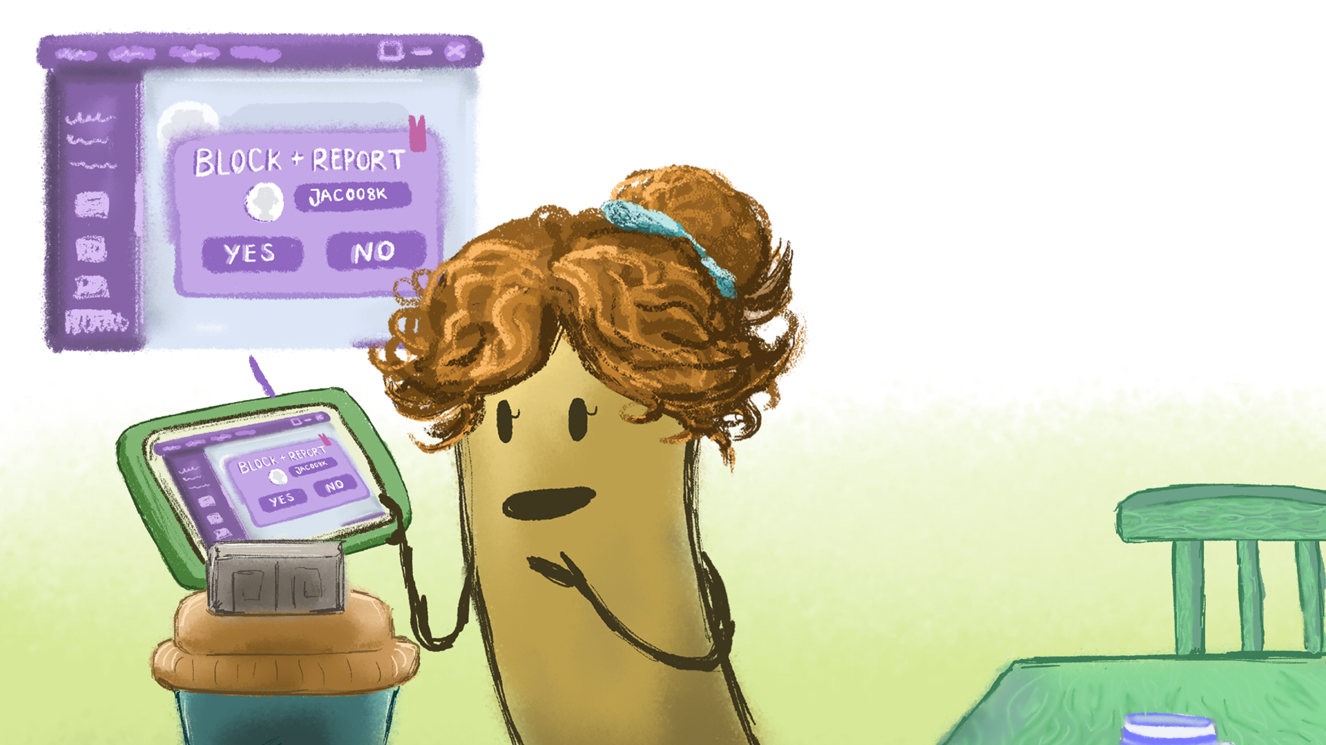
‘Now, I don’t want to play Robo Warriors again,’ said Archie, ‘in case I bump into jac008k.’
‘We can block that player,’ said Archie’s mum. ‘This means that jac008k can’t play with you or contact you again. Come on, let’s do it together.’
Archie followed her back to the laptop. Today, he’d learned a big lesson. Never reveal personal information on the internet, and if you do get in trouble, always tell a trusted adult.

Slide 26
Archie Plays Robo Warriors
What did Archie not have permission to play Magician of Doom?
How did Archie feel when the stranger was asking him so many personal questions?
(a) Why do you think Archie had a funny sensation in his tummy?
(b) Do you ever feel worried or anxious? What happens to you? What kind of things can you do if you are feeling worried or anxious?
How did Archie’s mum react when he explained what had happened?
What big lesson did Archie learn in the story?
Notes:
Notes: Once you have finished reading the story, go through the discussion questions to help pupils reflect on the internet safety scenario and safety messages explored in the story.
Finally, ask pupils to write down one thing they learned about playing online today. Invite pupils to share their responses and recap with the following points:
Playing games online is fun and can build important skills like team building and problem solving.
There are a lot of options of games to play and people you could meet so it’s important to stay safe while playing games online.
Here are some tips to help:
Always check the age rating of the game before you play.
Keep your profile private and don’t use real photos or your full name.
Don’t give out personal information to people you only know online.
Your password holds the key to your personal information online - Keep it private and only share it with your parents/guardian.
If you see any bad stuff or rules being broken, report it.
Never buy a game or pay for anything in the game without getting permission from your parents/guardians first.
Talk to your pupils about the importance of asking permission before downloading a game. Encourage them to always tell a parent/guardian or trusted adult if something has happened online, even when they feel they may have done something wrong.

