Slide 1
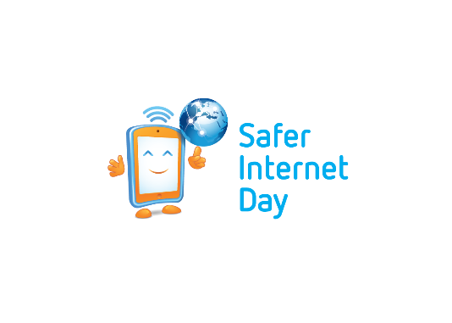
SAFER INTERNET DAY
Self Esteem Online: The Full Picture
Notes:
Notes for speaker – brief introduction and welcome.
Explain how long the talk will take and the types of things you will be doing over that time.
For example:
‘‘Today we are joining millions of people around the world in celebrating Safer Internet Day, a day for promoting a safer and better internet for all users, especially young people. During this assembly we are going to talk about being online and using the internet. We will look at the positives and possible negatives of the internet as well as some general advice on how to manage your online wellbeing.”

Slide 2
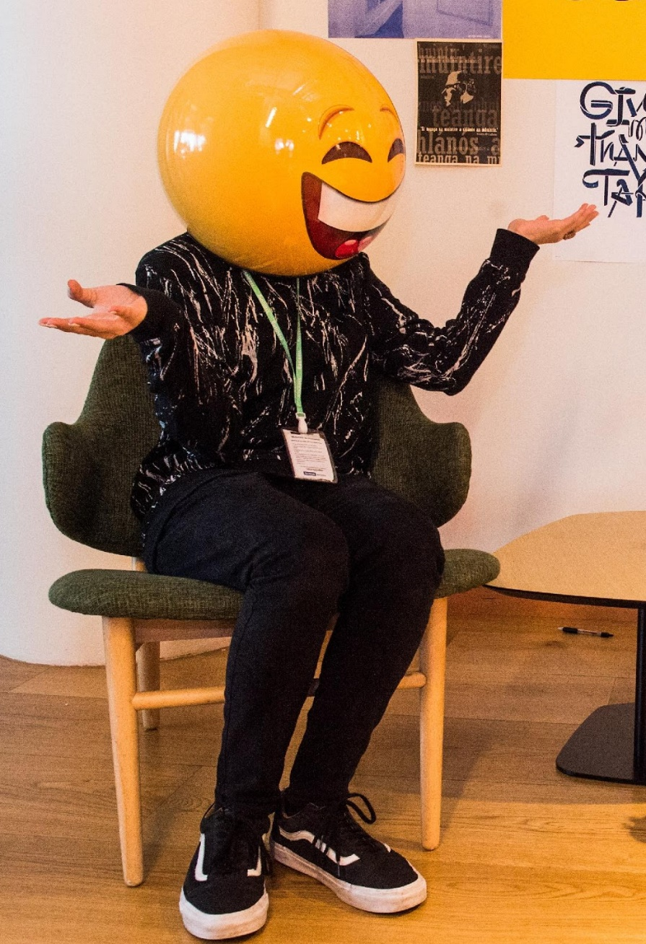
ABOUT WEBWISE
Irish Internet Safety Awareness Centre that promotes safer use of the internet by young people
Responsible for the promotion and coordination of Safer Internet Day in Ireland
Develop education resources and programmes for schools to address a range of online safety initiatives
Webwise are supported by a Youth Advisory panel made up of second-level students from across Ireland
Provide free training programmes to second-level students to support schools engaging in Safer Internet Day
Provide information, advice, and tools to parents to support their engagement in their children’s online live
Students can find more information on the dedicated youth hub: http://webwise.ie/youth
Notes:
Notes: Today’s talk has been developed by Webwise. Irish Internet Safety Awareness Centre that promotes safer use of the internet by young people
Some of the work Webwise are involved in:
Responsible for the promotion and coordination of Safer Internet day in Ireland
Develop education resources and programmes for schools to address a range of online safety initiatives
Webwise are supported by a Youth Advisory panel made up of second-level students from across Ireland
Provide free training programmes to second-level students to support schools engaging in Safer Internet Day
Provide information, advice, and tools to parents to support their engagement in their children’s online live
Students can find more information on the dedicated youth hub: http://webwise.ie/youth

Slide 3
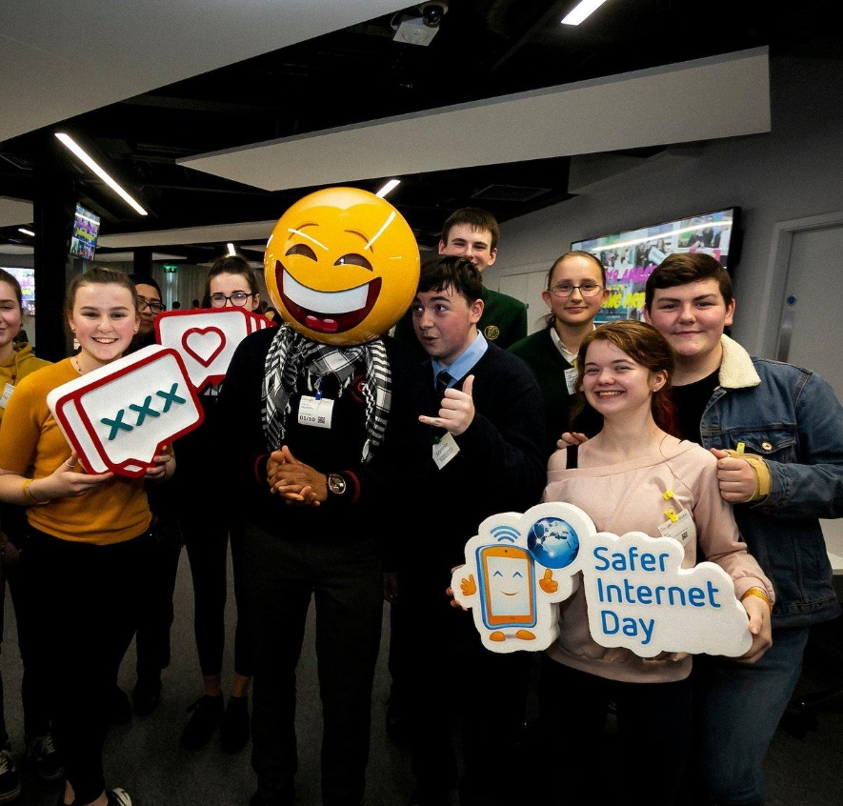
What is Safer Internet Day?
A day to create awareness of a better internet for ALL users
The theme for Safer Internet day is “Together for a Better Internet”
Safer Internet Day is celebrated all across Europe on the second Tuesday, of the second month, every year.
Notes:
Notes: Safer Internet Day (SID) is an EU wide initiative to promote a safer internet for all users, especially young people. Safer Internet Day in Ireland is promoted and coordinated by Webwise, the Irish Internet Safety Education Awareness Programme. The Theme for Safer Internet Day is “Together for a Better Internet”.
The aim of the day is a call on all stakeholders - industry, government and the public to join together to make the internet a safer and better place for all, and especially for children and young people.
Safer Internet Day is a day to promote safe and responsible use of the internet, a day for us to consider all the different ways we use the internet and how we can make the internet a safer and better place for all, and especially for children and young people.

Slide 4
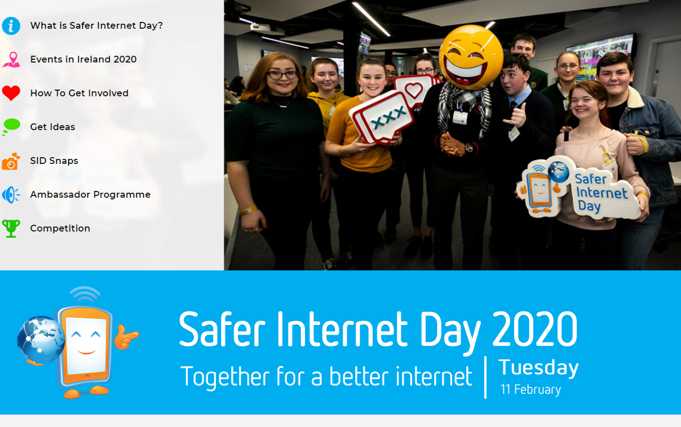
Getting involved in Safer Internet Day
webwise.ie/saferinternetday
01
IDEAS & INSPIRATION
02
PLAN YOUR CAMPAIGN
03
FREE RESOURCES
04
FREE SID WRISTBANDS
05
VIDEOS & PRESENTATIONS
Notes:
Notes: Safer Internet Day provides an opportunity for students to take the lead in raising awareness of internet safety concerns and issues of young people to the school community including teachers, students and parents/guardians. It provides an opportunity to address the issue of cyberbullying and internet safety by leading awareness-raising campaigns in their clubs, schools, and communities.
There are lots of ideas for SID activities on the Safer Internet Day page: www.webwise.ie/saferinternetday
Register your school's Safer Internet Day events on the Webwise event’s map and see how other schools are celebrating Safer Internet Day here: www.webwise.ie/saferinternetday

Slide 5
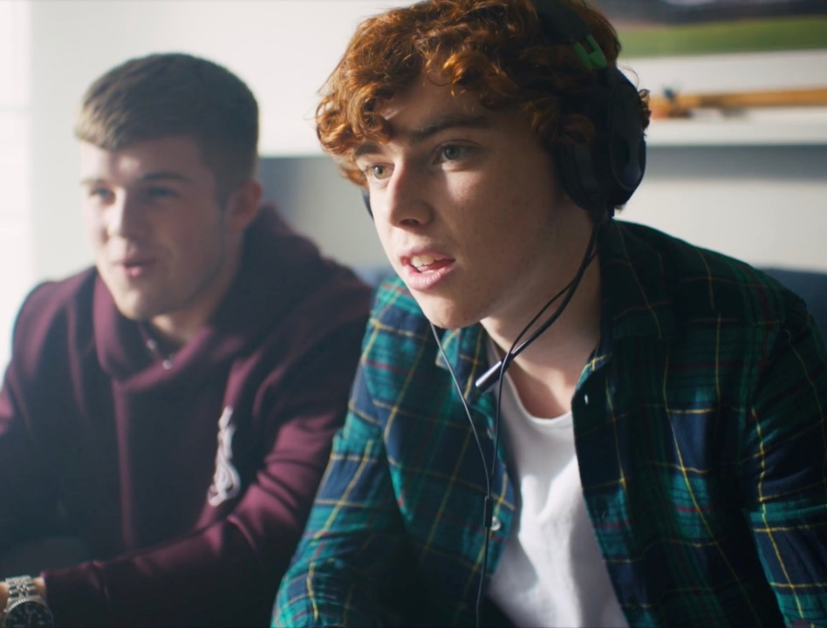
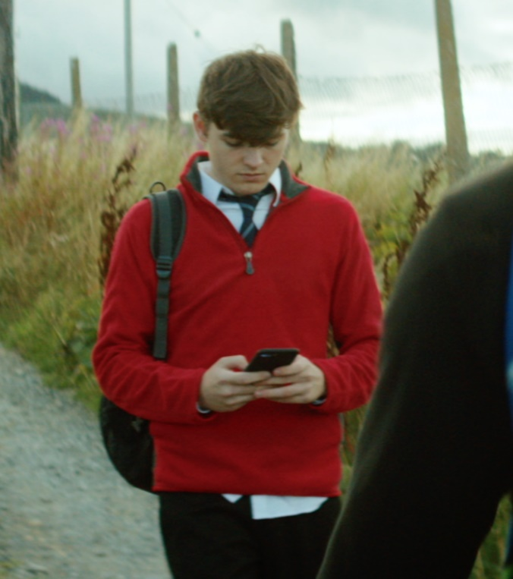
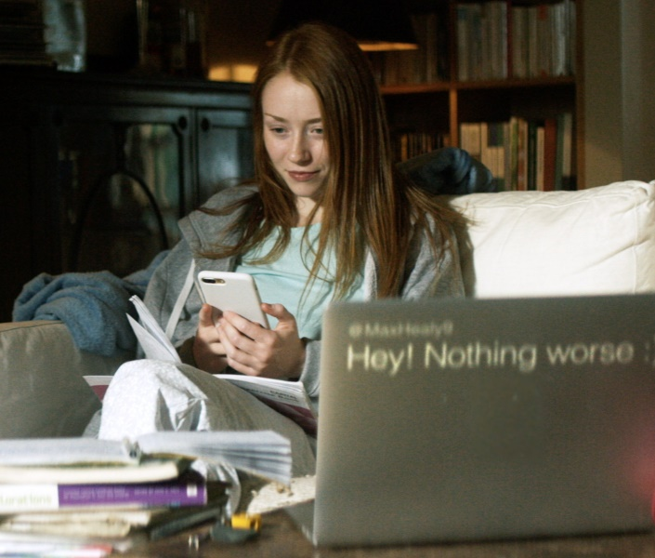
LET’S DISCUSS BEING ONLINE
What social media platforms/apps you are familiar with?
Remember:
The internet is a brilliant tool that provides opportunities for connection, creativity, learning, entertainment, etc.
During Covid-19 we turned more than ever to the internet to help us keep in touch, learn, work, play and understand the world around us.
For the vast majority the internet provides a positive and very useful experience.
What happens online is often just an extension of what is happening offline.
Notes:
Notes: Explain to students that for Safer Internet day they will explore the topics of self-image (how we see ourselves) and self-esteem (our sense of self-worth or confidence in our own value) online and the role that social media can play in this.
Ask students to list the social media platforms/apps they are familiar with.
Use a real time feedback platform such as Mentimeter (www.mentimeter.com) or Kahoot (www.kahoot.it) to get instant feedback on this. You also could use this to poll students on which social media app they use most often.
Ask students to discuss what they use social media platforms/apps for? For example, to stay in touch with friends and family, learn more about hobbies/interest, share interests and connect with people of a common interest/hobby.
*Teacher Note: It is important to reinforce the benefits of the internet and that the internet is a brilliant tool that provides opportunities for connection, creativity, learning, entertainment, etc. During Covid-19 we turned more than ever to the internet to help us keep in touch, learn, work, play and understand the world around us. For the vast majority the internet provides a positive and very useful experience. What happens online is often just an extension of what is happening offline and therefore a holistic view of wellbeing including online wellbeing is necessary to recognise.

Slide 6
Social media provides more opportunities for connection than it does comparison.
Discuss.
Notes:
Notes: Social media provides more opportunities for connection than it does comparison.
Read the above statement and ask your students to reflect on this and discuss. Employ think-pair-share to elicit responses with a show of hands, who agrees? Who disagrees?
Then ask students to explain their reasons why.
Alternatively, use a real time feedback platform such as Mentimeter (www.mentimeter.com) or Kahoot (www.kahoot.it) to get instant feedback on this.

Slide 7
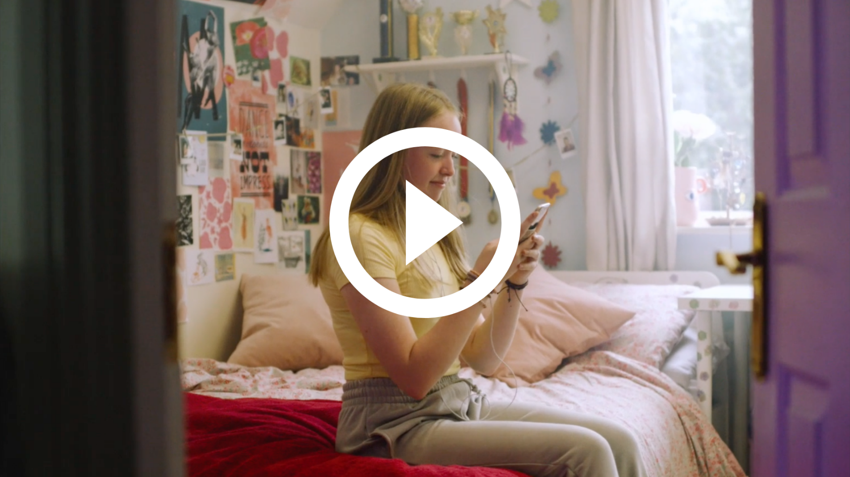
#TheFullPicture
Watch #TheFullPicture here:
https://vimeo.com/457720222
Notes:
Notes: Play The Full Picture video (https://www.webwise.ie/thefullpicture/#) for students.
Running time is 1:59.
The Full Picture is a short film exploring how young people use social media to connect and share. The film highlights the influences and pressures young people face online and encourages them to see the full picture. Social media helps us share our lives but it does not tell the whole story. The campaign encourages young people to be mindful of what influences them and how they respond to pressures online.

Slide 8
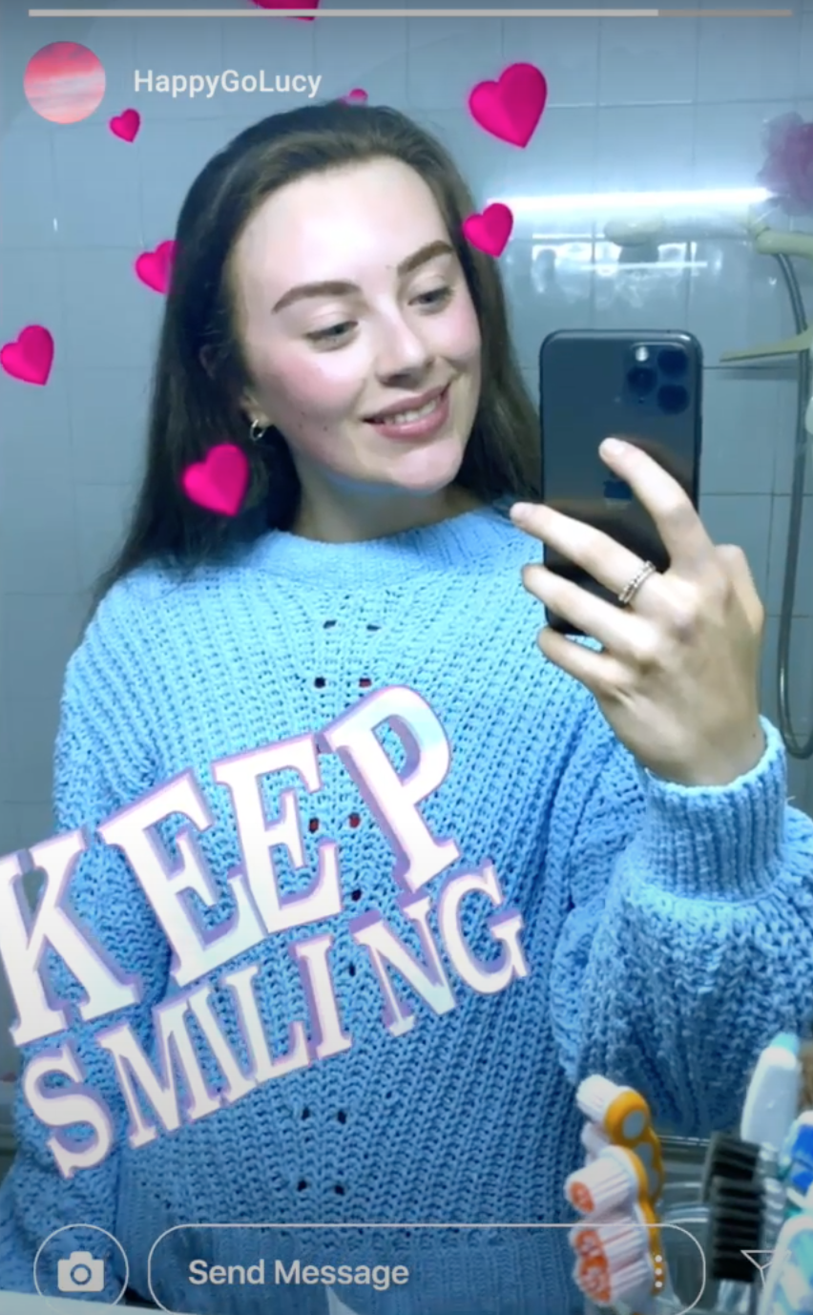
“Not everything we see online tell the whole story.”
#TheFullPicture
Notes:
Notes: The Full Picture ends with the lines:
See the full picture.
Not everything we see online tells the whole story.
What is your understanding of these lines after watching the video?
Get feedback from students on this.
Alternatively, use a real time feedback platform such as Mentimeter (www.mentimeter.com) or Kahoot (www.kahoot.it) to get instant feedback on this.

Slide 9
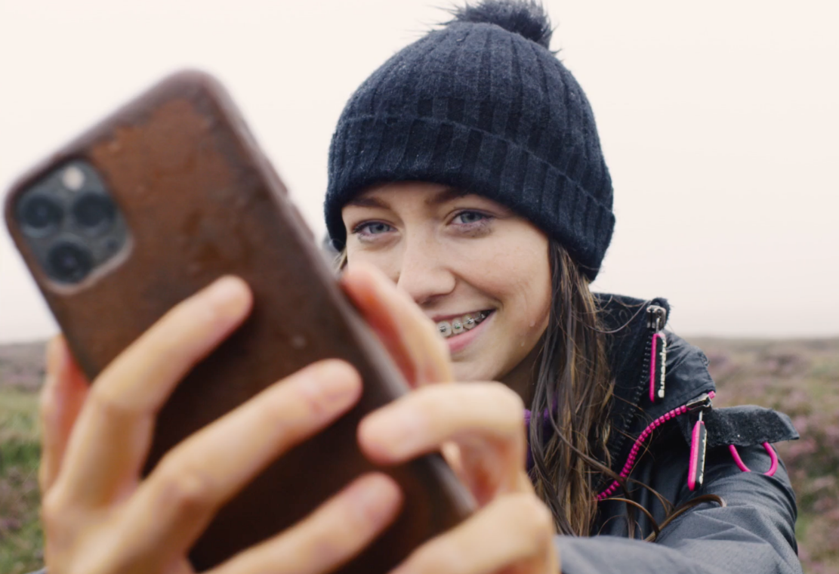
Social Media -
Filtering the Good from the Bad
Social media is a great place to connect and share with others.
Let’s consider what are the positives and potential downsides of being on social media?
Notes:
Notes: Social Media - Filtering the Good from the Bad
Social media is a great place to connect and share with others.
List the positives and potential downsides of being on social media.
Ask students to list the positives and potential downsides of being on social media. Use think-pair-share to elicit responses from students. Alternatively, use a real time feedback platform such as Mentimeter (www.mentimeter.com) or Kahoot (www.kahoot.it) to get instant feedback on this.
Examples of positives include sharing our lives and being able to see and keep up with friends and family, communicating with friends and family, connecting with other people and potential to make new friends, a platform to raise awareness of important issues, learn more about interests and hobbies.
Examples of the potential downside of social media could include it can add pressure by portraying an idealised version of normal life. Our news feeds often contain images of people looking great, wearing nice clothes, and doing exciting things. Living their best lives!
Remind students that potential downsides such as the pressure to be the picture perfect version we see of people’s lives online are just snapshots in time which may have often been carefully shot, selected, edited and filtered before they were posted. While most of us may do this to some extent, it can still be easy to fall into a trap of comparing our lives to the lives of others, or comparing the number of likes, comments and followers they have. This can have a negative impact on our mood and self-esteem and it is important that we can recognise and manage this.
There are lots of positives to being online as we have mentioned it is about learning how to manage our online wellbeing and filter the good from the bad on social media which we will look at in the next few slides.

Slide 10
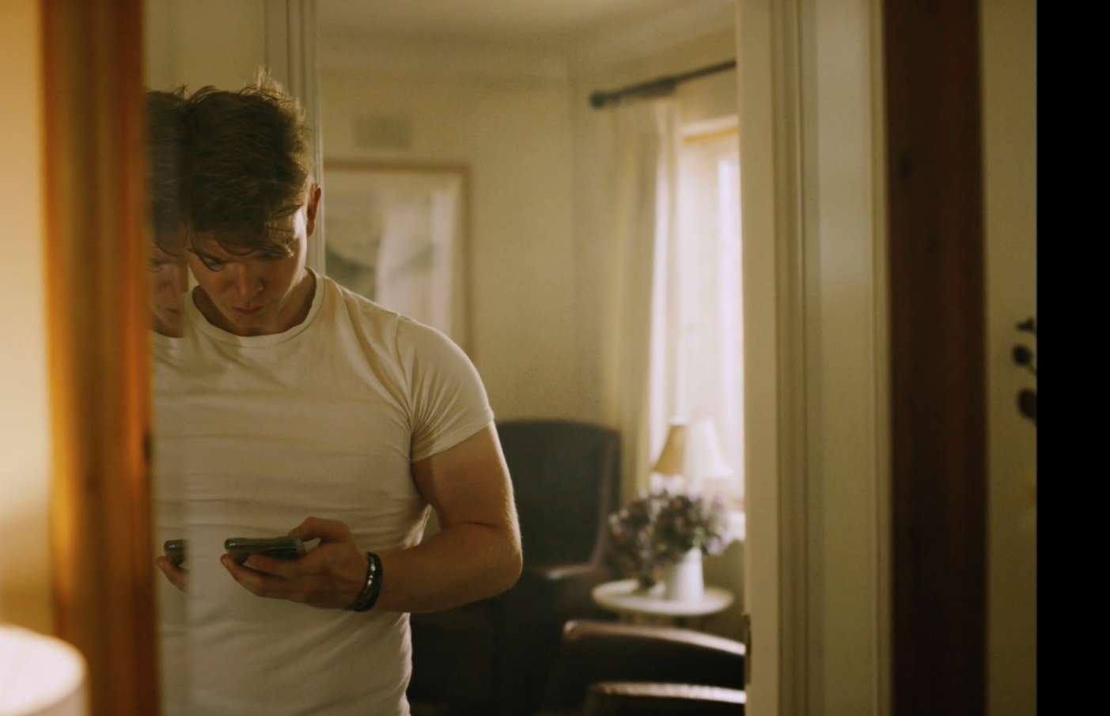
Myth V Reality -
See the Full Picture
Pressure to look a particular way is not a new phenomenon.
In the era of social media, these pressures are often amplified.
Have you ever felt pressure to look a certain way on social media?
Notes:
Notes: Explain to students that social media is a great way to explore content we are interested in and to discover new people, but it can create pressures to live up to certain ‘standards’. This can be unrealistic for lots of reasons – images may have been carefully selected and edited; celebrities have vast resources at their disposal; sports stars have 6 packs because their job requires an exercise regime that most people would not have the time for. The danger is that viewing content without a critical eye, can lead to self-esteem issues, and pressure to conform in ways that may not be a good fit for you as a person.
When discussing pressure to look a certain way it is important to remember the following points:
Pressure to look a particular way is not a new phenomenon, for decades some sections of advertising and the media industry have been criticised for promoting unrealistic image and lifestyle standards in the form of photoshopped celebrities, size zero models or lavish lifestyles.
In the era of social media, these pressures are often amplified. We know that people generally post the ‘best’ of themselves online and with easily accessible image editing tools and filters, what we are looking at can even be a digitally enhanced version of the ‘best’. Faces are slimmed, teeth become whiter, and blemishes are erased. Often it can be difficult to spot a picture that has been enhanced. It’s not all bad, it’s that the reality is more complicated.
Remember that often what we see on social media is a one-sided version of a person’s life online, and if you know someone well you will know that they are only showing the best bit – but if you don’t know a person, you don’t have any other information or context to go on.
Ask students to consider if they have ever felt pressure to look a certain way on social media?
Remind students that social media is a great tool for sharing and connecting with friends and family – the social aspect is fundamental to how it works! Getting likes and comments on moments that we choose to share about our lives is great – a self esteem boost, an endorsement! But not getting the ‘likes’ you expected can have the opposite effect. It’s natural to look for the approval of people around us, but it’s important not to fall into the trap of becoming too worried or anxious about it.

Slide 11
The Rise of the Influencer
It’s important to consider The Full Picture and think critically about what you are seeing.
Ask yourself:
has that person been paid to promote an item?
how has it been edited?
has what they are posting been designed to fit their online ‘brand’?
is it a realistic reflection of who they are?
Notes:
Notes: We follow influencers because we are interested in their content, we want to be entertained, we want to learn from them or even are inspired by them. But it can lead to pressure about what clothes to wear, how to look, and what music, food or brands to buy. So, it’s important to consider The Full Picture, and think critically about what you are seeing.
Has that person been paid to promote an item?
How has it been edited?
Has what they are posting been designed to fit their online ‘brand’?
Is it a realistic reflection of who they are?

Slide 12
Social Media Feeds and Algorithms
Algorithms are complex mathematical formulas working in the background of the websites or apps we use which help determine what content is presented to us online e.g. in your newsfeed or search results.
What we see on our online news feeds is determined by the algorithm of the particular platform we are using.
Social media platforms highlight content that they believe we will like, because it is popular or because you are being advertised to.
It’s important to remember our news feeds are not a full reflection of reality, they are just a part of The Full Picture.
Notes:
Notes: Explain to students:
Algorithms are complex mathematical formulas working in the background of the websites or apps we use which help determine what content is presented to us online e.g. in your newsfeed or search results.
What we see on our online news feeds is determined by the algorithm of the particular platform we are using.
Social media platforms highlight content that they believe we will like, because it is popular or because you are being advertised to.
It’s important to remember our news feeds are not a full reflection of reality, they are just a part of The Full Picture.
Filtering through content that appears on our online newsfeeds is complicated further, because what we see is determined by the algorithm of the particular platform we are using. What we encounter when we go online doesn’t appear by coincidence – social media or online platforms highlight content that they believe we will like, because it is popular or because you are being advertised to. Just like with images we see, or the people we follow, it is important to be mindful that what we see on our newsfeeds is not a full reflection of reality, it is just a part of The Full Picture.

Slide 13
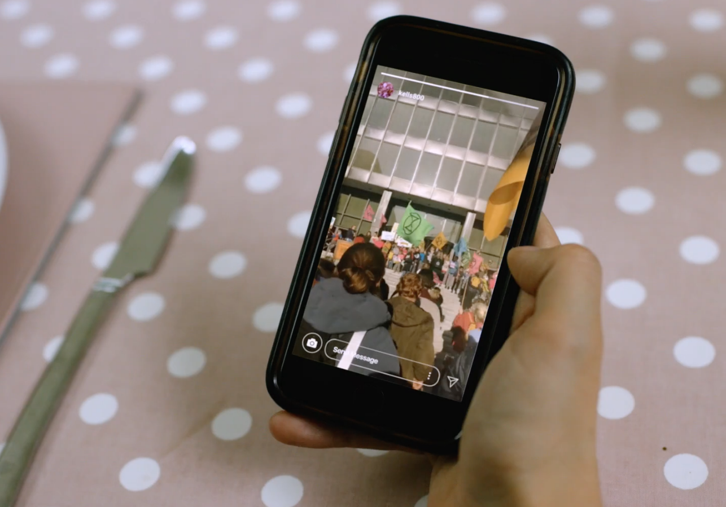
You are what you like?
Have you noticed that when you go online or login to social media you are presented with content, news, articles or ads that somehow know the things that you are interested in?
Why do you think this ?
Notes:
Notes: Ask students if they have noticed that when they go online or login to social media they are presented with content, news, articles or ads that somehow know the things that they are interested in? Ask students why they think this is?
[If time allows you can test this with your student by asking them to google something e.g. a country - Egypt and projecting the search results onto the whiteboard for the students to see. Then ask students to google the same thing e.g., Egypt and look at their own search results, noting if there is anything different than what appears on the whiteboard. Did their search results differ at all from what appears on the whiteboard. If so, ask why they think this is?]
Explain to students that this is because there are algorithms (complex mathematical formulas) working in the background which determine what content is presented in your newsfeed or search results. Platforms such as Google, Facebook, Instagram, and Tik Tok all have their own closely guarded algorithms which personalise the content they show to us – different users who use the exact same search terms or scroll through the same social media platform are likely to see different content. The results that we are presented with are likely to reflect the likes and interests that our browsing history and personal data suggests we would like to see more of – after all, online platforms want you to use their site and to stay for as long as possible.

Slide 14
You are what you like -
The influence of online algorithms
The results that we are presented with are likely to reflect the likes and interests that our browsing history and personal data suggests we would like to see more of – after all, online platforms want you to use their site and to stay for as long as possible.
It is important to be aware that the content being pushed to your newsfeed is filtered and tailored by what a social media network or online platform believes that you are interested in, or would like you to become interested in.
Different users who use the exact same search terms or scroll through the same social media platform are likely to see different content.
Not seeing an alternative point of view can affect our ability to think critically about content, make us less open-minded, and can have a skewed influence on how the world is presented to us.
Notes:
Notes: Ask students to consider what are the potential benefits and downsides of our news, search and social media feeds being filtered or tailored to who the internet thinks we are like this? Elicit responses.
Explain to students that potential benefits include: with having so much content available on the internet, these algorithms are used to reduce the volume of information and to filter what is displayed to users. For example, searching for exercise tips or liking a cute cat video will make it more likely that you will see content related to these topics in the future, or if you browse for a pair of trainers you may see advertisements for those shoes on other websites you visit. All this information is building up a picture of who you are online.
While this is not necessarily a bad thing, it is important to be aware that the content being pushed to your newsfeed is filtered and tailored by what a social media network or online platform believes that you are interested in, or would like you to become interested in.
Potential drawbacks include the fact that we can very easily get caught in a feedback loop or filter bubble meaning that what we see are variations of the same thing and alternative views or opinions are filtered out. It is important to emphasise to students that not seeing an alternative point of view can affect our ability to think critically about content, make us less open-minded, and can have a skewed influence on how the world is presented to us.

Slide 15
Filtering the good from the bad:
How can I manage my online wellbeing?
Think critically about the content you see online. Remember it’s not the full picture.
Create a social media presence that is true to you.
Remember your value as a person is not reflected in the number of ‘followers’ or ‘likes’ you have.
Unfollow accounts that lead you to make unhealthy or unrealistic comparisons.
Search for new perspectives and focus on the positive/productive.
Block online harassment & cyberbullying. Report it to An Garda Síochána.
Talk to someone you trust & get help.
If you can’t speak to someone you know or trust, call Childline.
Free Phone: 1800 66 66 66, Free Text: 50100 or chat online www.childline.ie
Make time for rest & reflection.
Set time notifications or screen free breaks.
Notes:
Notes: Filtering the good from the bad: Tips on how to manage my online wellbeing
Our online wellbeing can be influenced by the content we see, the interactions we have, the choices we make, and even how long we spend using technology and the internet.
It is important that we recognise how being online can influence the way we feel, think, and behave.
Being kind online
Showing kindness to yourself and others online will help boost your self-esteem and self-image online.
Use these simple tips to help you and others feel good about themselves online. If time allows ask students to create a list of their own tips for how they can be kind to themselves and others online.
How can I be kind to myself online?
Think critically about the content you see online. Remember it’s not the full picture.
Set time notifications or screen free breaks.
Create a social media presence that is true to you.
Remember your value as a person is not reflected in the number of ‘followers’ or ‘likes’ you have.
Unfollow accounts that lead you to make unhealthy or unrealistic comparisons.
Search for new perspectives and focus on the positive/productive content online.
Block & Report online harassment & cyberbullying. If you are the victim of online bullying, harassment or any crime online report it to An Garda Síochána. Contact your local Garda station, they will take your case seriously and deal with it in confidence, without judging you.
Talk to someone you trust & get help.
If you can’t speak to someone you know or trust call Childline.
Free Phone: 1800 66 66 66, Free Text: 50100 or chat online www.childline.ie
Make time for rest & reflection.
*Safer Internet Day Poster Extension Activity
If time allows, ask students to create a poster for Safer Internet Day of their own tips for how they can manage their online wellbeing.
Here are some simple strategies that may help to reduce negative emotions, increase your overall wellbeing, and make going online more enjoyable.
How can you be more mindful online?
Before you post something, think about why you are doing it? Is it because you are looking for appreciation, inclusion, reassurance? Ask yourself why this is important to you.
Pay attention to the amount of time you are spending online. It’s important to be aware of how it could be affecting your friendships, your family, or your school work. There are lots of apps and devices that help you to manage how much time you spend online. Consider turning off app notifications to minimize distractions.
Quantity v Quality. It can be very easy to lose track of time online. It’s always a good idea to review what types of things you do online. There’s so many great ways to spend your time online; learning, creating, communicating, entertainment… even looking at a cat video can help cheer us up. It’s important to get a good balance of productive and passive time online.
Make time for the things and people that make you happy. Think about how the content you see online is making you feel. If something comes up that makes you feel envious or not good enough, consider if it’s helpful or realistic to think that way?
Remember don’t be too hard on yourself. No one is perfect.
Look after your physical health. Make sure that you are eating well, and getting enough exercise.
Get support – a problem shared is a problem halved. If something is bothering you, or you are worried about a friend, reach out to someone you trust. There are also many organisations that offer support and advice.

Slide 16
Filtering the good from the bad:
How can I be a good digital citizen?
Seek out the positive. For example, post, like, share positive, encouraging, inspiring content & messages.
Purposefully connect with others. Be mindful/purposeful about how you use social media to connect with others, to learn or create something and not just to mindlessly scroll.
Don’t feed the trolls. Don’t post, like, share or comment on upsetting or nasty content & messages.
Respectfully Disagree. If you disagree with someone that’s okay but do so respectfully. Stick to the facts and don’t get personal.
Don’t harass others online. This can include behaviour such as personal threats and intimidation, stalking, exclusion, impersonation, personal humiliation or false reporting.
Respect copyright and fair use.
Notes:
Notes: Being kind to others online also can mean being a good digital citizen. Here are simple tips to be a good digital citizen.
Seek out the positive. For example, post, like, share positive, encouraging, inspiring content & messages.
Purposefully connect with others. Be mindful/purposeful about how you use social media to connect with others, to learn or create something and not just to mindlessly scroll.
Be kind online. Just as we would in a face-to-face situation, always treat others as you would like to be treated. Remember, online it can seem like you are speaking to real people, and it’s important to consider their feelings and concerns. Even a simple like on a post can have an impact on others. Before you post, take a moment to put yourself in someone else’s shoes to understand the impact it may have on them.
Don’t feed the trolls. Trolls are people who like arguing or aggravating others, and are usually found in comments sections, message boards, or anywhere else they can cause disruption. If you encounter a troll, resist the temptation to interact with them. Any response is likely to just encourage them to continue their behaviour. Don’t post, like, share or comment on upsetting or nasty content & messages.
Respectfully Disagree. If you disagree with someone that’s okay but do so respectfully. Stick to the facts and don’t get personal.
Don’t harass others online. This can include behaviour such as personal threats and intimidation, stalking, exclusion, impersonation, personal humiliation or false reporting.
#NoRegrets. Our digital world is permanent, and with every post we are building a digital footprint. This is basically the trail of data you create when using the internet, for example everything that is said, posted, shared, or website you visit. When you post or share content online think about who could potentially see it. It creates an impression of who they are – are you comfortable with friends, family, teachers, or employers seeing it now or in the future? Taking steps such as checking your privacy, deleting old accounts, and thinking before you post can help to ensure that you manage your online reputation. Ensure your online experience is a positive one with these tips for managing your online reputation.
Take a stand. Stand up for yourself and others if problems arise. Just like you would report an issue in real life, you should report problems, inappropriate content, and abusive behaviour. Speak to someone you trust, or get advice from organisations that can provide support.
Respect copyright, and fair use. It’s easier than ever to copy, paste, download and publish content. Writing, music, artwork, and movies can be easy to take without thinking twice. For anyone who creates material, copyright gives that person the right to control how this content is used.This means that you must check who owns the content, get permission to use it, give credit to the creator, buy it if necessary, and use it responsibly.
Unplug. Knowing when to stay connected, and when to turn off your device is part of being a good digital citizen. Though technology can be an amazing tool for learning, growing, and creating social change, sometimes you need to unplug.
For more information, advice and tips on online wellbeing visit the Full Picture campaign page here: https://www.webwise.ie/thefullpicture/#

Slide 17
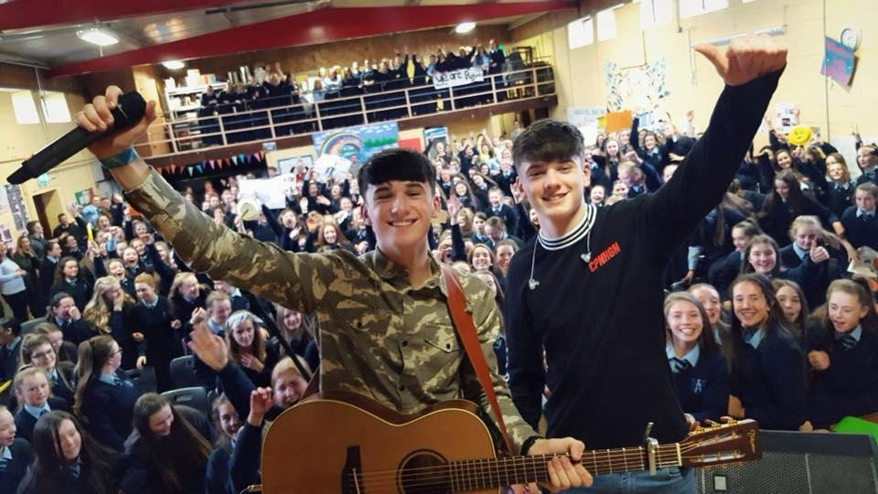
Safer Internet Day Selfie
Webwise love seeing all your photos from your online safety campaigns and Safer Internet Day activities.
Send in your photos, videos and posters to Webwise and you could be in with a chance of winning some great prizes.
Notes:
Notes: Webwise love seeing all your photos from your online safety campaigns and Safer Internet Day activities. Send in your photos, videos and posters to Webwise and you could be in with a chance of winning some great prizes. Just email: internetsafety@pdst.ie
Share your SID activities
We love seeing all your photos from your online safety campaigns and Safer Internet Day activities. Connect with us on:
Twitter @Webwise_Ireland
Facebook: facebook.com/webwise_Ireland
Instagram: webwiseireland
Share ideas tips/plans using #SaferInternetDay
Share your internet safety messages on webwise.ie/saferinternetday

Slide 18
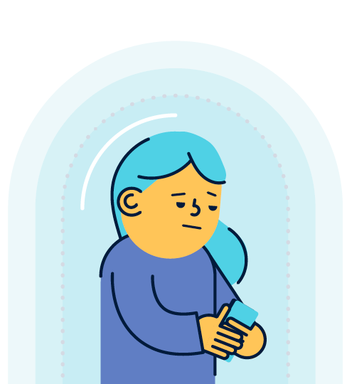
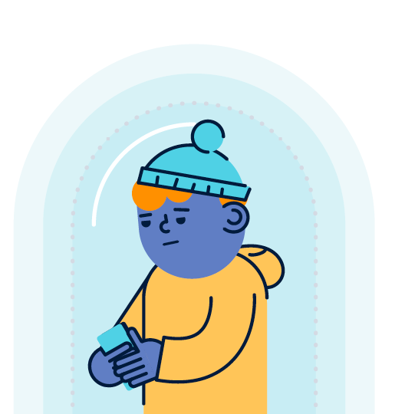
Join the conversation
#SaferInternetDay #Webwise
Connect with Webwise on:
Twitter: @Webwise_Ireland
Facebook: facebook.com/webwise_Ireland
Instagram: webwiseireland
Notes:
Notes: Join the conversation on online safety!
We love seeing your online safety campaigns and Safer Internet Day activities. Connect with us on:
Twitter @Webwise_Ireland
Facebook: facebook.com/webwise_Ireland
Instagram: webwiseireland
Share ideas tips/plans using #SaferInternetDay
Share your internet safety messages on webwise.ie/saferinternetday

Slide 19
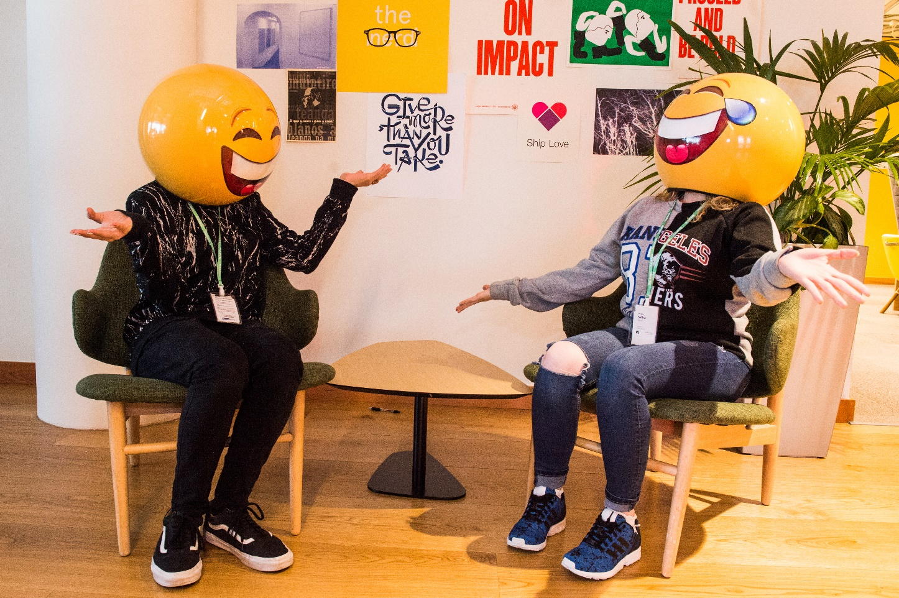
THANKS!
ANY QUESTIONS?
© Webwise_Ireland
This work is made available under the terms of the Creative Commons Attribution Share Alike 3.0 Licence http://creativecommons.org/licenses/by-sa/3.0/ie/. You may use and re-use this material (not including images and logos) free of charge in any format or medium, under the terms of the Creative Commons Attribution Share Alike Licence.
Notes:
Notes: Webwise would encourage you to download copies of the Parents' Guide to a Better Internet booklets and or Parent’s checklists to distribute to pupils to take home to their parents. The booklet can be ordered for free at webwise.ie/parents

Slide 20
EXTENDED SAFER INTERNET DAY ACTIVITIES
Notes:
Notes: These following supplementary extended Safer Internet Day slides are available for teachers to use to support the SID talk they will have just heard. These activities are to be completed in the classroom to continue the discussion on how to stay safe online. The following slides contain instructions and links to worksheets which can be downloaded and completed by students.

Slide 21
“Not everything we see online tell the whole story.”
Group Discussion Activity
#TheFullPicture
Notes:
Notes: Following on from the talk on self-esteem online and watching the Full Picture film we are now going to explore the influences and pressures the young people featured in the Full Picture face online and encourage them to be mindful of what influences them and how they respond to pressures online and help them to see the full picture.
Rewatch the Full Picture film with students. Play The Full Picture video (https://www.webwise.ie/thefullpicture/#) for students.
Running time is 1:59.
The Full Picture ends with the lines:
See the full picture.
Not everything we see online tells the whole story.
What is your understanding of these lines after watching the video?
Distribute Activity Sheet 1.1 and divide students into small groups.
Ask students to complete the activity sheet in their groups. Once finished, take whole-class feedback.

Slide 22
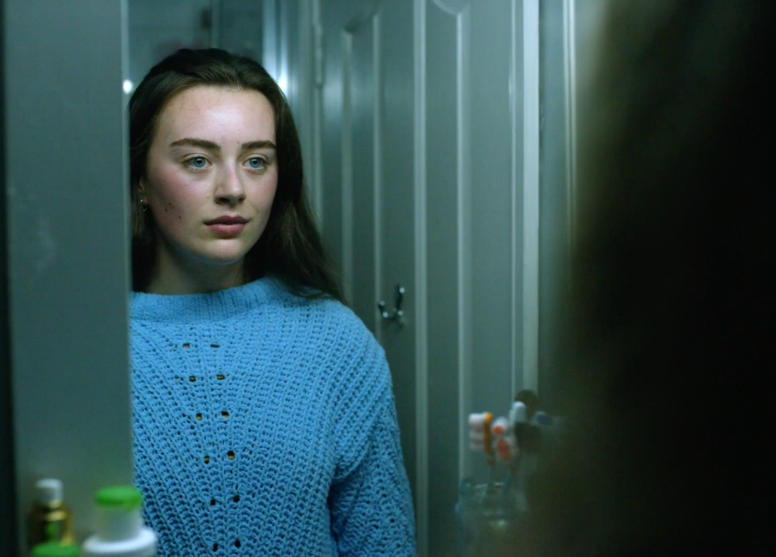
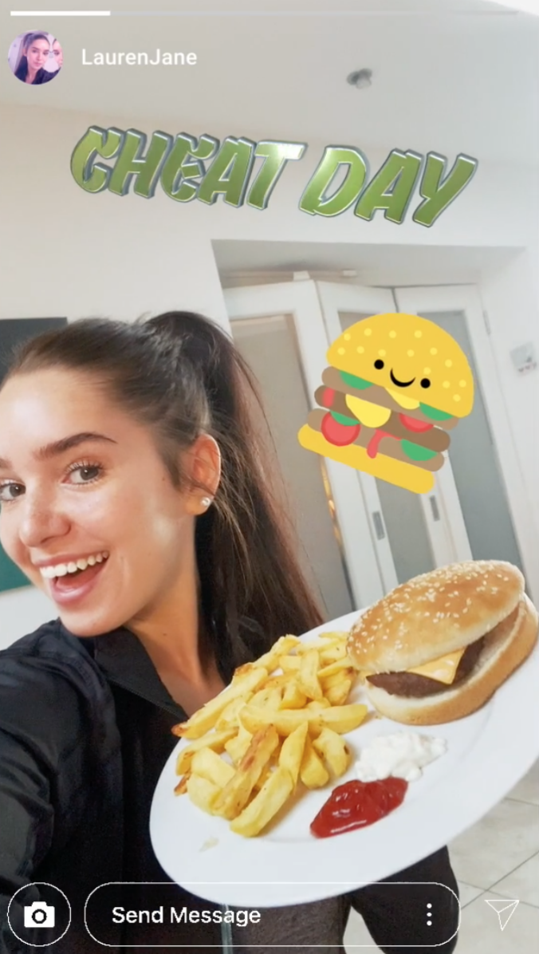
ACTIVITY: Agony Aunt/Uncle
Read the diary entries from the characters from the Full Picture.
Offer advice & support to the young person on how to deal with influences or pressures that might be affecting their self-esteem online and help them manage their online wellbeing better.
Notes:
Notes: Read the diary entries from the characters from the full picture and offer them support and advice.
Explain to the class that in groups of 3 they will read the problem and then write down support and advice to the person in need.
Distribute Activity Sheet 1.3 which contains the problems that they will need to provide advice for.
Remind students that it takes courage to reach out for help and they need to be respectful in their replies of support.
Activity Sheet 1.3: Agony Aunt/Uncle Activity
Suggest advice or a coping skill to the young person in each scenario for how to deal with influences and pressures that might affect their self-esteem online and help them manage their online wellbeing better.
Selfie boy
I train 7 days a week and it’s still no use. I'm just not seeing the results!! I don’t know what I’m doing wrong?! I shouldn’t still have to suck my gut in and flex my bicep to try get the same look as the boys on Love Island at this stage. It’s not fair. I am supposed to be going on a blind date and the only thing my date has to go on are these photos of me. I hope she isn’t disappointed when she sees me in person. Still, I don’t think I would have got the date with her without cheating my pics a little. I suppose I’ll find out what she thinks of the ‘real’ me anyway.
2. Nature gal
Today was a great day! Met up with the girls for a walk and the chats. Jamie was the only one complaining. First, about the rain, then about me being on my phone all the time but I think she still enjoyed it! Besides it was worth it - that video of us all falling over was hilarious and I’ve never got so many likes and comments on a post before. Sure it has to be worth it for that alone!! It’ll be a great one to have pop up as a memory on my page for years to come! I don’t get why Jamie always has to complain about it?!
3. ‘Cheat day’ girl
Today I posted a #cheatday boomerang of me about to eat a burger and chips. It got lots of great feedback and supportive messages from people. But then I noticed a comment “I don’t think you can afford to be eating that”. Who would do that?! The thing is after I saw this I couldn’t bring myself to eat the burger and chips and just chucked it in the bin instead. I feel so guilty and bad about myself now because I’m lying to my followers… I hate that I let the negative comments get to me so much. But what if they’re right? Sometimes I feel so much pressure to maintain this fitness persona online I just can’t afford to let my appearance slip.
4. New Shoe Show Off
I got my new trainers today!! I wanted to update my followers so I went to the park to shoot a video showing them off. I really want to be a vlogger and think live streams like this will help build my following. It was all going great until a group of the lads from sixth year came walking by and when I saw them I knew they would start. I grabbed my phone as quick as I could and started walking but it was too late - my live video caught them following me and slagging my new shoes. Now lots of people in school saw and are making fun of me online saying “I’m a loser with no style!”.
5. Dancing girl
I love dancing around my bedroom making videos to post online and boost my dancing profile. The problem is my dad is getting really annoyed at me saying I’m in my room on my phone all day and has even started threatening to take my phone off me. He doesn’t get me and doesn’t realise I’m in here practising my dance routines for my videos. How can I make him realise that I’m not wasting my time on my phone and taking my phone away is not the answer?
6. ‘Keep smiling’ girl
Another fight with my boyfriend Sean today. Everyone knows me as the positive, bubbly one and they think I have it all figured out. My advice and positivity videos are how i got so popular online. I want to help my followers but what would they think if they really knew my life was not as perfect as it seemed. How will anyone take my advice seriously if they find out I’m struggling with my own stuff too?

Slide 23
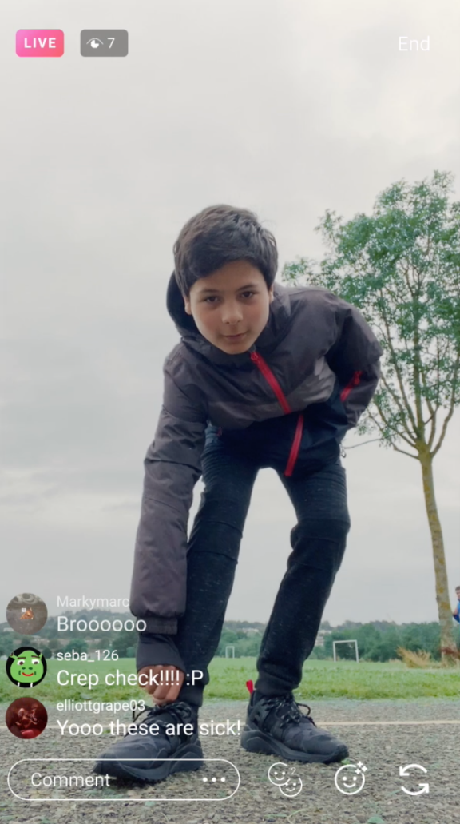
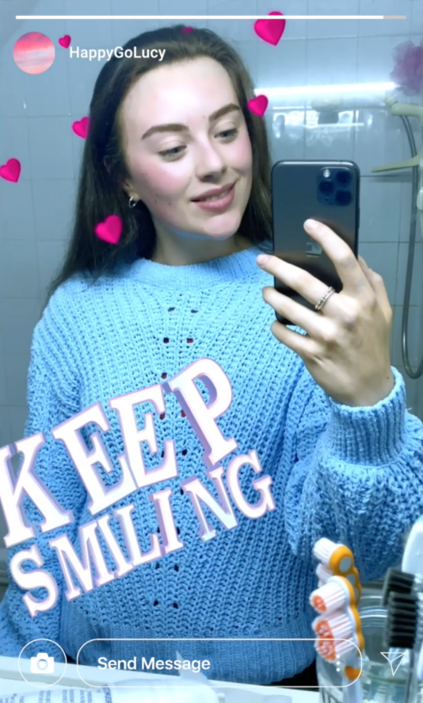
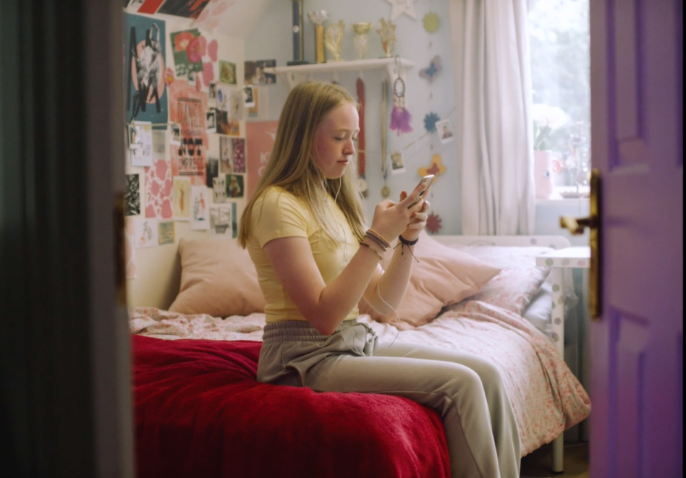
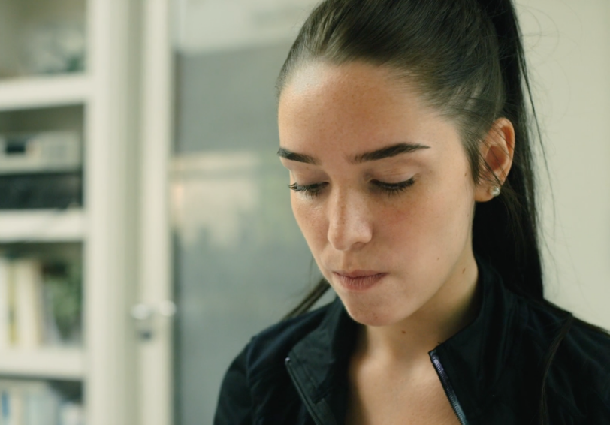
Reflection // Social Media and Me
Notes:
Notes: Following on from offering advice to the young people in the Full Picture film. Distribute Activity Sheet 1.2 and invite students to reflect on their own practices and habits on social media and complete the student reflection piece individually. Reassure students that this is a self-reflective activity for students to complete and that no one (including you) will see what they write.
Activity Sheet 1.2 Reflection: Social Media and Me
This is an opportunity for you to reflect on your own practices and habits on social media by completing the student reflection below. This is a self-reflective activity for you to complete on your own and your responses will not be shared with anyone.
What type of content do you tend to share online?
What factors do you think influence you to share this type of content?
What kind of things might you be more reluctant to share with others on social media?
Why do you think you might feel more reluctant to share this type of content?

