Slide 1


Slide 2
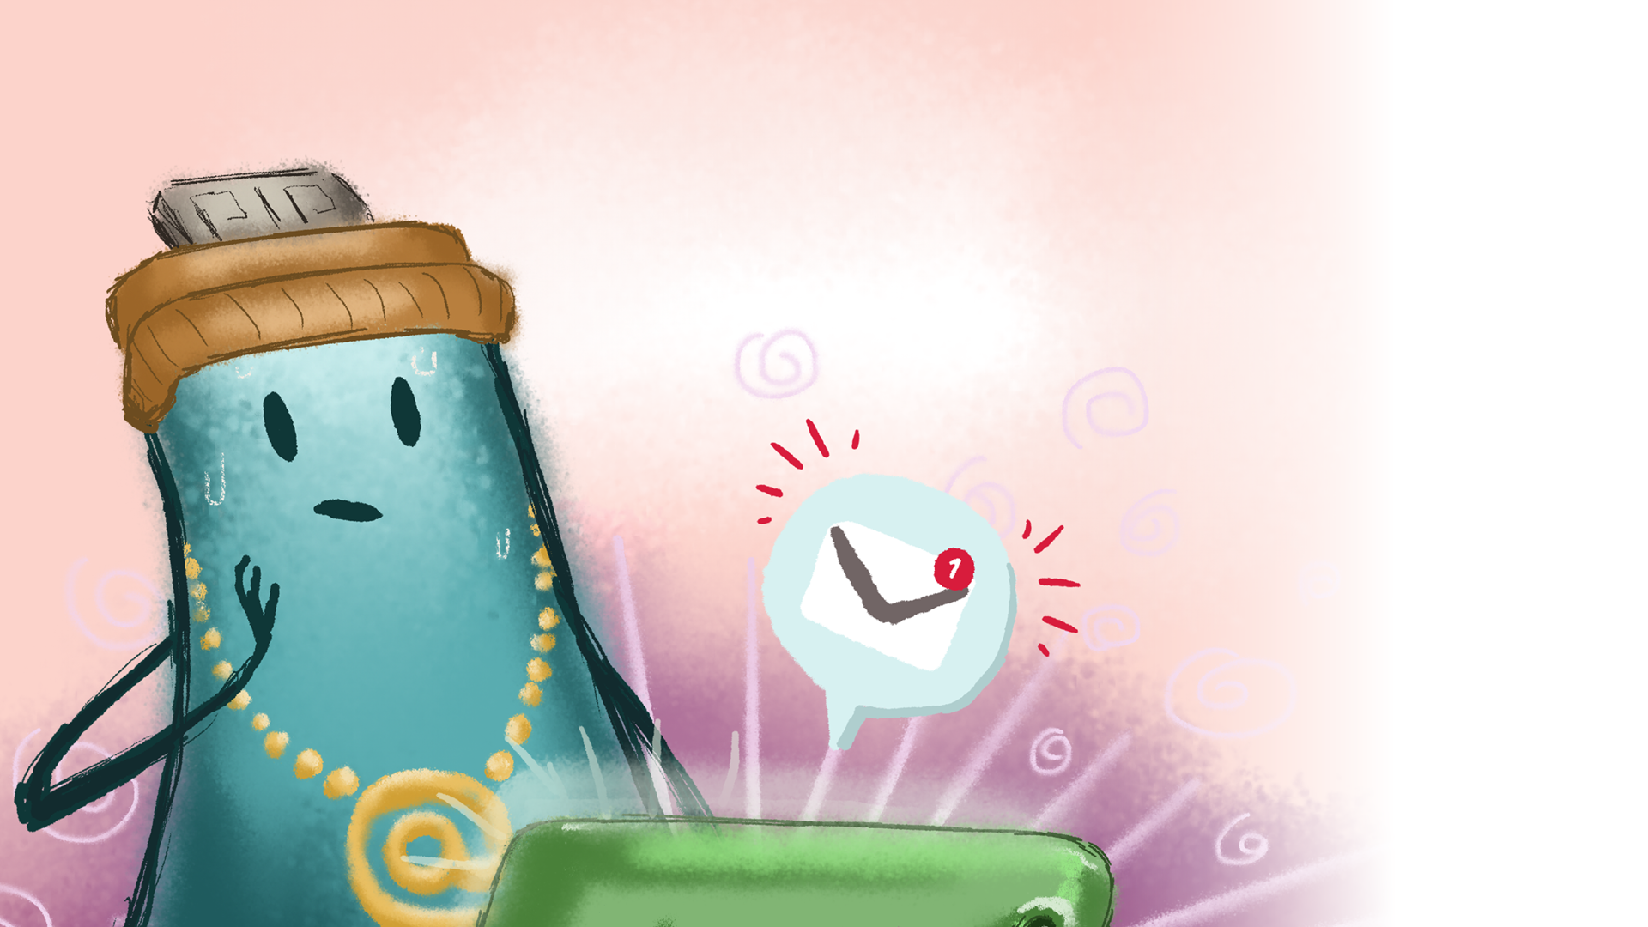

Archie plays Robo Warriors

Slide 3
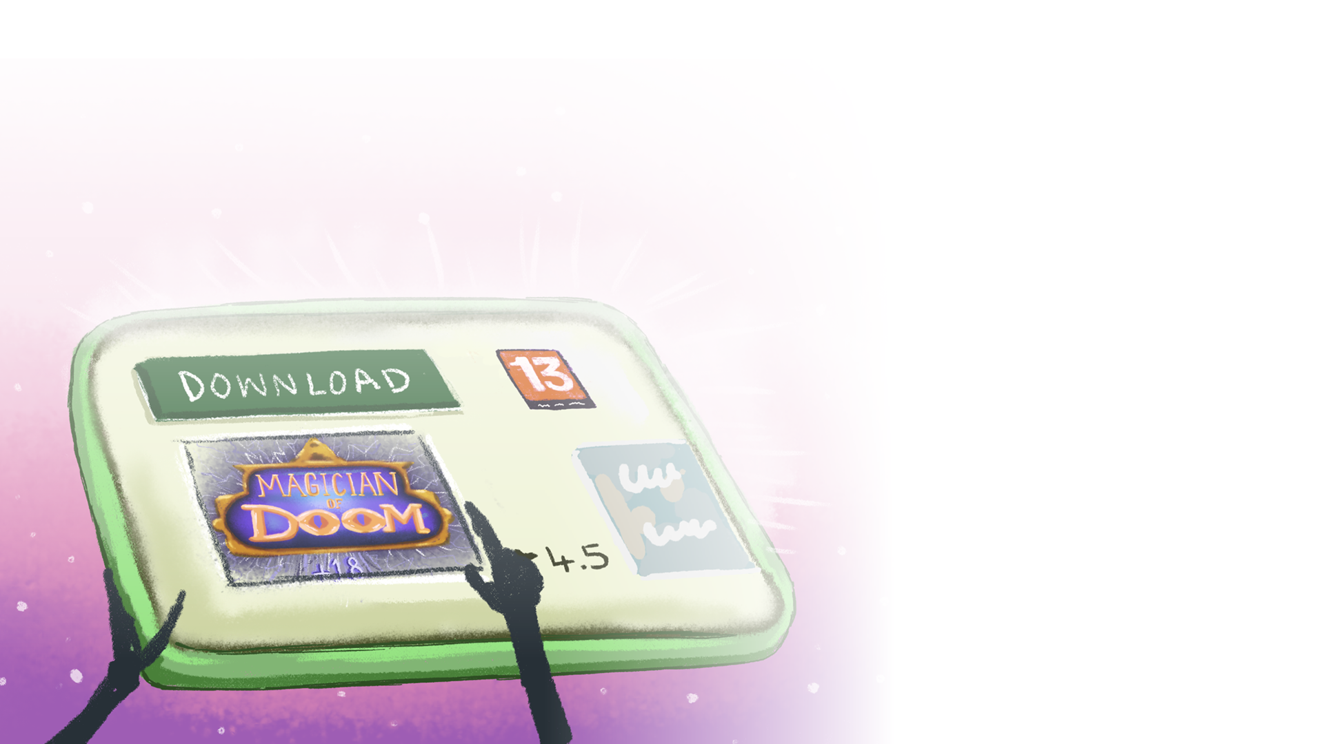
Archie’s favourite hobby is playing games. He loves playing with friends outside, and sometimes plays games on the internet.
He’d heard his friends talking about a new game called Magician of Doom and he couldn’t wait to try it. When he asked his mum if he could play it, she told him to check the age rating.
‘It’s 12,’ said Archie.
‘Then you can’t play it,’ said his mum. ‘It’s meant for older children, and wouldn’t be suitable for you. Why don’t you play Robo Warriors? You like that game.’
​Though disappointed, Archie nodded his head. He did like Robo Warriors. A lot.
In it, you played as a robot warrior, battling to protect your planet from an alien invasion. When you passed levels, you could unlock better armour and weapons. You played with other online players and worked as a team to defeat the enemy.

Slide 4
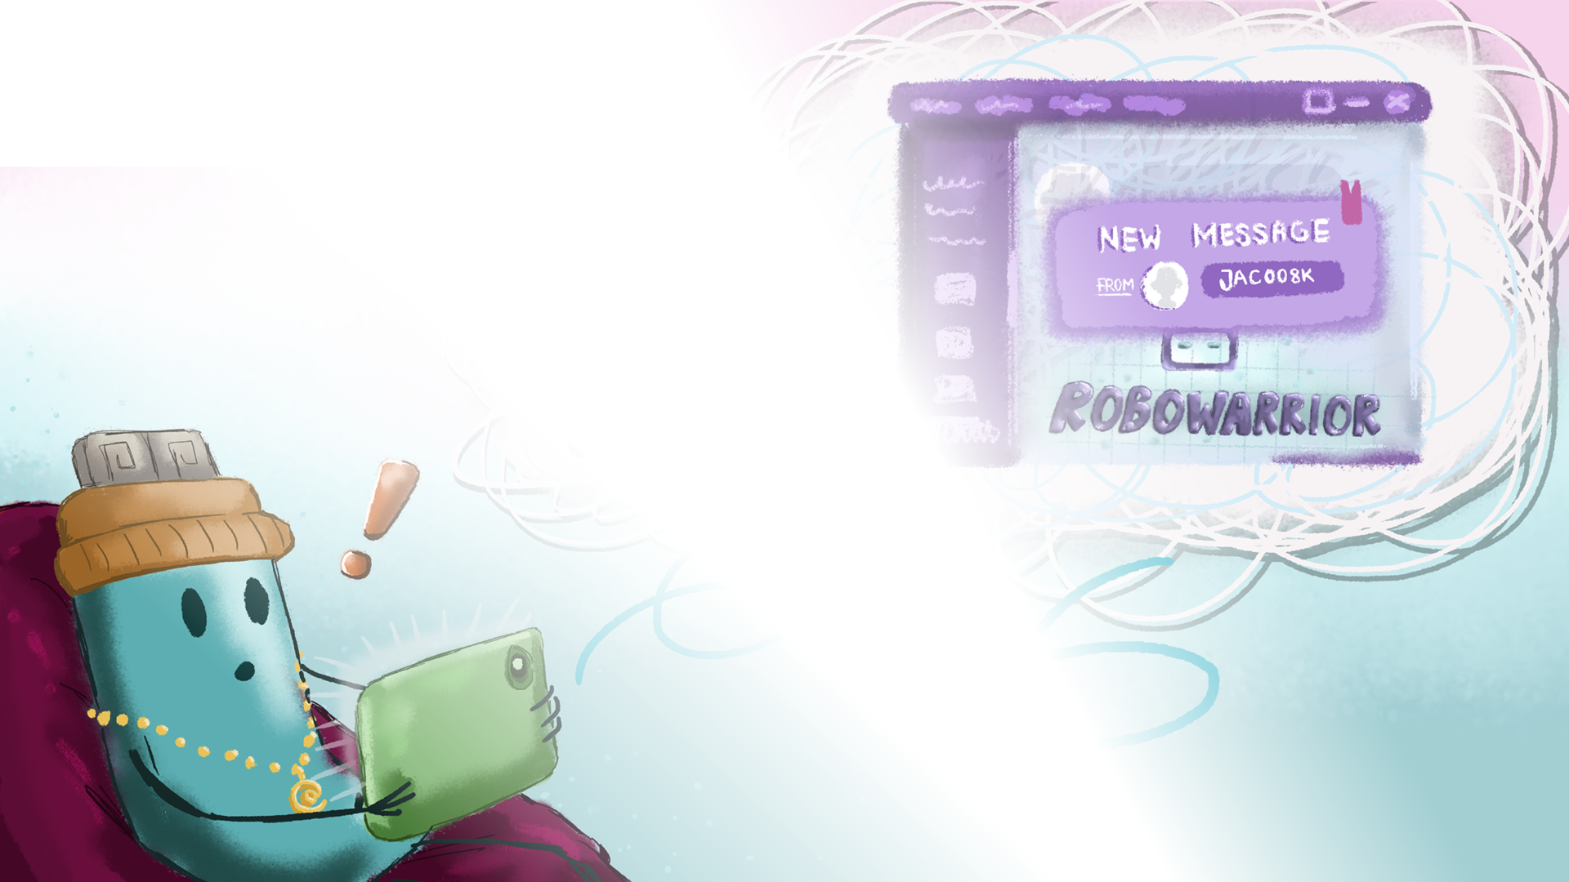
Today, there were two other players on Archie’s team. He had played with one of them before, crazycat971, but the other player was new.
While Archie was hiding behind a crashed spaceship in the game, he received a message from the new player, jac008k.
jac008k: Hi, my name’s Jack.
Archie typed in a reply. My name’s Archie.
jac008k: You’re really good at this game.
arch555: Thanks.
jac008k: I’m 9 years old. What age are you?

Slide 5

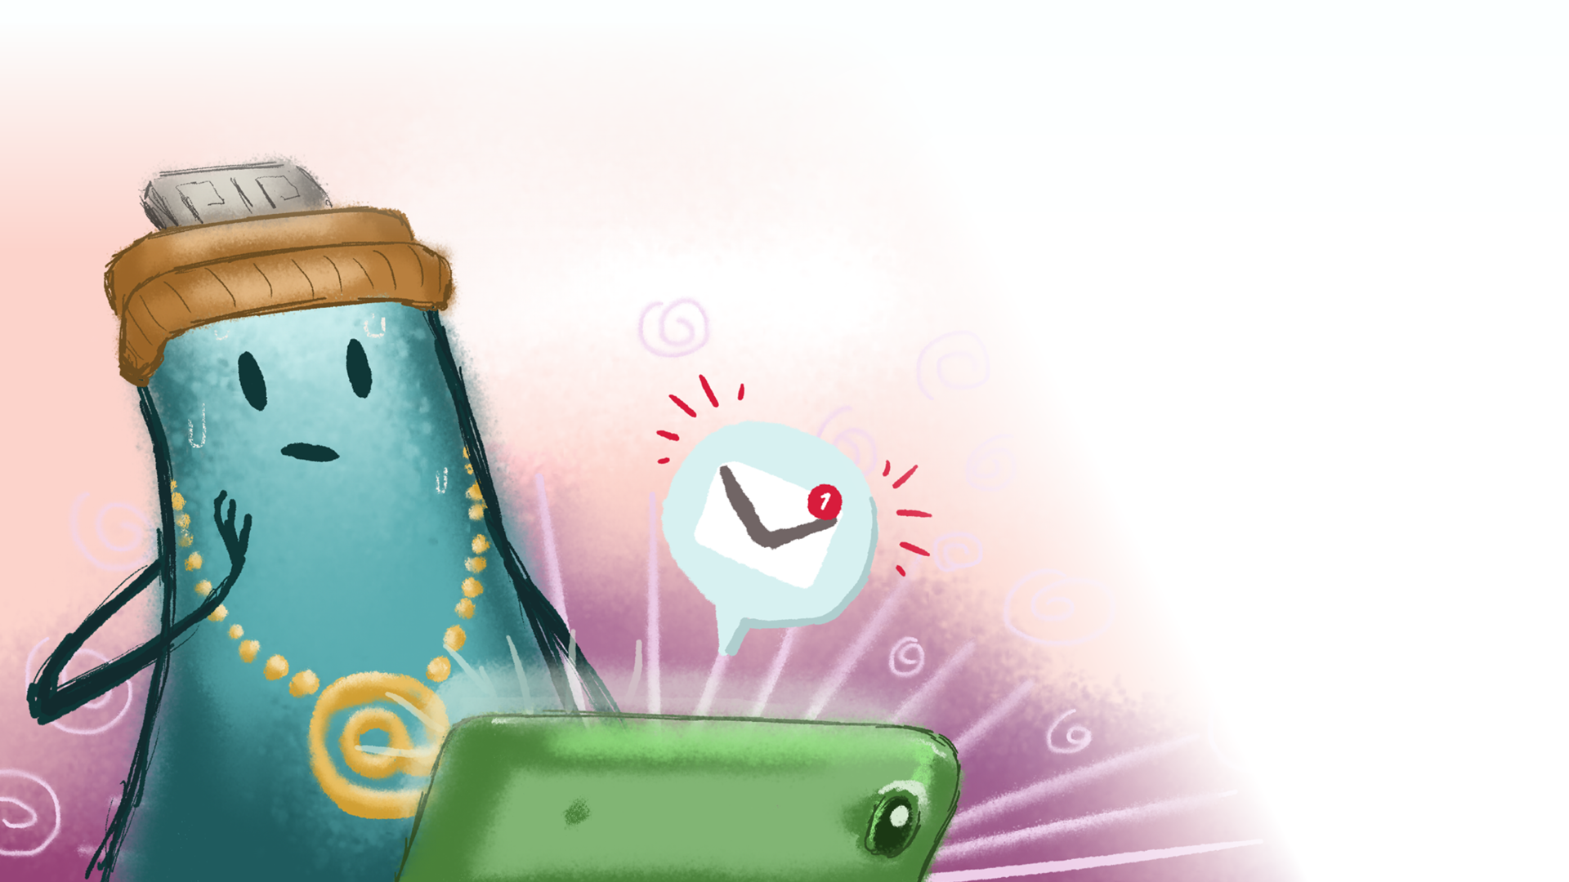
Archie wasn’t sure if he should say his age, but Jack was another kid, wasn’t he? So, it should be fine.
When Archie said his age, Jack asked him where he went to school.
Why does he want to know all this stuff? thought Archie.
Even if it felt a little wrong to do so, he told Jack where he went to school.
jac008k: What’s your address, Archie?
Archie had a funny sensation in his tummy. It didn’t feel right that this stranger was asking him so many personal questions. How was he going to get out of this situation?
jac008k: Archie, are you still there?

Slide 6
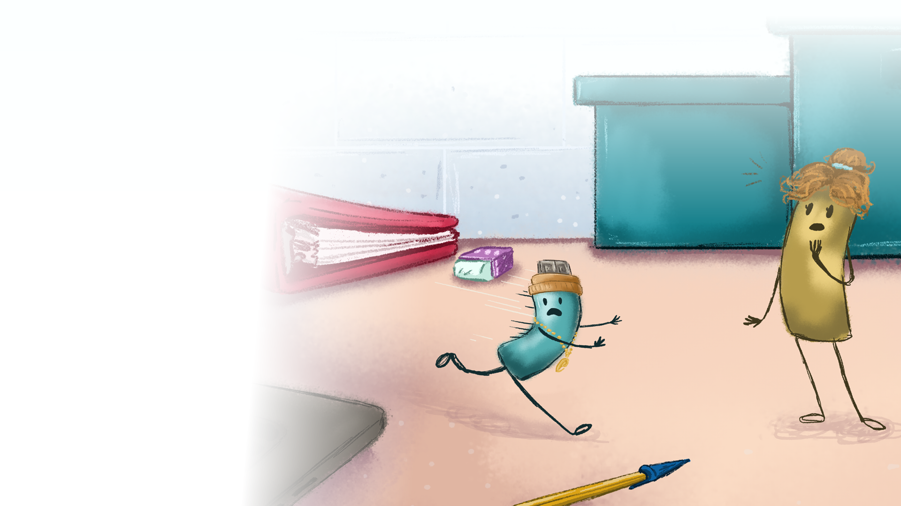

Archie jumped out of the game and ran away from the laptop to hide. Halfway across the teacher’s desk, he bumped into his mum.
‘Archie,’ she said. ‘There are tears in your eyes. What’s wrong?’
Archie wiped his eyes and told her the whole story. ‘I don’t think I should have told that kid so much about myself.’
‘Correct,’ said Archie’s mum, ‘because you can’t even be sure that person was a kid.’
‘I’m sorry,’ said Archie.
‘It’s okay. You did the right thing by telling me. You should always tell an adult if something upsets you on the internet.’

Slide 7
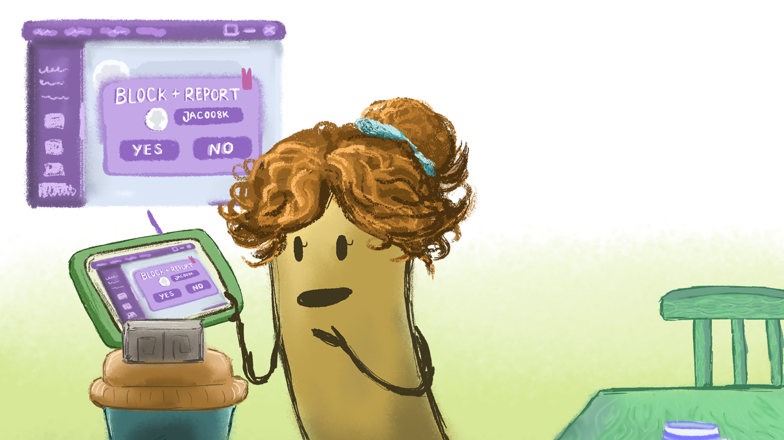
‘Now, I don’t want to play Robo Warriors again,’ said Archie, ‘in case I bump into jac008k.’
‘We can block that player,’ said Archie’s mum. ‘This means that jac008k can’t play with you or contact you again. Come on, let’s do it together.’
Archie followed her back to the laptop. Today, he’d learned a big lesson. Never reveal personal information on the internet, and if you do get in trouble, always tell a trusted adult.

