Slide 1

Notes:
Today we are going to discuss the Harassment, Harmful Communication and Related Offences Act 2020. That’s a mouthful, isn’t it? Some of you may have heard of it before under a different name, Coco’s Law. This is a new piece of legislation and we think it is important for you to know what it contains. Working with Webwise – the national organisation created to help educate young people about online safety, we have compiled some key facts which we will discuss today. We have called this What is Coco’s Law?, as hopefully by the end of this session everyone will have a clear understanding of this law and the part we all play in upholding it.

Slide 2

Notes:
Quick recap of class ground rules
In every aspect of life there are expected and acceptable ways of behaving. In school, you have the code of behaviour that sets out clearly the rules of the school and what happens when these are not adhered to. In society, we have laws to protect us and these set out a clear expectation of how people should conduct themselves. These laws act as safeguards and help create clear boundaries between right and wrong in a society.
I know that in your SPHE class you have a set of ground rules, or sometimes this is called a class contract. This helps ensure that everyone gets to participate and feel safe in your class environment. For the duration of this session I want you to remember that contract. These points that I have here are generally elements of class rules. I’d like to draw your attention to the second last one. What is shared in class stays in class, but there is a limit to this if a teacher or in this case myself, is concerned. The school and members of An Garda Siochana are required by law to seek advice and support from Tusla, the Child and Family Agency, if they are concerned you are in danger. Every school has a Designated Liaison Person and a Deputy Designated Liaison Person who they report to. Do you know who is the DLP in this school? [Get the teacher to confirm it, but it is generally the Principal.]
[At any point during the presentation if someone breaks one of the rules, gently point it out to them by saying something like “oh pause a second, I think you are forgetting the class agreement, remember the one about….]

Slide 3

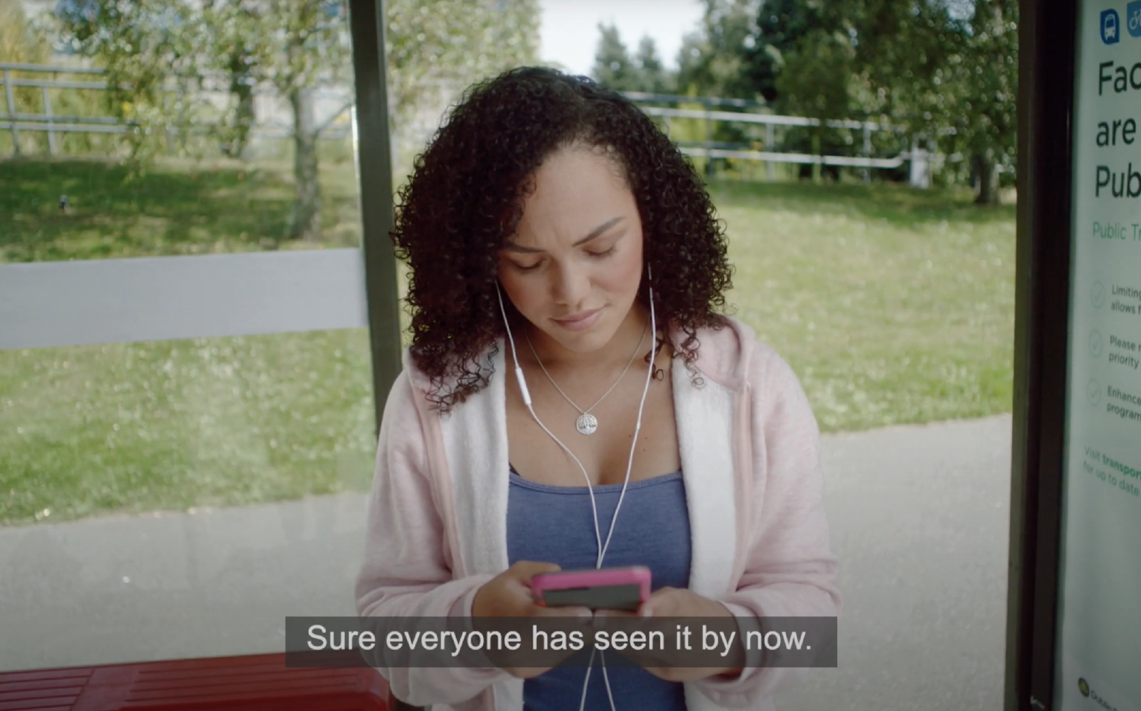
Click the screen to play the video
Notes:
Context
In February 2021 the Harassment, Harmful Communications and Related Offences Act was commenced. Sometimes this is known as Coco’s Law, after the 21 year old woman who’s experience of online harassment spurred legislators to action. This law is in addition to existing legislation which makes it is illegal to send, receive or share any sexually explicit images, video or text of someone under 18 years of age.
Coco’s Law creates two new offences which criminalise the non-consensual distribution of intimate images: Importantly, this applies even if the person initially gave consent for the picture to be taken, but they were later shared with other people without their consent.
There is also a third new offence that has been introduced under the 2020 Act which is also appropriate to note. S.4 of the Act creates an offence of “Distributing, publishing or sending threatening or grossly offensive communication”. This offence will cover situations where the perpetrator distributes or publishes a threat or grossly offensive communications to the victim or about the victim and is likely to be used to address cyberbullying. It can cover once-off threatening or grossly offensive communications.
Play the following video:
https://www.youtube.com/watch?v=I7yQcyPWu8M
Once the clip is completed…
This legislation covers more than just what is depicted in the video and hopefully by the end of this session we will have teased out the main points of the new legislation which are important to know.
VIDEO TBC

Slide 4
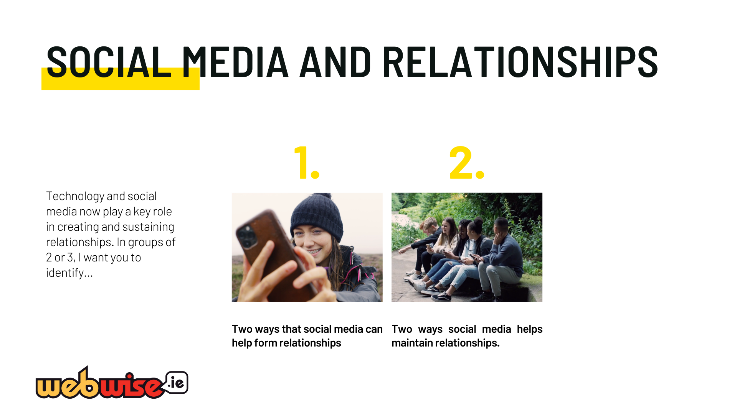
Notes:
Social media and relationships
Technology and social media now play a key role in creating and sustaining relationships. In groups of 2 or 3, I want you to identify:
two ways that social media can help form relationships
two ways it helps maintain them.
[Give the students about 4 minutes to discuss this and then take some feedback. Acknowledge their input without critiquing their answers. This is important as they might have different ideas and experiences of social media’s role in their relationships. This feedback will give you a good idea of where the room is at with relationship and their comfort level with participating. If students are reluctant to volunteer answers, throw out a few ideas…
Did any group discuss dating apps? How about looking someone up online to find out their interests, did any group discuss that? What were your thoughts on texting versus phone calls?

Slide 5
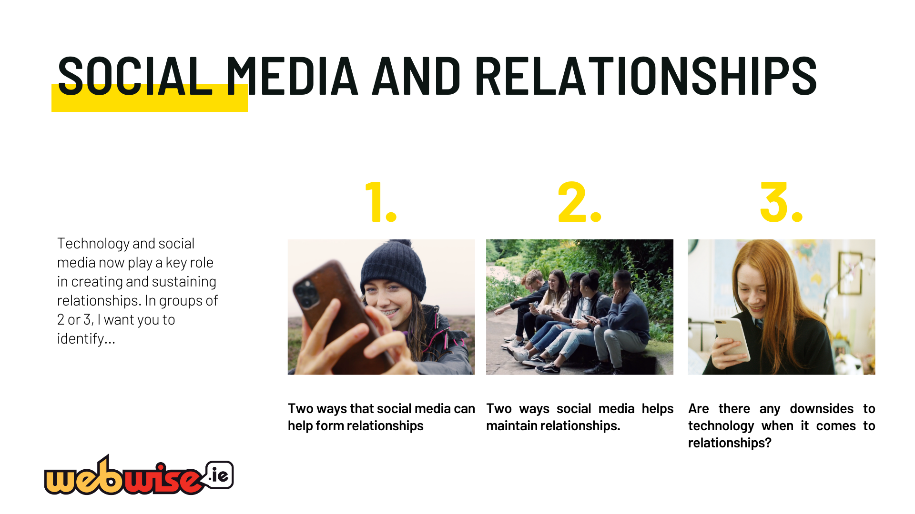
Notes:
Social media and relationships (Continued)
Once this section is complete, click to add the following questions to the slide:
Are there any downsides to technology when it comes to relationships?
[Similarly, give then 2-3 minutes to discuss this question and then take some feedback. The potential range of answers for the question are vast. Anything from, always being contactable / FOMO – Fear of missing out / comparing your relationships to celebrities / misunderstanding the tone of a message / seeing all your friends in relationships when you are not…..etc.
Take feedback and don’t comment on it (unless they break the rules in the previous slide, in which case stop them). This is the students opportunity to express their concerns. Once you feel that all the major points are covered, then proceed.]
We know how useful technology and social media is for keeping people connected. Unfortunately though, sometimes social media can cause problems for people in their relationships. This new law has been passed to help create a clear understanding of safe boundaries around technology and social media in relationships.

Slide 6
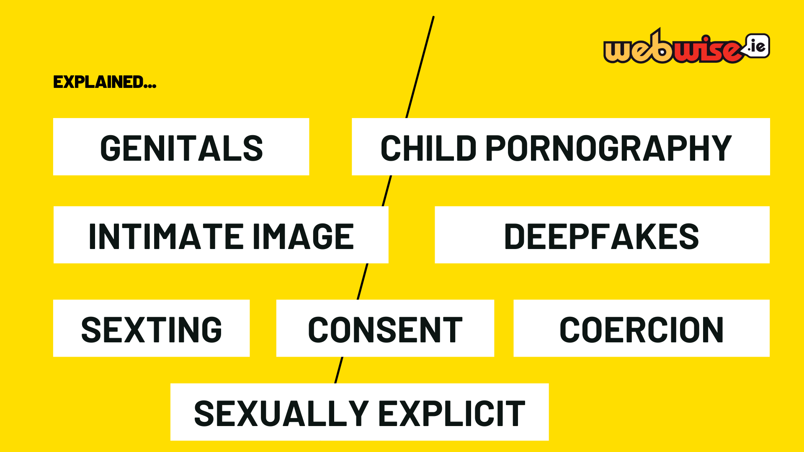
Notes:
Key words
These words are going to be used in our discussion of the Harassment, Harmful Communications and Related Offences Act. It is important we all have a clear understanding of what they mean. So in pairs [ask the teacher to help you with ensuring that every child is in a group] discuss what you understand these words to mean.
[This activity might get some people embarrassed and we will not be taking feedback in case the students get the term wrong. The purpose is not to assess their understanding, but to get an opportunity to clarify any mis-understanding.]

Slide 7
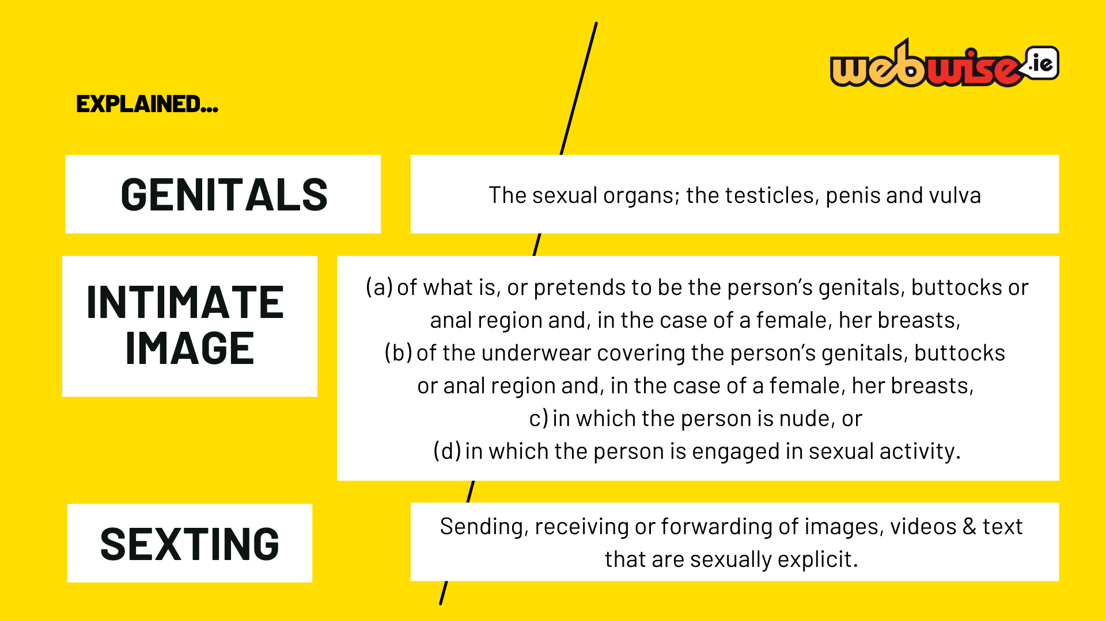
Notes:
Jargon busting
[If you feel uncomfortable reading out these definitions then you can just leave the slide on the OHP, however it would be best to read through them so the students who have difficulty with reading can hear the definitions out loud.]
What are genitals? The sexual organs; the testicles, penis and vulva
What is meant by intimate image?
(a) of what is, or pretends to be the person’s genitals, buttocks or anal region and, in the case of a female, her breasts,
(b) of the underwear covering the person’s genitals, buttocks or anal region and, in the case of a female, her breasts,
c) in which the person is nude, or
(d) in which the person is engaged in sexual activity.
What is sexting? Sending, receiving or forwarding of images, videos & text that are sexually explicit.

Slide 8
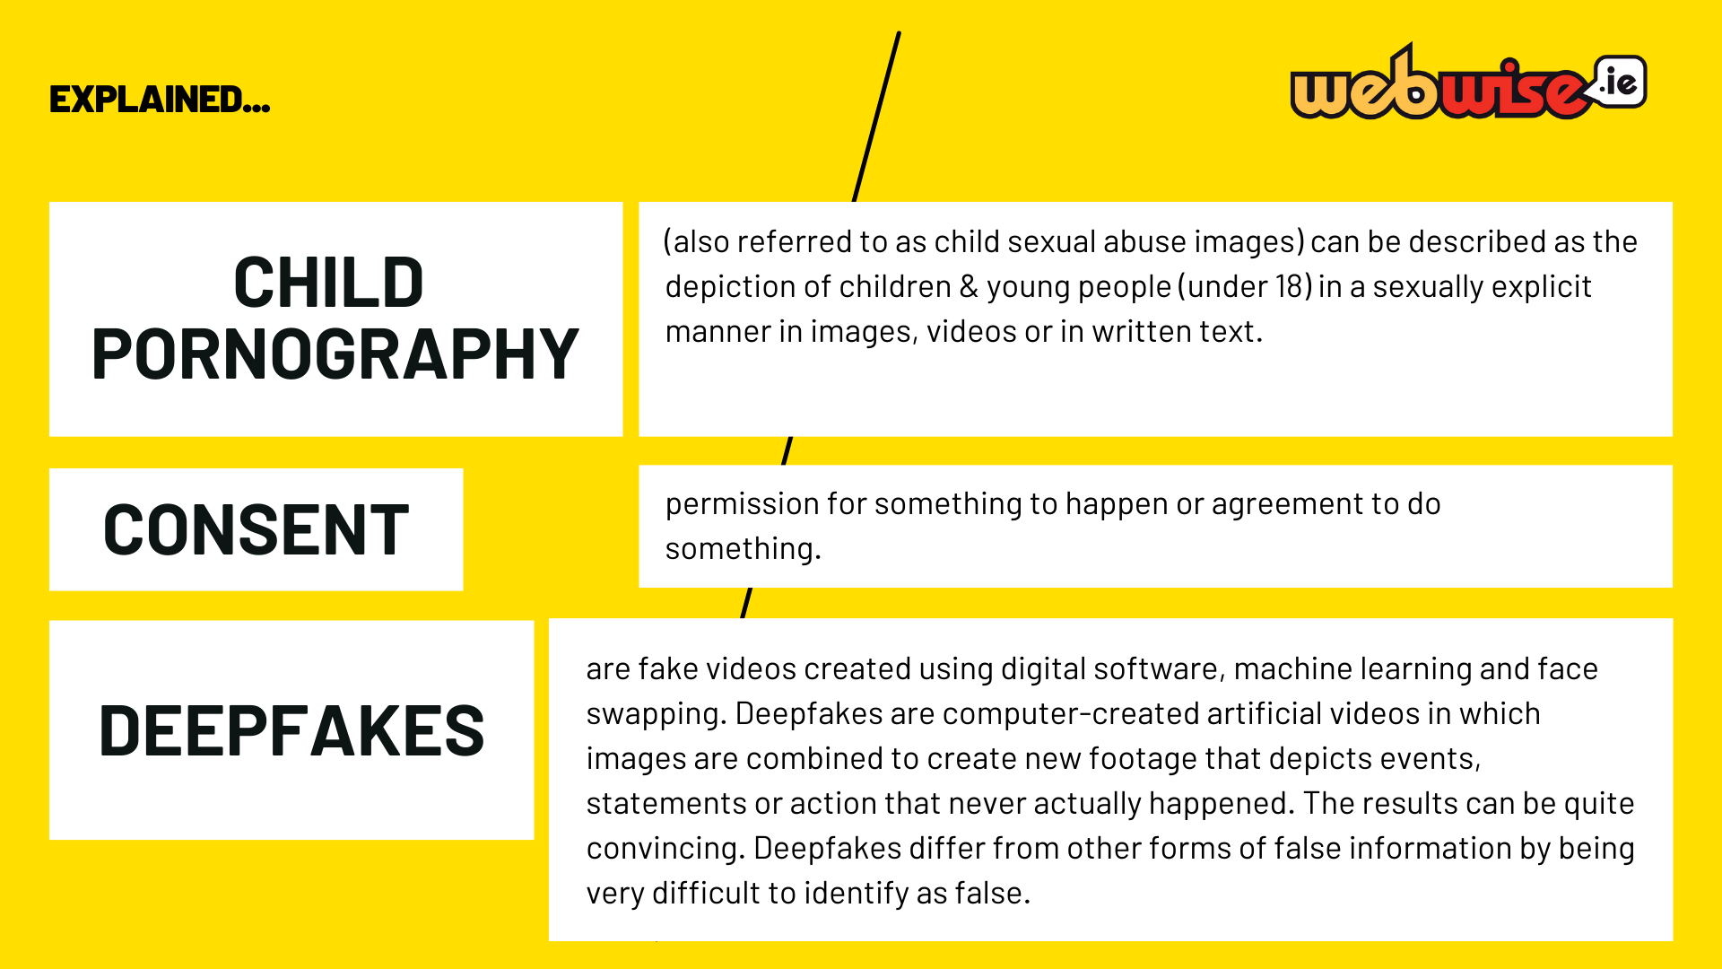
Notes:
Child Pornography (also referred to as child sexual abuse images) can be described as the depiction of children & young people (under 18) in a sexually explicit manner in images, videos or in written text.
Consent: permission for something to happen or agreement to do something.
Consent should be a freely given yes, it should allow space to say no and to change your mind.
Deepfakes are fake videos created using digital software, machine learning and face swapping. Deepfakes are computer-created artificial videos in which images are combined to create new footage that depicts events, statements or action that never actually happened. The results can be quite convincing. Deepfakes differ from other forms of false information by being very difficult to identify as false.

Slide 9
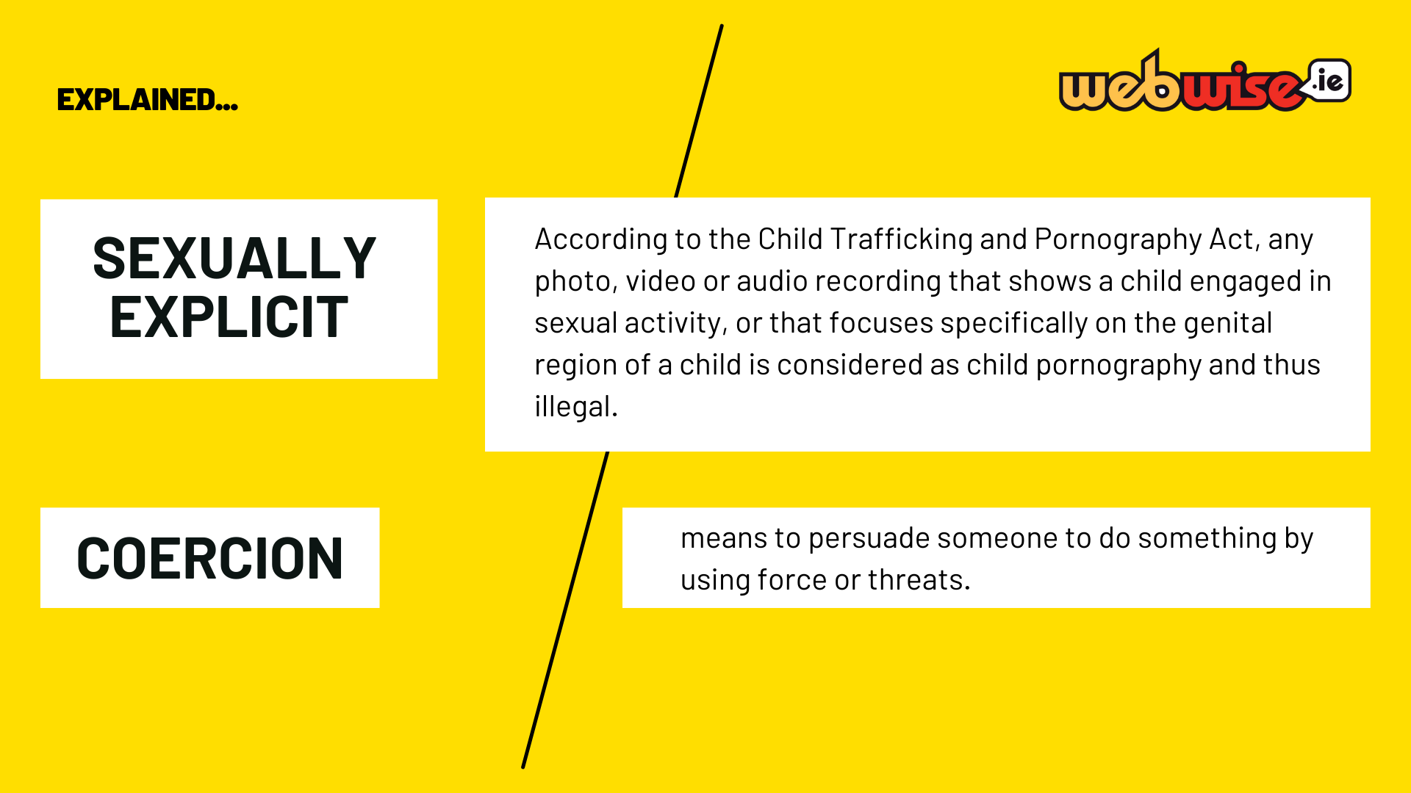
Notes:
Sexually Explicit: : According to the Child Trafficking and Pornography Act, any photo, video or audio recording that shows a child engaged in sexual activity, or that focuses specifically on the genital region of a child is considered as child pornography and thus illegal. It is less clear whether content that is provocative rather than sexually explicit is illegal. Part (d) of the act could be interpreted so that almost any provocative content produced or sent by a child could be considered as child pornography. Ultimately only a court would decide if particular content could be considered illegal under this section.
Coercion means to persuade someone to do something by using force or threats.

Slide 10
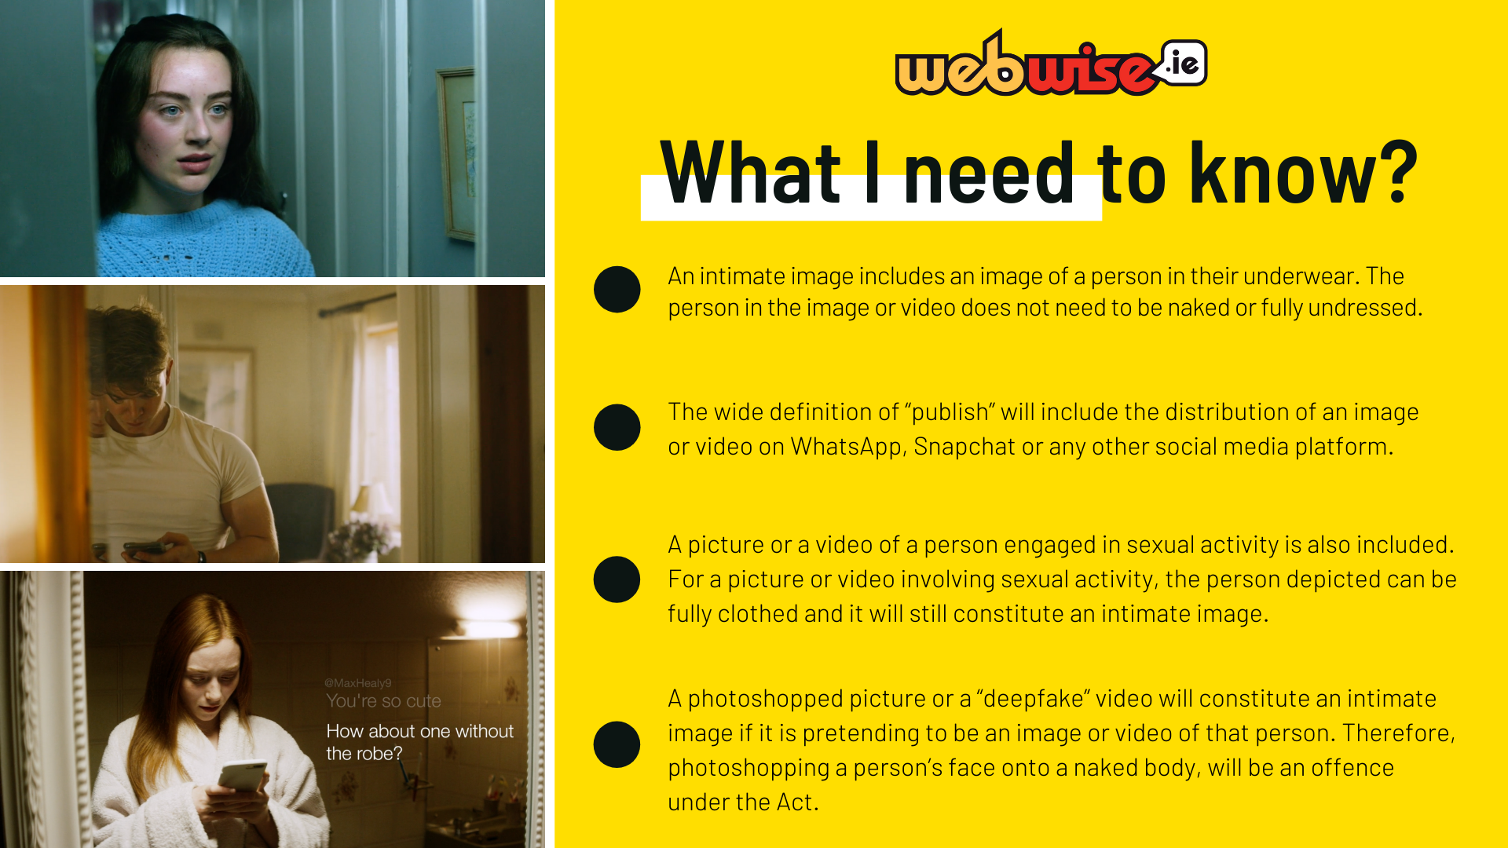
Notes:
Some key points
• An intimate image includes an image of a person in their underwear. The person in the image or video does not need to be naked or fully undressed.
• The wide definition of “publish” will include the distribution of an image or video on WhatsApp, Snapchat or any other social media platform.
• A picture or a video of a person engaged in sexual activity is also included. For a picture or video involving sexual activity, the person depicted can be fully clothed and it will still constitute an intimate image.
• A photoshopped picture or a “deepfake” video will constitute an intimate image if it is pretending to be an image or video of that person. Therefore, photoshopping a person’s face onto a naked body, will be an offence under the Act.

Slide 11
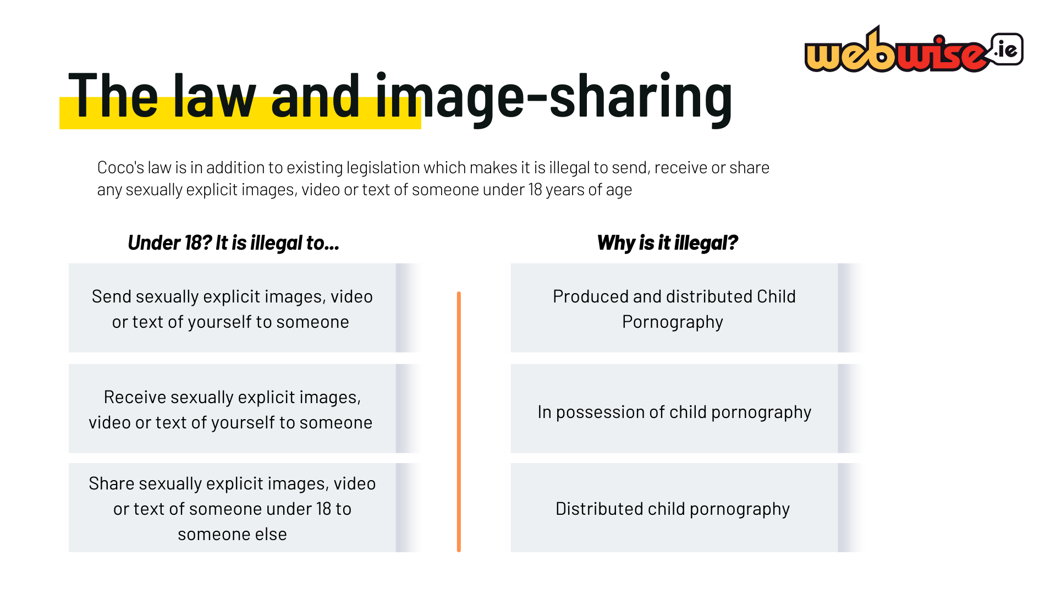
Notes:
Please note: The term child pornography is still used in legislation in Ireland. For the purposes of highlighting the relevant legislation on this slide we have used the legal term. The preferred term is Child sexual abuse material. In non-legal contexts the term Child Sexual Abuse Material (CSAM) should be used.
Other applicable laws
Coco's law is in addition to existing legislation which makes it is illegal to send, receive or share any sexually explicit images, video or text of someone under 18 years of age
Under 18? It is illegal to...
Send sexually explicit images, video or text of yourself to someone
Why?
Produced and distributed Child Pornography
Under 18? It is illegal to...
Receive sexually explicit images, video or text of yourself to someone
Why?
In possession of child pornography
Under 18? It is illegal to...
Share sexually explicit images, video or text of someone under 18 to someone else
Why?
Distributed child pornography
Important Note: The Child Trafficking and Pornography Act states that the creation, distribution and possession of child pornography are all illegal. This could be interpreted as meaning that anyone who creates, sends, shares, stores or even just receives explicit images of a child under the age of 17 could potentially be prosecuted under the 1998 Act. In cases of self-generated explicit content or ‘nude selfies’, the person him/herself can be the creator, distributor and possessor of illegal content. The law in this area was designed to protect children from exploitation and not to criminalise their reckless acts. That said, approaches will differ from Garda Station to Garda Station.

Slide 12

Notes:
Scenarios – Has an offence occurred?
Distribute Photocopies of Appendix 4 and get the students in their pairs to discuss the scenarios. This is a key element of the session, as by giving them an opportunity to discuss the scenarios they are teasing out the issues without you needing to explicitly go through each element of the legislation. This will probably take about 10 minutes – don’t try and hurry it along. Circulate around the room and ask probing questions if you can (health and safety permitting).
Note – The A Scenarios are suitable for 3rd year (slides 11-17), the B Scenarios (slides 18-24) should only be used with students in 4th year and up. Please remove slides 18-24 in this powerpoint before teaching junior cycle level.

Slide 13
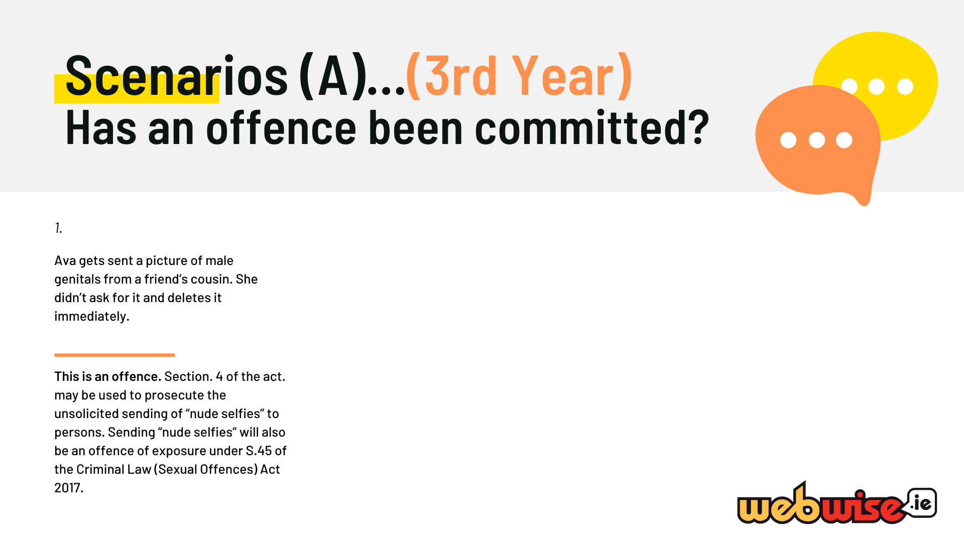
Notes:
Answers to scenarios
Bring the class back to focus and discuss their answers. Use the PP slides and answers on Appendix 5 to help. It will emerge after a few slides, that all of the scenarios are offences under the legislation. In all likelihood questions will then emerge about prosecution and sentencing.
If they do, state that the Gardaí have an obligation to investigate all allegations and present their findings to the Director of Public Prosecutions. It is up to the DPP if a child under 17 years of age can/will be charged with an offence under this particular Act. Scenarios A – Answers (suitable for 3rd year up)
This is an offence. Section. 4 of the act. may be used to prosecute the unsolicited sending of “nude selfies” to persons. Sending “nude selfies” will also be an offence of exposure under S.45 of the Criminal Law (Sexual Offences) Act 2017.
This is an offence. It is an intimate image of John as he is in his underwear and John did not consent for the photo to be taken. By sending it to someone John’s “Friends” published it.
This is not an offence as the image is not explicit and is shared consensually.
This is an offence. A threat to distribute the image is sufficient to trigger the provisions of the Act, even if the image is never sent to anyone. Furthermore, even if
the threat was a joke and the person who made the threat never actually intended to send the image, it is still an offence.
This is an offence. “Up-skirting” is covered in the legislation under section 3. that recording, distribution or publication, as the case may be, seriously interferes with that other person’s peace and privacy or causes alarm, distress or harm to that other person.
This is not an offence as the image is not explicit and is shared consensually.
This is an offence under section 3 as it is an intimate image taken without consent. It is important to note that there is no requirement to distribute the intimate image and the recording is sufficient on its own to complete the offence.
This is not an offence as the image is shared on Ian’s timeline consensually and is happy to join in on the banter around the image.

Slide 14
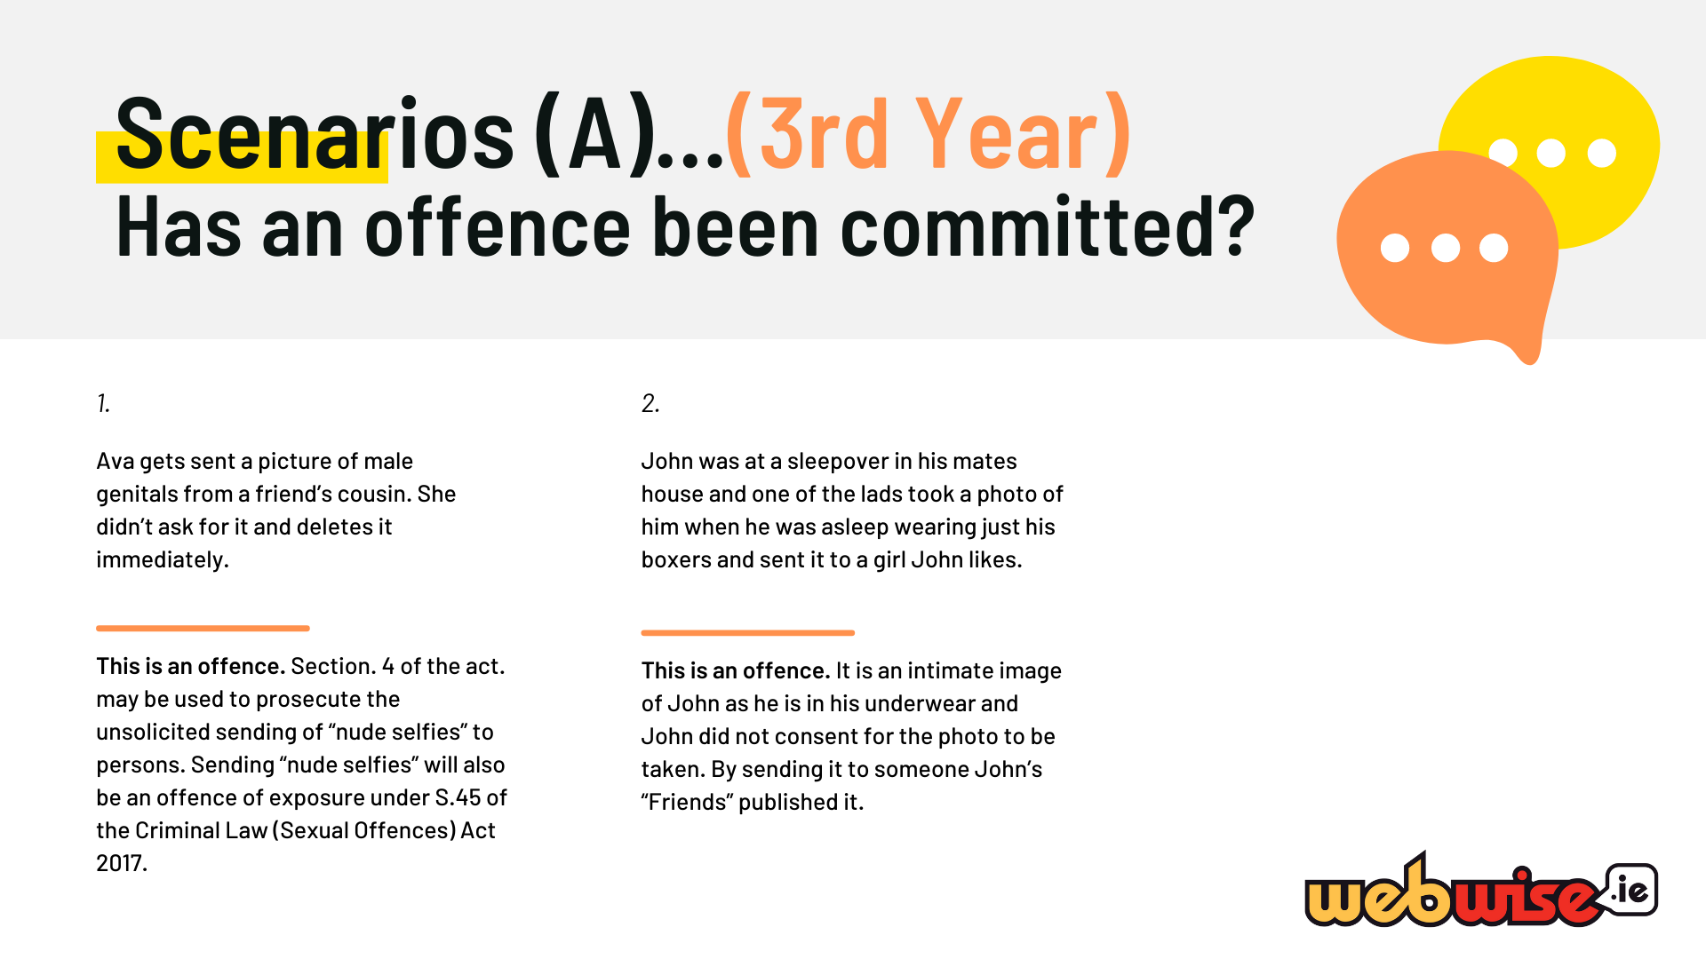
Notes:
Scenarios A – Answers (suitable for 3rd year up)
This is an offence. Section. 4 of the act. may be used to prosecute the unsolicited sending of “nude selfies” to persons. Sending “nude selfies” will also be an offence of exposure under S.45 of the Criminal Law (Sexual Offences) Act 2017.
This is an offence. It is an intimate image of John as he is in his underwear and John did not consent for the photo to be taken. By sending it to someone John’s “Friends” published it.
This is not an offence as the image is not explicit and is shared consensually.
This is an offence. A threat to distribute the image is sufficient to trigger the provisions of the Act, even if the image is never sent to anyone. Furthermore, even if
the threat was a joke and the person who made the threat never actually intended to send the image, it is still an offence.
This is an offence. “Up-skirting” is covered in the legislation under section 3. that recording, distribution or publication, as the case may be, seriously interferes with that other person’s peace and privacy or causes alarm, distress or harm to that other person.
This is not an offence as the image is not explicit and is shared consensually.
This is an offence under section 3 as it is an intimate image taken without consent. It is important to note that there is no requirement to distribute the intimate image and the recording is sufficient on its own to complete the offence.
This is not an offence as the image is shared on Ian’s timeline consensually and is happy to join in on the banter around the image.

Slide 15
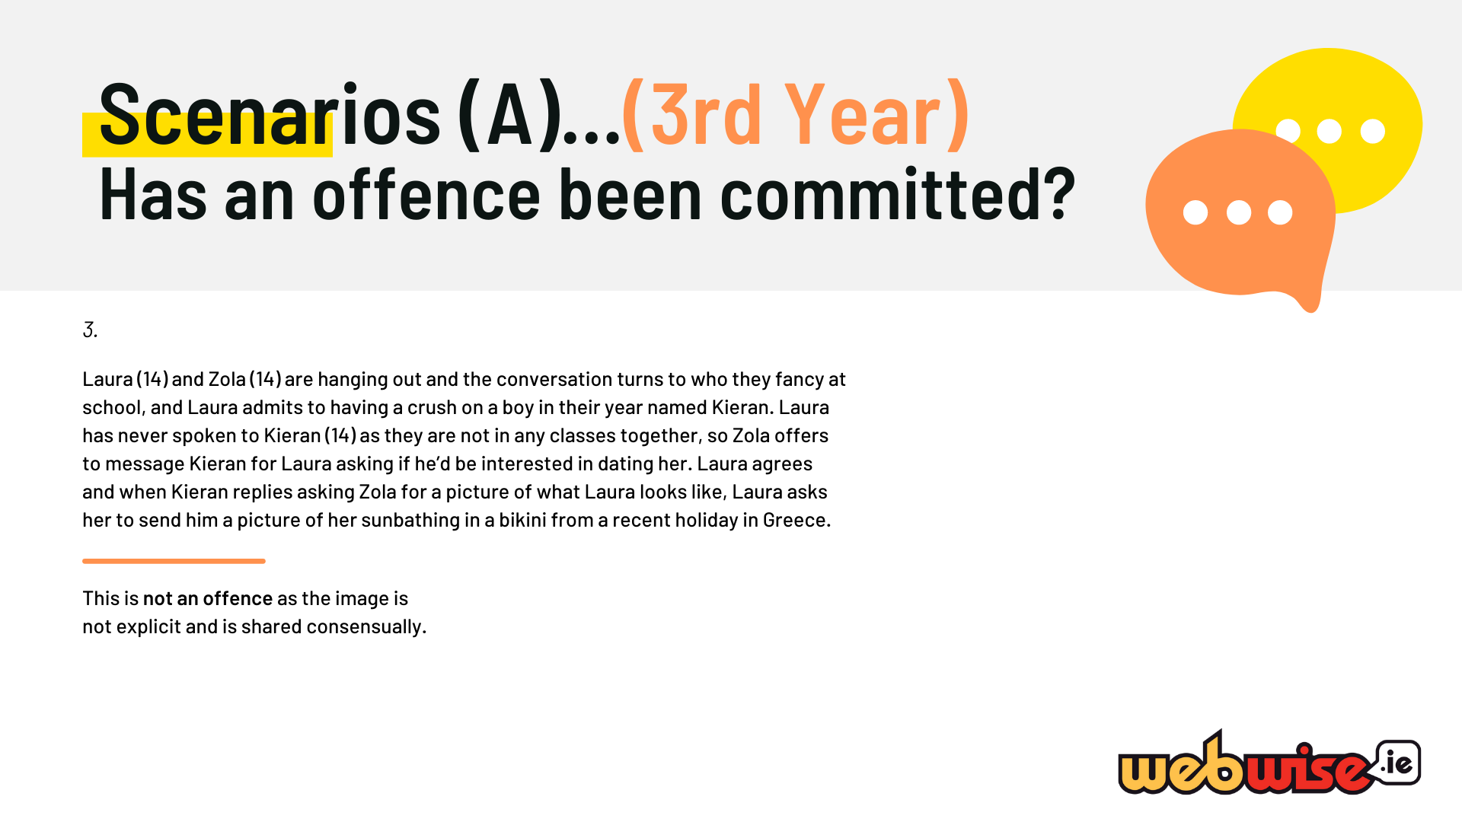
Notes:
Scenarios A – Answers (suitable for 3rd year up)
This is an offence. Section. 4 of the act. may be used to prosecute the unsolicited sending of “nude selfies” to persons. Sending “nude selfies” will also be an offence of exposure under S.45 of the Criminal Law (Sexual Offences) Act 2017.
This is an offence. It is an intimate image of John as he is in his underwear and John did not consent for the photo to be taken. By sending it to someone John’s “Friends” published it.
This is not an offence as the image is not explicit and is shared consensually.
This is an offence. A threat to distribute the image is sufficient to trigger the provisions of the Act, even if the image is never sent to anyone. Furthermore, even if
the threat was a joke and the person who made the threat never actually intended to send the image, it is still an offence.
This is an offence. “Up-skirting” is covered in the legislation under section 3. that recording, distribution or publication, as the case may be, seriously interferes with that other person’s peace and privacy or causes alarm, distress or harm to that other person.
This is not an offence as the image is not explicit and is shared consensually.
This is an offence under section 3 as it is an intimate image taken without consent. It is important to note that there is no requirement to distribute the intimate image and the recording is sufficient on its own to complete the offence.
This is not an offence as the image is shared on Ian’s timeline consensually and is happy to join in on the banter around the image.

Slide 16
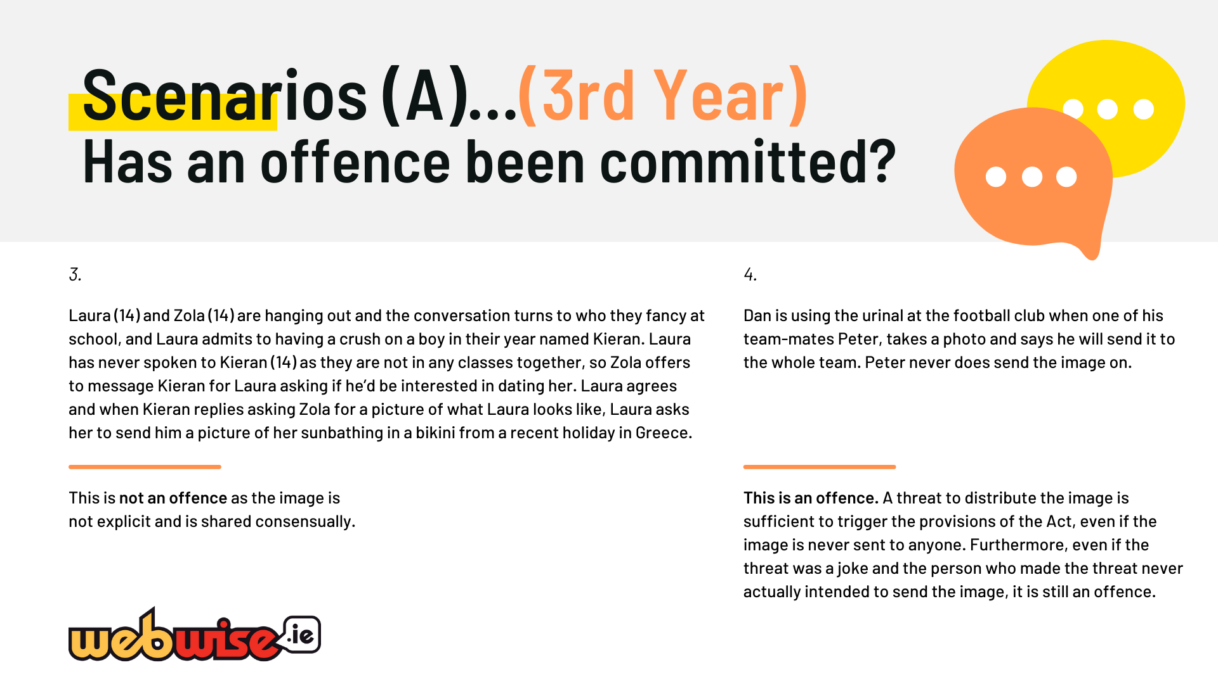
Notes:
Scenarios A – Answers (suitable for 3rd year up)
This is an offence. Section. 4 of the act. may be used to prosecute the unsolicited sending of “nude selfies” to persons. Sending “nude selfies” will also be an offence of exposure under S.45 of the Criminal Law (Sexual Offences) Act 2017.
This is an offence. It is an intimate image of John as he is in his underwear and John did not consent for the photo to be taken. By sending it to someone John’s “Friends” published it.
This is not an offence as the image is not explicit and is shared consensually.
This is an offence. A threat to distribute the image is sufficient to trigger the provisions of the Act, even if the image is never sent to anyone. Furthermore, even if
the threat was a joke and the person who made the threat never actually intended to send the image, it is still an offence.
This is an offence. “Up-skirting” is covered in the legislation under section 3. that recording, distribution or publication, as the case may be, seriously interferes with that other person’s peace and privacy or causes alarm, distress or harm to that other person.
This is not an offence as the image is not explicit and is shared consensually.
This is an offence under section 3 as it is an intimate image taken without consent. It is important to note that there is no requirement to distribute the intimate image and the recording is sufficient on its own to complete the offence.
This is not an offence as the image is shared on Ian’s timeline consensually and is happy to join in on the banter around the image.

Slide 17
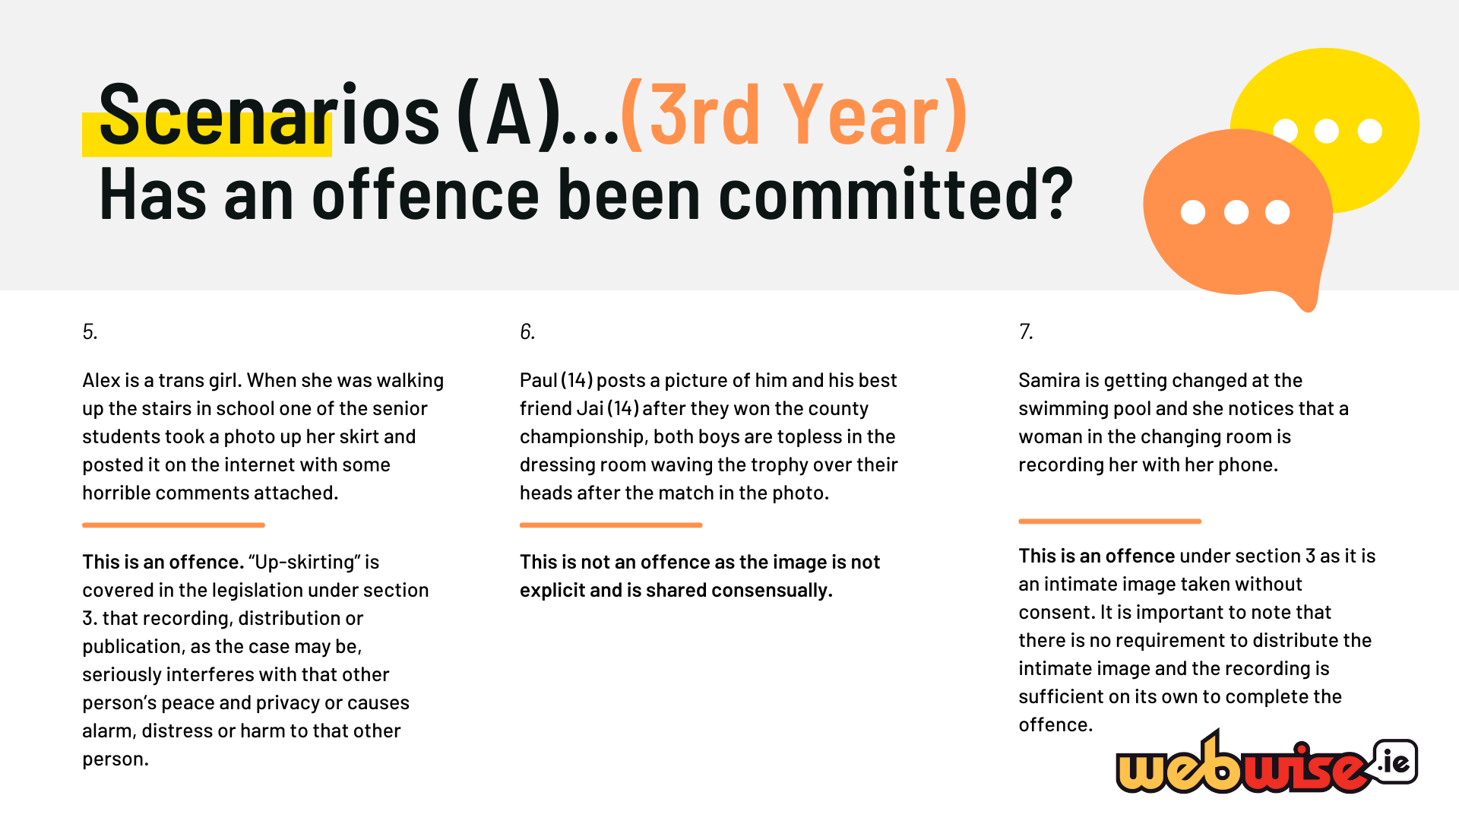
Notes:
Scenarios A – Answers (suitable for 3rd year up)
This is an offence. Section. 4 of the act. may be used to prosecute the unsolicited sending of “nude selfies” to persons. Sending “nude selfies” will also be an offence of exposure under S.45 of the Criminal Law (Sexual Offences) Act 2017.
This is an offence. It is an intimate image of John as he is in his underwear and John did not consent for the photo to be taken. By sending it to someone John’s “Friends” published it.
This is not an offence as the image is not explicit and is shared consensually.
This is an offence. A threat to distribute the image is sufficient to trigger the provisions of the Act, even if the image is never sent to anyone. Furthermore, even if
the threat was a joke and the person who made the threat never actually intended to send the image, it is still an offence.
This is an offence. “Up-skirting” is covered in the legislation under section 3. that recording, distribution or publication, as the case may be, seriously interferes with that other person’s peace and privacy or causes alarm, distress or harm to that other person.
This is not an offence as the image is not explicit and is shared consensually.
This is an offence under section 3 as it is an intimate image taken without consent. It is important to note that there is no requirement to distribute the intimate image and the recording is sufficient on its own to complete the offence.
This is not an offence as the image is shared on Ian’s timeline consensually and is happy to join in on the banter around the image.

Slide 18
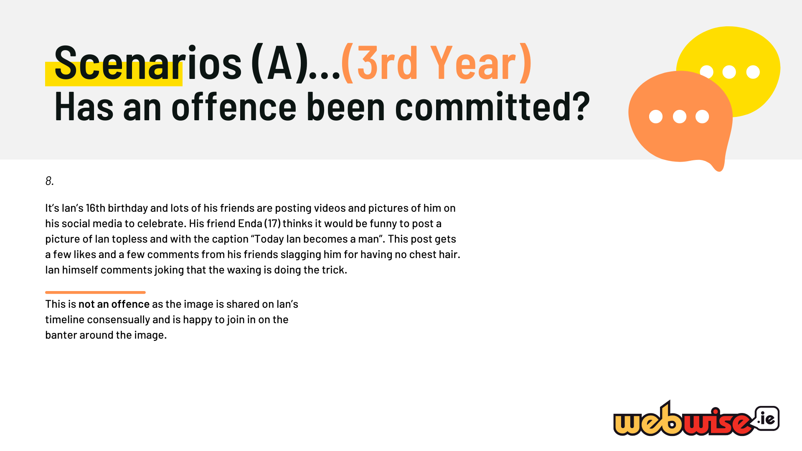
Notes:
Scenarios A – Answers (suitable for 3rd year up)
This is an offence. Section. 4 of the act. may be used to prosecute the unsolicited sending of “nude selfies” to persons. Sending “nude selfies” will also be an offence of exposure under S.45 of the Criminal Law (Sexual Offences) Act 2017.
This is an offence. It is an intimate image of John as he is in his underwear and John did not consent for the photo to be taken. By sending it to someone John’s “Friends” published it.
This is not an offence as the image is not explicit and is shared consensually.
This is an offence. A threat to distribute the image is sufficient to trigger the provisions of the Act, even if the image is never sent to anyone. Furthermore, even if
the threat was a joke and the person who made the threat never actually intended to send the image, it is still an offence.
This is an offence. “Up-skirting” is covered in the legislation under section 3. that recording, distribution or publication, as the case may be, seriously interferes with that other person’s peace and privacy or causes alarm, distress or harm to that other person.
This is not an offence as the image is not explicit and is shared consensually.
This is an offence under section 3 as it is an intimate image taken without consent. It is important to note that there is no requirement to distribute the intimate image and the recording is sufficient on its own to complete the offence.
This is not an offence as the image is shared on Ian’s timeline consensually and is happy to join in on the banter around the image.

Slide 19
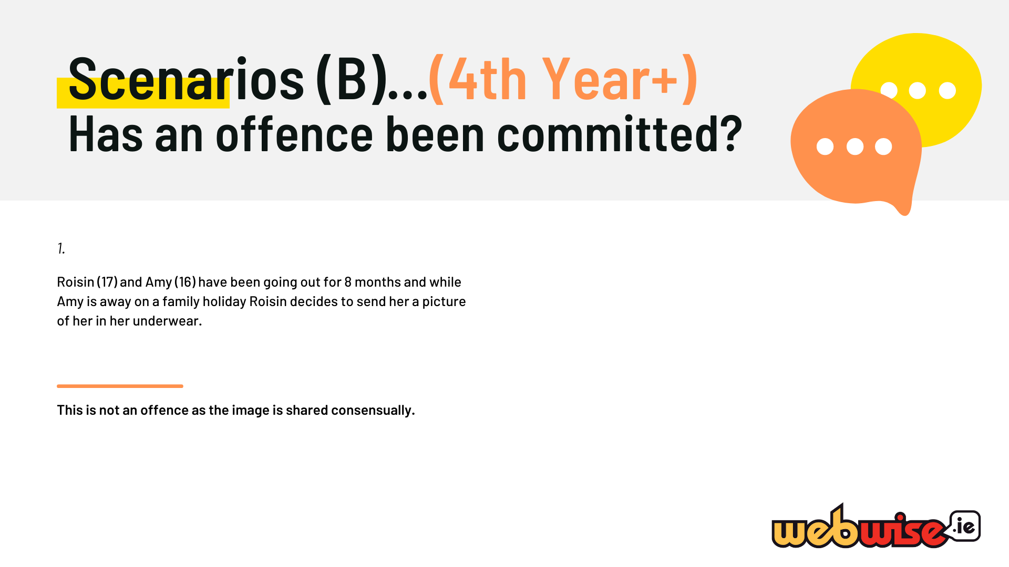
Notes:
Scenarios B – Answers (suitable for 4th year up, not suitable for 3rd year)
This is not an offence as the image is shared consensually.

Slide 20
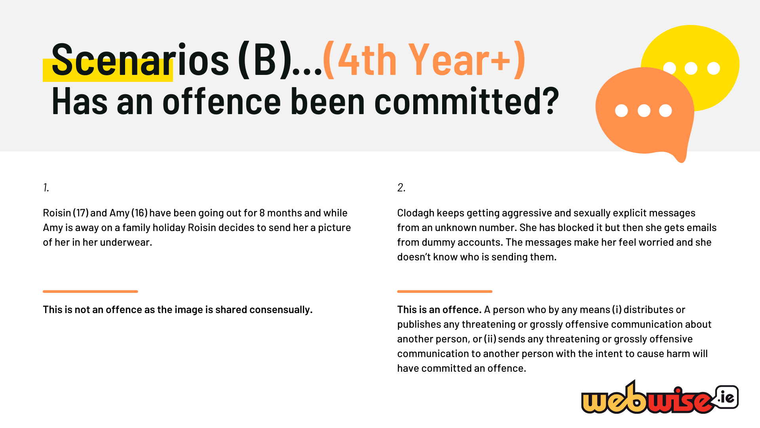
Notes:
Scenarios B – Answers (suitable for 4th year up, not suitable for 3rd year)
This is not an offence as the image is shared consensually.
This is an offence. A person who by any means (i) distributes or publishes any threatening or grossly offensive communication about another person, or (ii) sends any threatening or grossly offensive communication to another person with the intent to cause harm will have committed an offence.

Slide 21
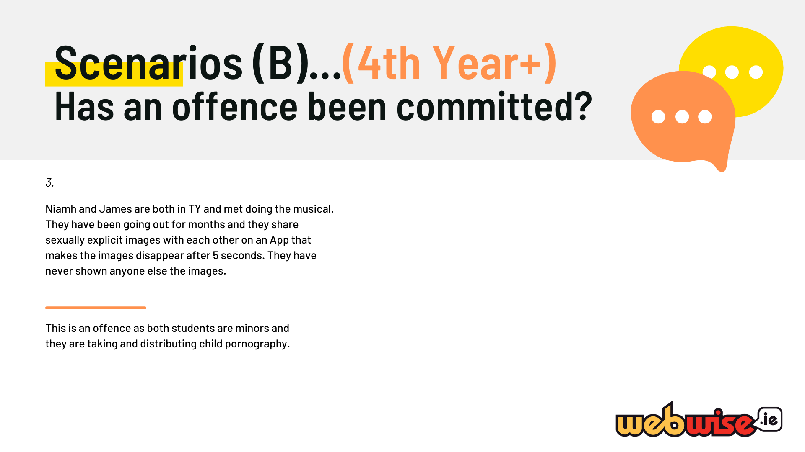
Notes:
Scenarios B – Answers (suitable for 4th year up, not suitable for 3rd year)
3. This is an offence as both students are minors and they are taking and distributing child pornography. The images created are sexually explicit.

Slide 22
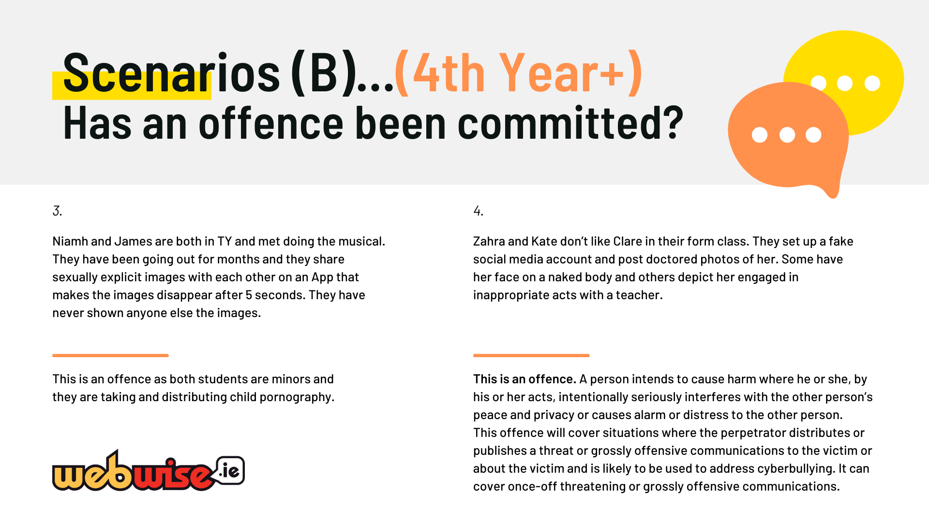
Notes:
3. This is an offence as both students are minors and they are taking and distributing child pornography. The images created are sexually explicit.
4. This is an offence. A person intends to cause harm where he or she, by his or her acts, intentionally seriously interferes with the other person’s peace and privacy or causes alarm or distress to the other person. This offence will cover situations where the perpetrator distributes or publishes a threat or grossly offensive communications to the victim or about the victim and is likely to be used to address cyberbullying. It can cover once-off threatening or grossly offensive communications.

Slide 23
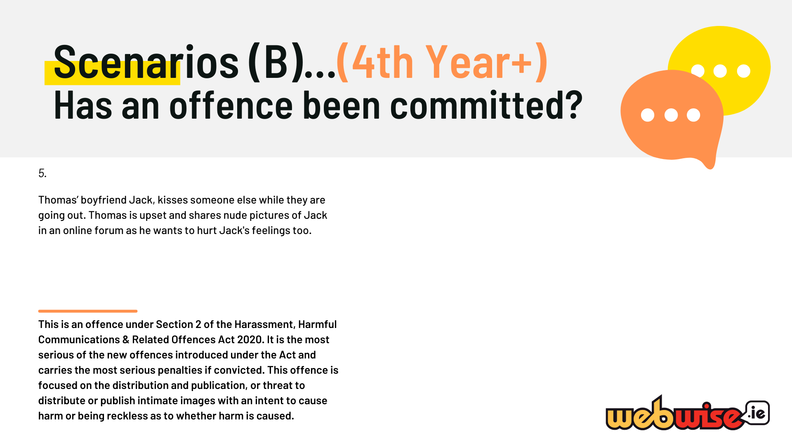
Notes:
Scenarios B – Answers (suitable for 4th year up, not suitable for 3rd year)
5. This is an offence under Section 2 of the Harassment, Harmful Communications & Related Offences Act 2020. It is the most serious of the new offences introduced under the Act and carries the most serious penalties if convicted. This offence is focused on the distribution and publication, or threat to distribute or publish intimate images with an intent to cause harm or being reckless as to whether harm is caused.

Slide 24
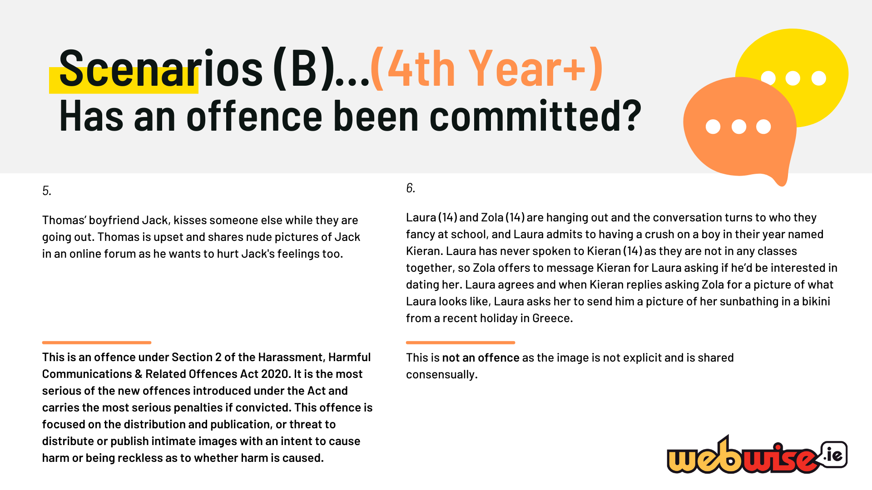
Notes:
Scenarios B – Answers (suitable for 4th year up, not suitable for 3rd year)
5. This is an offence under Section 2 of the Harassment, Harmful Communications & Related Offences Act 2020. It is the most serious of the new offences introduced under the Act and carries the most serious penalties if convicted. This offence is focused on the distribution and publication, or threat to distribute or publish intimate images with an intent to cause harm or being reckless as to whether harm is caused.
6. This is not an offence as the image is not explicit and is shared consensually.

Slide 25
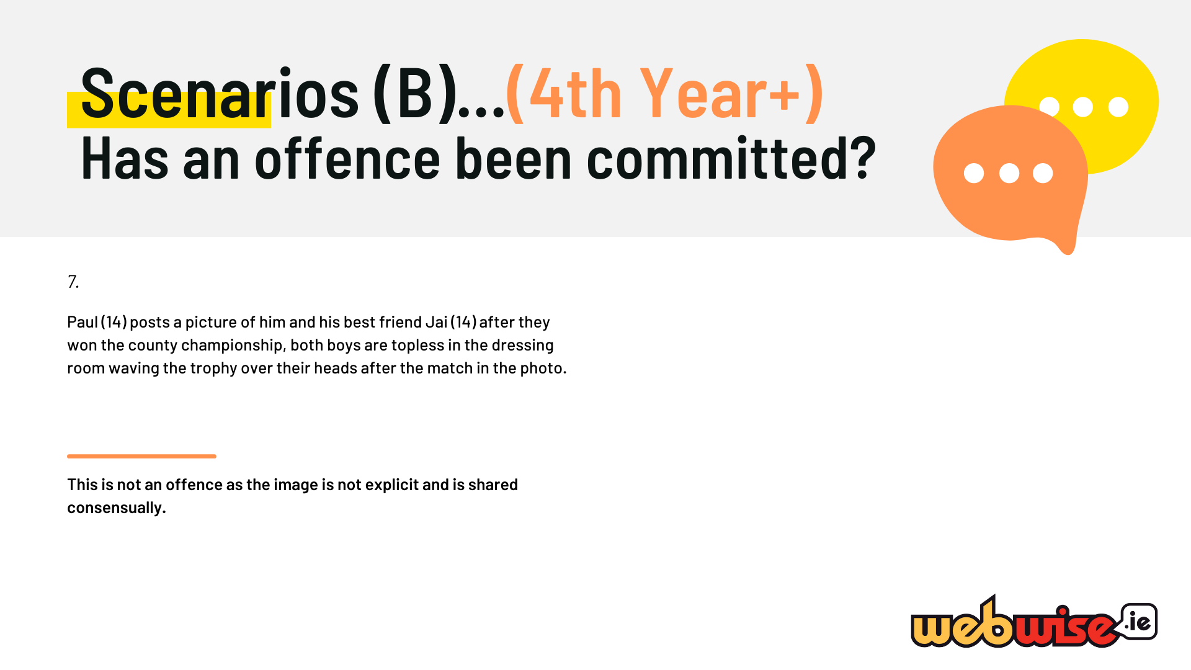
Notes:
Scenarios B – Answers (suitable for 4th year up, not suitable for 3rd year)
7. This is not an offence as the image is not explicit and is shared consensually.

Slide 26
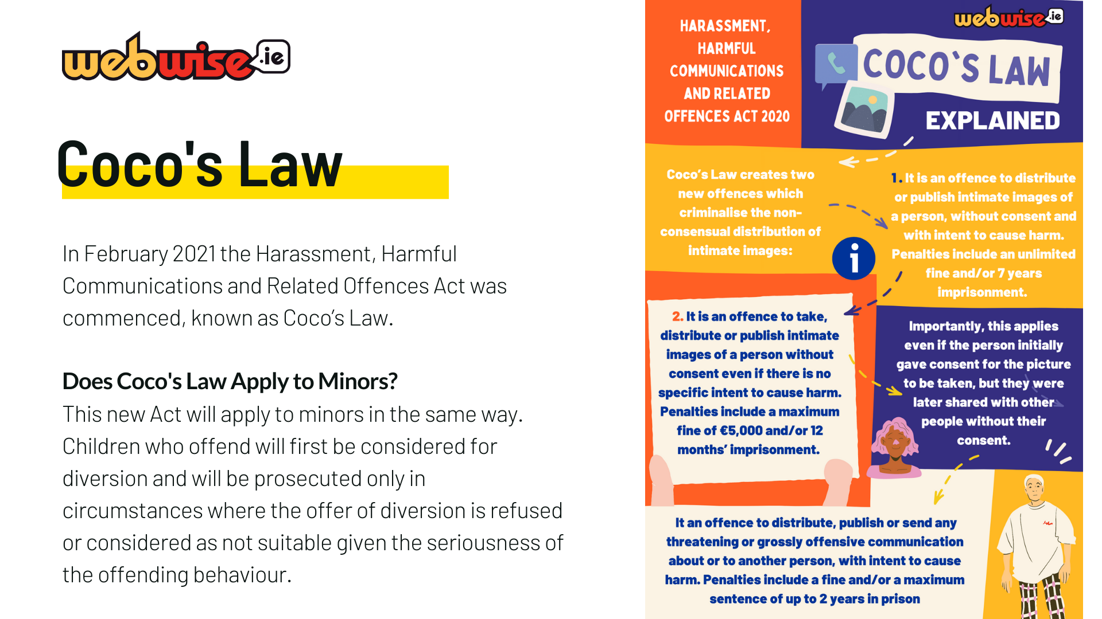
Notes:
– Coco’s Law Recap
In February 2021 the Harassment, Harmful Communications and Related Offences Act was commenced, known as Coco’s Law.
Does Coco's Law Apply to Minors?
This new Act will apply to minors in the same way. Children who offend will first be considered for diversion and will be prosecuted only in circumstances where the offer of diversion is refused or considered as not suitable given the seriousness of the offending behaviour.

Slide 27
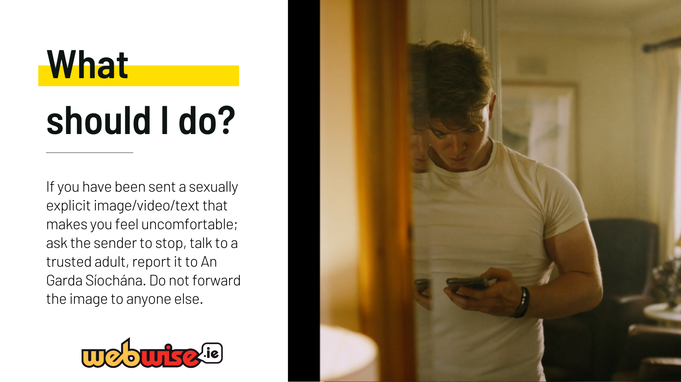
Notes:
What should I do?
If you find yourself in a situation where you have been sent a sexually explicit image/video/text that makes you feel uncomfortable it can be embarrassing and distressing and difficult to know what to do.
The following is the recommended course of action: ask the sender to stop, talk to a trusted adult and report it to An Garda Síochána.
It is important that you do not forward this image on to anyone else.
If an intimate image belonging of you has been posted online without your consent can now report the matter to a hotline.ie which will help in getting them removed. Reports can also be made to An Garda Síochána

Slide 28
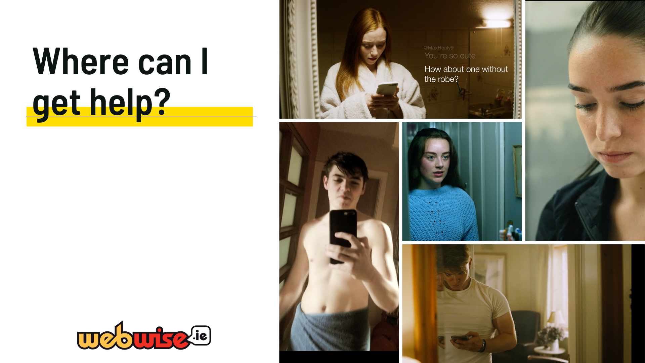
Notes:
Where to get help?
If you found yourself in any of the situations we discussed today – Where would you get help?
Give them a moment to think and then elicit answers from the floor.

Slide 29
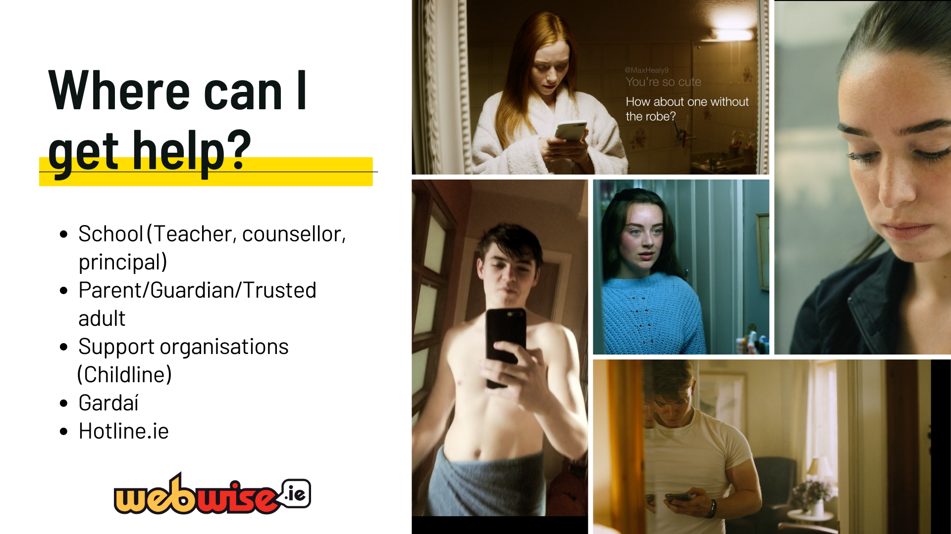
Notes:
The Gardaí are here to help you if ever you need them.
It is not acceptable that people are harassed or embarrassed online and we want to make sure that no one ever feels that they have nowhere to turn.
No matter how you are feeling, know that you are never alone. Society is getting better informed about these matters and there is always somewhere to turn.
If an intimate image of you has been posted online without your consent, you or a parent/guardian can now report the matter to hotline.ie which will help in getting them removed. Where intimate images are shared, Hotline.ie can help those affected with reporting it and removing them. It can also liaise with gardaí in some cases, where requested.

Slide 30

Notes:
Hopefully at this stage the students will feel comfortable enough in your presence to ask questions. Offer them an opportunity to ask them now.
Use the background information in Lockers to help you.
It is ok to say – wait a moment while I look this up I want to make sure I give you the correct answer.

