Slide 1
SAFER INTERNET DAY
TECH IN OUR WORLD
Post Primary
Notes:
Notes for speaker – brief introduction and welcome.
Explain how long the talk will take and the types of things you will be doing over that time.
For example:
'Today we are joining millions of people around the world in celebrating Safer Internet Day, a day for promoting a safer and better internet for all users, especially children. During this assembly we are going to talk about the role technology and the internet plays in our world and daily life. We will look at the benefits and challenges as well as some general advice on how to reset our online experiences to promote a positive impact on our time online.'

Slide 2
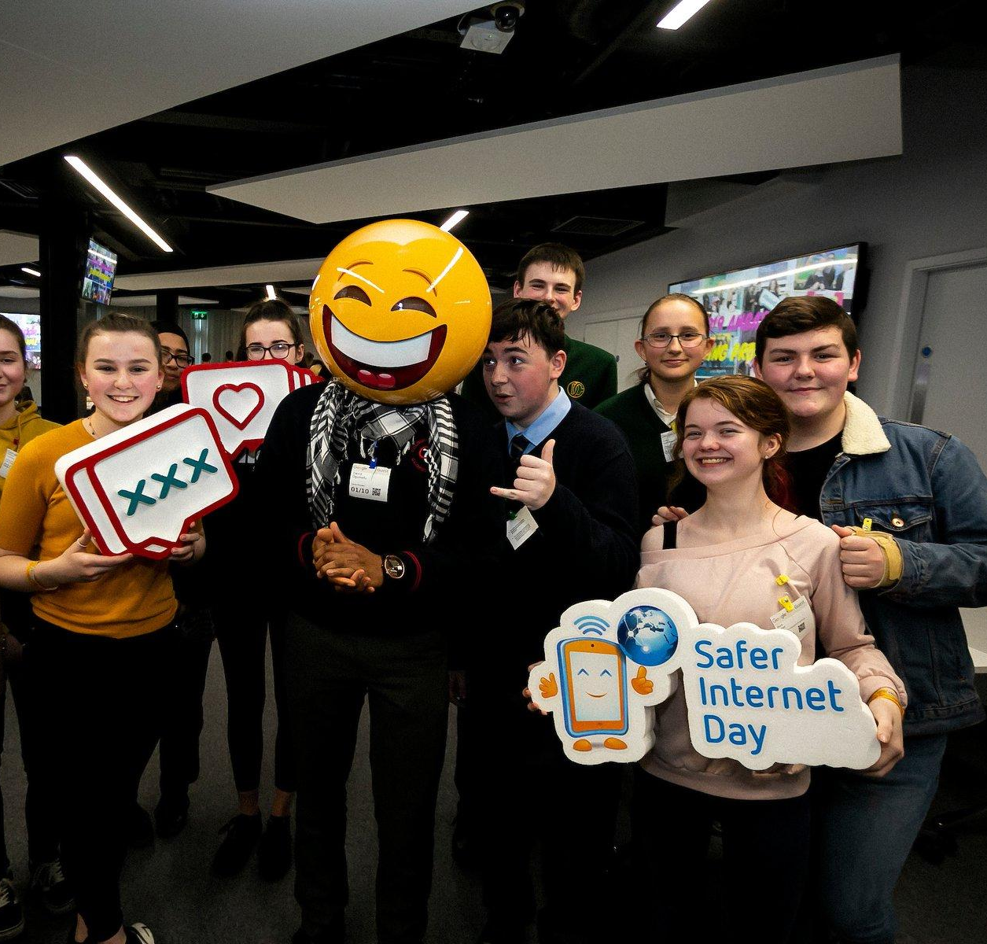
What is Safer Internet Day?
A day to create awareness of a better internet for ALL users
The theme for Safer Internet Day is “Together for a Better Internet”
Safer Internet Day began as an EU wide initiative and is now celebrated in over 180 countries worldwide
Notes:
Notes: Safer Internet Day (SID) is an EU wide initiative to promote a safer internet for all users, especially young people. Safer Internet Day in Ireland is promoted and coordinated by Webwise, the Irish Internet Safety Education Awareness Programme. The Theme for Safer Internet Day is “Together for a Better Internet“.
The aim of the day is a call on young people, parents, teachers, schools, government, businesses to join together to make the internet a safer and better place for all, and especially for children and young people.
Safer Internet Day is a day to promote safe and responsible use of the internet, a day for us to consider how all the different ways we use the internet and how we can make the internet a safer and better place for all, and especially for children and young people.

Slide 3
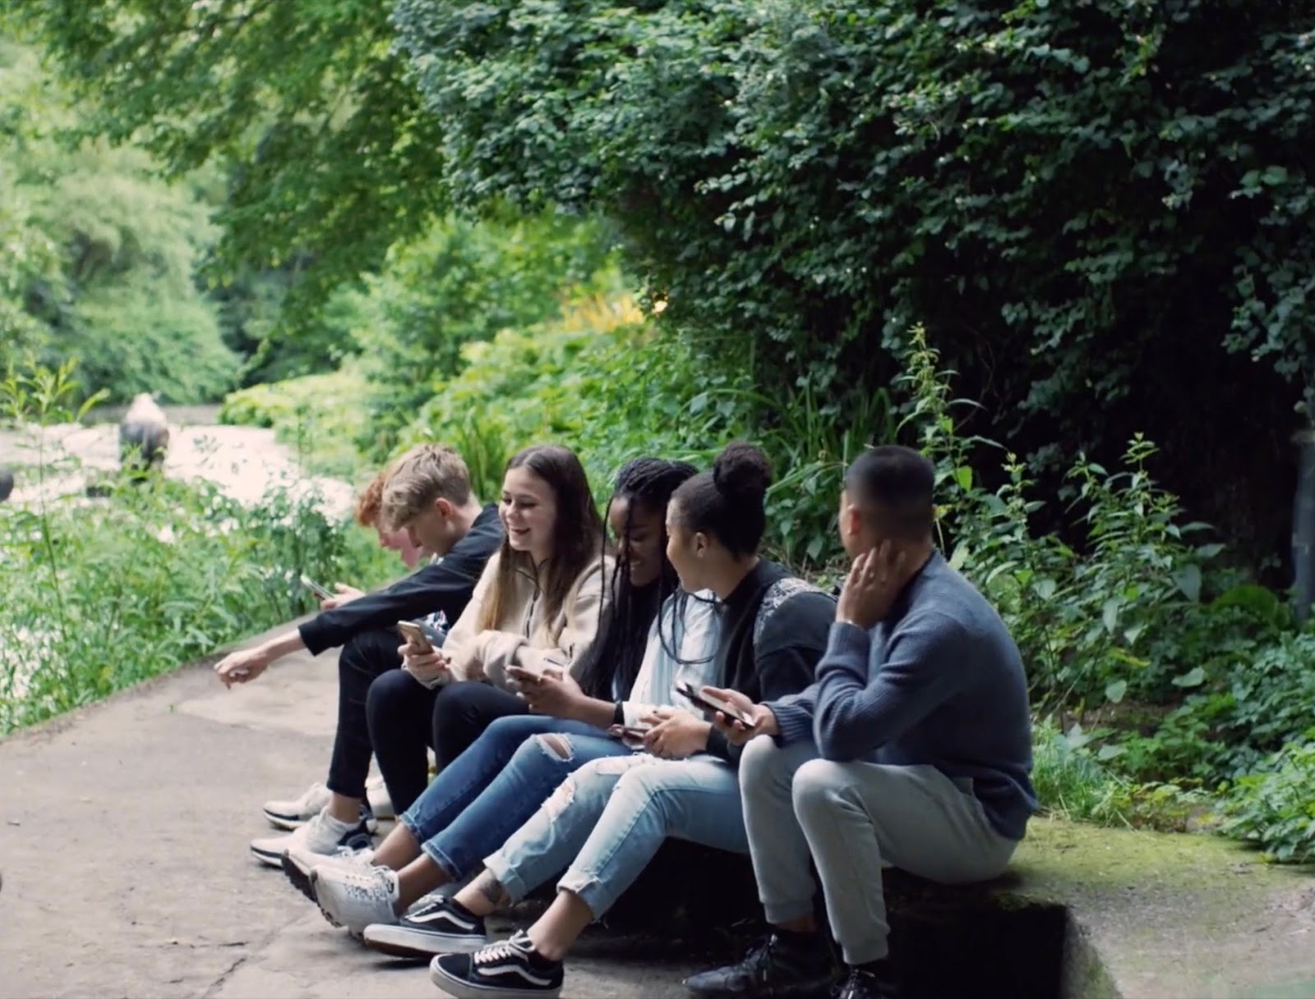
Tech in Our World
On Safer Internet Day let's take time to:
Reflect: An opportunity to reflect on the role of technology in our world, the challenges and opportunities.
Recognise: Recognise the influence of persuasive design features and algorithms on our online experiences.
Reset: Learn tips to help reset our online experiences to promote a positive impact on our time online.
Notes:
Notes: This Safer Internet Day we want to encourage you to reflect, recognise and reset the role of tech in our world and how it shapes your online experience.
On Safer Internet Day let's take time to:
Reflect: An opportunity to reflect on tech in our world, the challenges and opportunities.
Recognise: Recognise the influence of persuasive design features and algorithms on our online experiences.
Reset: Learn tips to help reset our online experiences to promote a positive impact on our time online.

Slide 4
Advancements in technology have improved our lives for the better.
Discuss.
Notes:
Notes: Ask students what actions will they be taking this Safer Internet Day. Now that we can recognise how tech works to keep us engaged for longer...
What is one thing you are going to do to reset your online experience?
Alternatively, use a real time feedback platform such as Mentimeter (www.mentimeter.com) or Kahoot (www.kahoot.it) to get instant feedback on this.

Slide 5
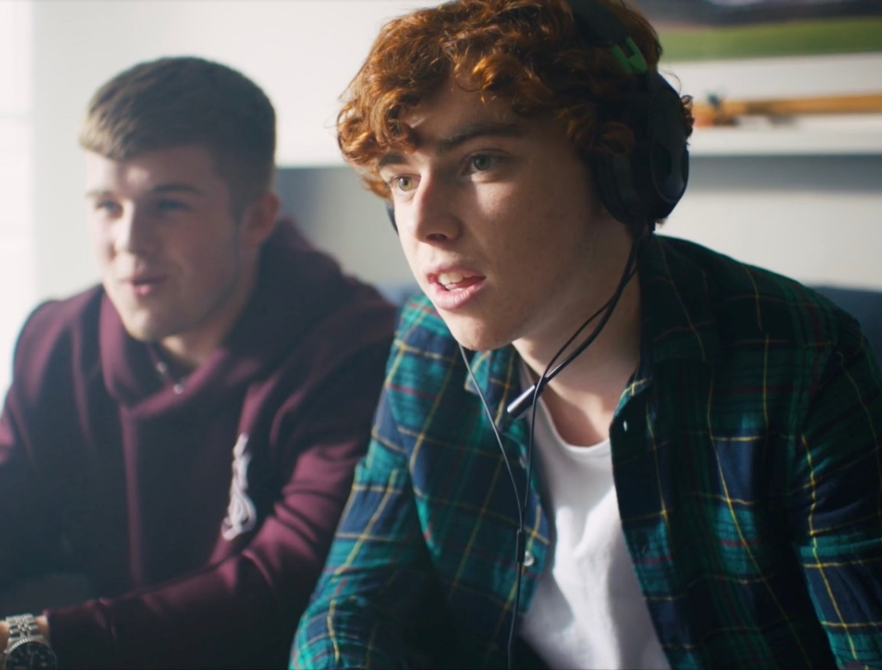
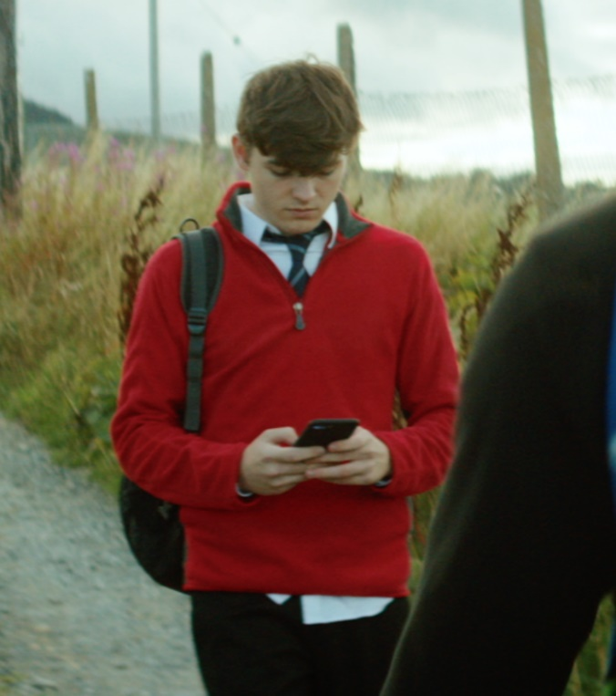
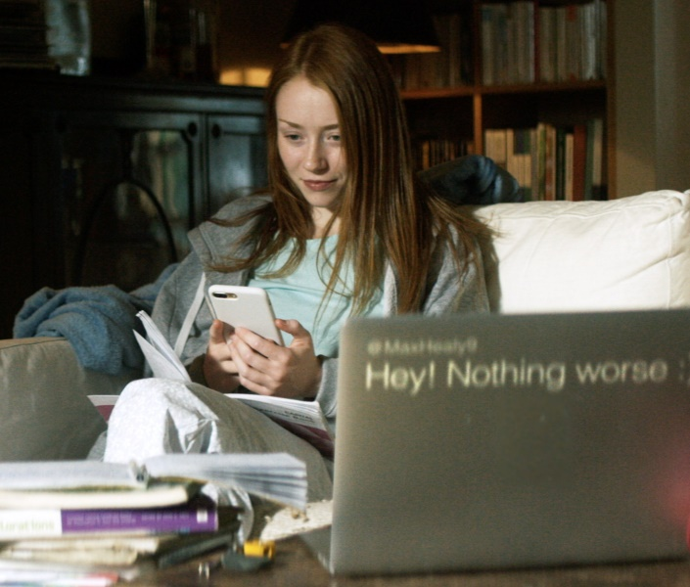
Tech in Our World:
Let's Reflect
One good thing for me about the online world is…
One challenging thing for me about the online world…
Notes:
Notes: Ask students to reflect on the role of technology in their lives using the following prompts:
One good thing for me about the online world is…
One challenging thing for me about the online world…
Use a real time feedback platform such as Mentimeter (www.mentimeter.com) or Kahoot (www.kahoot.it) to get instant feedback on this. You also could use this to poll students on which social media app they use most often.

Slide 6
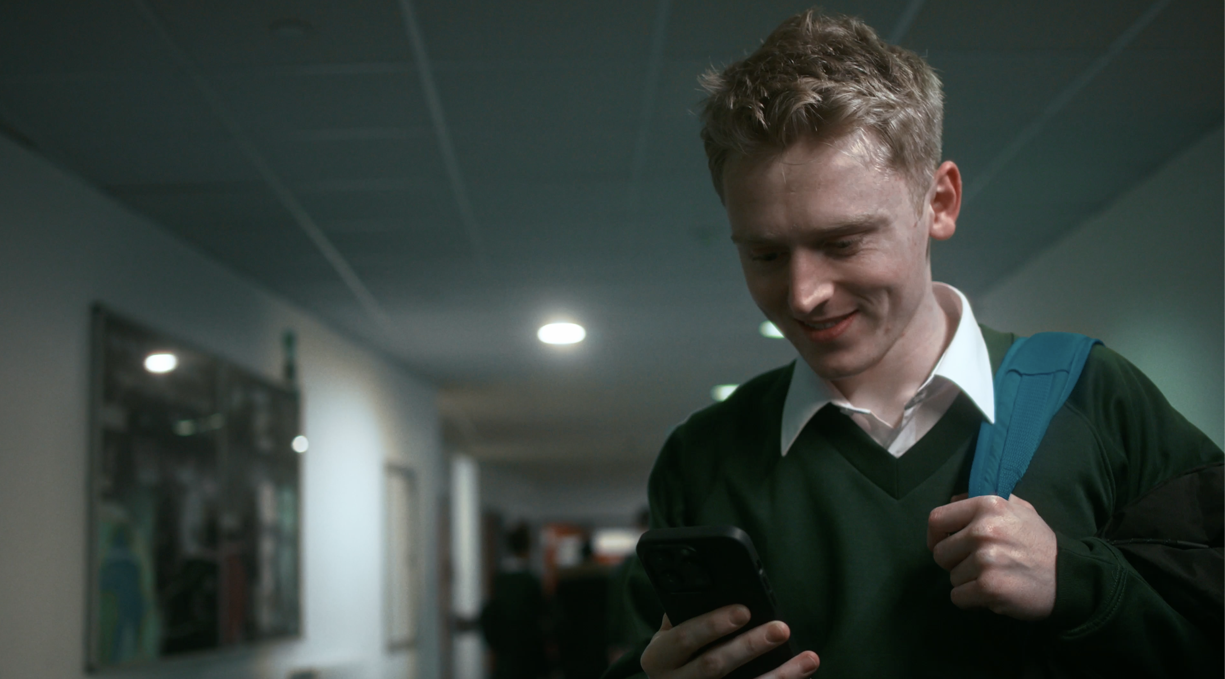
Tech in Our World: Let’s Reflect
How big a part does technology play in our daily life?
Let’s find out!
What is your screen time total for today and the last 7 days?
What are the Top 5 most used apps?
Notes:
Notes: Ask students to estimate how much time they spend on their devices each day and which apps/websites they spend the most time on. Get feedback from everyone.
Then, ask students to find out their screen time by going to setting and using the digital wellbeing/screen time tool there and find out the following information:
What is their Screen time total for today and the last 7 days?
What are the Top 5 most used apps?
Once everyone has found this information ask them:
Were you surprised by the amount of screen time?
Do you feel your time is well spent on your 5 most used apps?
Which apps/games make you feel good after you use them? Are there ever times when you feel the apps affect your wellbeing? e.g., affect your mood, sleep?

Slide 7
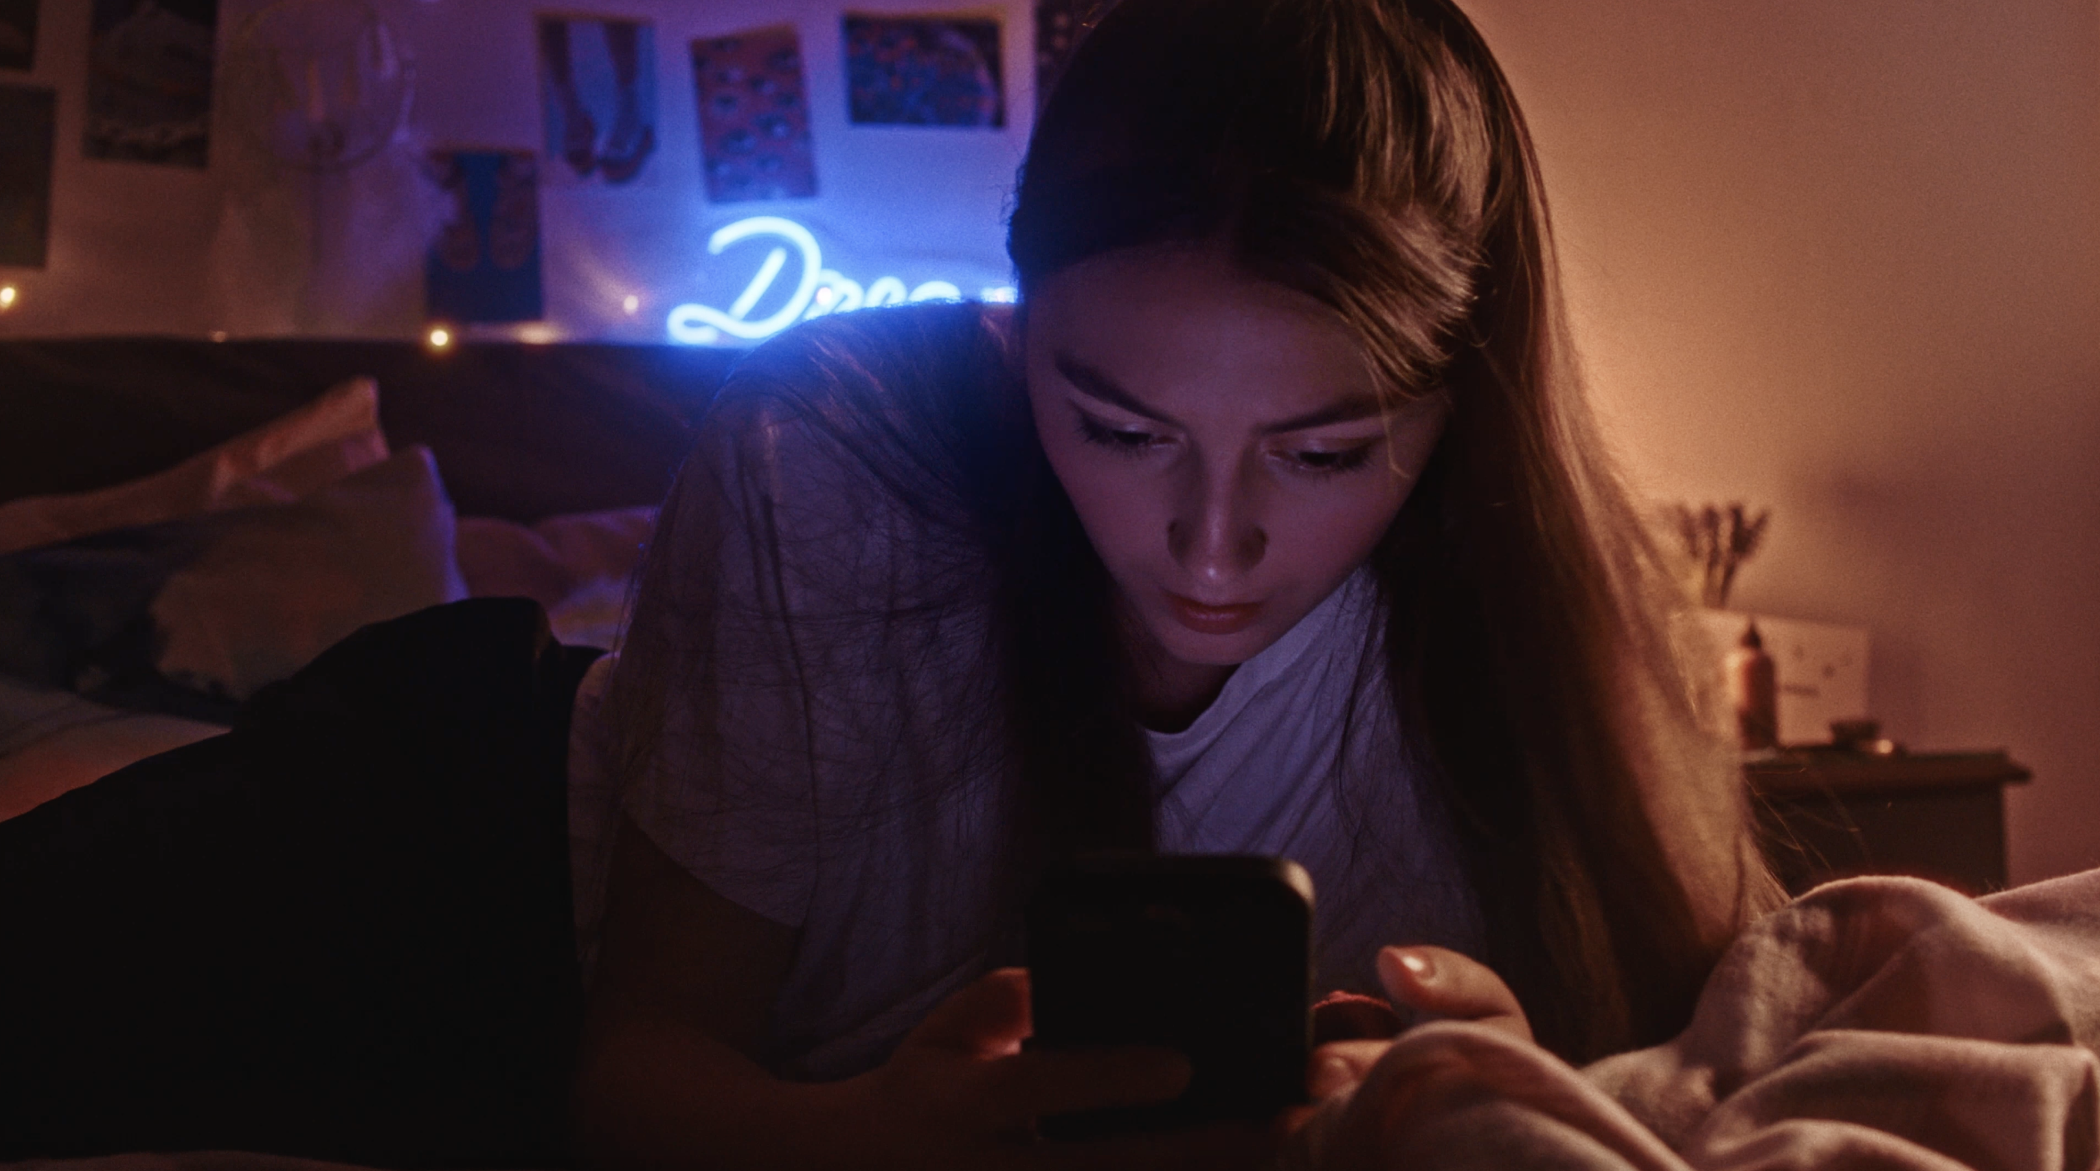
Tech in Our World: Let’s Recognise
What is it about our technology (e.g., smartphones, social media, games, etc.) that draws us in and makes us want to spend so much time on them?
Notes:
Notes: Using think-pair-share ask students, what is it about our technology (e.g., smartphones, social media, games, etc.) that draws us in and makes us want to spend so much time on them?

Slide 8
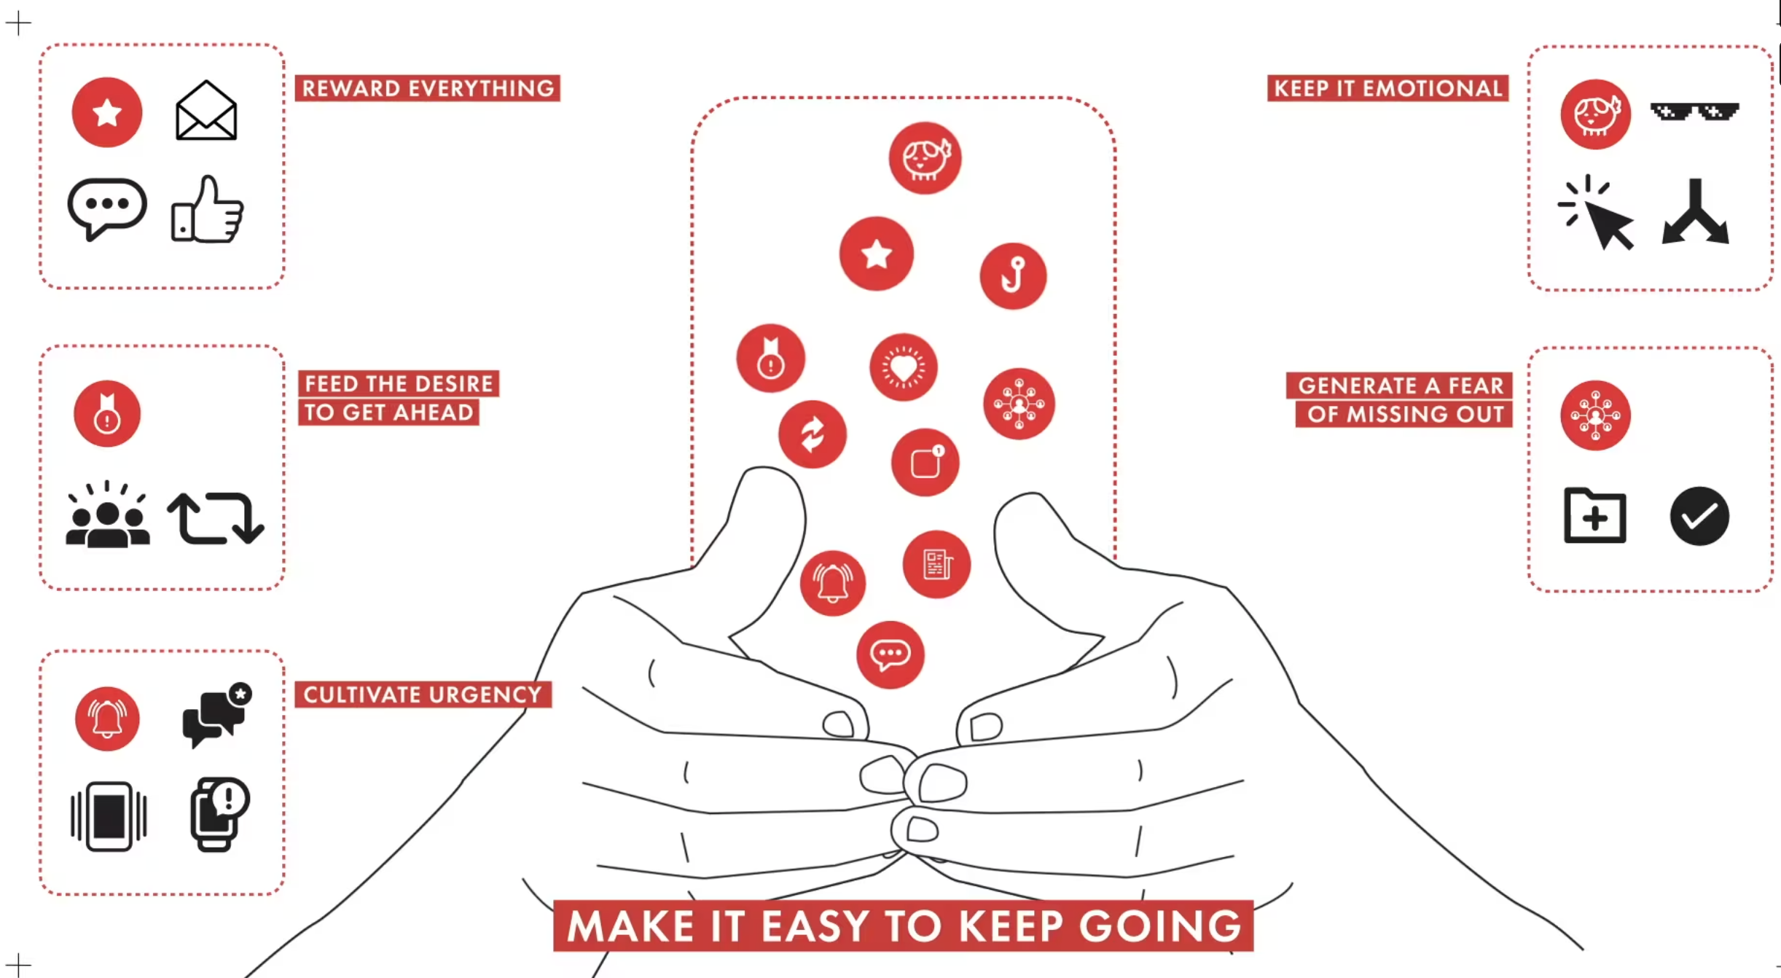
Tech in Our World: Let's Recognise
Let’s consider some of the design features technology companies use to persuade us to stay online for longer...
Watch Six Easy Steps to Get Us Addicted to Our Phones here: https://vimeo.com/503021412
Notes:
Notes: Now explain to students that we are now going to consider some of the design features that technology companies use to persuade us to stay online and using our devices for longer.
Play the following video for students Six Easy Steps to Get Us Addicted to Our Phones, available here: https://vimeo.com/503021412

Slide 9
Tech in Our World: Let’s Recognise
What design features can you recognise your favourite apps use to draw you in?
Notes:
Notes: After watching the video ask students what design features they can recognise their favourite apps use to draw them in.

Slide 10
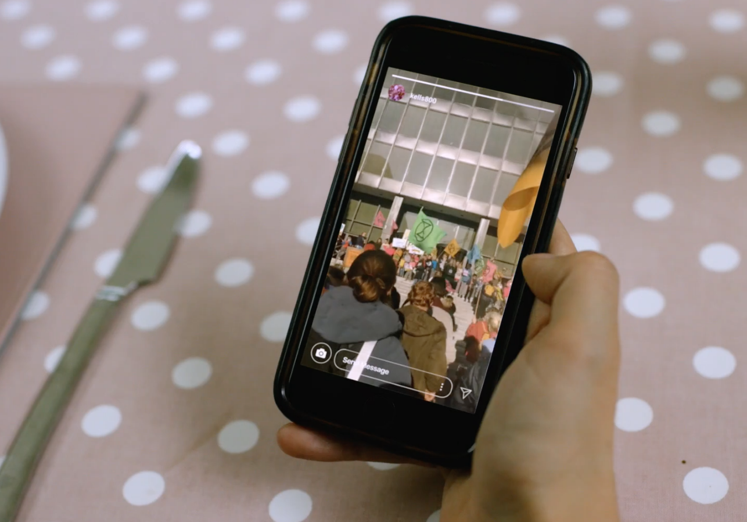
Tech in Our World: Let’s Recognise
Have you noticed that when you go online or login to social media you are presented with content, news, articles or ads that somehow know the things that you are interested in?
Why do you think this ?
Notes:
Notes: Ask students if they have noticed that when they go online or login to social media they are presented with content, news, articles or ads that somehow know the things that they are interested in? Ask students why they think this is?
Explain to students that this is because there are algorithms (complex mathematical formulas) working in the background which determine what content is presented in your newsfeed or search results. Platforms such as Google, Facebook, Instagram, and Tik Tok all have their own closely guarded algorithms which personalise the content they show to us – different users who use the exact same search terms or scroll through the same social media platform are likely to see different content. The results that we are presented with are likely to reflect the likes and interests that our browsing history and personal data suggests we would like to see more of – after all, online platforms want you to use their site and to stay for as long as possible.

Slide 11
Tech in Our World: The Influence of Online Algorithms
Algorithms are complex mathematical formulas working in the background of the websites/apps we use which help determine what content is presented to us online e.g. in your newsfeed or search results.
What we see on our online news feeds is determined by the algorithm of the particular platform we are using.
Social media platforms highlight content that they believe we will like, because it is popular or because you are being advertised to.
Notes:
Notes: Go through and explain the following points with students:
Algorithms are complex mathematical formulas working in the background of the websites/apps we use which help determine what content is presented to us online e.g. in your newsfeed or search results.
What we see on our online news feeds is determined by the algorithm of the particular platform we are using.
Social media platforms highlight content that they believe we will like, because it is popular or because you are being advertised to.
It’s important to remember our news feeds are not a full reflection of reality, they are just a part of The Full Picture.
Filtering through content that appears on our online newsfeeds is complicated further, because what we see is determined by the algorithm of the particular platform we are using. What we encounter when we go online doesn’t appear by coincidence – social media or online platforms highlight content that they believe we will like, because it is popular or because you are being advertised to. Just like with images we see, or the people we follow, it is important to be mindful that what we see on our newsfeeds is not a full reflection of reality, it is just a part of The Full Picture.

Slide 12
Tech in Our World: The Influence of Algorithms
The results that we are presented with are likely to reflect the likes and interests that our browsing history and personal data suggests we would like to see more of – after all, online platforms want you to use their site and to stay for as long as possible.
It is important to be aware that the content being pushed to your newsfeed is filtered and tailored by what a social media network or online platform believes that you are interested in, or would like you to become interested in.
Different users who use the exact same search terms or scroll through the same social media platform are likely to see different content.
Notes:
Notes: Go through and explain the following points with students:
The results that we are presented with are likely to reflect the likes and interests that our browsing history and personal data suggests we would like to see more of – after all, online platforms want you to use their site and to stay for as long as possible.
It is important to be aware that the content being pushed to your newsfeed is filtered and tailored by what a social media network or online platform believes that you are interested in, or would like you to become interested in.
Different users who use the exact same search terms or scroll through the same social media platform are likely to see different content.

Slide 13
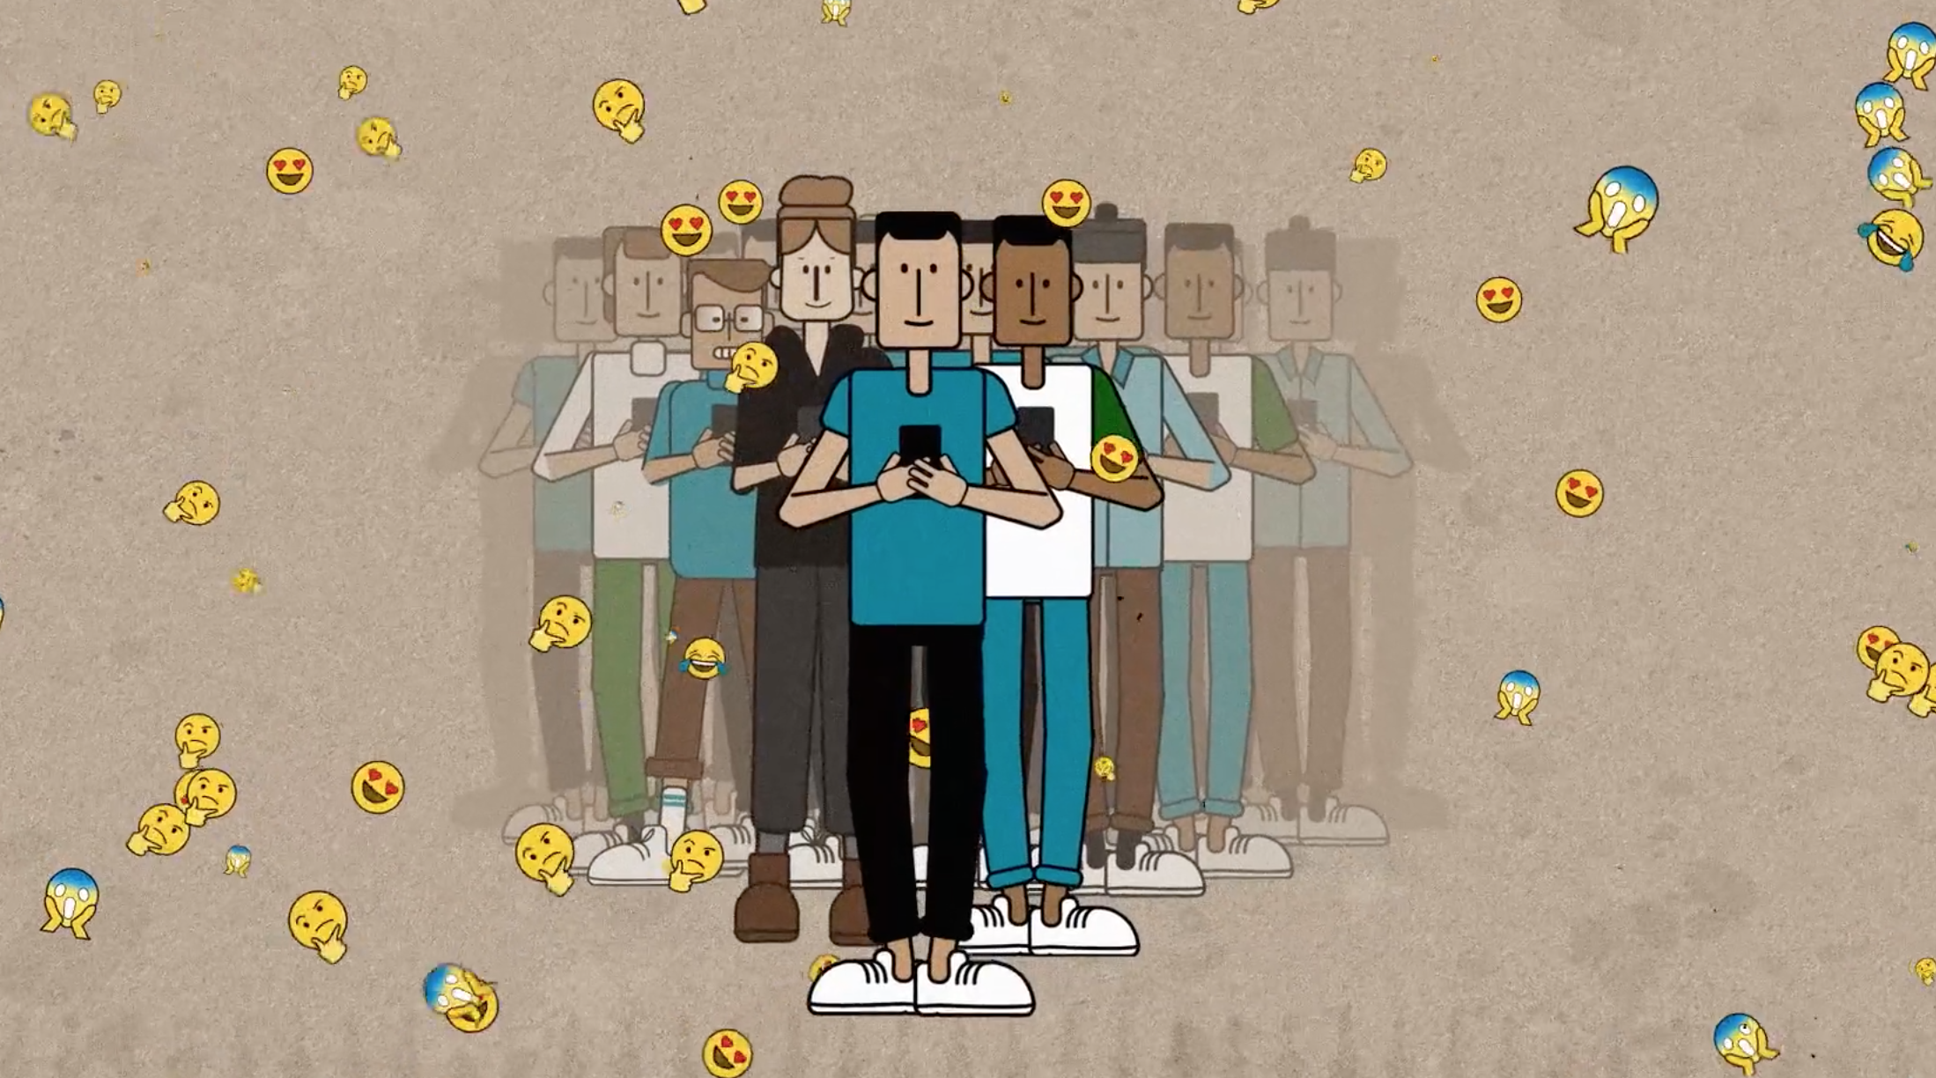
Tech in Our World: The Influence of Algorithms
List one benefit and one downside for how companies use algorithms to influence and tailor your online experiences?
Notes:
Notes: Ask students to consider what are the potential benefits and downsides of how tech companies use algorithms to influence and tailor our online experiences and content based on who the internet thinks we are like this? Use the think-pair-share strategy to get student feedback on this.
Explain to students that potential benefits include: with having so much content available on the internet, these algorithms are used to reduce the volume of information and to filter what is displayed to users. For example, searching for exercise tips or liking a cute cat video will make it more likely that you will see content related to these topics in the future, or if you browse for a pair of trainers you may see advertisements for those shoes on other websites you visit. All this information is building up a picture of who you are online.
While this is not necessarily a bad thing, it is important to be aware that the content being pushed to your newsfeed is filtered and tailored by what a social media network or online platform believes that you are interested in, or would like you to become interested in.
Potential drawbacks include the fact that we can very easily get caught in a feedback loop or filter bubble meaning that what we see are variations of the same thing and alternative views or opinions are filtered out. It is important to emphasise to students that not seeing an alternative point of view can affect our ability to think critically about content, make us less open-minded, and can have a skewed influence on how the world is presented to us.

Slide 14
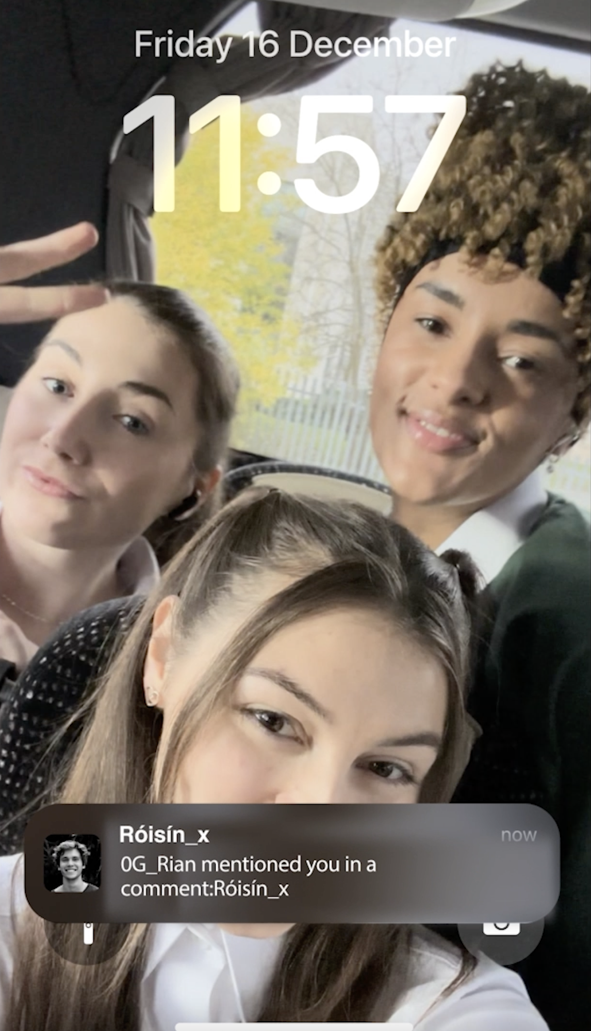
Tech in Our World: Time to Reset
Top Tips for a Digital Reset
Manage your time online using App Timers.
Take back control over your newsfeeds and algorithms - review accounts you follow and build a positive newsfeed that reflects your interests.
Regularly Review and Clear Your Data on social media apps.
Take a step back. It's hard to switch off when our devices are by our side at all times. Try switching off by keeping your devices in another room at night time or while watching tv.
Help bring in new perspectives and avoid echo chambers by clearing your browser history.
Review Your Location Footprint & remove unnecessary sharing.
Review Apps on your phone and delete any you don’t need or use.
Notes:
Notes: Read through the following Top Tips for a Digital Reset
Manage your time online using App Timers.
Take back control over your newsfeeds and algorithms - review accounts you follow and build a positive newsfeed that reflects your interests.
Regularly Review and Clear Your Data on social media apps.
Take a step back. It's hard to switch off when our devices are by our side at all times. Try switching off by keeping your devices in another room at nighttime or while watching tv.
Help bring in new perspectives and avoid echo chambers by clearing your browser history.
Review Your Location Footprint & remove unnecessary sharing.
Review Apps on your phone and delete any you don’t need or use.

Slide 15
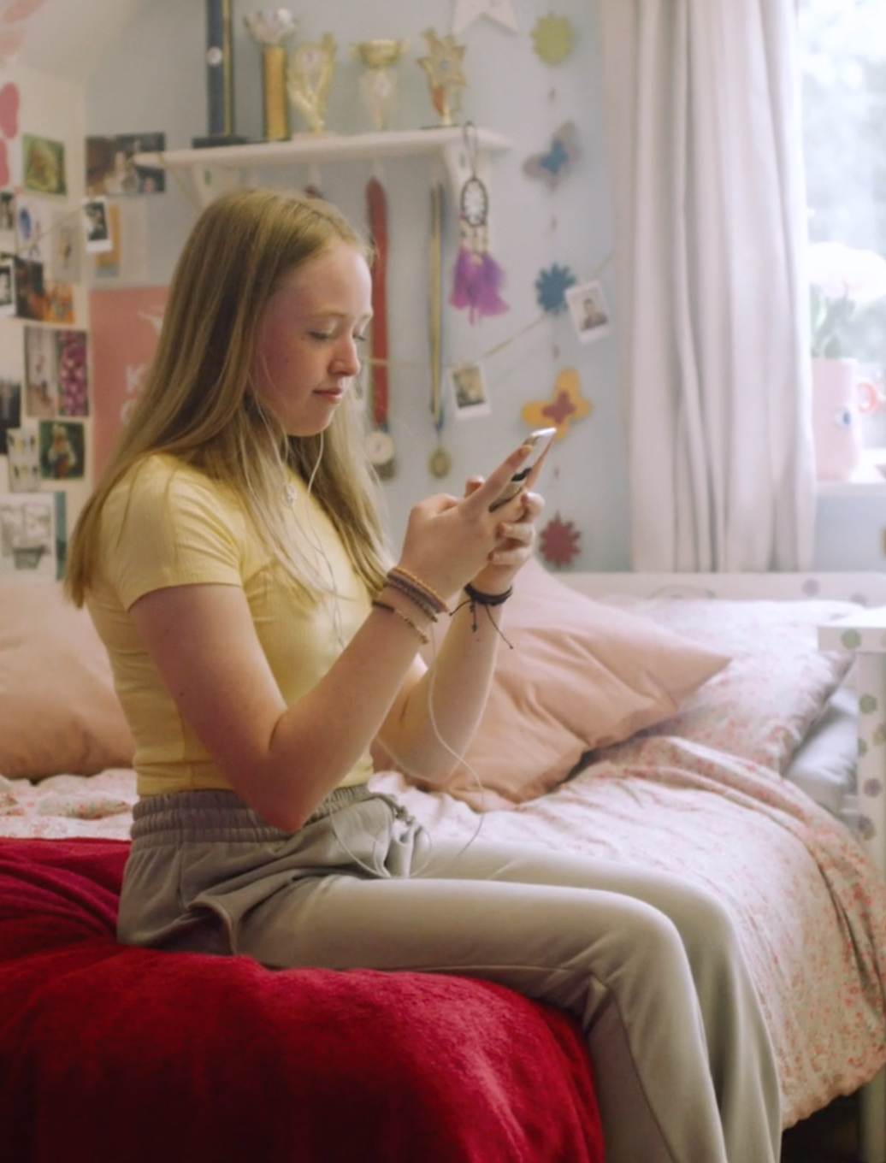
Tech in Our World: Time to Reset
Don’t like a persuasive or addictive feature you’ve noticed on your favourite app/website?
Tell them about it: Take a screenshot, post about it, tag the tech company, email them about it.
You can ask them to change their app to better protect young people’s online wellbeing.
Finally, you can spot using it or find an alternative app to use… the future is in your hands!
Notes:
Notes: Remind students of that they have choice in shaping their online experiences and to use their voice to ask for change for the better.
Don’t like a persuasive or addictive feature you’ve noticed on your favourite app/website?
Tell them about it: Take a screenshot, post about it, tag the tech company, email them about it.
You can ask them to change their app to better protect young people’s online wellbeing.
Finally, you can spot using it or find an alternative app to use… the future is in your hands!

Slide 16
Now that we can recognise how tech works to keep us engaged for longer...
One thing I will do to balance my time on and offline is...
Notes:
Notes: Ask students what actions will they be taking this Safer Internet Day. Now that we can recognise how tech works to keep us engaged for longer...
One thing I will do to balance my time on and offline is...
Alternatively, use a real time feedback platform such as Mentimeter (www.mentimeter.com) or Kahoot (www.kahoot.it) to get instant feedback on this.

Slide 17
Tech in Our World
On Safer Internet Day you have learned:
The role technology plays in your daily life.
To recognise the influence of persuasive design features and algorithms on our online experiences.
Tips to help you reset your online experience and reduce the influence of persuasive design features.
Notes:
Notes: Review with students what they have learned this Safer Internet Day. On Safer Internet Day you have learned:
The role technology plays in your daily life.
To recognise the influence of persuasive design features and algorithms on our online experiences.
Tips to help you reset your online experience and reduce the influence of persuasive design features.

Slide 18
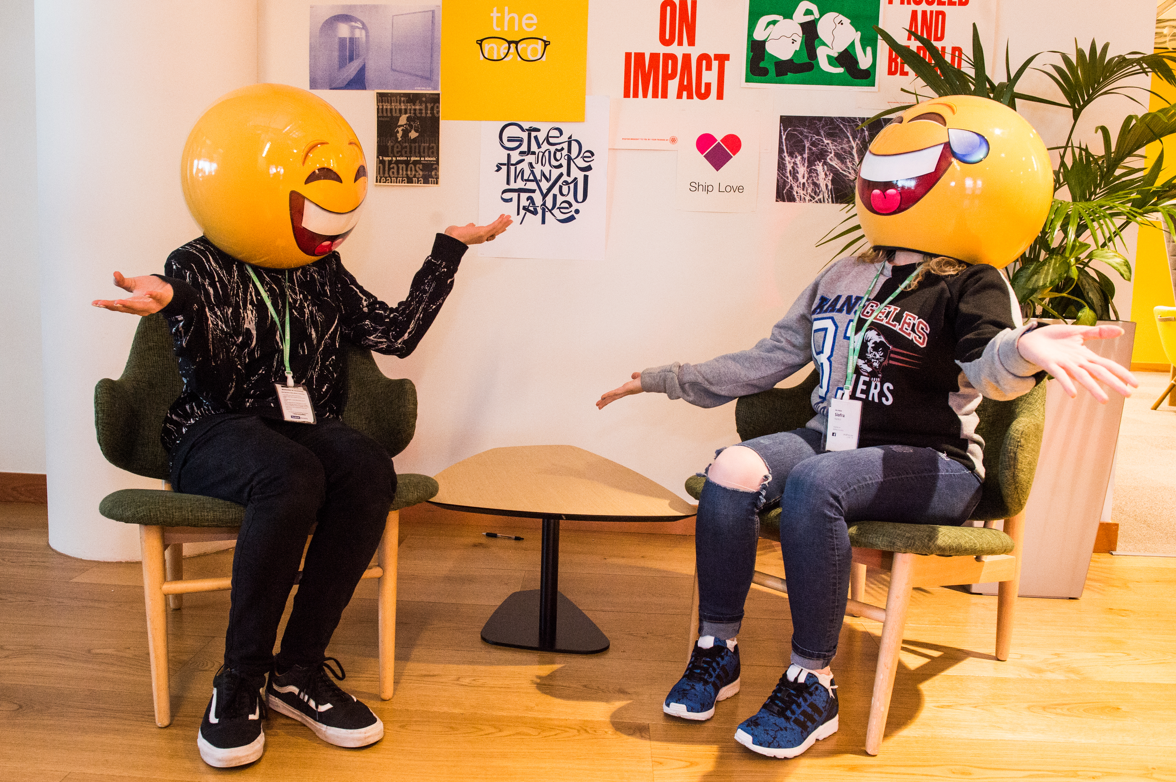
THANKS!
WANT TO FIND OUT MORE?
© Webwise_Ireland
This work is made available under the terms of the Creative Commons Attribution Share Alike 3.0 Licence http://creativecommons.org/licenses/by-sa/3.0/ie/. You may use and re-use this material (not including images and logos) free of charge in any format or medium, under the terms of the Creative Commons Attribution Share Alike Licence.
Notes:
Notes: Webwise would encourage you to download copies of the Parents' Guide to a Better Internet booklets and or Parent’s checklists to distribute to pupils to take home to their parents. The booklet can be ordered for free at webwise.ie/parents

Slide 19
EXTENDED SAFER INTERNET DAY ACTIVITIES
Notes:
Notes: These following supplementary extended Safer Internet Day slides are available for teachers to use to support the SID talk they will have just heard. These activities are to be completed in the classroom to continue the discussion on how to stay safe online.

Slide 20
Tech in Our World:​
Artificial Intelligence
Technology works using
Artificial Intelligence or A.I.
A.I. is when technology is able to gather information and put it together to perform a task in a human like way e.g., making recommendations.
Can you think of any examples of artificial intelligence when using something like a smart phone or tv?
Notes:
Notes: A lot of the technology we use nowadays is called "smart" but what does that mean? It are called 'smart' is because it uses something called Artificial Intelligence or A.I. to work.
AI is when technology is able to gather information and put it together to perform a task in a human like way e.g. making recommendations.
Using think-pair-share ask students to think of any examples of artificial intelligence around them when they use smart devices such as mart phones or tv's or another smart device.
Get student feedback.
Suggested A.I. examples to go through with students include: many smartphones have a personal assistant, for example, that will do certain things for us like telling us what the weather will be like today or finding and starting up a piece of music we want to listen to. Other examples include when YouTube, Netflix recommend what you should watch next, translating a piece of text into another language for you, using Maps to find out what is the quickest route to your destination, Google search engine, a robot vaccum hoovering the floor by itself, facial recognition i.e. when a device is set to unlock by scanning your face.
After getting feedback from students and discussing how technology and the internet can help our lives, it’s important to explain to students that in order for a lot of these items, to work they collect information from us, for example, personal information when signing up, our location, searching history.
This means it’s important to check the settings of these items with a parent or guardian and make sure they are set to private and that they are not sharing too much information without realising it or knowing where it is going.

Slide 21
A.I. WebQuest Activity
Go to the Webwise AI Hub: https://www.webwise.ie/ai-hub/
Find and read the article Guest Article: AI Explained – what is AI? and answer the following questions:
Explain AI in your own words.
How do you come across AI in your life?
A.I. can help us solve the problems of tomorrow. Do you agree with this statement? Why/Why Not?
Notes:
Notes: Explain to students that they will now have the opportunity to find out more about AI using the following webquest activity. Ask students to go to the Webwise AI Hub: https://www.webwise.ie/ai-hub/
Find and read the article Guest Article: AI Explained – what is AI? and answer the following questions:
Explain AI in your own words.
How do you come across AI in your life?
A.I. can help us solve the problems of tomorrow. Do you agree with this statement? Why/Why Not?
An optional homework activity is to ask students to listen also to the podcast Casting the Net Podcast: What do teens need to know about Chat GPT and AI? Available here: https://www.webwise.ie/news/casting-the-net-what-do-teens-need-to-know-about-chatgpt/

Slide 22
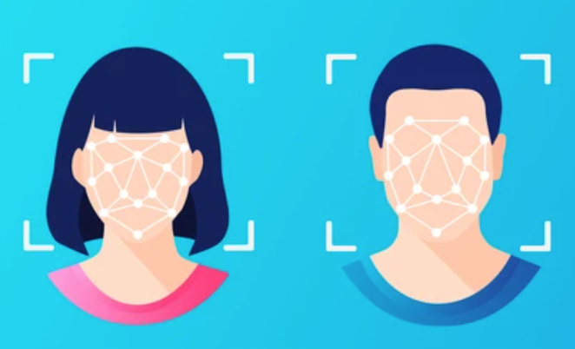
Tech in Our World:
Facial Recognition
What does facial recognition mean and where can we see it used in our world?
Facial recognition is technology that can automatically identify a person from a digital image or a frame from a video.
In some ways, this can be useful. But it can also be risky, annoying and a threat to our right to privacy.
Notes:
Notes: Another example of technology that is becoming more increasingly common to see used in our world is facial recognition. But what does facial recognition mean and where can we see it used in our world?
Explain to pupils that facial recognition is technology that can automatically identify a person from a digital image or a frame from a video. In some ways, this can be useful. But it can also be risky, annoying and a threat to our right to privacy.

Slide 23
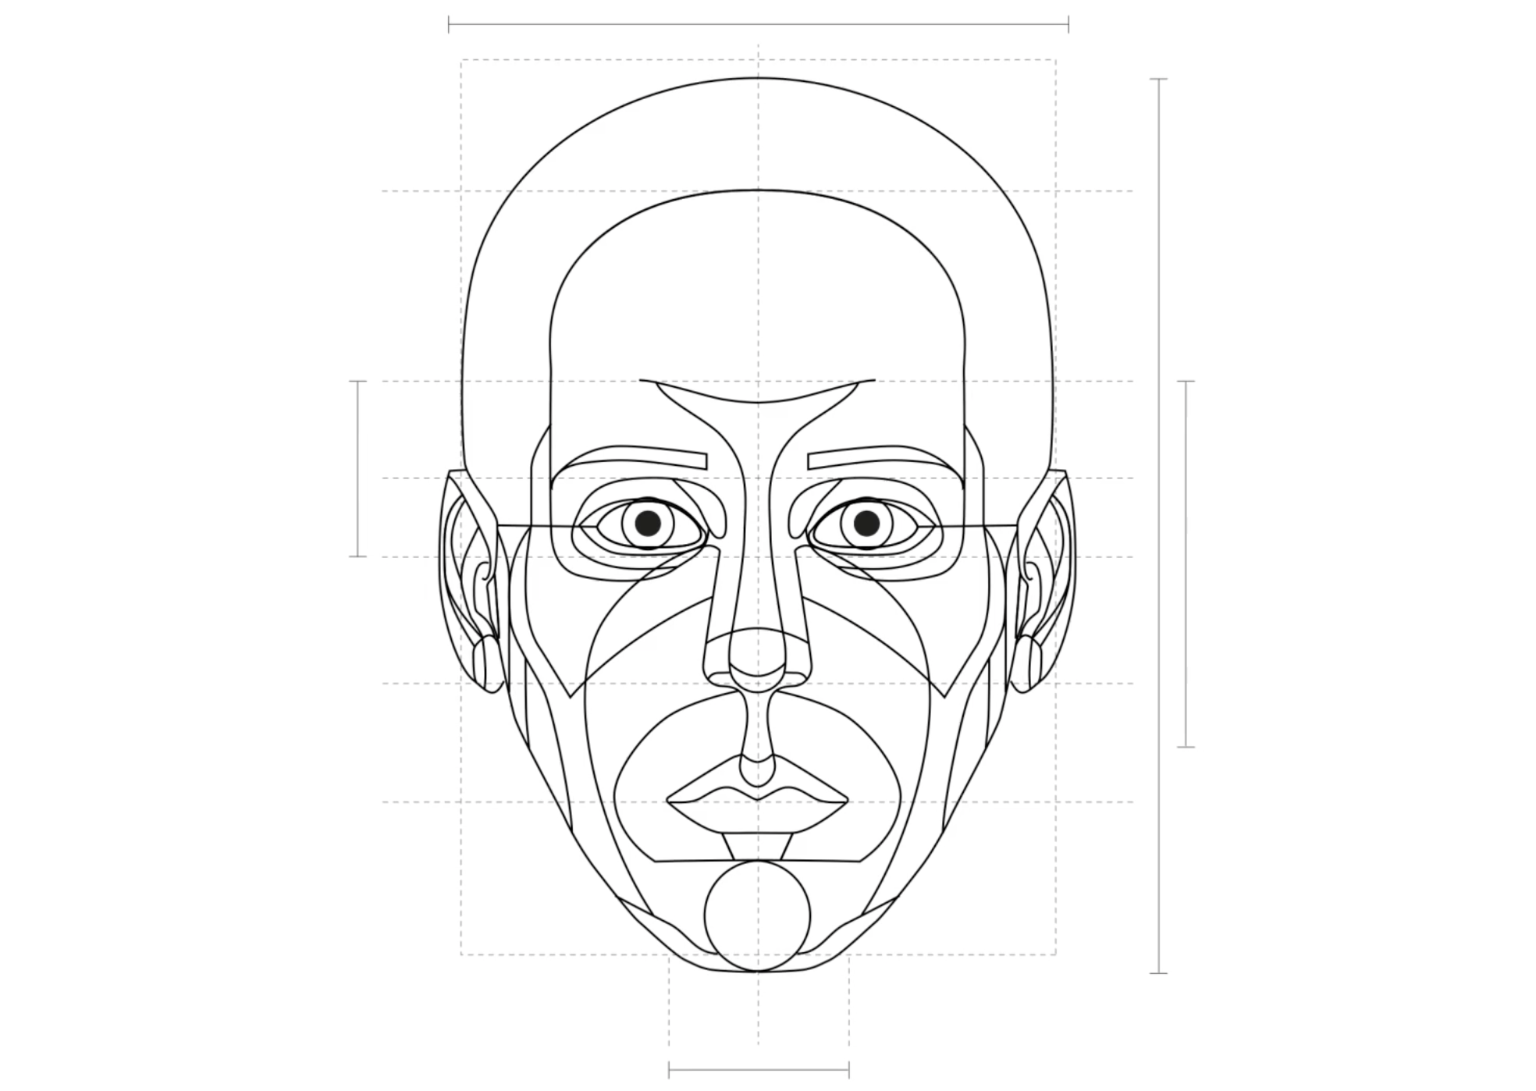
Tech in Our World:
Facial Recognition
Watch“The Real Life of Your Selfie” here: https://vimeo.com/503021673
Notes:
Notes: Play the following video for students to explore facial recognition further. Watch“The Real Life of Your Selfie” available here: https://vimeo.com/503021673

Slide 24
Tech in Our World:
Facial Recognition
Here's an example of facial recognition technology:
Tagging someone on social media.
Can you think of one example of how this might be useful and how it might be a problem?
Notes:
Notes: Next, give the following example of facial recognition technology to students: Tagging someone in a picture/video on social media. Can you think of one example of how this might be useful thing and how it might be a problem?
Can you think of any other examples of when facial recognition technology might be used and how it could be a good thing or a bad thing?

Slide 25
Tech in Our World:​
Facial Recognition Walking Debate
Statement: Facial recognition technology will make society a safer place.
Notes:
Notes: To finish your discussion on facial recognition technology use the following walking debate activity.
Set Up: Display ‘Agree,’ ‘Don’t know’ and ‘Disagree’ signs in that order along one wall of the classroom.
Steps:
Explain that the three signs represent a spectrum of opinion. Students can place themselves anywhere along the spectrum. For example, if they are not fully sure, they don’t have to choose ‘Agree’, they can stand between ‘Don’t know’ and ‘Agree’ to represent their current position.
Ask students to stand in the middle of the room and read the following statement aloud: Facial recognition technology will make society a safer place.
Invite students to stand at the point on the ‘Agree,’ ‘Don’t know’ and ‘Disagree’ spectrum that most closely represents their current point of view with regards to the statement.
Ask open questions (e.g. why, how, what, describe, tell me about..., or what do you think about...) as a way of encouraging students to explain why they are standing in a particular place.
Invite students to move if they hear something that changes their opinion.
Notes:
If you find that the everyone shares a similar point of view in relation to the statement, you can represent alternate perspectives to draw out the discussion. Make sure to give students enough time to think, move and explain their stance throughout the activity.

