Slide 1
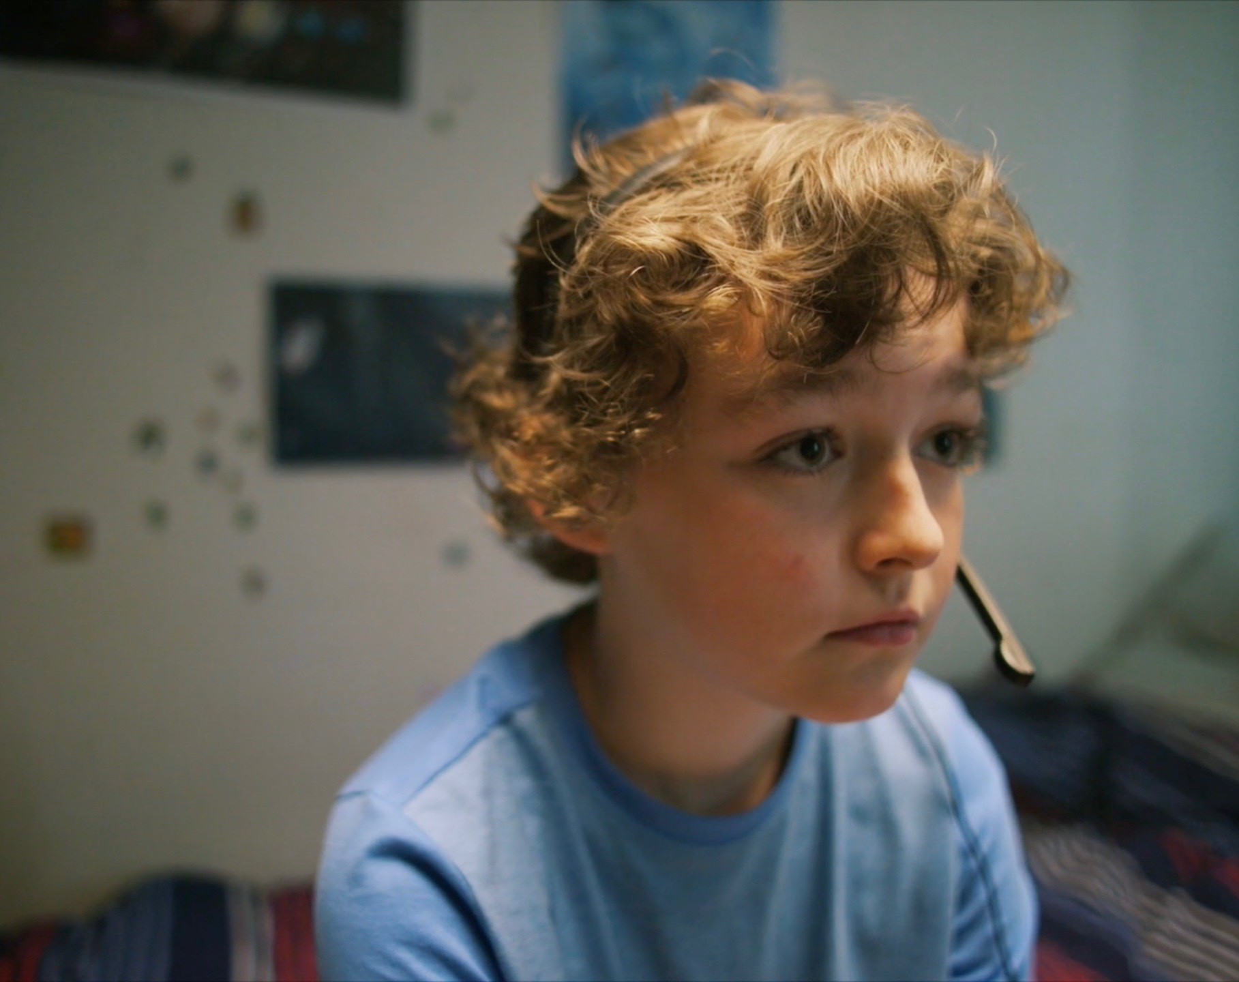





Primary
webwise parents
SUPPORTING Children ONLINE
Primary
Notes:
Welcome to the Webwise Parents Introduction to Online Safety talk. This talk is designed to introduce parents to the first steps of supporting children as the go online.

Slide 2
Hello!
I am INSERT NAME
Webwise is the online safety initiative of the Department of Education and co-funded by the European Commission.
The overall objective of this workshop is to provide parents with information and skills to support their children's online activity.
  We recognise every family and child is different
  You know your family best
  Today is about giving you information you need to make best decisions
Notes:
Notes for speaker – brief introduction and welcome. ​
Explain how long the talk will take and the types of things you will be doing over that time. For example​:
‘This evening we are going to talk to you about some common concerns parents have around internet safety. This one hour talk will look at topics such as screen time, cyber-bullying, online gaming and we’ll also do some group activities. The aim of the talk this evening is to give you an introduction to the topic, give you some tips for talking to your child, find out what supports are available and how to access them.’​

Slide 3

What do we know?
  Almost one quarter (24%) of parents say their children have been bothered or upset by something that has happened online.
  59% of parents are unsure of how often their child has been upset by something online.
  Only 26% of parents think their child can cope with things online that bother or upset them.
National Parents Council Primary’s (NPC) “Your Child & The Internet”
2022
Notes:
What do we know?
Almost one quarter of parents say their children have been bothered or upset by something that has happened online.
59% of parents are unsure of how often their child has been upset by something online.
Only 26% of parents think their child can cope with things online that bother or upset them.

Slide 4
What do we know?
Top concerns for Irish parents
  Cyberbullying;
  Being exposed to pornography;
  Hateful or racist messages or activities;
  Self-esteem online;
  Being contacted by a stranger for sexual purposes;
  Online reputation / digital footprint
Report of a National Survey of Children, their Parents and Adults regarding Online Safety 2021 - National Advisory Council for Online Safety
Notes:
What do we know?
Almost one quarter of parents say their children have been bothered or upset by something that has happened online.
59% of parents are unsure of how often their child has been upset by something online.
Only 26% of parents think their child can cope with things online that bother or upset them.

Slide 5

What do we know?
Things that upset young people
  People being nasty to each other;
  Bullying;
  Inappropriate/disturbing videos/ photos;
Many children don’t tell if something bothers them online
Report of a National Survey of Children, their Parents and Adults regarding Online Safety 2021 - National Advisory Council for Online Safety
Notes:
What do we know about the children’s negative experiences online?
The most common experiences that upset them are,
People being nasty to each other;
Bullying;
Inappropriate/disturbing videos/ photos;
The research also shows us that many children’s don’t tell if they encounter something that bothers them online. This shows the importance of encouraging regular conversations, and helping to ensure that children do ask for help if something bothers them online.

Slide 6



#TalkListenLearn
REMEMBER THE BENEFITS OUTWEIGH THE RISKS!
While undoubtedly there are valid concerns about children spending too much time online, accessing inappropriate content, and communicating with people with intent to harm or exploit them: it is equally clear that the internet presents fantastic opportunities for children.
What do you think are the main benefits of the internet for children?
Notes:
Group Discussion Activity – The benefits of the Internet
While undoubtedly there are valid concerns about children spending too much time online, accessing inappropriate content, and communicating with people with intent to harm or exploit them: it is equally clear that the internet presents fantastic opportunities for children.
Ask the group ‘What do you think are the main benefits for children from using the internet?’
Sample responses: Learning, communicating with people, developing new skills – coding, creativity, etc.

Slide 7
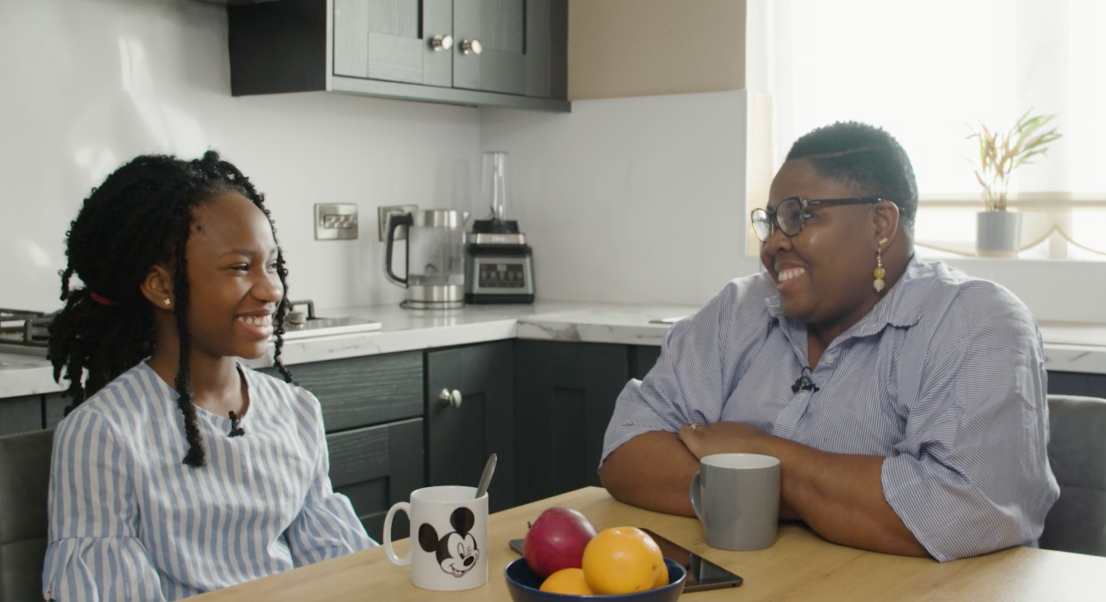
PRACTICAL STEPS FOR PARENTS
Parental Supervision
Use Parental Controls
Activate Safe Search
Agree what to do when things go wrong
Notes:
Practical steps for parents
Internet Safety Advice for Parents of Young Children​
It is never too early to think about your child’s safety online. If you are a parent of a young child who is just starting to discover the online world, there are a few things to consider:​
​
Parental Supervision​
It is very important that young children be supervised at all times while using the internet. It can be easy to access inappropriate content without intending to, parents should guide their child as they discover the online world for the first time.​
Talk about Internet Safety with your Child​
Have a conversation with your child on some of the important things to watch out for when going online for the first time. Young children will not be aware of the dangers, so it is very important to talk with them about who they talk to online and about sharing personal information online.​
​
Use Parental Controls​
Most internet technologies have built-in controls that allow you to limit the amount of time your child can spend online, restrict their access to adult content, and switch off functions like shopping and chatting. Filtering controls are particularly useful at preventing young children from accidentally encountering content that might bother them.​
​
Disable In-App Purchases​
Many apps and games give their users the option of buying additional game functionality, additional points/bonuses, or a host of other extras. Children can easily make purchases without even realising. You can disable in-app purchases using your phone/device settings. ​
​
Activate Safe Search​
Help minimise the risk of your child coming across inappropriate content in response to search queries by activating “safe search” in your search engine. ​
​
Agree on what to do when things go wrong​
We recommend that you speak to your child about what to do if they come across something on the internet that bothers them. This could be closing the laptop lid, or turning off the screen, and coming to get you. ​
​
Set Up a Family Email​
Set up a family email address that your children can use when signing up to new games and websites online.​
​
Play it Safe
For young children we would recommend that parents choose safe and appropriate games for their child to play online. Most games should have a PEGI rating to check what if they are age appropriate, parents should also check if a game allows for player interaction and if there is a safe chat mode.
​
Play it Safe​
For young children we would recommend that parents choose safe and appropriate games for their child to play online. Most games should have a PEGI rating to check what if they are age appropriate, parents should also check if a game allows for player interaction and if there is a safe chat mode. ​

Slide 8
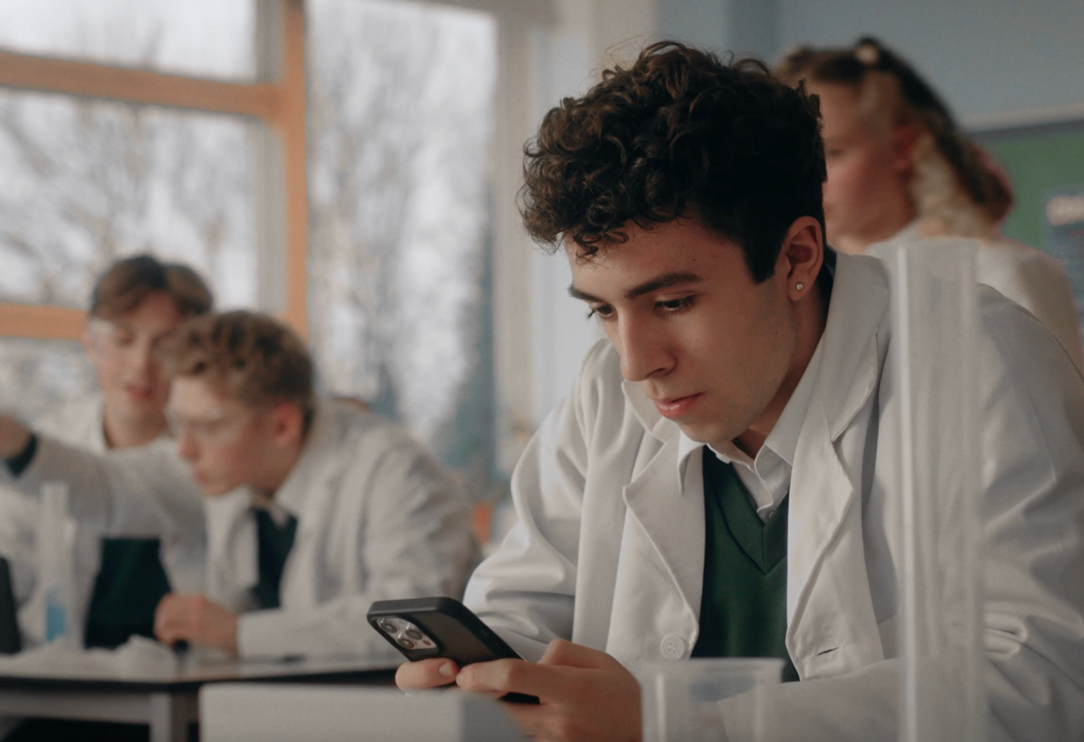


SCREEN TIME
How much is too much?
Agree limits
Walk the walk
6
Notes:
Time online / Screentime
Are you concerned about how much time your child spends on their phone, tablet, or computer? We’ve put together a guide for parents to help deal with this tricky issue. It is important to remember that children often welcome time-off from social media and games and can welcome clear guidelines and boundaries in this area.
How much is too much?
Unfortunately, there is no magic number, children use their devices and computers for lots of different reasons – to learn, to play, and to socialise. If you are concerned your child is spending too much time online, the most important thing is to agree clear rules on screen time and set a good example.
Here are some helpful Pointers
Agree a clear set of rules with your child on screen time in the home. Talk to your child on when and where you think it is appropriate to use screens. Agree times when screens are allowed and when they are not allowed in the home. We suggest dinner time, homework time and bed time is a good start to the not-allowed list.
Restrict the use of computers and devices in the bedroom. Depending on the age of your child you may want to set a curfew or ban devices from the bedroom completely.
Avoid conflict over time online – it can be helpful to give your child 10 minute, 5 minute warnings before the end of their time online. Display Family Agreements in the home to help reinforce the rules and be ready with alternative for when their time online is over.
Try not to rely on screens too much to keep the kids amused. It can be easy to encourage them to pick up the tablet or play a game on the computer to keep them occupied. This only confuses rules on screen time, try and stick to the agreed rules with your child and remember to set a good example.
Chat to your child about what they do online and encourage them to use their screen time for learning and education. Help your child find good quality content online for example RTE Junior, National Geographic, BBC Bitesize
Encourage your child to develop healthy digital habits by setting boundaries around screen time and promoting a balanced lifestyle. Make time for offline activities, such as being outdoors, hobbies, and family activities, to ensure they strike a healthy balance.
Don’t have screens always on in the background. Turn off TVs and computers when not in use, these can be distracting for kids if they are trying to participate in another activity.
Do as you say. Modelling behaviour is the most powerful way you can influence your child’s behaviour.
Finally, join in - why not set some time aside to play your child’s favourite computer game and discover the online world together.
add in... Help your child find good quality content online for example...RTE Junior, National Geographic, BBC Bitesize, etc.

Slide 9
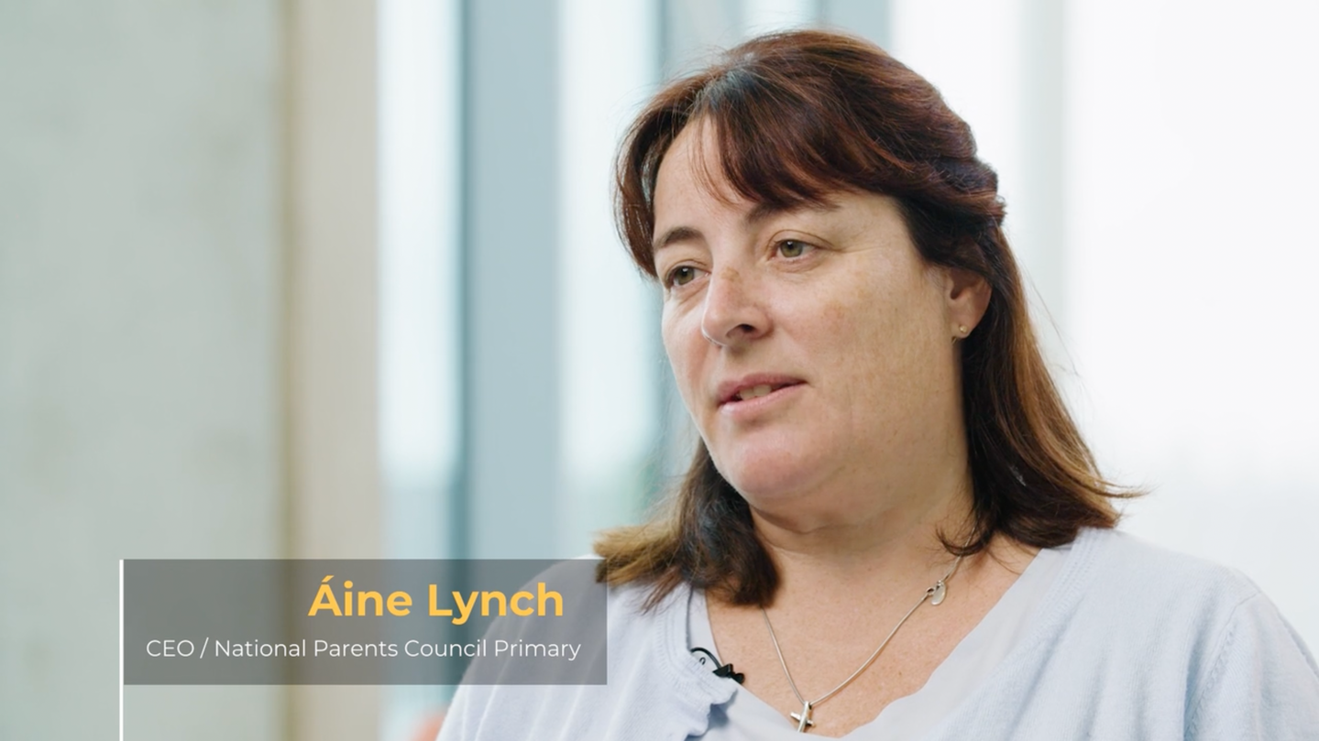

VIDEO:
is my child spending
too much time online
Click the Link to play video: https://vimeo.com/353994676
8
Notes:
Video – Is my child spending too much time online?
Áine Lynch, CEO of the National Parents Council offers advice on managing screen time in the home.​
Click the Link to play video or click the image on screen: https://vimeo.com/353994676​
Please ensure pop-ups are enables on your computer. Video will play on vimeo. Alternatively, videos can be accessed on the Webwise.ie/parents page.

Slide 10

6 steps
parents can take to
manage online safety
Notes:
Steps that parents can take to manage online safety
There are practical steps that parents can take to help ensure that their child has a safe and positive experience online.

Slide 11

1.
get informed
webwise.ie/parents
Notes:
Get informed.
The first step parents can take is to visit the Webwise Parent Hub. There’s lots of helpful information available on a range of online safety topics and issues.

Slide 12
WEBWISE.IE/PARENTS
Expert Advice Videos
Explainer Guides
Talking Points
How-To Guides
Free Resources
Notes:
Get informed.
The Hub has a wide range of free advice and supports that parents can access.
Resources for Parents:​ - Parents' Guide to a Better Internet​
This free online safety booklet is a guide for parents with support, advice and information to help their children have a positive experience online. Topics explored in the guide include cyberbullying, screen time, sexting, social media and online pornography. This can be downloaded for free at Webwise.ie/parents ​
​
Advice Videos ​
The Webwise parenting experts offer advice on everything from talking to your child about screentime to modelling good behaviour. The expert videos feature advice from child psychologists, education experts, SPHE experts and tech experts. ​
​ ​
‘Apps Explained’ - the latest apps children are using
It can be difficult to stay up to date with the latest apps and platforms that children are using. It is updated on a regular basis and is an excellent starting point for parents who have children using social media for the first time, and also if you want to understand how an app works.
​
‘Advice for Parents’
Advice and support for parents on key issues such as making friends online and sharing personal information.​
​
‘Talking Points’
These are conversation starters to help facilitate parents open communication with their child around internet safety.​
​
‘How to’ Guides
These provide support and step by step instructions on blocking, reporting, parental controls and more.

Slide 13






WEBWISE.IE/PARENTS
apps explained
Get Informed
Keep up-to-date with the latest apps and platforms your children are using
TikTok
Instagram
Snapchat
WhatsApp
Learn More
Learn More
Learn More
Learn More
Notes:
Apps Explained
The Explainer Guides to popular apps, games and platforms is a great resource for parents to learn about how particular ones work, why children like them, and what risks parents should know about.
​
AGE RESTRICTIONS ON SOCIAL MEDIA – WHAT I NEED TO KNOW ​
Most social media platforms and services have a minimum age requirement, for the majority of these services it is 13 years old. Therefore technically, children under the age of 13 should not have a social media account. However most social media platforms do not have robust age-verifications in place making it relatively easy for underage users to sign-up with a false age. ​
Under the E.U General Data Protection Regulation (GDPR), Ireland has now set the Digital Age of Consent to 16 years old. This is the age at which children can legally consent to companies/organisations processing their personal data or information for example when you sign up to an online platform or social media account. For children under the age of 16, consent must be given/authorised by the parent or guardian of the child. For the purposes of data collection teenagers between the age of 13 and 16 years old must have parental permission to sign-up to social media services. ​

Slide 14


OPTIONAL ACTIVITY:
GET INFORMED
As a parent it is important that you understand what apps, games and social networks your child is using.
Work in groups of four.
Visit Webwise.ie/parents - Explainers/Get Informed
Find the relevant explainer for the
app/game/network given to your group
Review of the explainer and note down three points
about the app (for example; potential risks, how it
works, why it is popular).
Notes:
Optional Activity – Get Informed.
Activity Suggestion – Break the group into small groups and give them one app/network to look up on Webwise.ie​
Ask each group to have a quick review of an explainer article – and ask them to note down three points about that app.

Slide 15
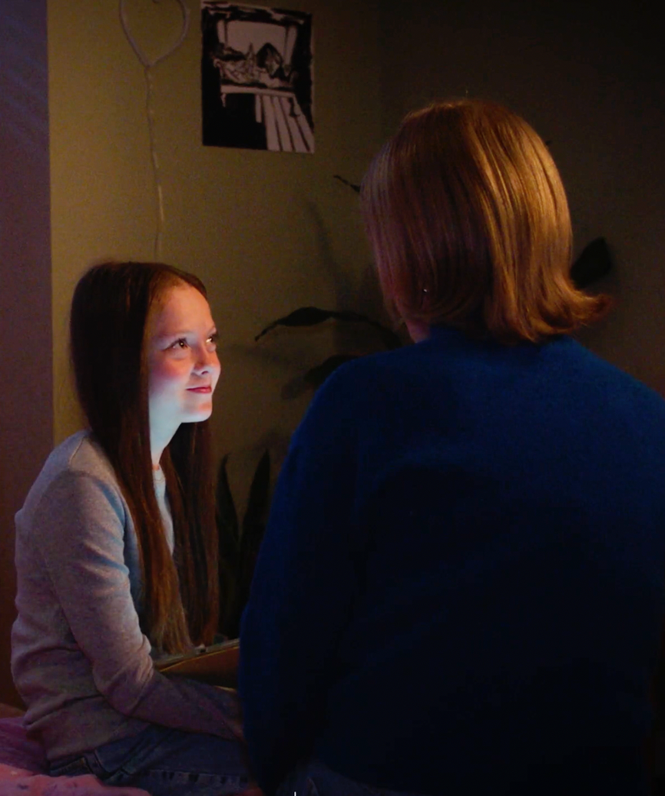
2.
Have the chat
Ask them about interests
Webwise Talking Points
Keep Talking
Notes:
Have the chat
The most important thing parents can do when it comes to supporting their child online is have regular conversations. Have a conversation with your child on some of the important things to watch out for when going online for the first time. ​
​
Not sure how to start a conversation with your child – use the Webwise Talking points or use the Online Topic Generator – available on the webwise.ie/parents hub. ​
​
We recommend that you speak to your child about what to do if they come across something on the internet that bothers them. This could involve closing the laptop lid, or turning off the screen, and coming to get you.​
​
Finally - Keep checking in with your child! Online safety isn’t a once off conversation. The internet is part of all our world now, so it is vital that parents/guardians continue the conversation.​

Slide 16
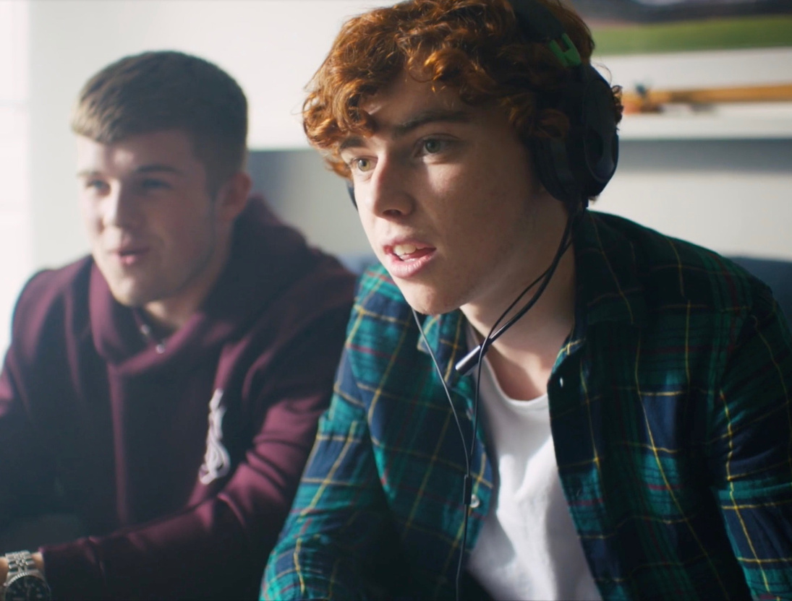
2.
Have the chat
ONLINE GAMING
Here are some helpful talking points to help start the conversation with your child about online gaming:
1. Can you show me your favourite game?
2. Can you play against other kids?
3. How much time should you spend playing?
4. Can you chat with the other kids you are playing?
5. What sort of information is NOT okay to share when gaming?
6. What would you do if something inappropriate happens when you are playing a game online?
Notes:
Online Gaming
Lets look at online gaming as an example. Here are some helpful talking points to help start the conversation with your child about online gaming:​
​
1. Can you show me your favourite game?​
It is a good idea to get to know the games yourself, why not sit down with your child and let them show you how the game is played. Talk to your child about what they can do in the game they are playing. What is the overall objective of the game, what do they like most about playing it, and is there anything about the game that they don’t like.​
​
2. Can you play against other kids?​
Some games have optional multi-player modes where your child can play with and against others. Make sure you are clear on whether you are happy for your child to play with others. If you are, ask them who they are playing with? Establish rules around this that you can both agree on. Most games have a rating you can check to see if they are age appropriate.​
​
3. How much time should you spend playing?​
It makes life a lot easier if you bring this subject up early on; it can be tricky to change well-established practices. Talk about why it is important to have limits. it is a good opportunity to talk about the importance of being active, being outdoors, and spending time in the company of other children. Striking a suitable balance is key.​
​
Remember, it can be hard to enforce restrictions. It can also be difficult to accurately track the amount of time they are spending playing the game. Some devices allow you to use parental controls to strictly enforce daily or weekly limits. In many cases, the device simply switches off once the allocated time has been exceeded. While this is handy; it can be very frustrating for a child who is just about to reach a landmark in the game after a great deal of effort. We recommend not relying exclusively on parental controls. Use them to support your usual parenting approaches.​
​
4. Can you chat with the other kids you are playing?​
Many games allow players to chat with each other. Agree rules around this, ask your child about who they think it is okay to talk to online. Discuss your expectations around the type of language they should not use and how they treat others. Be very clear on consequences of using bad language, being disrespectful, or not following the other agreed rules. The threat of withdrawing access to the game can be a good deterrent to bad behaviour.​
​
Check if the game gives the option of disabling chat and if there is a safe chat mode. Some games allow limited forms of chatting where gamers can communicate with each other by selecting from a menu of phrases. ​
​
5. What sort of information is NOT okay to share when gaming?​
Explain to them the importance of not giving away any personal information online. In the case of online gaming, it is a good idea not to use real names for game profiles and not to share passwords with friends.​
​
6. What would you do if something inappropriate happens when you are playing a game online?​
It is important that your child is familiar with safety setting, privacy and reporting tools. It is equally important that your child understands they can talk to you if they experience anything inappropriate online. This is also a good opportunity to encourage your child to play fairly and treat other gamers with respect. ​
​
For more information on gaming go to: webwise.ie/parents/play-it-safe

Slide 17

VIDEO:
TALKING TO YOUR CHILD
ABOUT WHAT THEY DO ONLINE
Click the Link to play video: https://vimeo.com/353996493
8
Notes:
Video – Talking to your child about what they are doing online
CEO of National Parents Council; Áine Lynch on the importance of talking to your child about what they do online. ​
Click the Link to play video: https://vimeo.com/353996493​
Please ensure pop-ups are enables on your computer. Video will play on vimeo. Alternatively videos can be accessed on the Webwise.ie/parents page.

Slide 18
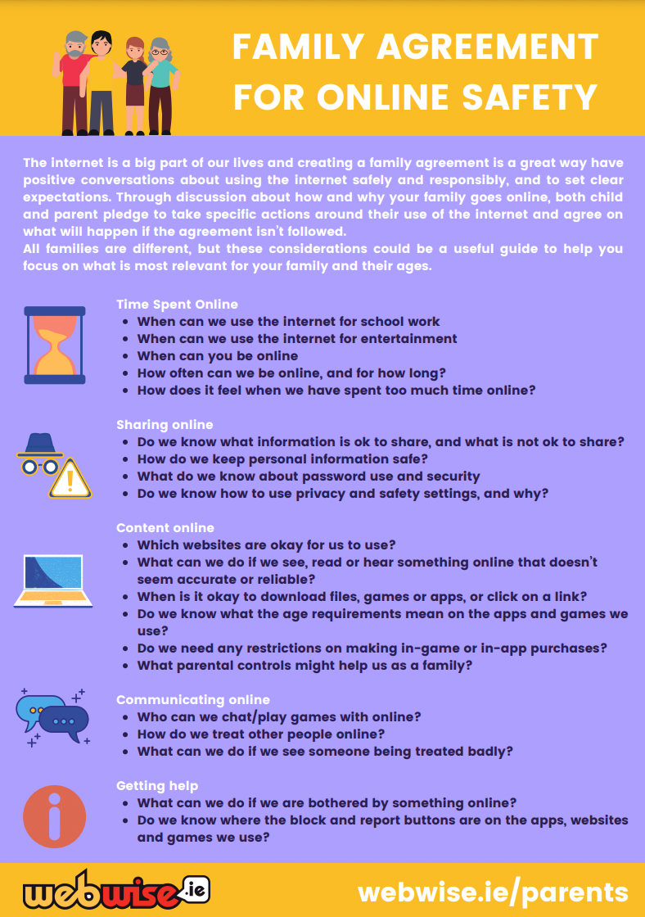
3.
Agree Rules
Have a two-way conversation
Set clear boundaries
Follow the rules!
Notes:
Agree rules
Agree with your child rules for Internet use in your home​. Every family is different, and the Webwise Family Agreement Template is a great resource to help you agree rules that suit your family and circumstances.
Here are some tips to get started:​
Discuss when and for how long it is acceptable for your child to use the Internet​
Agree how to treat personal information
Discuss how to behave towards others when gaming, chatting, e-mailing or messaging​
Agree what type of sites and activities are OK or not OK in our family​
Follow the rules yourself! Or at least explain why the rules are different for adults.

Slide 19

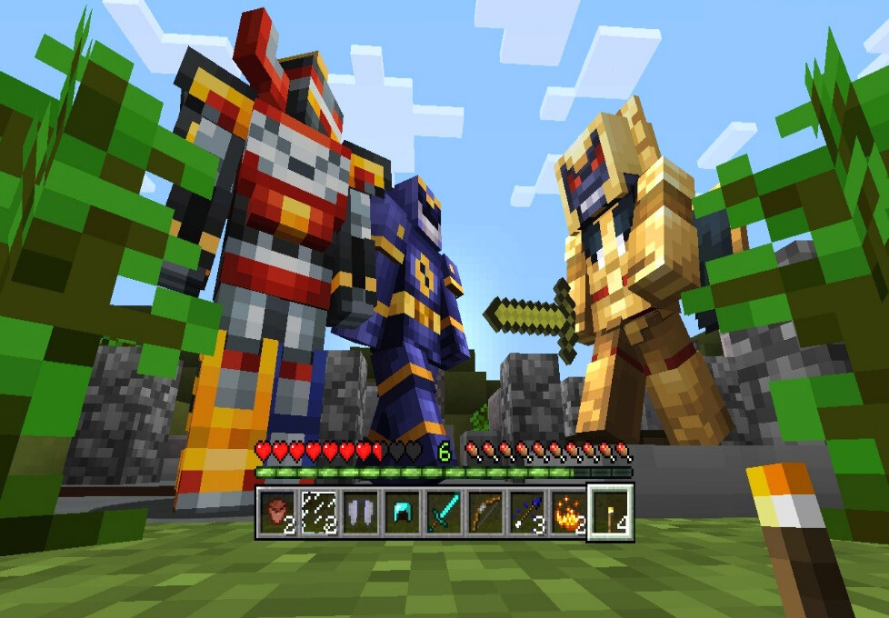



Online Games:
things to consider
Check age rating
Use parental controls
Agree limits
Know who they are playing with
Notes:
Online Gaming
Let’s return to online gaming, what can parents do and what rules can you put in place to ensure your child makes the most of their time online.
What is Online Gaming?
Online gaming is a popular activity for many children and teens. These games range from adventure and strategy-based challenges to sports simulations and virtual social spaces.
Gaming can be a great way for young people to have fun, develop problem-solving skills, and connect with friends. However, it’s important for parents to understand the potential risks and ensure their child has a safe and positive gaming experience.
Here are some useful tips:
Check Age Ratings
Game ratings, such as PEGI, which indicate appropriate age levels based on content.
Use Parental Controls
Most gaming consoles, apps, and devices offer settings to limit screen time, restrict purchases, and block inappropriate content. Activate these controls to manage your child’s gaming experience.
Agree Limits
Set clear boundaries on when and how long your child can play. Encourage a healthy balance between gaming, schoolwork, and offline activities.
Know Who They Are Playing With
Many games allow interaction with other players. Teach your child to keep their profile private, avoid sharing personal information, and report or block anyone who makes them feel uncomfortable.
By staying informed and involved, parents can help children enjoy online gaming while staying safe.

Slide 20

VIDEO:
Agreeing rules around
technology use at home
Click the Link to play video: https://vimeo.com/200804832
8
Notes:
Video – Agreeing rules around technology use
Child Psychologist Dr. John Sharry offers advice on agreeing rules around technology use on the home. ​
Click the Link to play video: https://vimeo.com/200804832​
Please ensure pop-ups are enables on your computer. Video will play on vimeo. Alternatively videos can be accessed on the Webwise.ie/parents page.

Slide 21
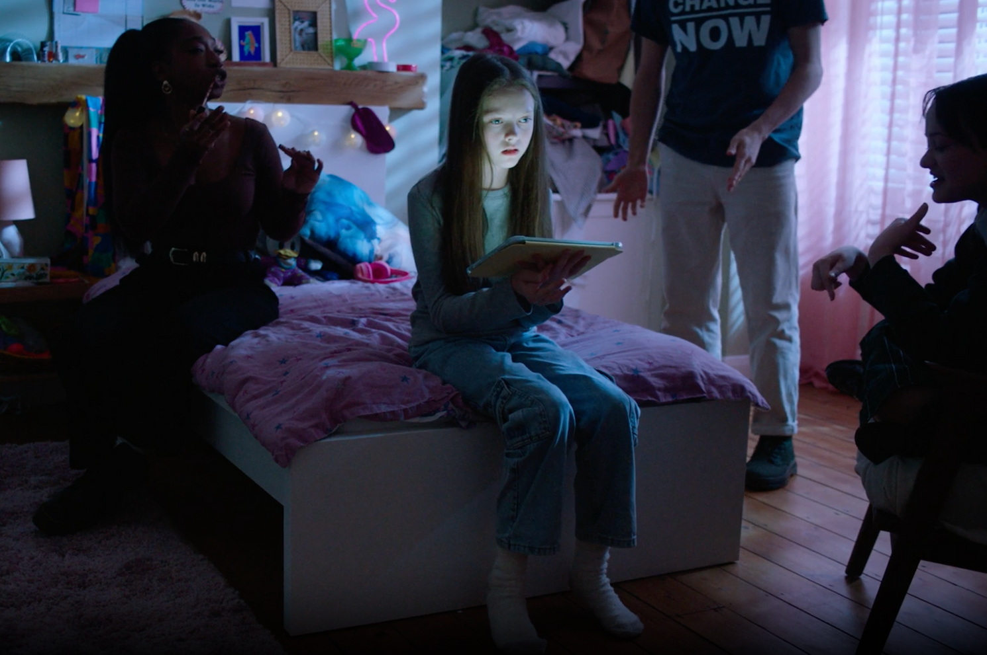
4.
ask for help
Reassure your child
Don’t panic
Avoid total bans
Notes:
Ask for Help
Reassure your child that they will be listened to and they should come to you if something upsets or bothers them online.​
Listen to what your child has to say to help them make sense of what’s happened.​
Stay calm and don’t panic. The best way to do this is make sure you have an open dialogue from the beginning. ​
Don’t be too critical towards your child’s exploration of the Internet​
Children may come across adult material by accident on the web. Also, a child may intentionally search for such websites; remember that it is natural for children to be curious about off-limits material. Try to use this as an opening to discuss the content with them and perhaps make rules for this kind of activity. Be realistic in your assessment of how your child uses the internet.​
Avoid bans - sometimes teens may not tell you about a bad experience if they know it will lead to getting cut off from their online world. If they feel like they can talk about their online habits with you, without judgement or the treat of being disconnected, it will lead to more honesty in the long-run.​
Having continuous open communication is a vital part of helping your child engage positively online​.

Slide 22

VIDEO:
What to do if something
goes wrong online
Click the Link to play video: https://vimeo.com/354004510
8
Notes:
Video – What to do if something goes wrong online
Áine Lynch, CEO of the National Parents Council Primary offers advice for parents on supporting their children online.​
​
Click the Link to play video: https://vimeo.com/354004510​
Please ensure pop-ups are enables on your computer. Video will play on vimeo. Alternatively videos can be accessed on the Webwise.ie/parents page. ​

Slide 23
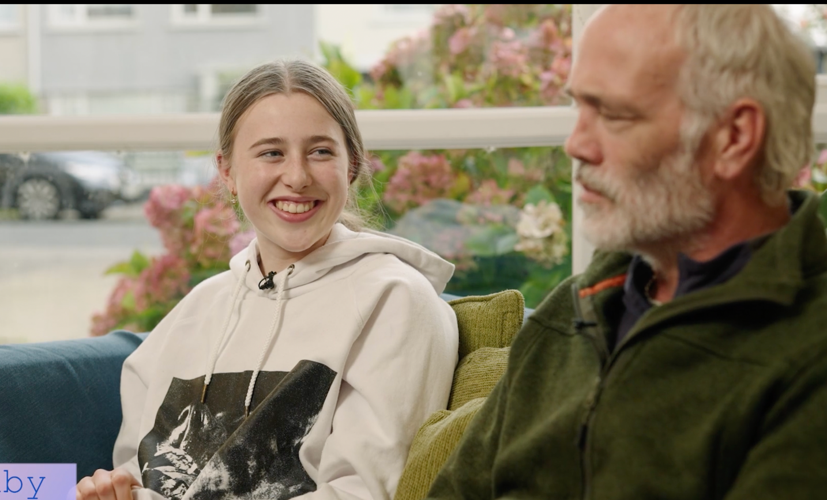
5.
lead by example
Model good behaviour
Follow the rules
Promote respect and consent
Notes:
Lead by example
​
Lead by example - Modelling behaviour is the most powerful way you can influence your child’s behaviour.
Stick to the rules - To avoid confusion about the rules on technology use, stick to the boundaries that you have agreed with your child, and remember to set a good example. Review the rules with your child as they get older.
Promote the importance of respect, consent, and being a good friend online.

Slide 24
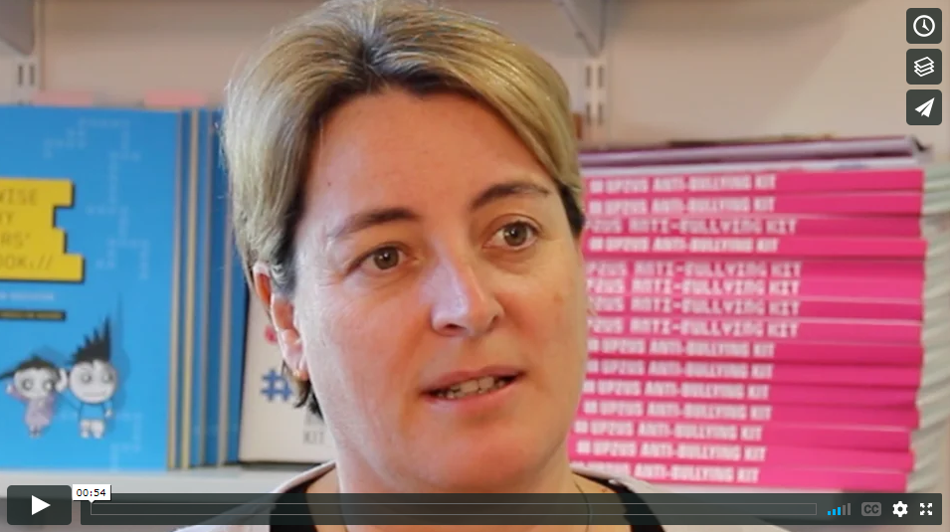
VIDEO:
lead by example
Click the link to play video: https://vimeo.com/191043980
8
Notes:
Video – Lead by example
CEO of National Parents Council; Áine Lynch on the importance of modelling good behaviour when it comes to addressing internet safety in the home.​
Click the Link to play video: https://vimeo.com/191043980​
Please ensure pop-ups are enables on your computer. Video will play on vimeo. Alternatively, videos can be accessed on the Webwise.ie/parents page.

Slide 25

6.
Finally join in!
The Internet is a great tool!
Discover the internet together
Get involved in
Safer Internet Day!
Notes:
Finally – join in!
Remember that the positive aspects of the Internet outweigh the negatives.​
The Internet is an excellent educational and recreational resource for children. Encourage your child to make the most of it and explore the internet to its full potential.​
​
Discover the Internet together​
Be the one to introduce your child to the internet. For both parent and child, it is an advantage to discover the internet together. Try to find websites that are exciting and fun so that together you achieve a positive attitude to internet exploration. This could make it easier to share both positive and negative experiences in the future.​
​
Let your children show you what they like to do online​
To be able to guide your child with regard to Internet use, it is important to understand how children use the Internet and know what they like to do online. Let your child show you which websites they like visiting and what they do there.​
​
About Safer Internet Day ​
Safer Internet Day (SID) is an EU wide initiative to promote a safer internet for all users, especially young people. ​
Safer Internet Day offers a great opportunity for parents to have a chat with your child about online safety. Celebrated every February, Parents can get involved by using the brilliant resources and videos developed by Webwise.

Slide 26
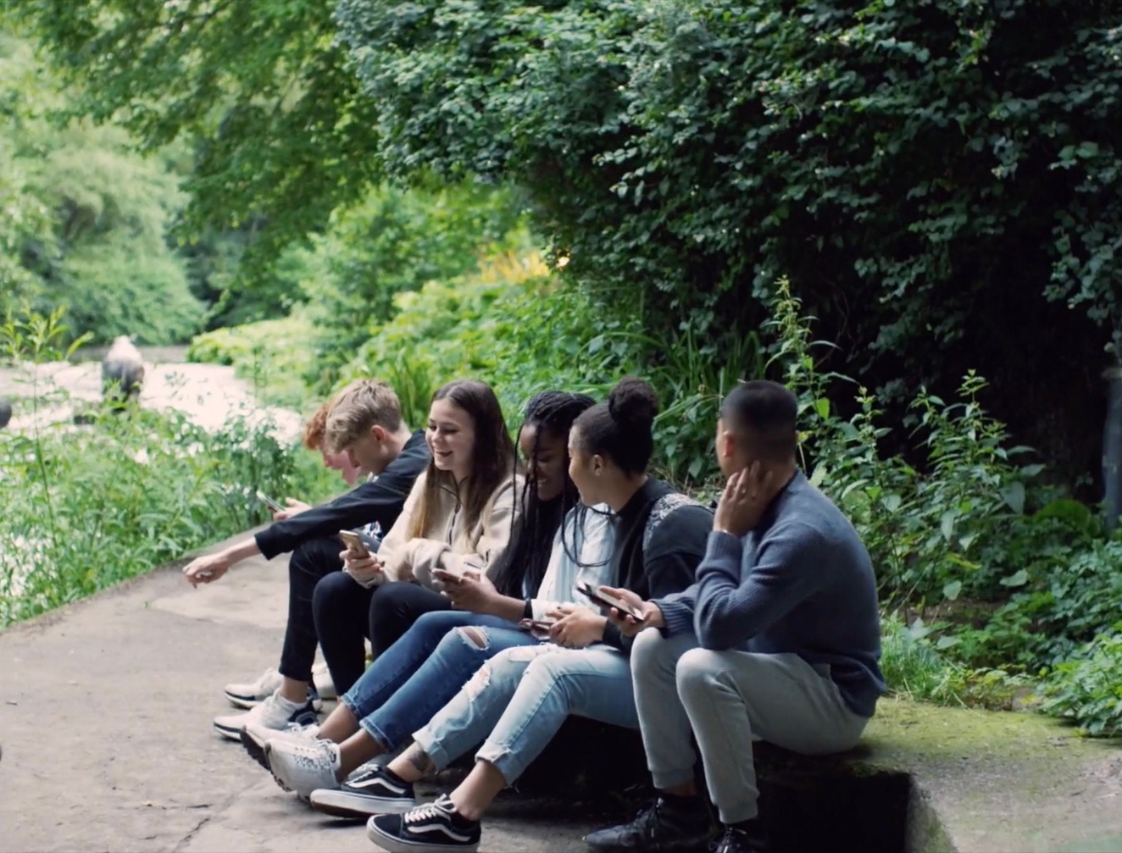
OPTIONAL ACTIVITY:
Respectful Communication
Go to p.18 of the Webwise Parents booklet offering advice on what advice to give their child on cyberbullying.
Spend a few minutes in pairs going over the advice and agree some steps they would take on what a parent can do their child is being bullied online.
Click the link to play video: https://vimeo.com/359094916
Notes:
Optional activity – Respectful Communication
This final activity looks at cyberbullying and respectful communication. ​
Play the Connected Video: https://vimeo.com/359094916​
Ask parents to go to page 18 of the Webwise Parents booklet offering advice on what advice to give their child on cyberbullying. Ask them to spend a few minutes in pairs going over the advice and agree some steps they would take on what a parent can do their child is being bullied online.​
Sample answers include: Listen to your child, be supportive, seek advice from school – they may be able to help, keep the evidence. In serious incidents report it to the Gardai,

Slide 27






Critical thinking tips
stop / think / check
Encourage your child to Stop, Think, Check!
With so much information at our fingertips it can be hard to judge if what you see, read, or hear online is accurate and reliable.
Here are some simple tips:
Check the source
Look beyond the headline
Remember - the camera can lie
Just because information goes viral does not mean that it is accurate
You are what you like?
15
Notes:
Critical thinking tips
With so much information online it can be hard to know if what we are seeing, reading or hearing online is accurate and reliable.​
​
By encouraging your child to STOP, THINK, CHECK when they are online, it will help to develop their critical thinking skills to question the accuracy of what they encounter online. ​
​
Here are some simple tips: ​
​
Check the source – check the source of the story, is it a credible, reliable source? If you can't find the same information from other sources, it might be inaccurate, unreliable, or outdated. This is especially true if the information seems overly topical or sensational.​
​
Look beyond the headline - Headlines are meant to grab your attention, but they can't tell the whole story, and neither can a brief social media post. If it seems too good (or bad) to be true, it likely is.​
​
Sometimes pictures lie. - Don’t assume that a picture or video is giving you the whole story. If a picture or video has been altered or simply used out of context, then it can be easy to draw the wrong conclusions. ​
​
Just because something is viral or trending doesn't mean it's accurate. - Disinformation is often created to trigger strong emotional reactions, encouraging immediate sharing or "liking" in moments of outrage, excitement, or disbelief. Social media and messaging apps make it incredibly easy to spread information quickly to large groups of people.​
​
You are what you like? Be aware that what you see online has been tailored to your preferences, and online algorithms filter what content you see, and what you don’t see, in order to try to hold your interest. If a piece of content is being highlighted by an online platform, why might that be? It is because you are likely to be interested in it? ​

Slide 28
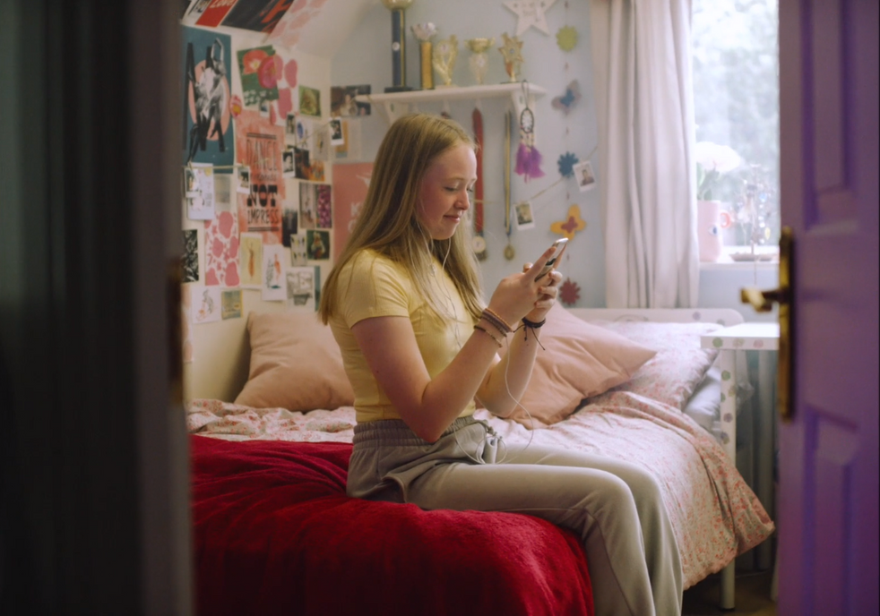
ACTIVITY:
reflection
Think back over some of the issues we have spoken about today:
  Parental controls
  Managing screen time
  Setting guidelines around technology use
  Online Gaming
  Talking to your child about online safety
  Leading by example
  Respectful communication
Create a to-do list of actions that you think will help your children to have more positive online experiences.
Notes:
Reflection Slide
​
Think back over some of the issues we have spoken about today:​
Managing Screen time​
Dealing with conflict​
Talking to your child about what they do online​
Social Media ​
Image-sharing​
Digital Footprint ​
Responding to cyberbullying​
Teaching your child how to protect themselves online. ​
ACTIVITY ​
Create a to do list of actions that you think will help your children to have more positive online experiences. ​
Suggestion – go around the room and take some responses from the group

Slide 29




supports for parents
IRISH SAFER INTERNET CENTRE
National Parents Council
ISPCC
Hotline.ie
www.npc.ie
www.ispcc.ie
www.hotline.ie
Coimisiún na Meán
www.cnam.ie
Notes:
Supports for parents
There are more great supports from the other organisations in the Irish Safer Internet Centre, alongside Webwise.​
​
The National Parents Council operates a parent/adult helpline, which is a dedicated helpline to deal with issues relating to internet safety, including cyberbullying. The NPC also provides parents with training courses, both online and face to face​
​
ISPCC operates a helpline (Childline), which provides services on a 24/7 basis where children affected by issues encountered on the internet may turn for advice and guidance. They also have Digital Ready Hub which provides advice and information on online safety.​
​
Hotline.ie is the Irish national reporting centre where members of the public can securely, anonymously, and confidentially report concerns in respect of illegal content online, especially child sexual abuse material (CSAM).​
​
Coimisiún na Meán are responsible for Ireland’s Online Safety Framework. This framework means that there are now more rules requiring online platforms to protect children and adults rights online. Online platforms must protect people, especially children, from being harmed by their experience online.

Slide 30
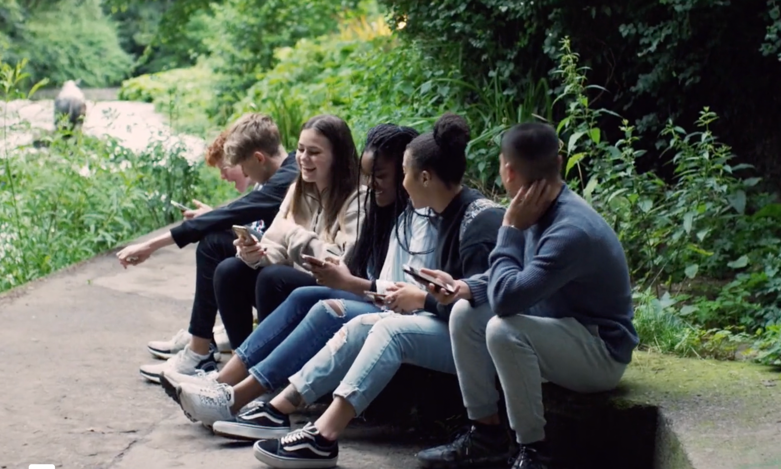
Next Steps
Visit Webwise.ie/Parents
Have the chat
Agree guidelines
Keep up to date..
Follow Webwise Ireland
Notes:
Next steps
Stay informed by visiting the Webwise Parents Hub​
​
Have regular, open, conversations with your child about the opportunities and challenges they may encounter online​
​
Agree guidelines to help protect your child, and to help ensure they strike a healthy balance​
​
And stay up to date by following Webwise on social media

Slide 31

Thanks!
ANY QUESTIONS?
www.webwise.ie
© Webwise_Ireland
This work is made available under the terms of the Creative Commons Attribution Share Alike 3.0 Licence http://creativecommons.org/licenses/by-sa/3.0/ie/. You may use and re-use this material (not including images and logos) free of charge in any format or medium, under the terms of the Creative Commons Attribution Share Alike Licence.
Notes:
Take questions.
Thank you for joining us.

